Slide 1
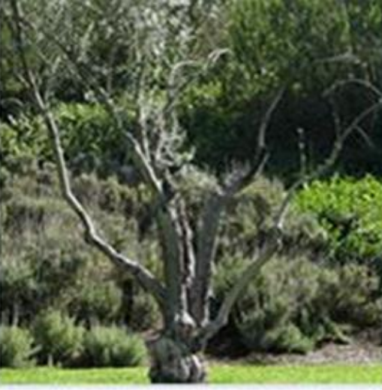
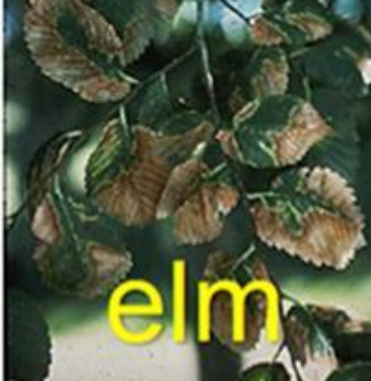
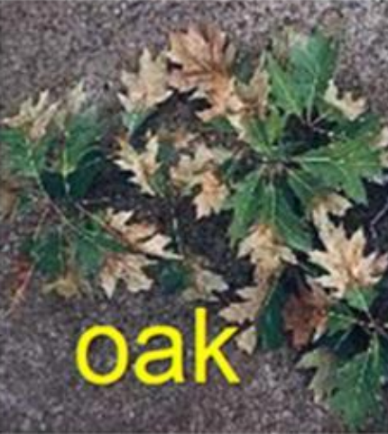
Xylella
After 1987 X. fastidiosa found in large number of other hosts. The most important diseases are:
– Pierce’s Disease (PD)
– Leaf scorch diseases
– Phony Peach Disease (PPD)
– Citrus Variegated Chlorosis (CVC)
In the 80s: on almond, olive and forestry in USA
In Brasil: 1987
3 orange trees 1992 > 2.000.000 trees

Slide 2
Prevention: present situation
Risk assessment
Host plants at your nursery? See: List of host plants
Are these also host plants in EU? European list of host plants

Slide 3
Prevention: points of attention
Origin plants, plantmaterial
Profile supplier
Transport
Arrival inspection (entrance inspection)
Monitoring at the nursery: symptoms and vectors
When you are not sure:
Contact immediately officials or take a sample and sent it to the an authorised lab.
IT IS VERY IMPORTANT TO DETECT AN INFECTION OF XYLELLA AS SOON AS POSSIBLE

Slide 4
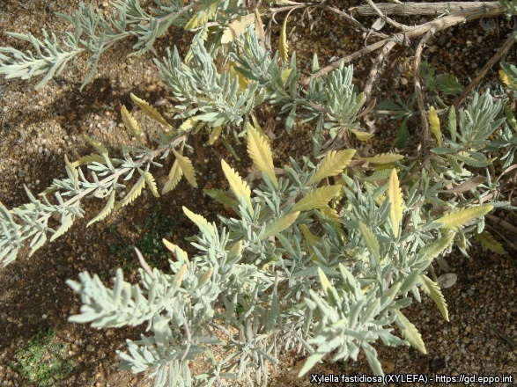
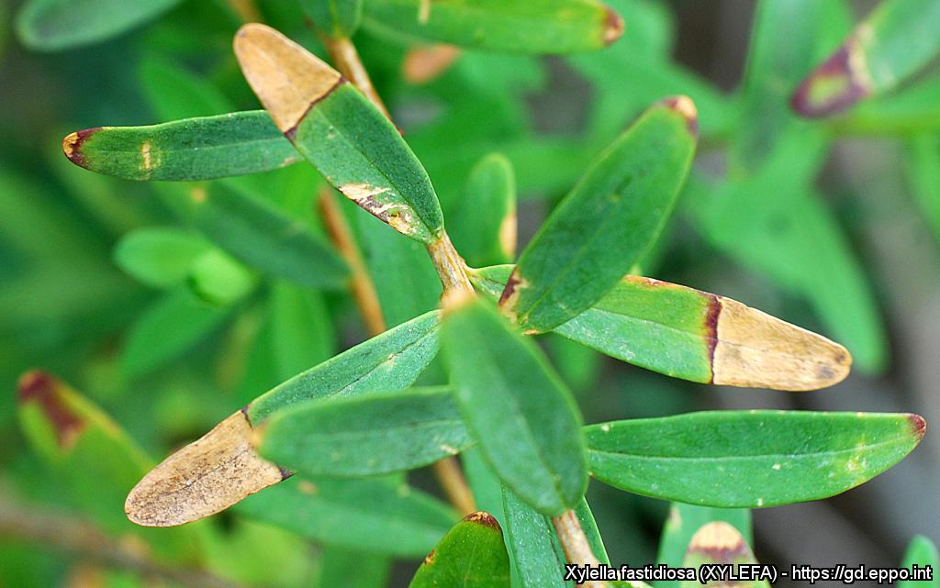
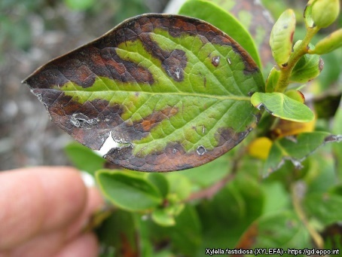
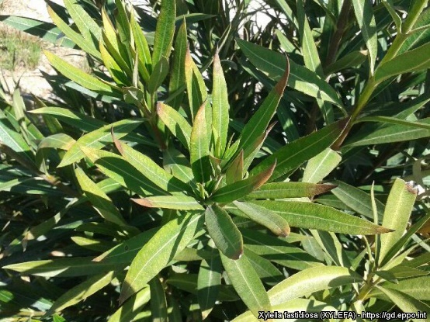
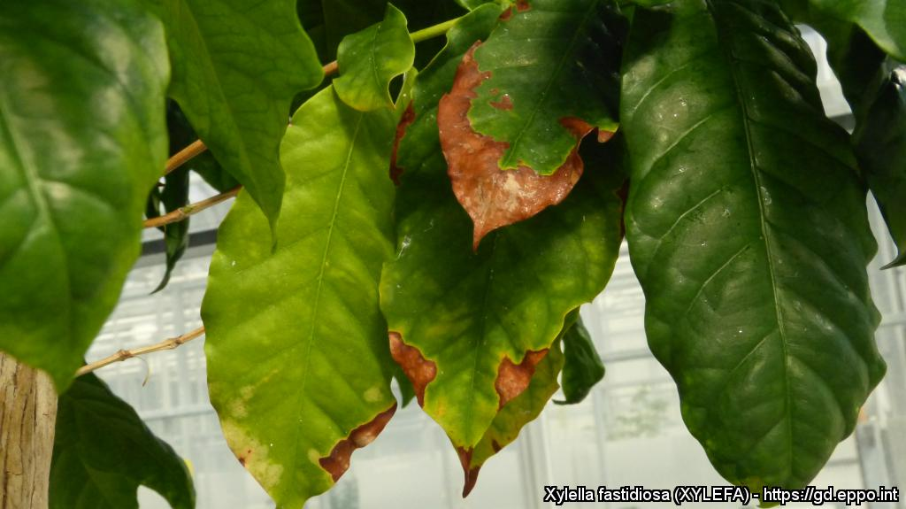
Symptoms

Slide 5
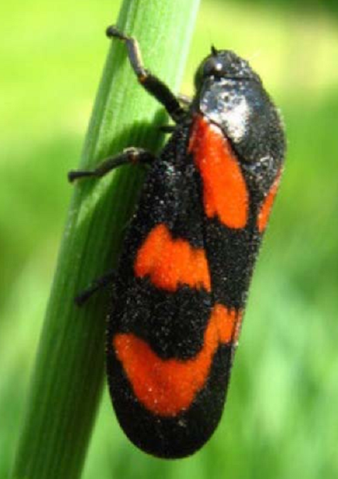
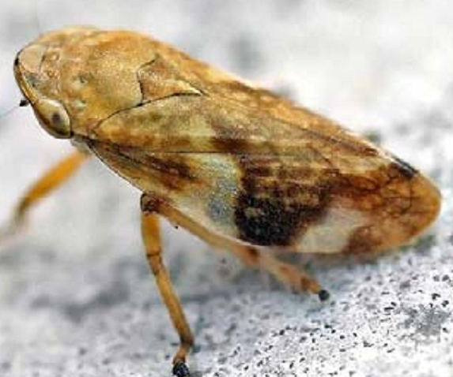
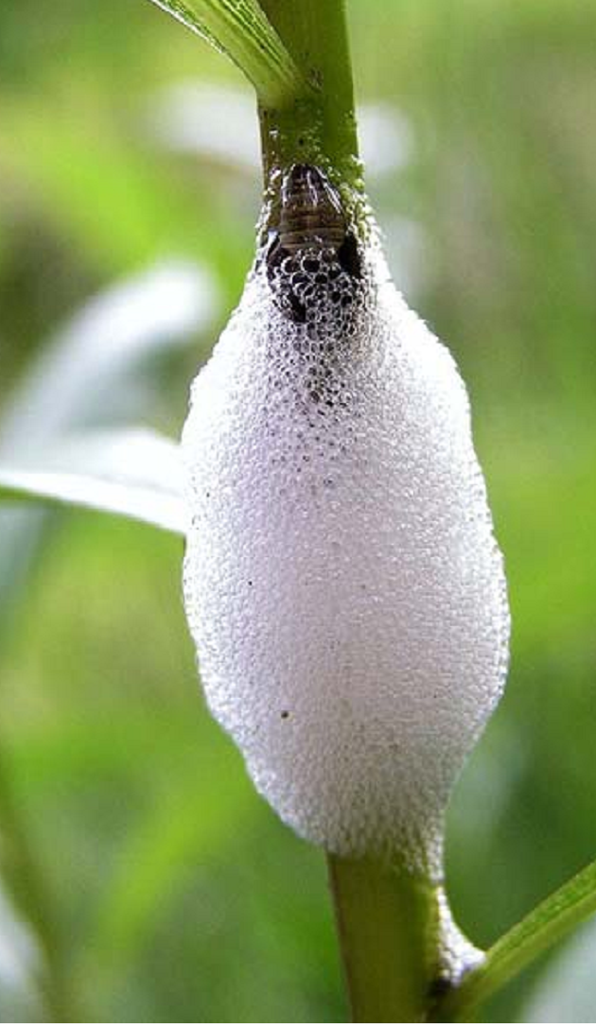
Insects

Slide 6
Origin plantmaterial
EU
See list of demarceted union territory
All EU host plants: plant pasport
outside EU
Phytosanitary certificate
Different categories:
- a country is free from Xylella
- A region is free from Xylella
A location is free from Xylella
EU list of countries and areas free from Xylella
at Xylella, declaration of third countries

Slide 7
Risk profile supplier
Where are your suppliers located? What is the distance from infected area’s? See infected area’s Europe en information about third countries
Visit the supplier where you purchase plant material and check the origin of the plant reproduction material;
• What is the background history of the plant material? At which companies was it present previously?
• Do those companies work with hygienic measures?

Slide 8
Risk profile supplier
* How are diseases and infestations prevented at these companies?
• Check whether 0.5 cm cicadas are present (brightly coloured cicadas).
• Check whether diseases and/or weeds are present, for example the host plants Capsella bursa-pastoris (shepherd’s purse),
• Make agreements with your supplier about hygiene measures to be followed, inspections and clean packaging;
How is your experience with the supplier in the last years
Are there a lot of crossing, different product flows at the place of your supplier?

Slide 9
Transport
a. Do not make a combination with other products originated from Xylella infected area’s.
b. Weed absent
c. Sucking insects absent
d. Plantmaterial wrapped propriate
e. Do not allow to place temporarily “strange” material on your nursery.

Slide 10
Check at arrival plantmaterial
Control of
plantpasport, documents
Visual control of potential symptoms Xylella
see photo’s of plants infected with Xylella .
Visual control of insects
Visual control of weed
Advise:
Seperate place
For every order an unique number

Slide 11
Arrival at the nursery
When you are not sure:
Contact immediately officials or take a sample and sent it to the authorised lab.
(In The Netherlands: http://www.naktuinbouw.nl/xylella )
IT IS VERY IMPORTANT TO DETECT AN INFECTION OF XYLELLA AS SOON AS POSSIBLE

Slide 12
Points of attention operational management
Clearly document the lot-handling steps for plants in the company in your administration system (e.g. crop-handling steps and relocation);
Ensure that the plant material can be easily traced from the moment of arrival until delivery;
Use a new set of disinfected tools (knives, pruning shears) for each row or compartment;
Always work through the crop in the same direction;
Examine the crop for xylem-sucking cicadas and eliminate them. Note this measure clearly in your administration system;
Eliminate weeds with herbicides. Some weeds are host plants of Xylella, for example Capsella bursa-pastoris (shepherd’s purse),
Monitor potential deviations and symptoms in the crop. If you have any doubts, get your plants examined by the official autority. Mark these plants and put them in a separate facility.

Slide 13
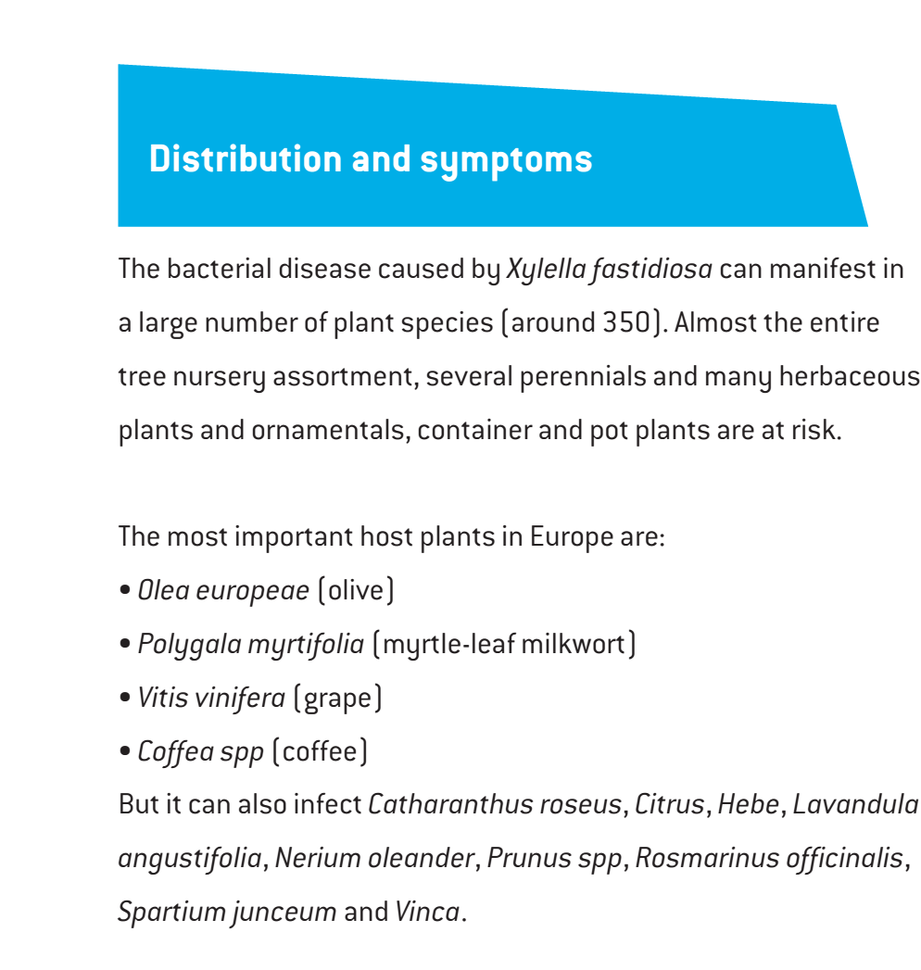
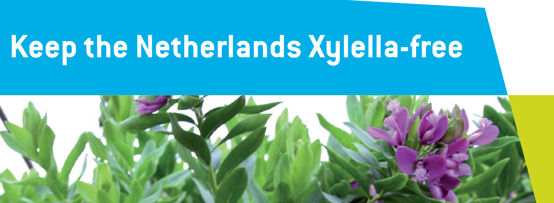
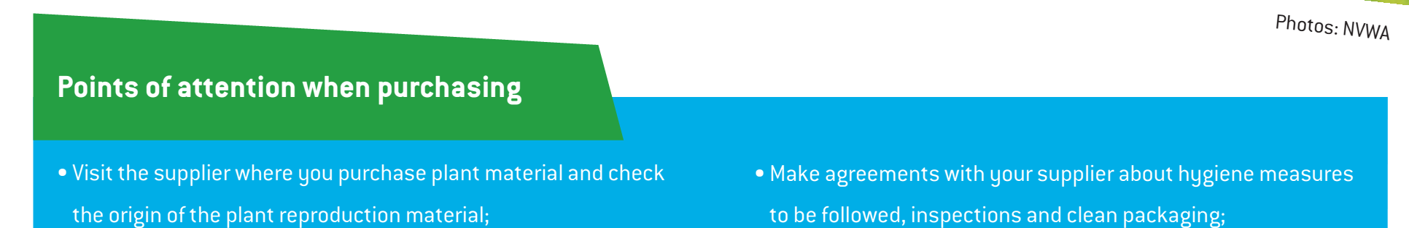
Flyer Xylella

Slide 14
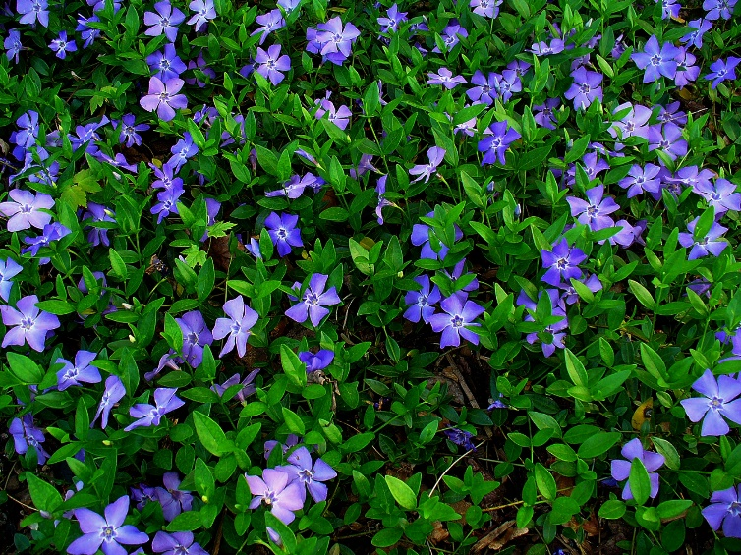
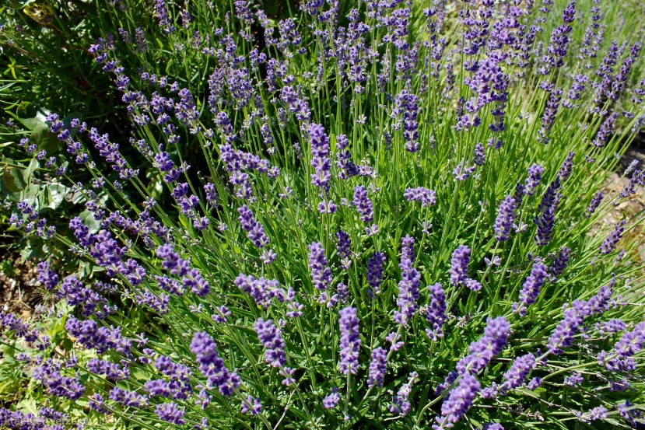
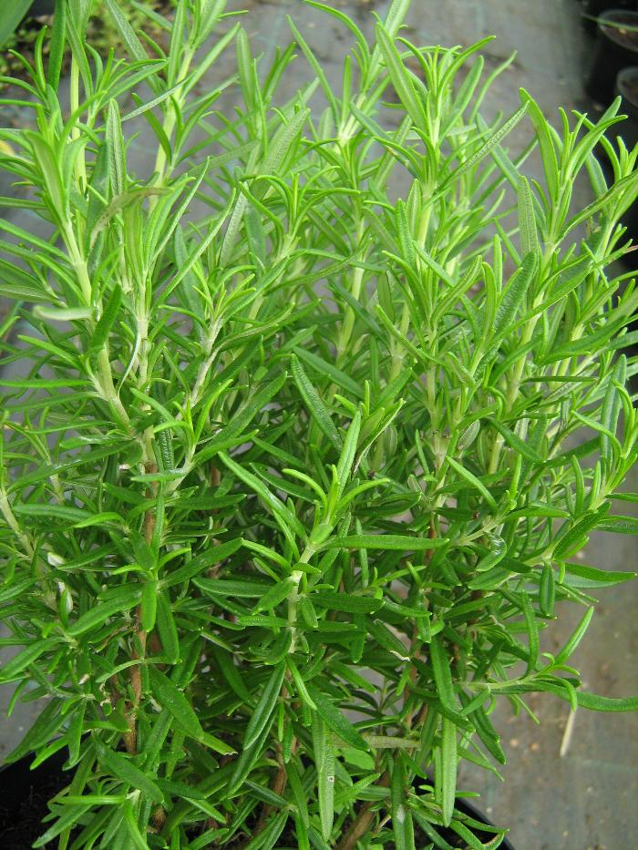
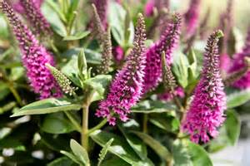
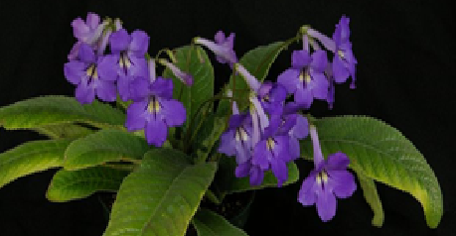
Prevention Xylella

