Slide 1
Weed Control in Nursery Stock
Dr. Heinrich Lösing

Slide 2
Personal background:
Working as a nursery advisor in Germany for over 30 years
Specialist in weed and pest control, also in machinery
Organizing the show ‘Nursery machinery‘ every 5 to 7 years
Next exhibition: 29. and 30. August 2019 in Ellerhoop, north of Hamburg
Practical work experience in England, Netherlands, Japan and USA

Slide 3
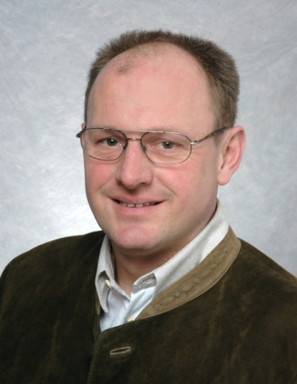
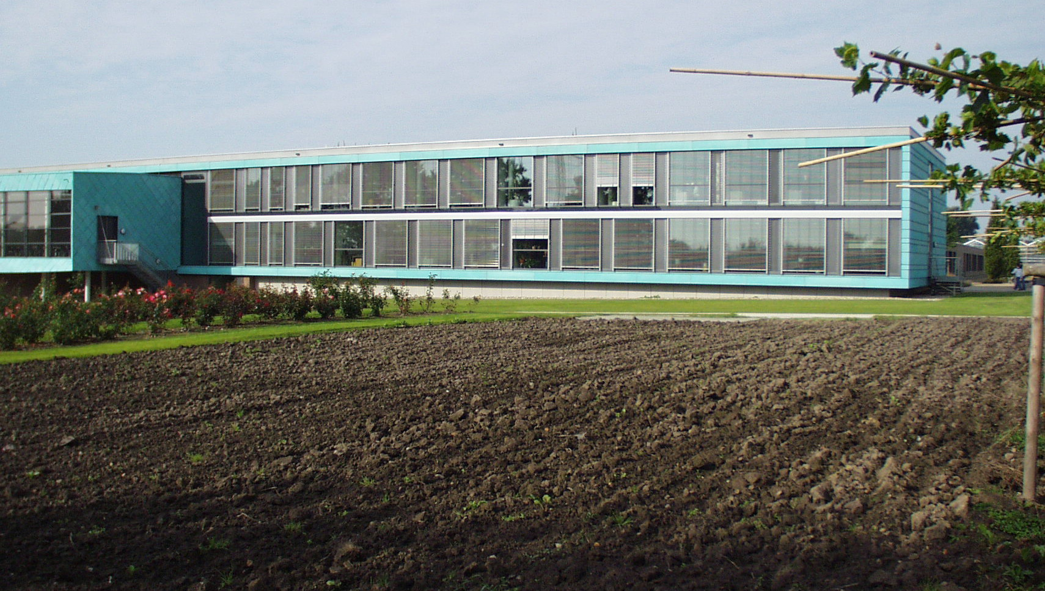
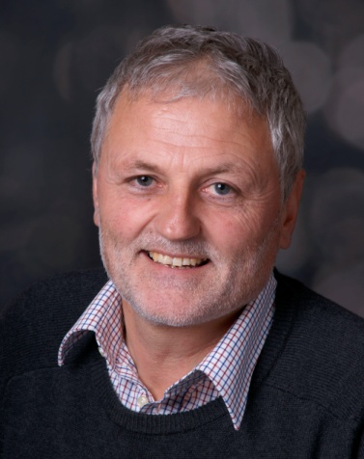
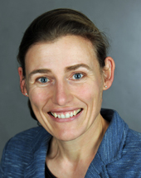
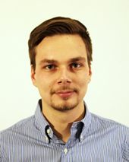
VuB – a grower’s organization
Chairman:
Frank Ostermann
Dr. Heinrich Lösing
CEO VuB
Plant Protection
Technique
Study tours
Britta Zielke
Plant Protection
EDP / IT
Experimentation
Sebastian Heise
Fertilization
Soils / Substrates
Irrigation
Experimentation
Dr. Heinrich Lösing

Slide 4
VuB- a grower’s organization
About 300 nurseries are members, cultivating an area of about 4.500 ha
40 promoting members (Industry/Trade)
Cultural technical advise
  Plant Protection
  Fertilization
  Soils and substrates
  Nursery machinery
30-40 field trials each year
machine demonstrations
Organization of exhibition ‘Baumschultechnik’ 2019 www.nurserymachinery.com

Slide 5
Glyphosate - registration in Europe
For use in many crops, like most farm crops, fruit orchards, hardy nursery stock and many others all over Europe
Standard comes with 360 g/l active ingrediant, some products with 480 and 720 g/l a.i.
Restrictions on maximum rate of 10 l/ha (360 g/l a.i.)
Number of applications: 2 times per year, 60 days in between
Many countries have Tallow amine-free products nowadays

Slide 6
Glyphosate and the cancer problem
Especially the solvent Tallow amine (POEA) is under pressure
All products in Europe should to be free of Tallow amine since 2016
Consequence for the user/grower is using Tallow amin free products only
Labeling with „TF“
        Example: Glyphos TF Classic

Slide 7
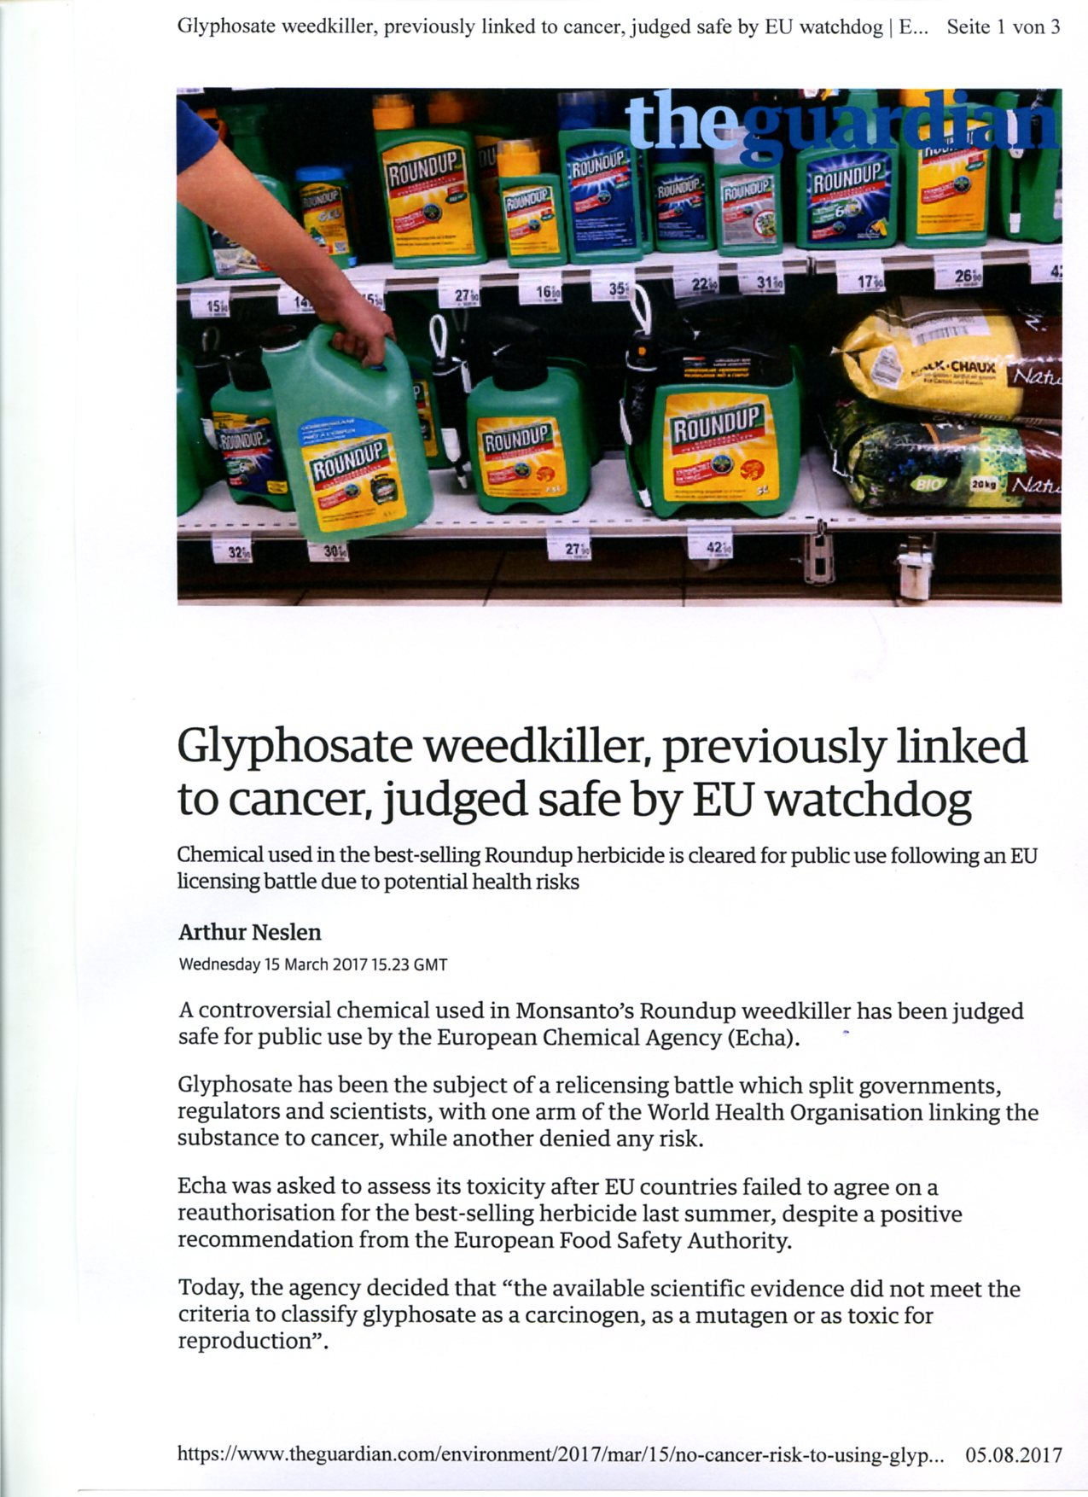
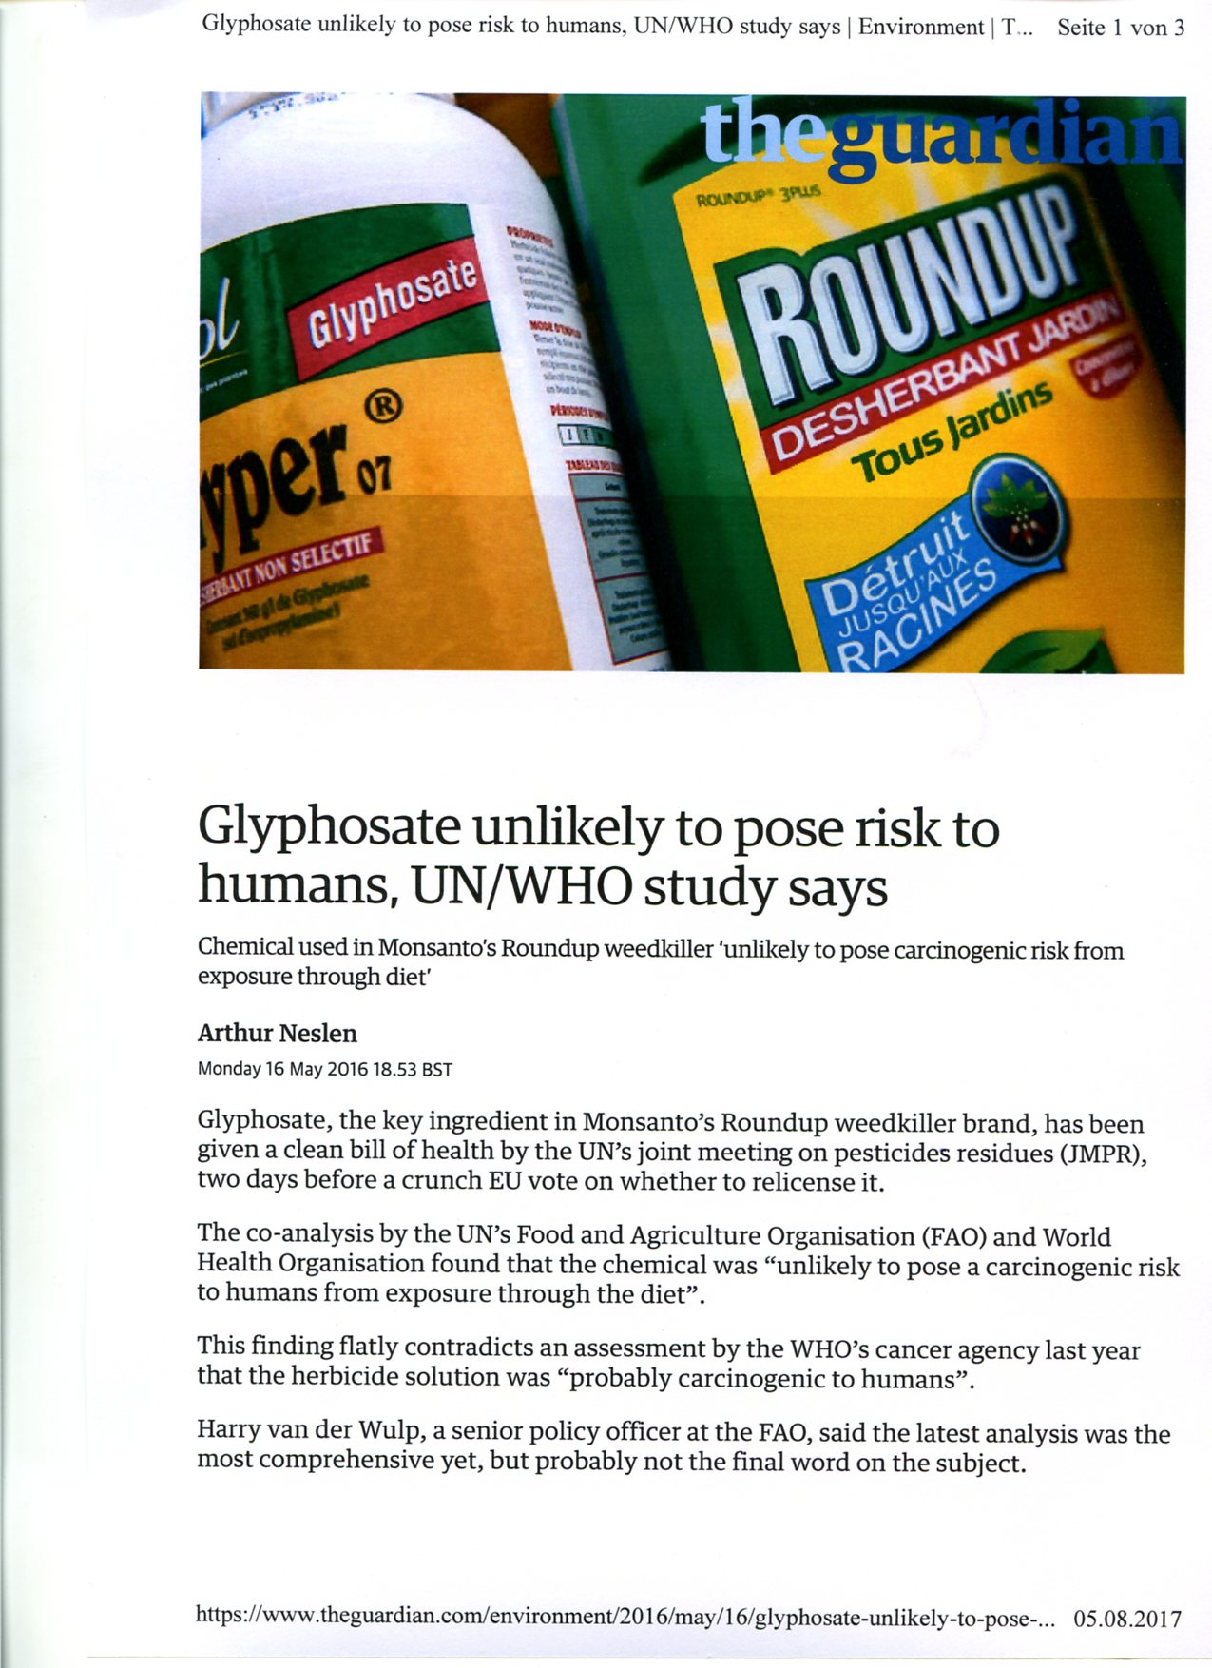
Glyphosate in the Press, examples

Slide 8
Glyphosate – what does it make so special
Action mainly by contact, limited soil action
Systemic action in the plant (weed)
Active ingredient cannot be broken down by the plant
Selectivity and weed control relies very much on the applied rate
Lowest rate for top dressing in Germany would be
1 l/ha of the product with 360 g/l a.i.
Works when applied in the winter month as well
Effect does slow down with cold temperatures

Slide 9
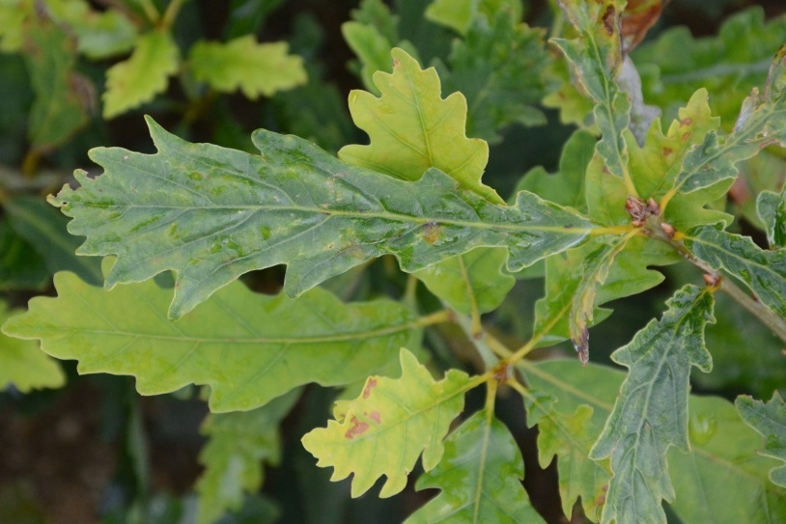
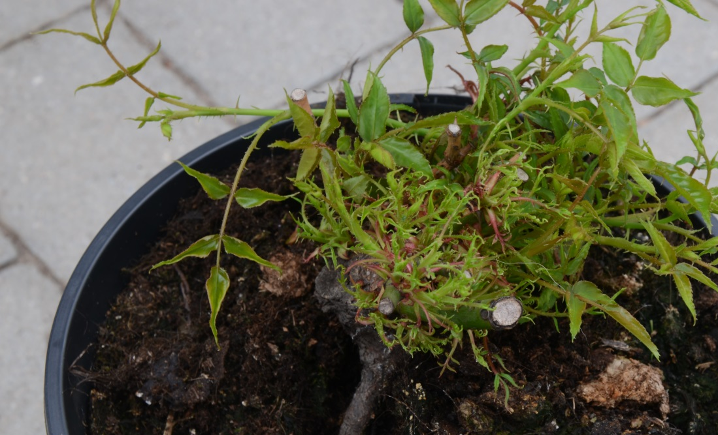
Glyphosate – what does make it so special
Uptake with the roots is possible !!!
Damage mainly on broadleaf plants, leaves getting very narrow
Pictures: Damage on oak and roses

Slide 10
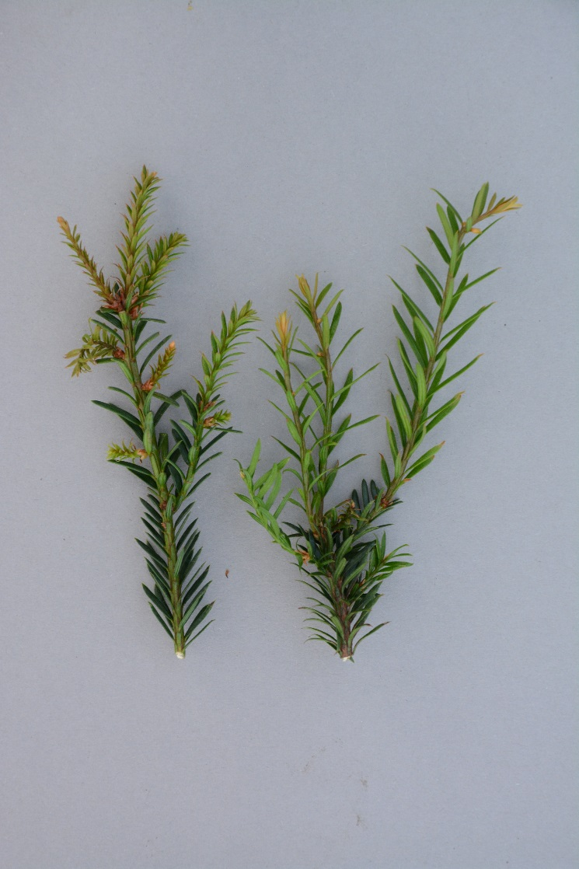
Glyphosate – what does it make so special
Conifers get shorter needles after over the top application
Over the top application of the product at fully dormant stage is done a lot in Europe
Selective in oak, beech, White fir, Nordmann fir
Not possible in Douglas fir, Noble fir and others

Slide 11
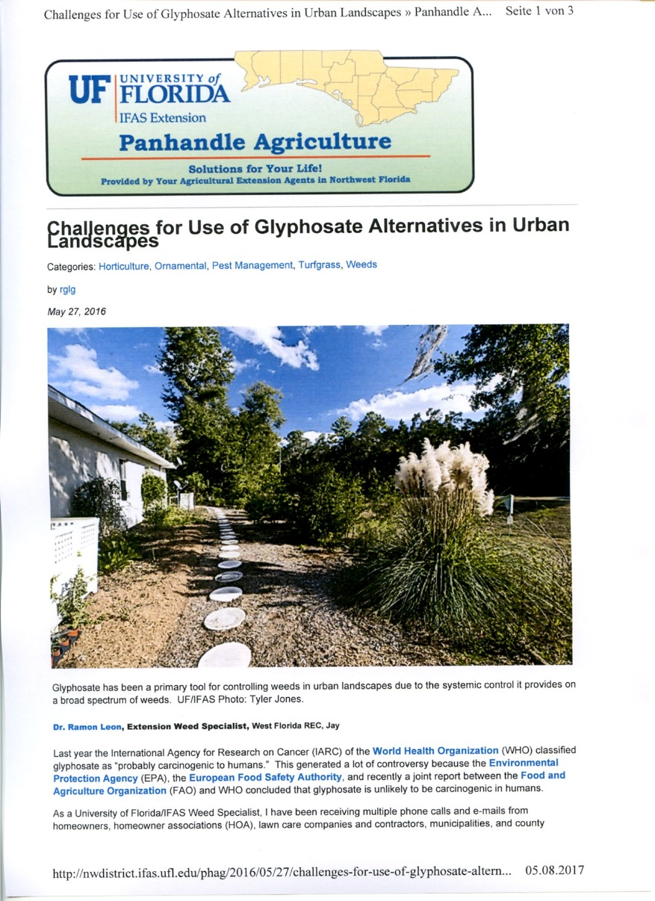
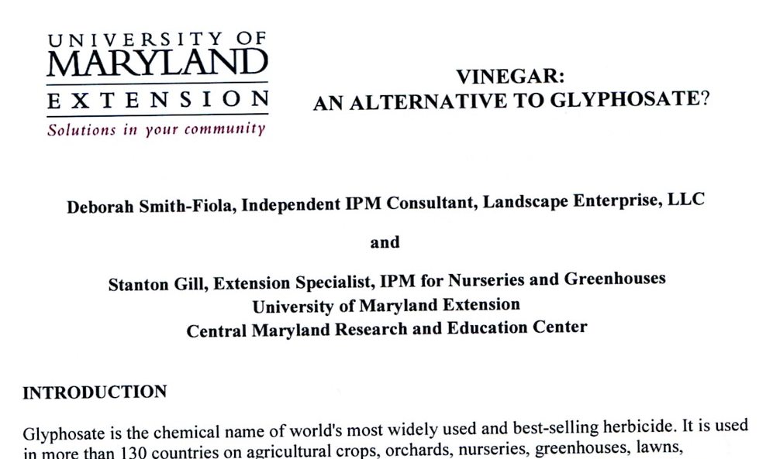
What about alternatives - Is vinegar the answer ??

Slide 12
Are there any replacements for Glyphosate ?
Tests are going on for a few years, especially after our best alternative product Finale (Basta) as a replacement will lose or has already lost registration in Europe
Overview:
Pelargonic acid (Finalsan)
Diquat (Reglone), Paraquat (Gramoxone)
Hormans like MCPA, Dicamba
Mesotrione (Callisto), Sulcotrion (Mikado), Tembotrion (Laudis)
Carfentrazone (Shark), (Pyraflufen) Quickdown
Flazasulfuron (Chikara), Forumsulfuron + Iodosulfuron (MaisTer), Thifensulfuron (Harmony), Tribenuron (Pointer)
Pyridate (Lentagran)

Slide 13
Finale, Finale 150 SL – Characteristics
Active ingrediant Glufosinat-ammonium
Needs light, does not work during winter
Semi systemic action, no long lasting control of couch-grass and others
Over the top application is not possible on conifers and broad leaf plants
New formulation called Basta/Finale 150 SLl
No further registration of Glufosinat-ammonium in Europe

Slide 14
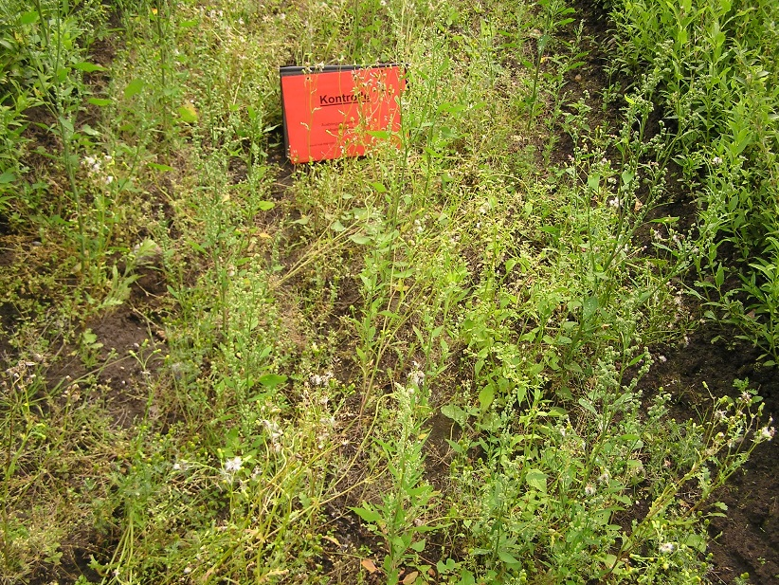
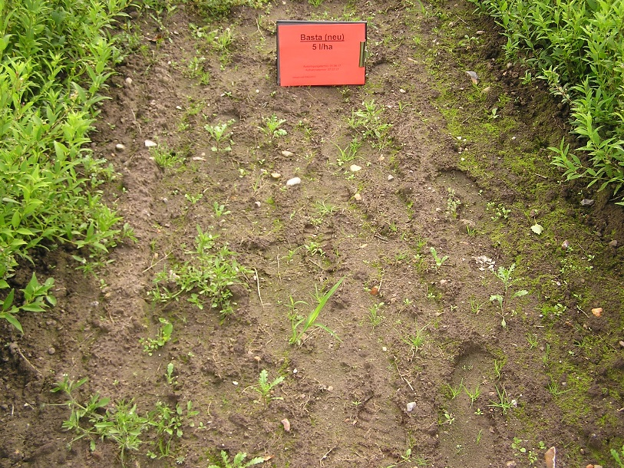
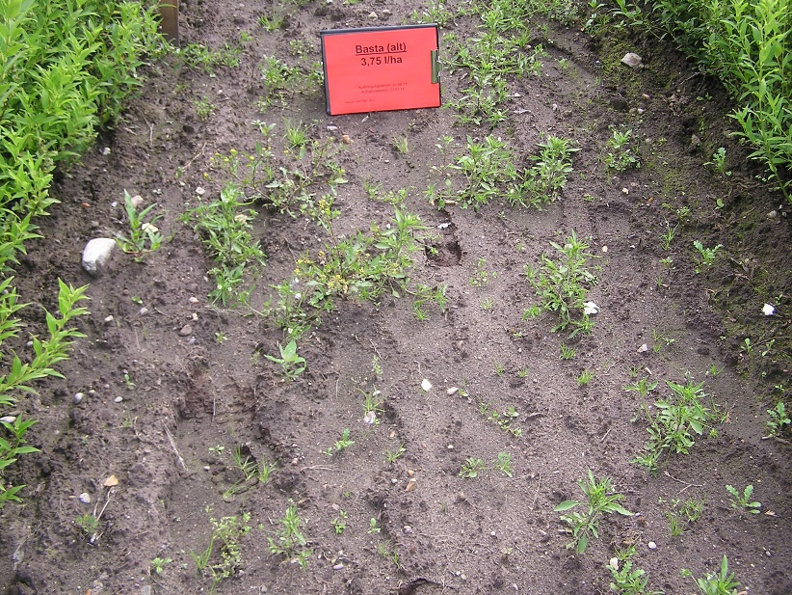
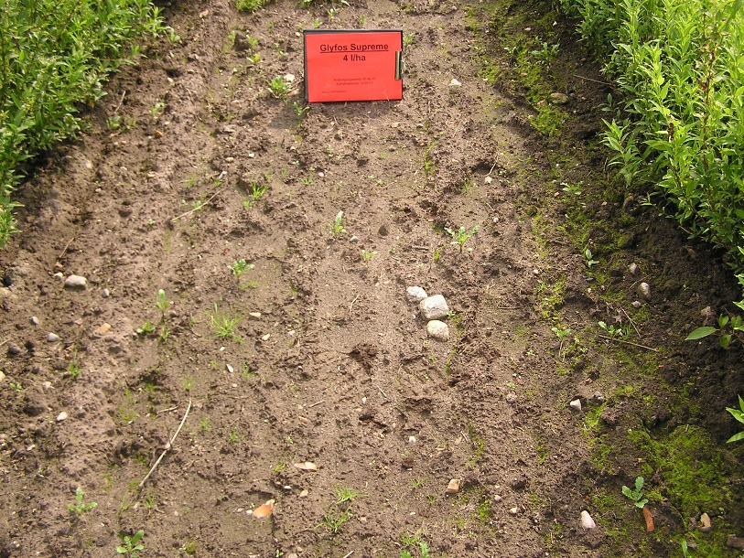
Finale, Finale 150 SL and Glyphosate in comparison
Untreated control Basta, Finale 150 SL, 5 l/ha
Basta, Finale, 5 l/ha Glyphosate (360 a.i.), 4 l/ha

Slide 15
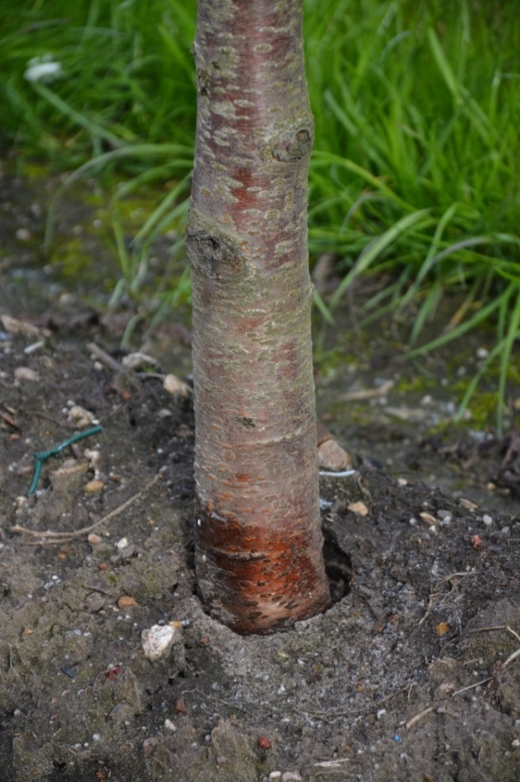
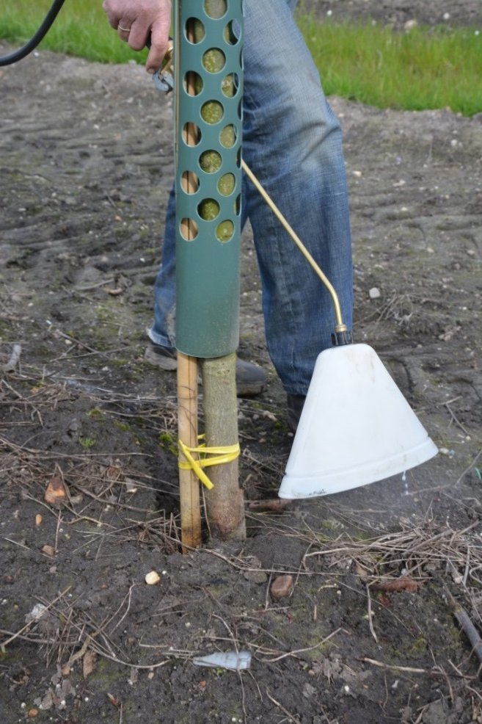
Basta, Finale – spraying of trunks
With young shoots or buds at the bottom, application is not safe for the tree
Trees with green bark should not be treated as well

Slide 16
Are there any alternatives for Glyphosate in nurseries,
a closer look to Pelargonic acid
Product | Chemical | Rate/ha
Finalsan | Pelarganic acid, 186,7 g/l | 166 l
Beloukha | Pelargonic acid, 680 g/l | 16 l
Beloukha + Select | Pelargonic acid, 680 g/l + Clethodim, 240 g/l | 16 l + 0.75 l
Katoun Gold | Pelargonic acid, 500 g/l | 16 l
- Pelargonic acid does not have effect on grass
- Amount of water per ha should be lower than 500 l

Slide 17
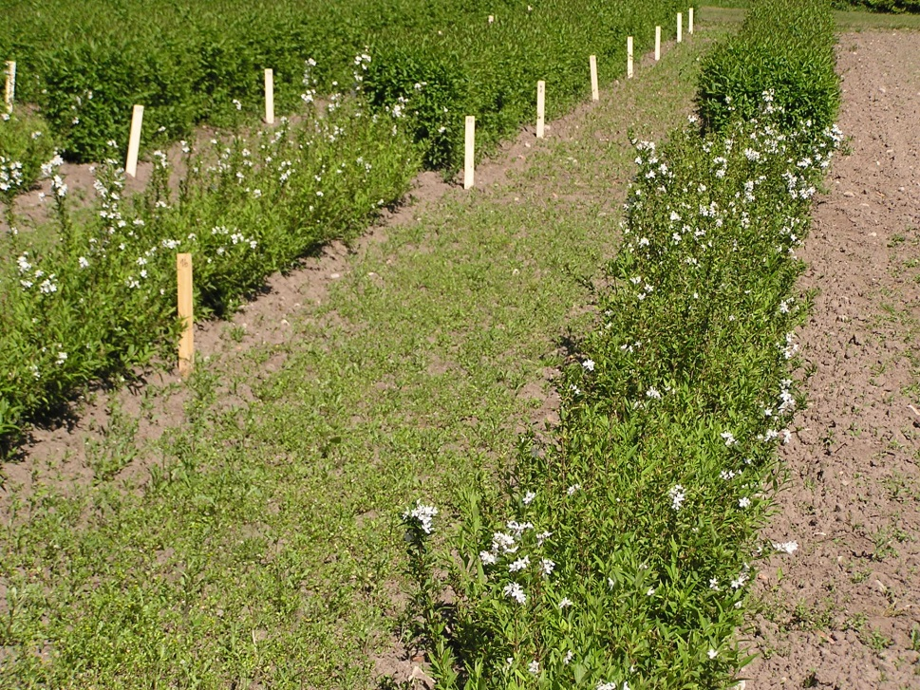
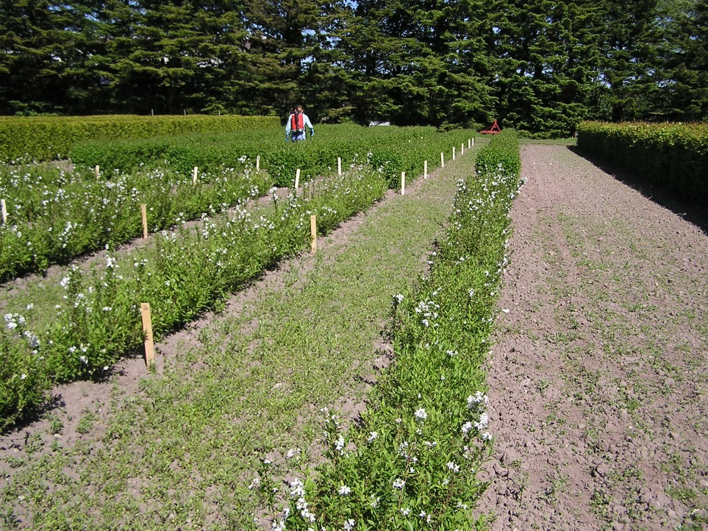
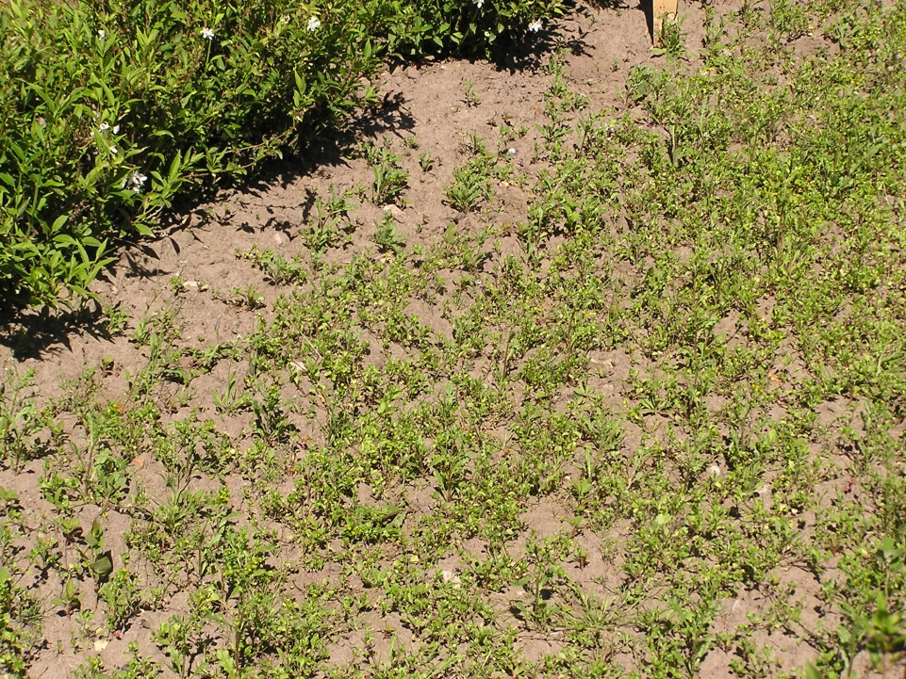
View on the test field, small and soft weeds

Slide 18
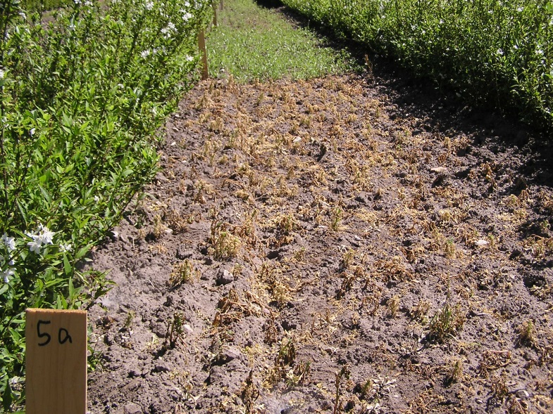
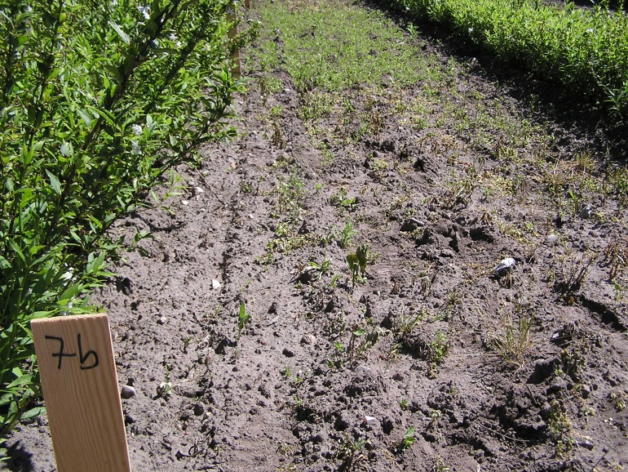
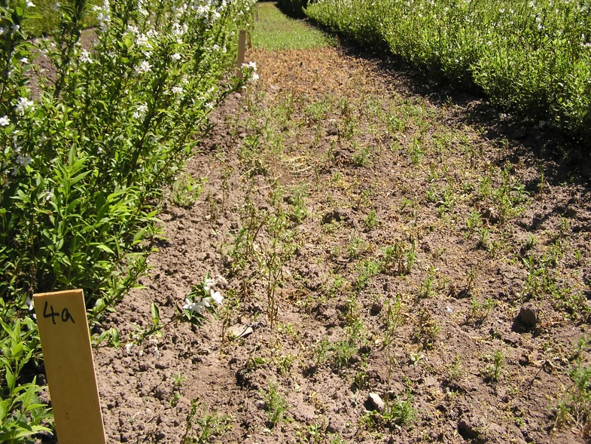
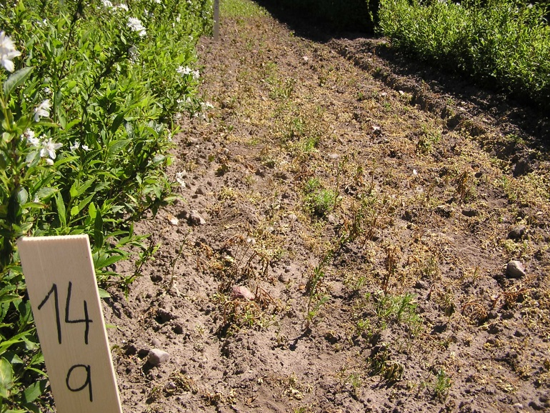
Pelargonic acid on small weeds – results after 2 weeks
Katoun Gold, 16 l/ha
Finalsan, 166 l/ha
Beloukha, 16 l/ha
Beloukha, 16 l + Select, 0.75 l/ha

Slide 19
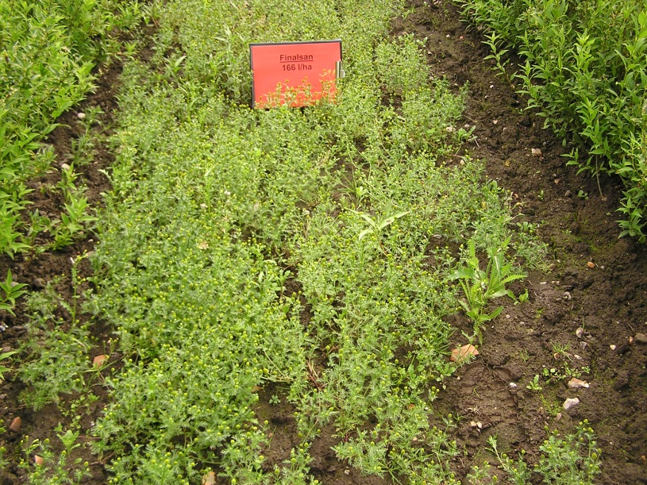
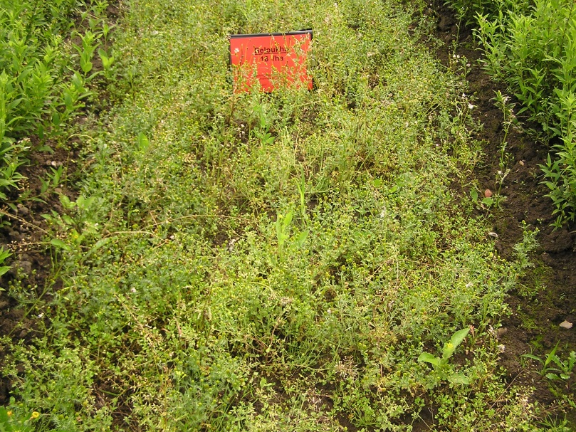
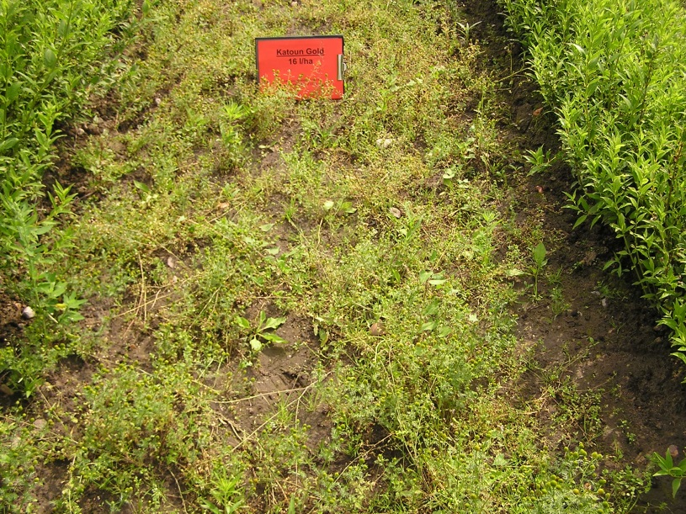
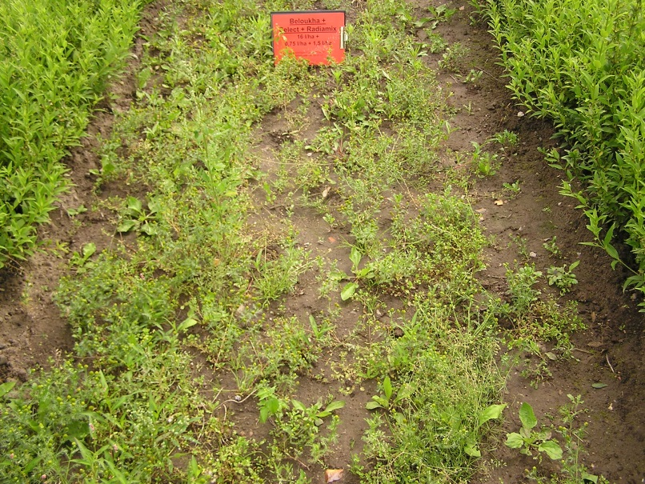
Pelargonic acid on bigger weeds – results after 4 weeks
Finalsan, 166 l/ha
Beloukha, 16 l/ha
Katoun Gold, 16 l/ha
Beloukha, 16 l + Select, 0.75 l/ha

Slide 20
Are there any replacements for Glyphosate ?
Diquat (Reglone)
  mainly for dicotyledonous weeds (potatoe product)
Paraquat (Gramoxone)
  Mainly for grass weeds, but also others
General: - No movement in the soil
        No translocation in the plant
        Both very old chemicals
        Both very toxic products
Both chemicals do have problems with registration in Europe, Paraquat lost registration already

Slide 21
Are there any replacements for Glyphosate ?
MCPA,
2,4 D
Dicamba and others
General:
- in use for many years in cereals and other crops
- active against dicotyledonous weeds only
- practical use only in bigger nursery stock against
some problem weeds
- some translocation in the soil
- systemic action in the plant

Slide 22
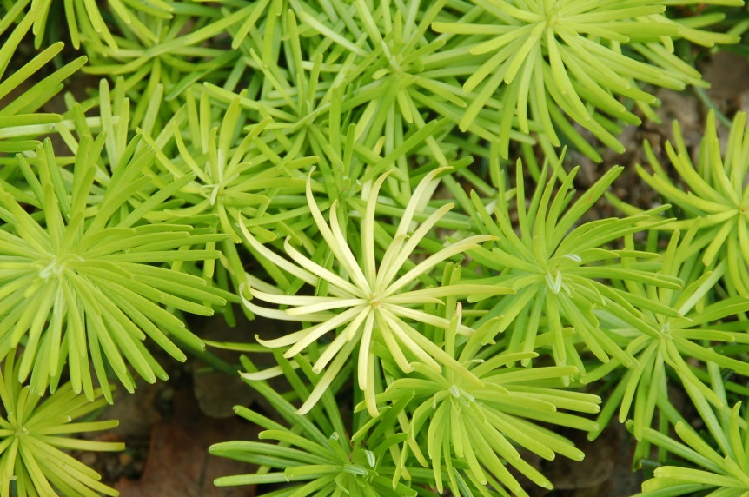
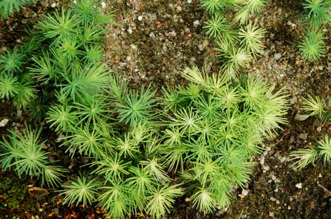
Are there any replacements for Glyphosate ?
Mesotrione (Callisto), Sulcotrion (Mikado), Tembotrion (Laudis)
General:
- contact action, uptake through leaves and roots
- damage on small nursery plants possible
Nordmann fir seedling treated with Callisto, Blue spruce treated with Mikado, 1.5 l/ha,
1.5 l/ha in dormant stage in dormant stage

Slide 23
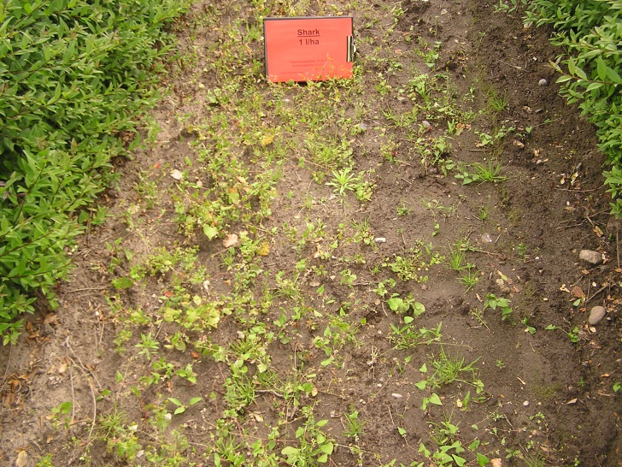
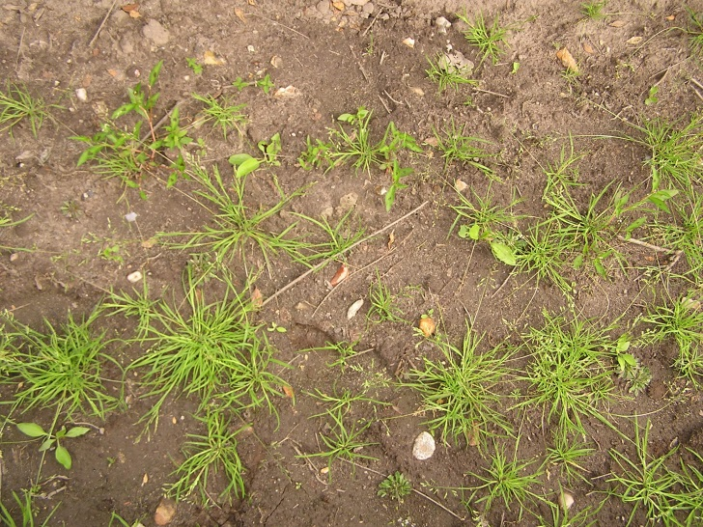
Are there any replacements for Glyphosate ?
Carfentrazone (Shark), Pyraflufen (Quickdown)
General:
    Registration for potatoes, killing the leaves before harvest
    No control of grass, needs a partner for grass
    Active only during the summer month with light
    Quickdown seems to be the better product by our experience
Shark treatment 1 l/ha No controll of annual meadow grass with Shark

Slide 24
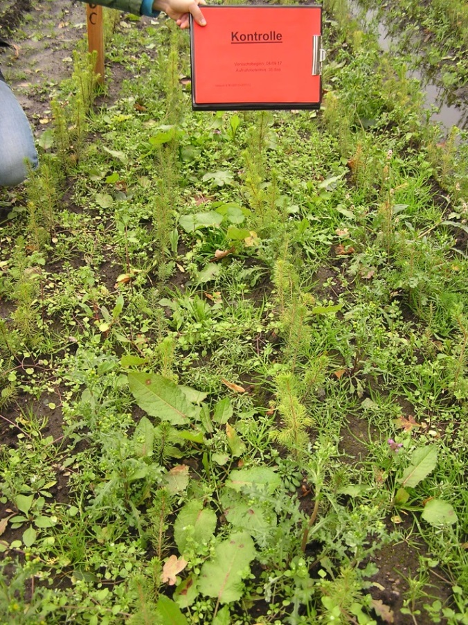
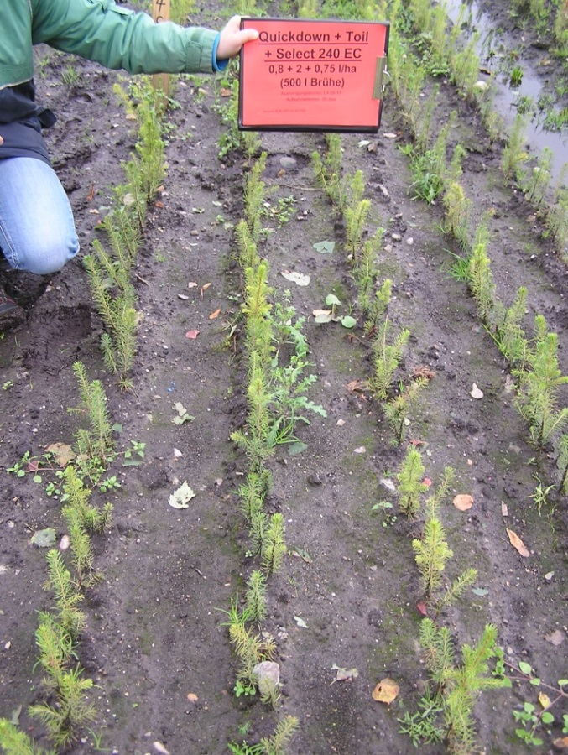
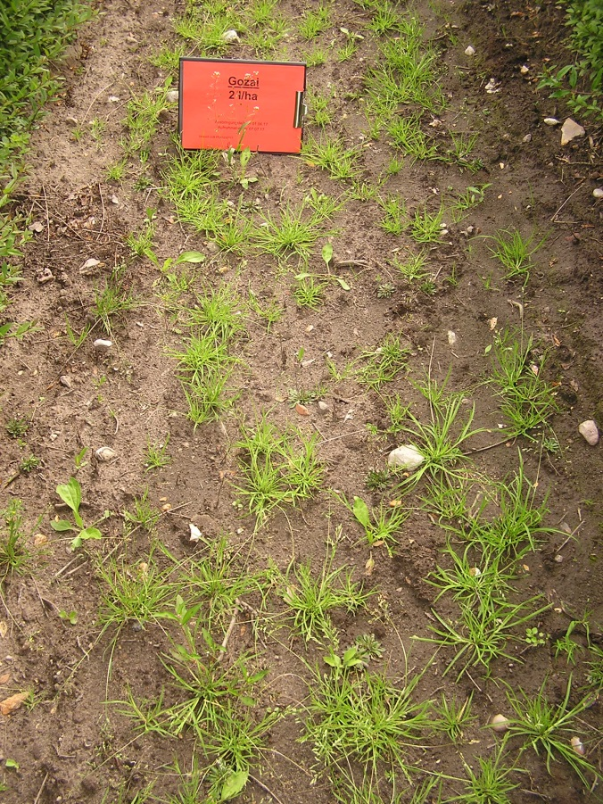
Quickdown (Pyraflufen), results of 2017
Untreated control
Quickdown + Toil + Select 240 EC (Clethodim)
0,8 + 2 l + 0,75 l/ha
Quickdown + Toil,
0,8 + 2 l/ha
Pictures taken 5 weeks after treatment, B. Zielke, VuB

Slide 25
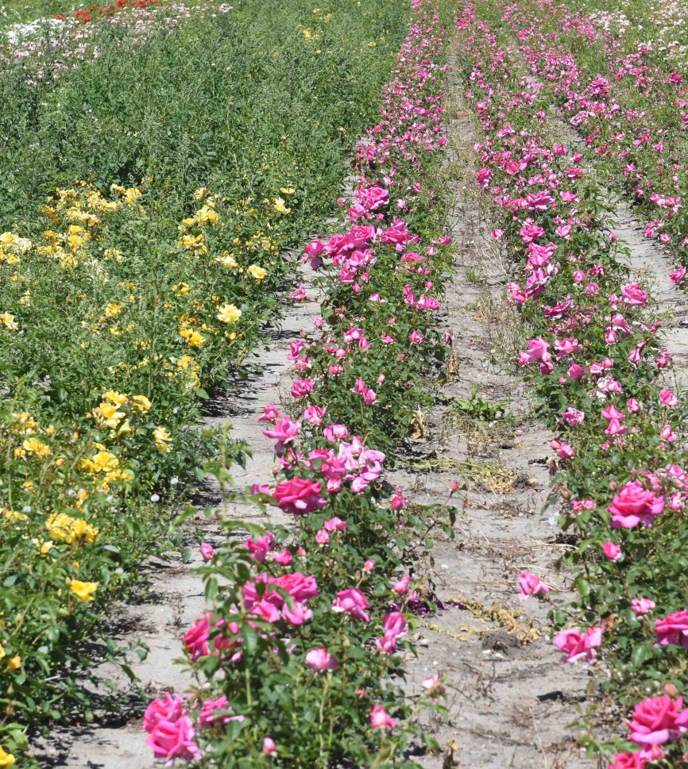
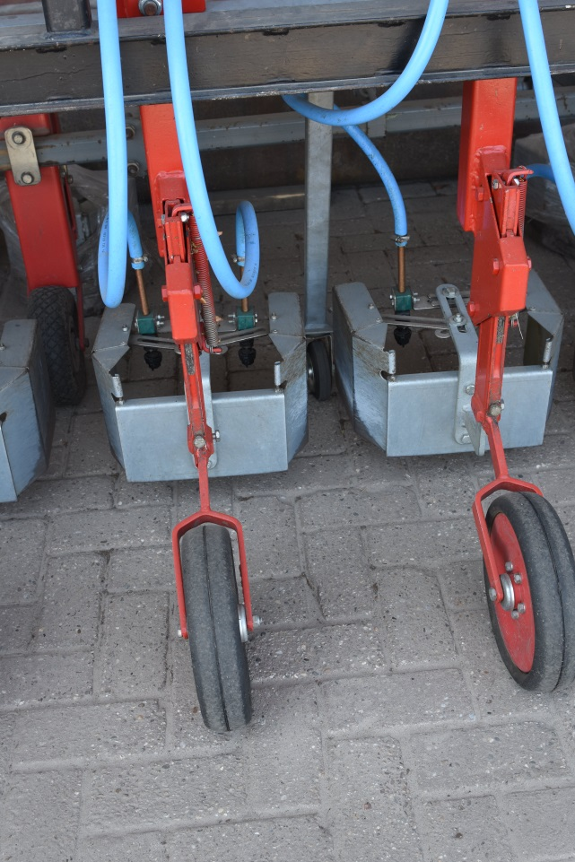
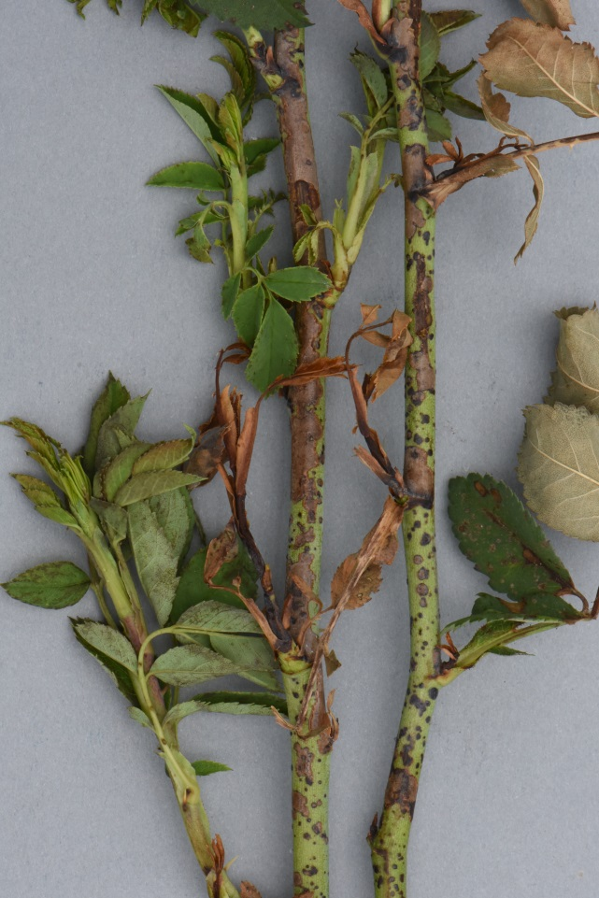
Pyraflufen (Quickdown, Gozai) treatment interrow in roses in summer
Product needs good application without drift
Damage can occur on green bark species, like roses

Slide 26
Are there any replacements for Glyphosate ?
Flazasulfuron (Chikara), Forumsulfuron + Iodosulfuron (MaisTer), Thifensulfuron (Harmony), Tribenuron (Pointer)
General:
    not very selective in small nursery crops
    Most products are specialized only against a few weeds
    Contact action and long lasting effect
    Plants in the rose family (Rosaceae) seem to be more sensitive
    Flazasulfuron and Forumsulfuron +Iodosulfuron are the most promissing products in this group
    New product (MaisTer Power) with Thiencarbazone is not selective in small nursery stock

Slide 27
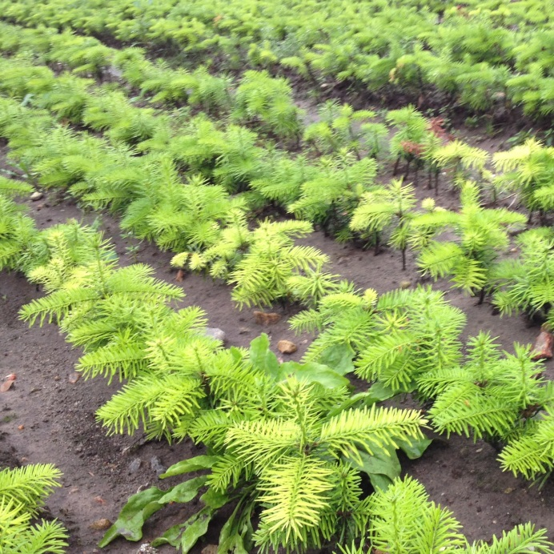
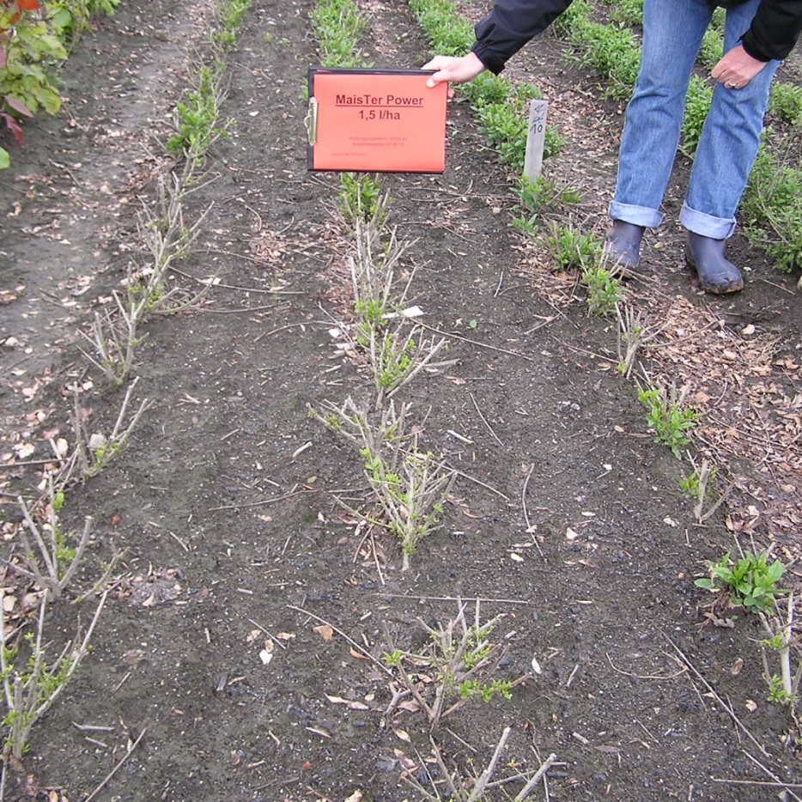
Selectivity of MaisTer Power in hardy nursery stock
Active ingrediants: Foramsulfuron 31,5 g/l, Iodosulfuron 1 g/l, Thiencarb. Methyl 10 g/l, Cyprosulfamide 15g/l
MaisTer Power in A. nordmanniana
MaisTer Power in Ligustrum

Slide 28
Are there any replacements for Glyphosat ?
Pyridate (Lentagran)
General
    Registration mainly for dicotyledonous weed controll in corn
    Controll of smaller weeds possible with a partner against grass

Slide 29
Top 10 soil active herbicides for nurseries in field grown production, registration is different in each country
Active ingredient | Product name | Comments
Dimethenamid-P | Spectrum Plus, Wing-P, Springbook | Combinations with Pendimethalin or Metazachlor
Diflufencan | Herold | Some crops show strong pink colouration
Flufenacet | Artist | Combination with Metazachlor
Flumiaoxazin | Sumimax, Vorox F | Very good, but lost registration in some countries, future unsure
Isoxaben | Flexidor, Galery, AZ | No grass control , needs a partner
Metamitron | Goltix | Mainly in seedbeds and hardwood cuttings, good in combination with Pendimathalin
Metobromuron | Fresco, Praxim, Proman | New , not in Abies – species, needs a partner

Slide 30
Top 10 soil active herbicides for nurseries in field grown production, registration is different in each country
Active ingredient | Product name | Comments
Metamitron | Goltix | Mainly in seedbeds and hardwood cuttings
Metazachlor | Butisan | Not selective in pines
Metribuzin | Sencor | Not selective in Prunus
Pendimethalin | Stomp | Good partner for many other products
Propyzamid | Kerb Flow | Winter treatment, control of limited weed species
Lost registration: Linuron, Isoproturon, Lenacil
Limeted use: Aclonifen

Slide 31
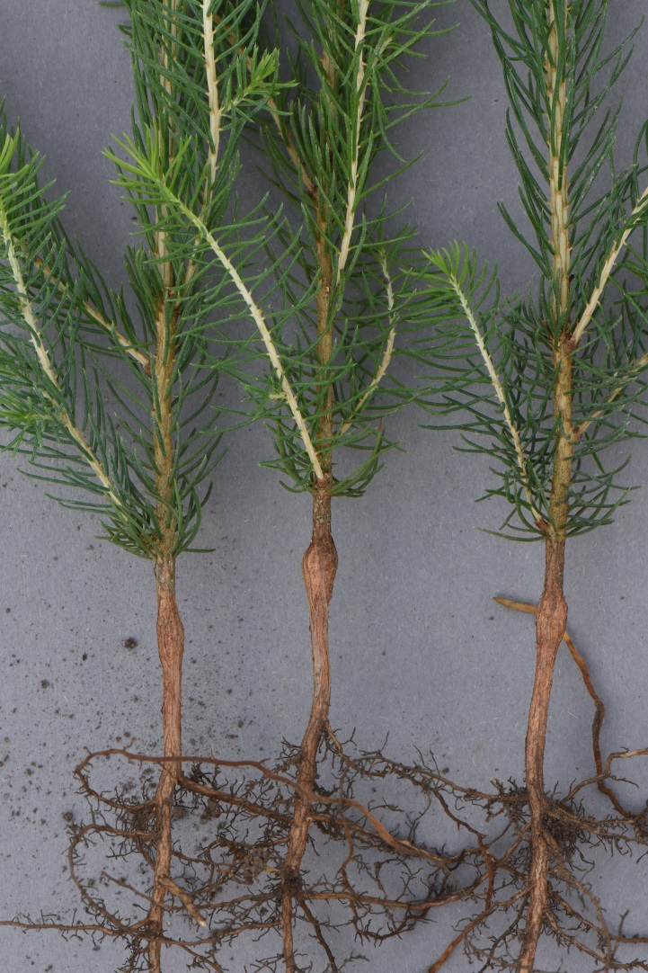
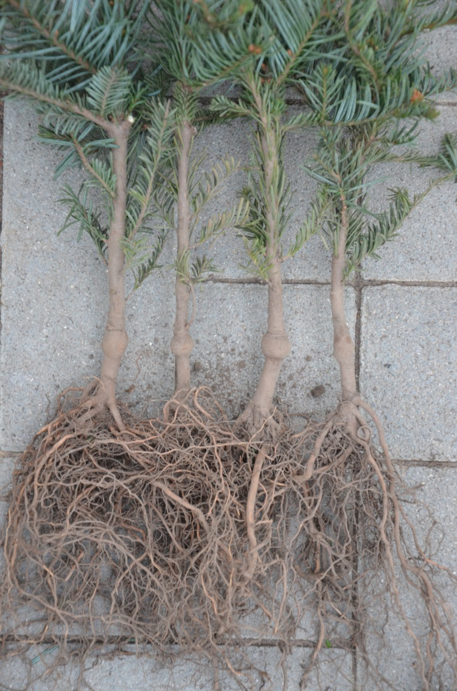
No treatment of Pendimethalin (Stomp) in conifer seedbeds, Propyzamid (Kerb) only in low dosage
Damage on Noble fir and Norway spruce after treatment with Stomp

Slide 32
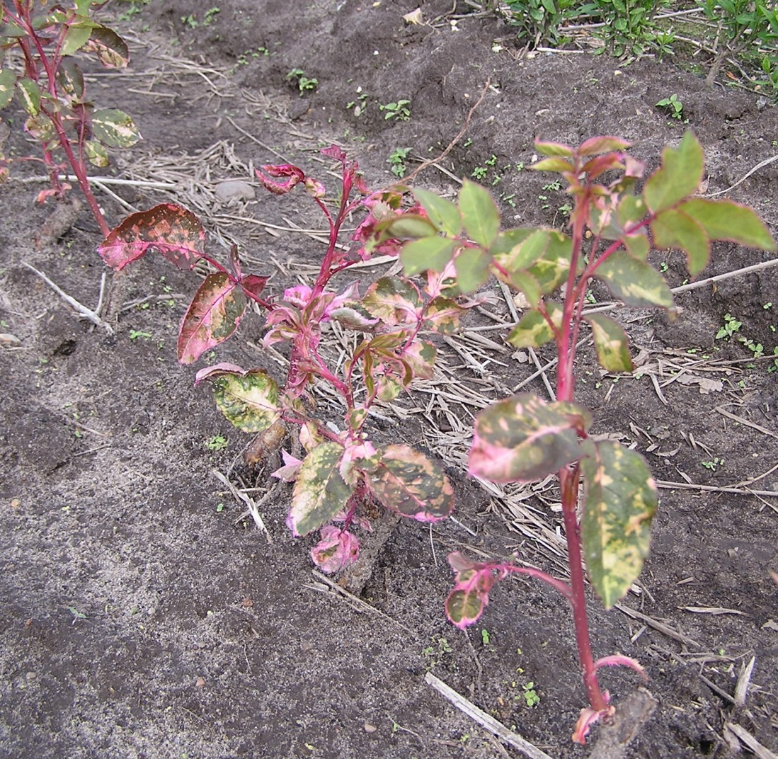
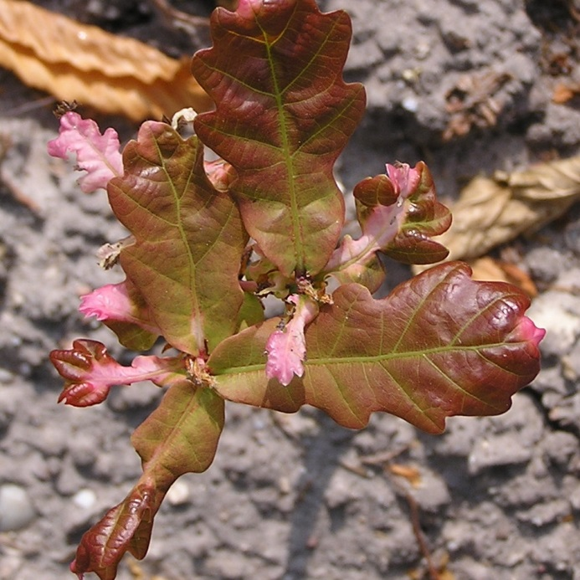
Selectivity of Herold, rate/ha: 0,5 l
Active ingrediant: Diflufenican + Flufenacet

Slide 33
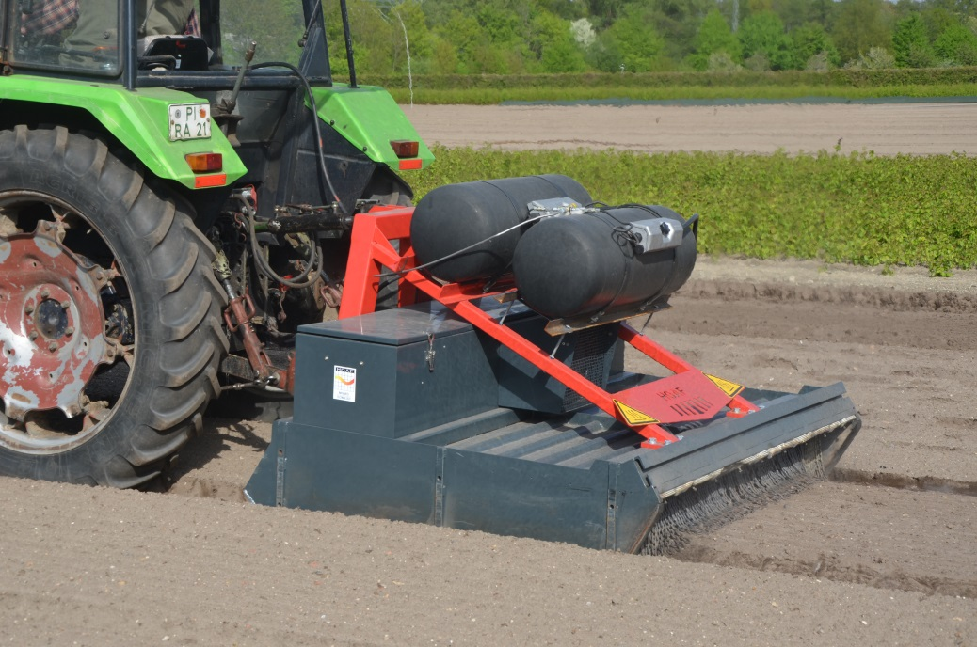
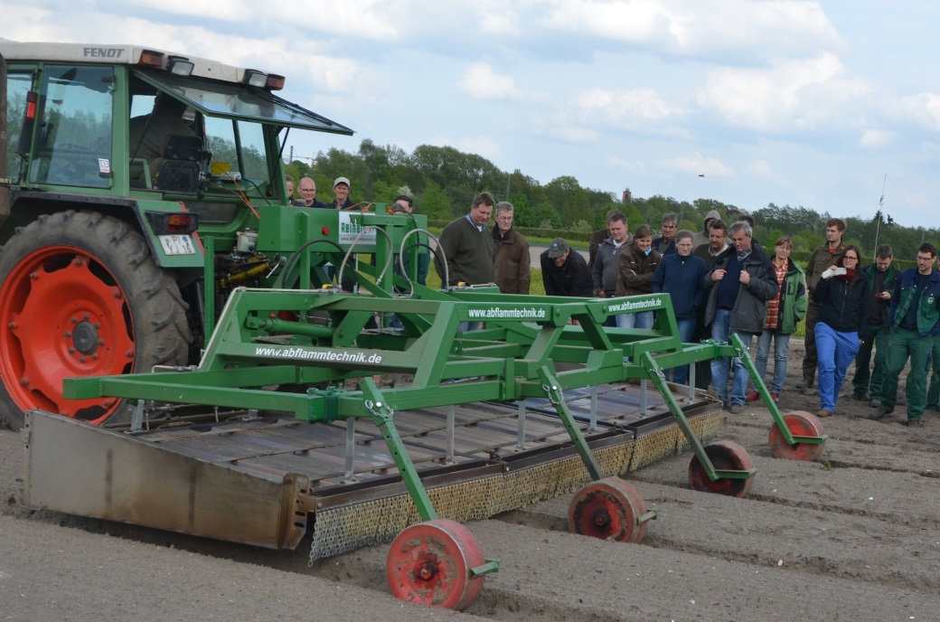
Infra-Red technology used after sowing and before germination of the nursery crop
www.hoaf.nl www.abflammtechnik.de
Alternative: Use of Reglone (200 g/l Diquat) – no activity against grass, 1.5 l/ha or Finalsan Plus (Maleic hydrazide + Pelargonic acid), not safe to use in many crops
Use of Finale (Glufosinate-ammonium, 120 g/l) or Roundup-products is not safe to apply shortly before germination !!!!

Slide 34
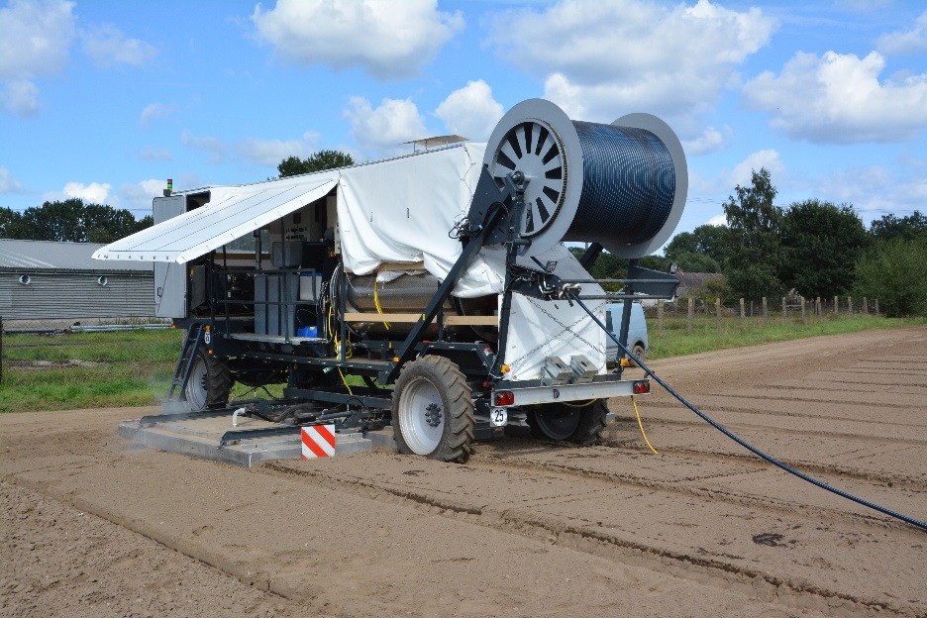
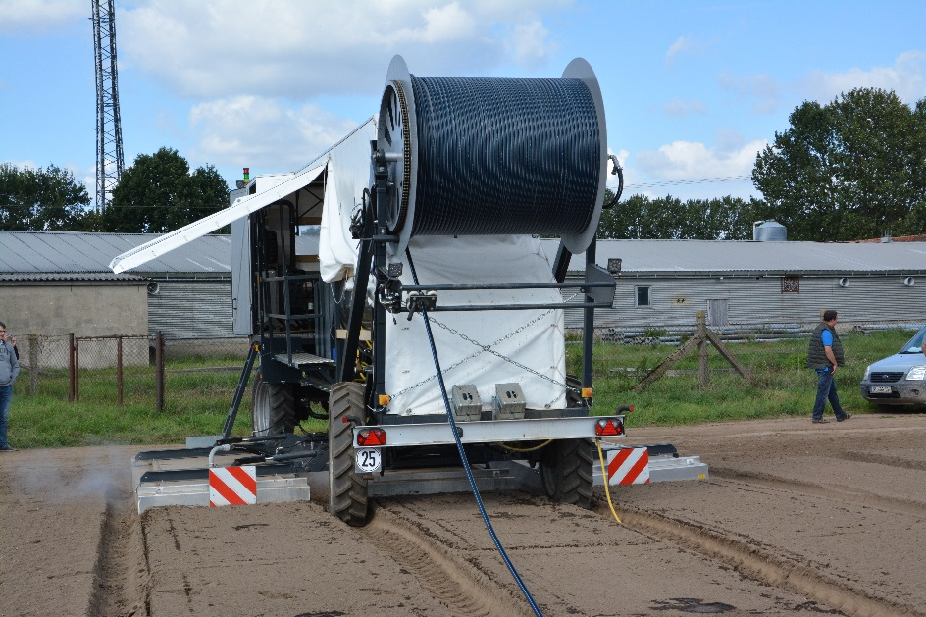
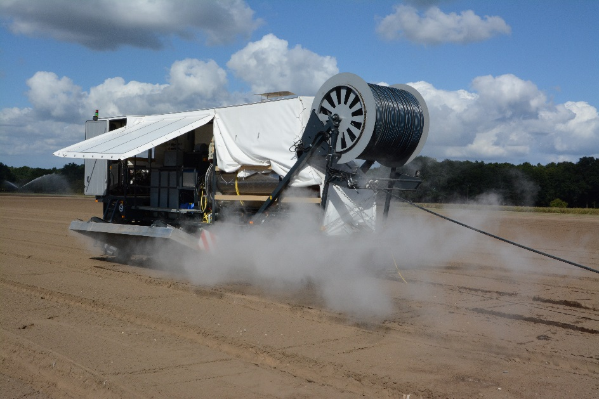
Fully automatic steaming in the field
Hood steamer, does press the steam into the soil
First machine world wide
Built by www.zeyer.biz
and www.moeschle.de
Price: about 300.000 €

Slide 35


Hood steamer in the field, other producers
Regero machine in Zundert, Netherlands
Hood steamers are available from:
www.egedal.dk
www.moeschle.de, www.zeyer.biz
www.regero.fr
www.simongroup.fr

Slide 36


Steaming with Mobildampf.de
Machine injects the steam into the soil at about 10 cm depth, afterwards it is mixed and the temperature is protected by a special blanket.
Used in Pinneberg region since 2012
Since 2013 on bigger scale (20-40 ha per year)
about 80 °C soil temperature necessary
Speed: 150 m/h, work distance
1-1,80 m
Amount of oil needed per qm:
0,45-0,75 l

Slide 37


Alternativ ways of weed control
Hotwater Foam
Companies in Germany:
Elmo, Rheine www.flaechenpflege.de
or
Ipros, Iserlohn, www.ipros.de
No long lasting effect !!

Slide 38


Mechanical weed control in transplants
Distance 25 cm between the rows is easy, problem is between the plants
Power Rake from Egedal company, Denmark
Risk of mechnical damage
Companies:
www.egedal.dk
www.elco-machinebouw.nl
www.jacobsconstructie.nl
www.handelsondernemingschrauven.nl

Slide 39



High clearance tractors as a standard made by different companies
Can do nearly any job with the plants and around the plants
Companies/Examples:
www.damcon.com
www.ezendam.info
www.lommers-vaneijken.com
www.rath-maschinen.com

Slide 40



Driven Power rake by hydraulic of the tractor
Metal bars are mowing around driven by hydraulic of tractor
Metal bars are 60-70 cm long
Produced by: www.jacobsconstructie.nl

Slide 41



Robotics, developements by Naio,www.naoi-technologies.com
Different machines Dino (left) and the Oz (bottom)
Self steering, working independently from grower/driver
Weeding Robot Dino, Picture: Naoi company
Weeding Robot Oz

Slide 42


Future: Robotics ?
Selfsteering and working
machinery without
assistance by people
First prototypes available
Frauenhofer Institut, www.ipa.fraunhofer.de/agriapps.html
and others
Working Platform: BoniRob,
Source: InMach, Picture M. Wopfner

Slide 43
Summary 1
Glyphosate is still a very important herbicide for nursery production
If available, always use the Tallow amine-free (TF) products
Especially for some weeds like couch-grass there is no real replacement
Basta, Finale (Glufosinate) is an alternative in the summer month to a certain extent, but there will be no future registration in Europe

Slide 44
Summary 2
Pelargonic acid and other products give some control of weeds, but control of grass is missing with most products
Many other products like the hormones (Dicamba, MCPA are not safe to use in most nursery crops
Mechanical and thermal methods can be used for weed control, but they do have limitations for weather, soil types, cost and other factors as well

Slide 45
Nursery machinery show 2019
Days:Termin: 29./30.August 2019, Thursday/Friday
Location: Gartenbauzentrum, Ellerhoop (25 km north of Hamburg)
Same time: Florum 2019, www.florum.sh
200 year anniversary H. Meyer, Rellingen
www.meyer-shop.com
The exhibition is carried out only every 5-7 years. We are expecting 300 companies and 5-7.000 visitors.
Further information on: www.baumschultechnik.de
www.nurserymachinery.com

Slide 46
Disclaimer:
Every effort has been made to ensure that the information in this presentation is complete and correct at this time.
The author does not accept liability for any error or omission in the content, or for any loss, damage or other accident arising from the use of products listed here in. Omission of a product does not necessarily mean that it is not approved and available to use.
It is essential to follow the instruction on the approved label for your country before handling, storing or using any crop protection product.
Always start on a small scale with new products !

