Slide 1

Welcome

Slide 2

Tree nursery
Totally 4 hectares
1,25 hectares of green houses
5 employees

Slide 3
Mycorrhiza
Compost
Compost tea
Insects
Biochar

Slide 4
Mycorrhiza
Compost
Compost tea
Insects
Biochar
Inner development

Slide 5
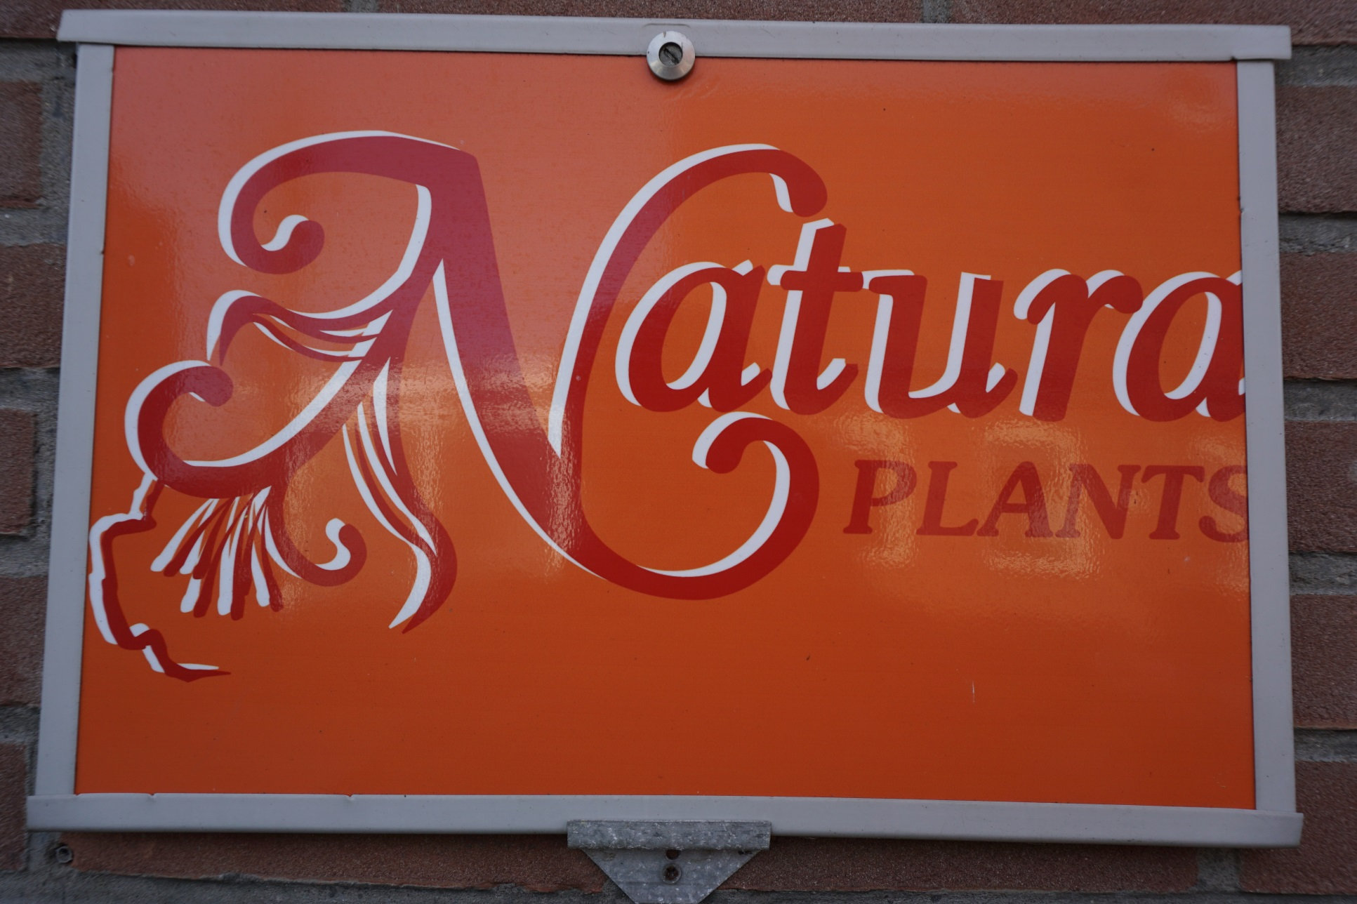

Slide 6
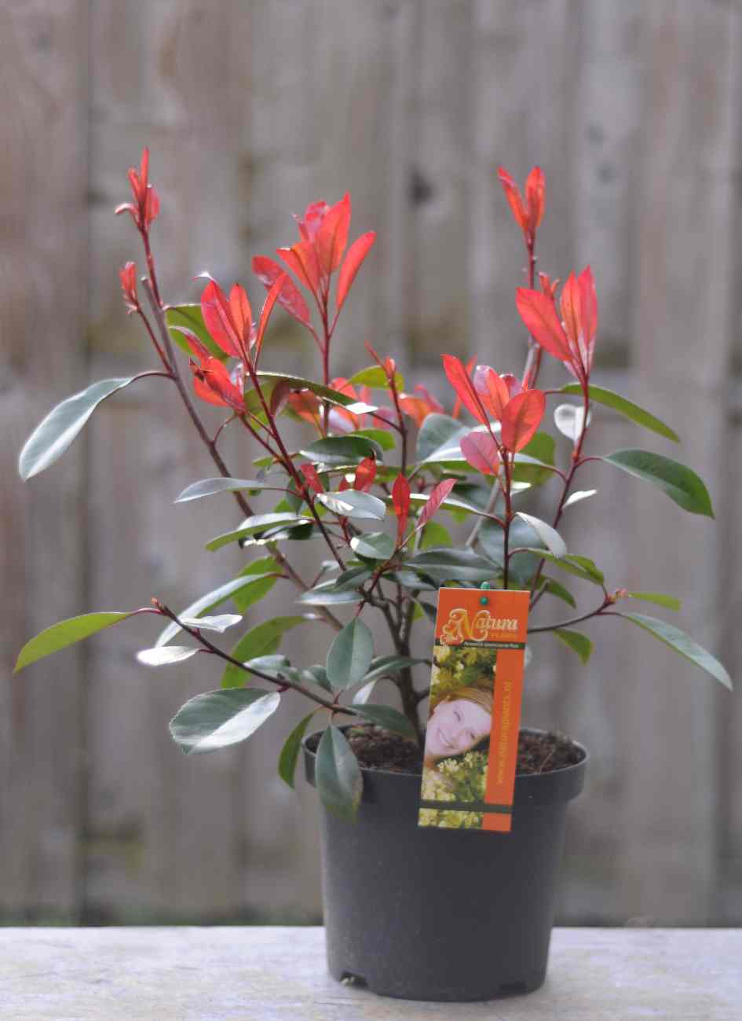
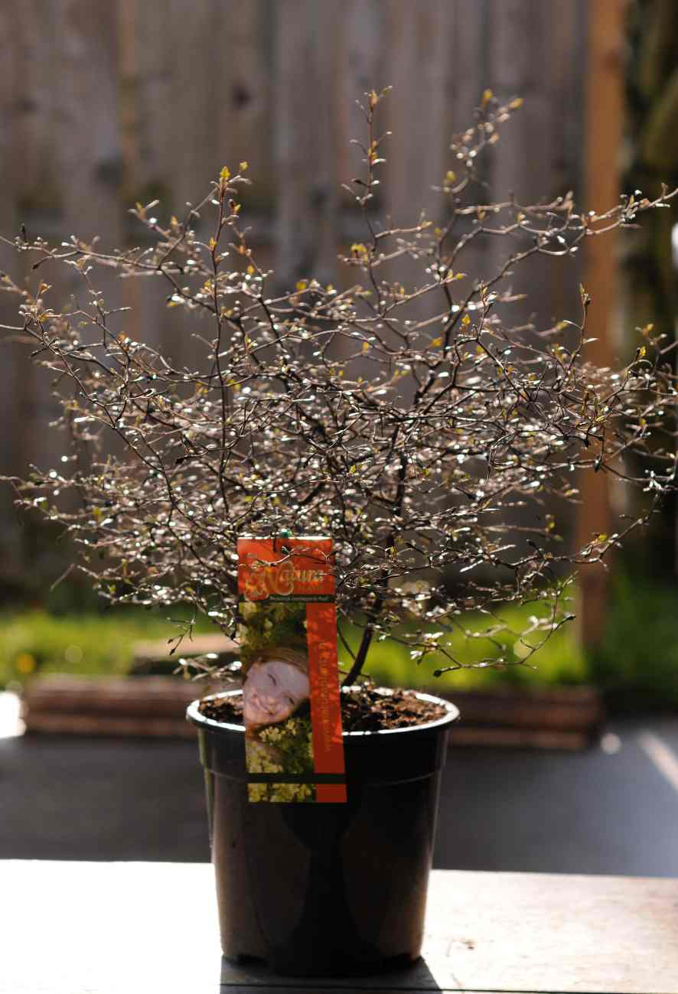

Slide 7
A garden with an impact on the health of the people

Slide 8
Effect
Original source

Slide 9


Slide 10
Thank you for your attention

