Slide 1

Water: Exploring strategies for monitoring and managing disease risks
Tim Pettitt
University of Worcester

Slide 2
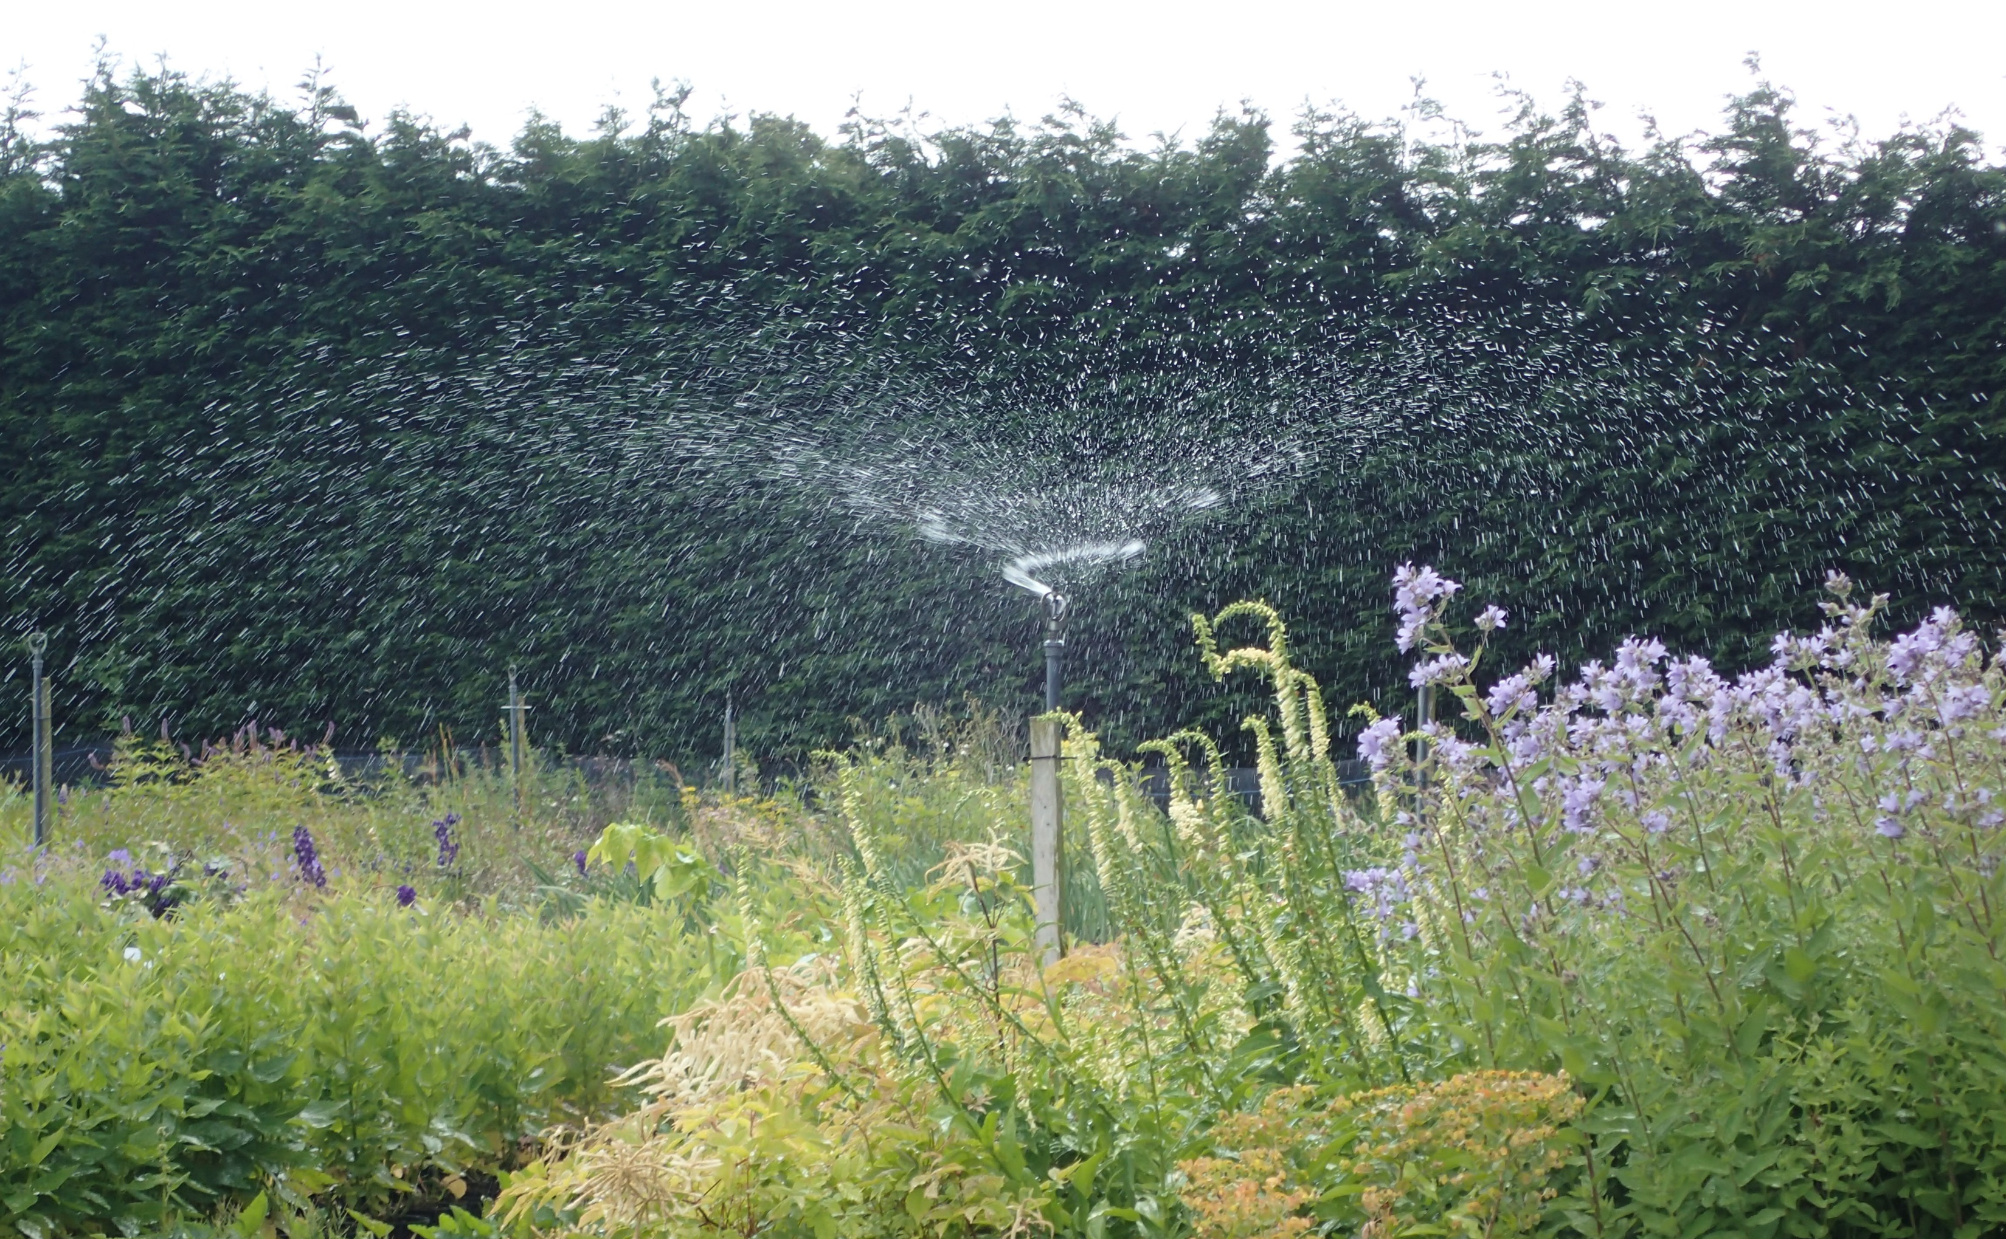
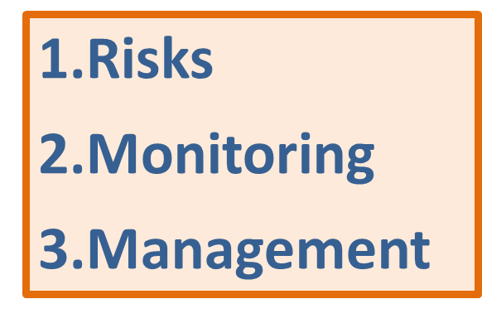
Water: Exploring strategies for monitoring and managing disease risks

Slide 3
What are the disease risks with irrigation water?
A wide range of plant pathogens are spread by contaminated water
Some pathogen groups very readily & rapidly spread in water (e.g. Pythium, Phytophthora and some bacteria e.g. Xanthomonas sp.) and are higher risk
Disease risk, depends on the water’s source, quality, storage and transport

Slide 4
Plant pathogen groups frequently encountered in irrigation water
Oomycetes Pythium & Phytophthora
Various Fusarium species
Thielaviosis
Rhizoctonia
Verticilium
Xanthomonas
Pseudomonas
Some viruses (e.g. Pelargonium flower break virus)

Slide 5
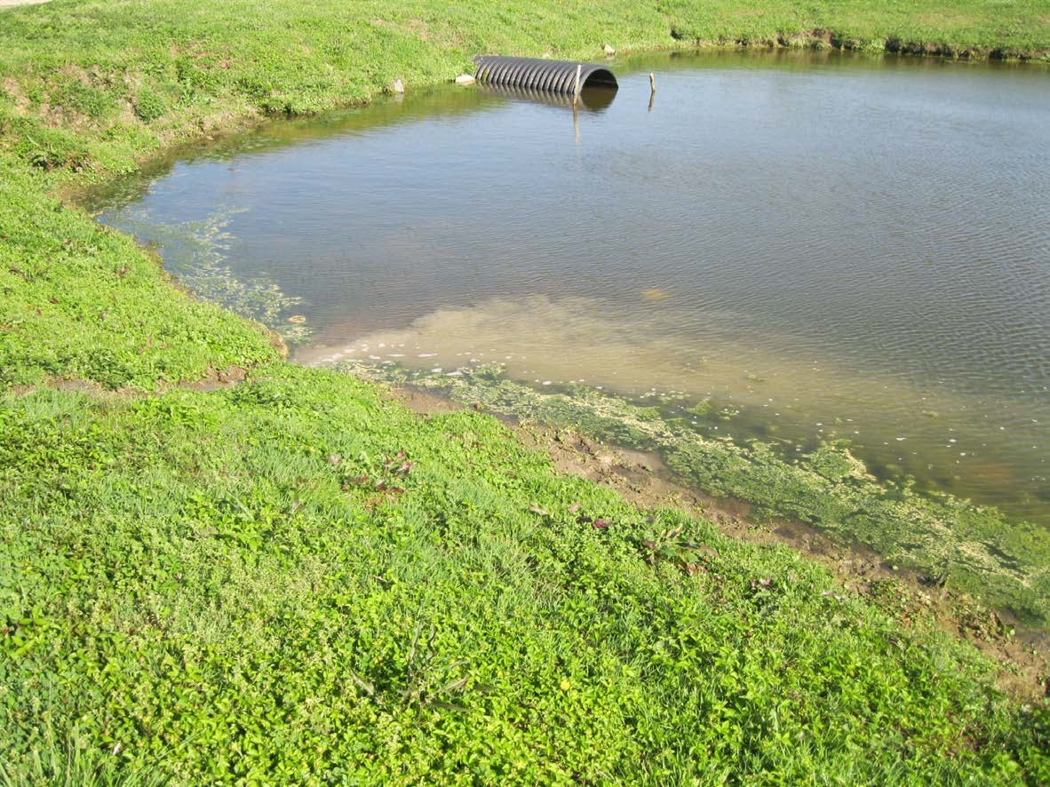
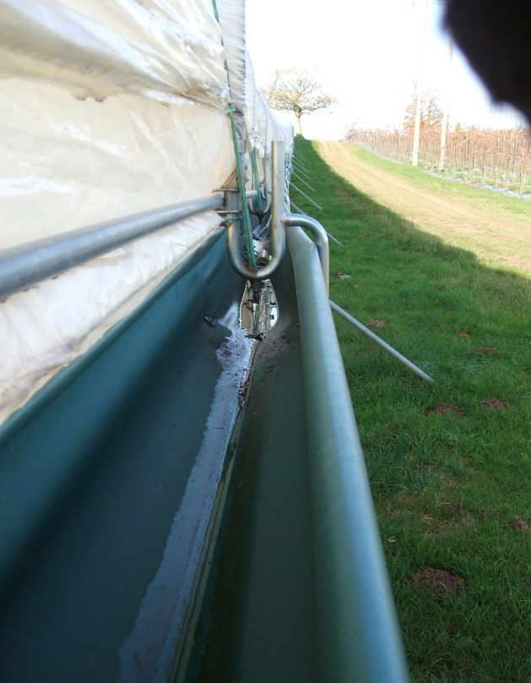
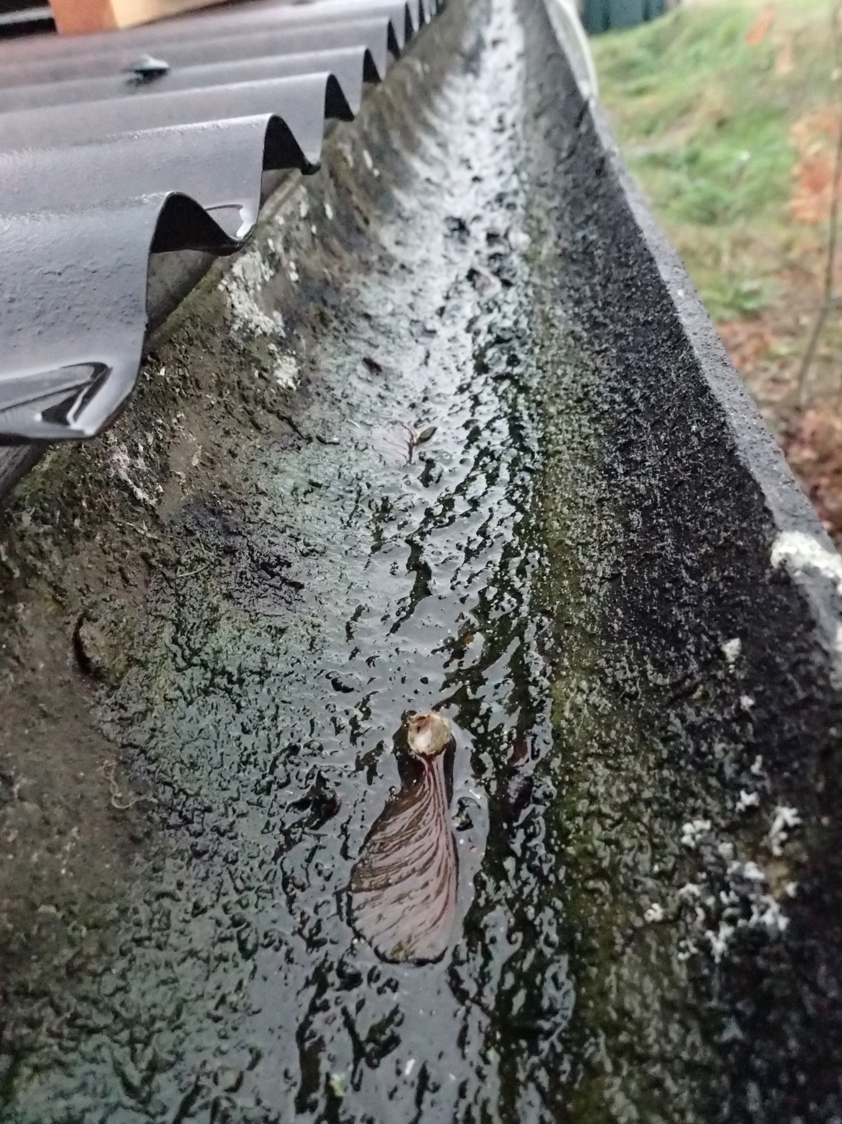
Plant disease risks associated with sources of irrigation water
(risks similar for human pathogens)
Low to no risk
Mains
Bore-holes
  Medium to high risk
Open reservoirs/ponds/lakes
Rivers
Rain-water from roofs etc.
Run-off
Recirculation (eg ebb/flow)

Slide 6
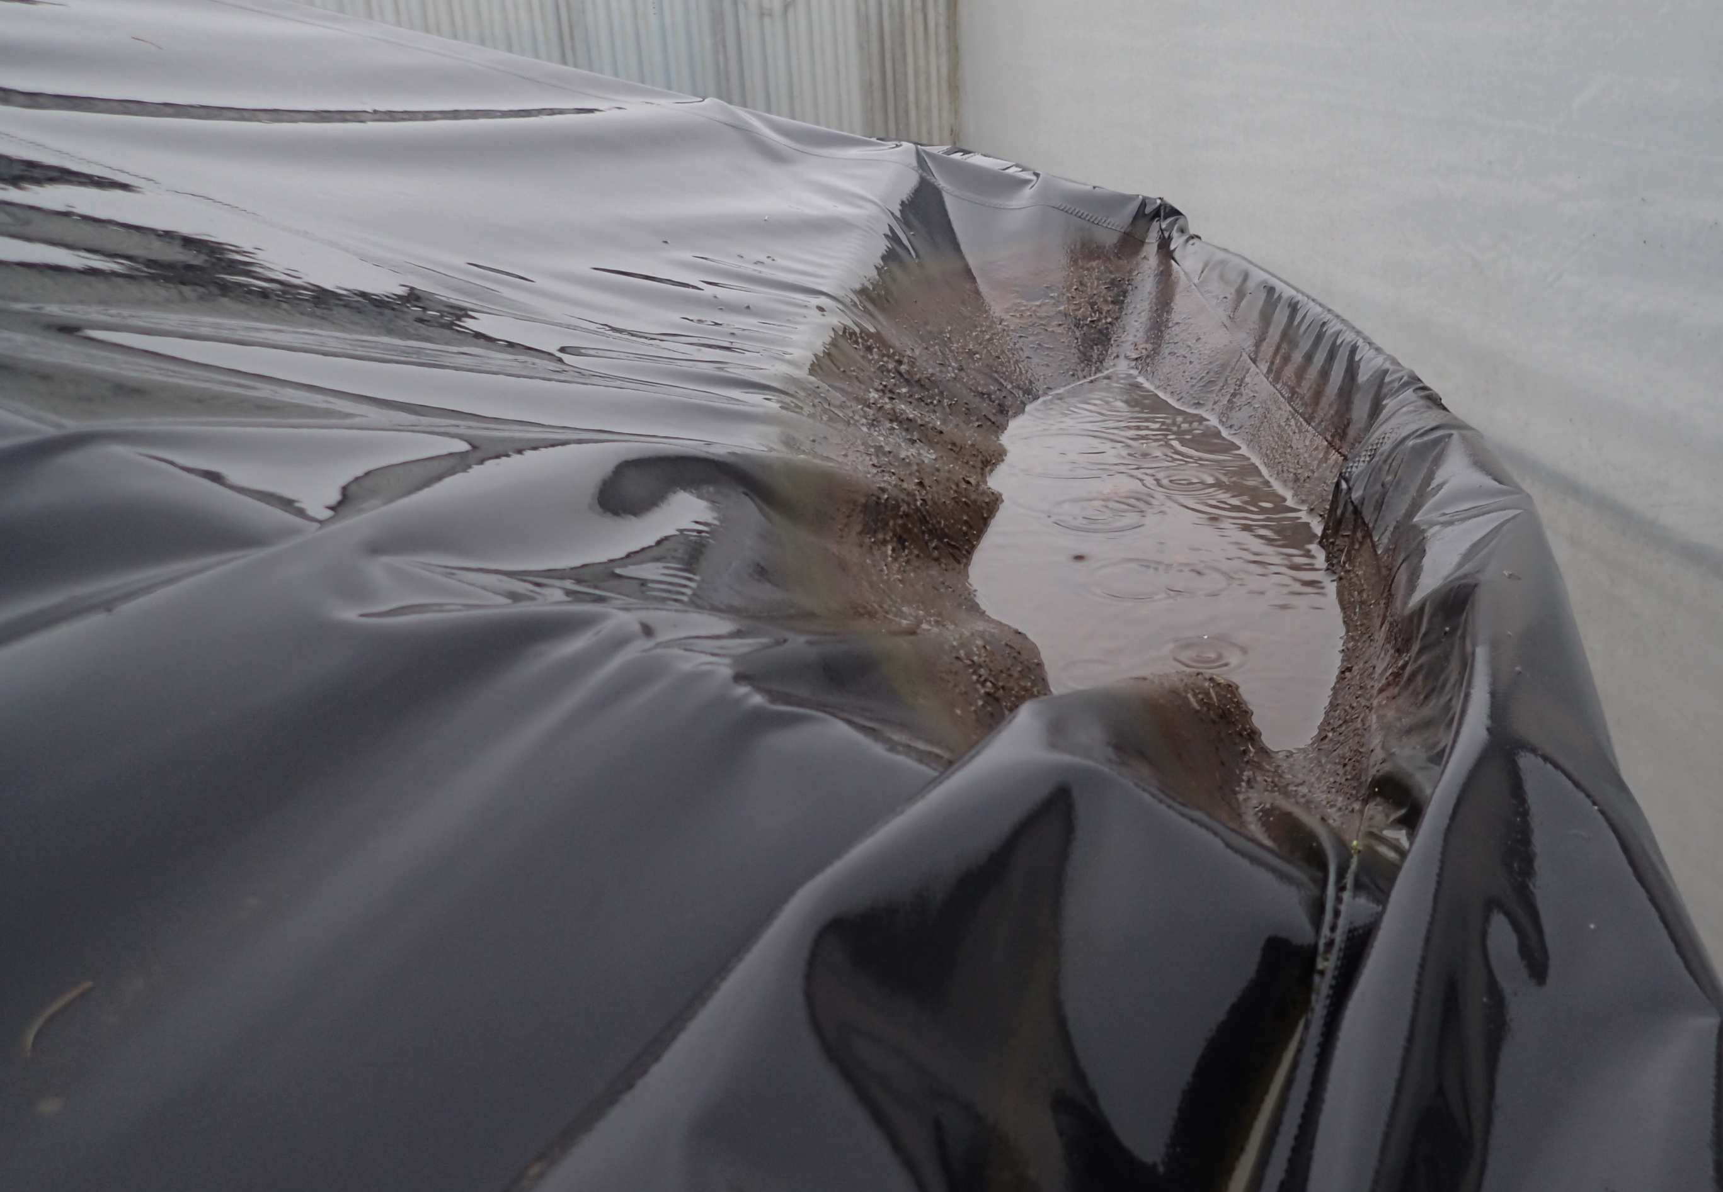
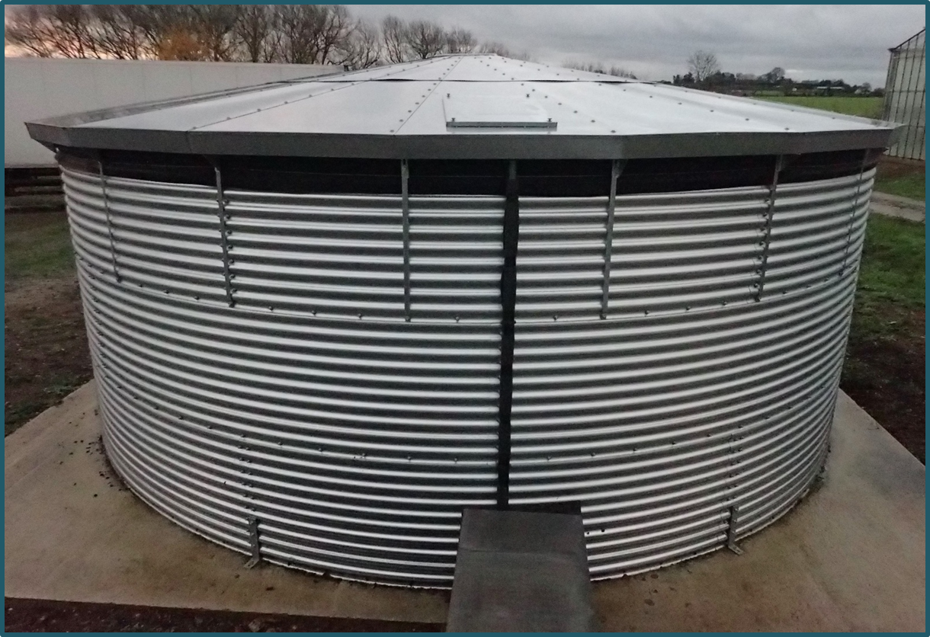
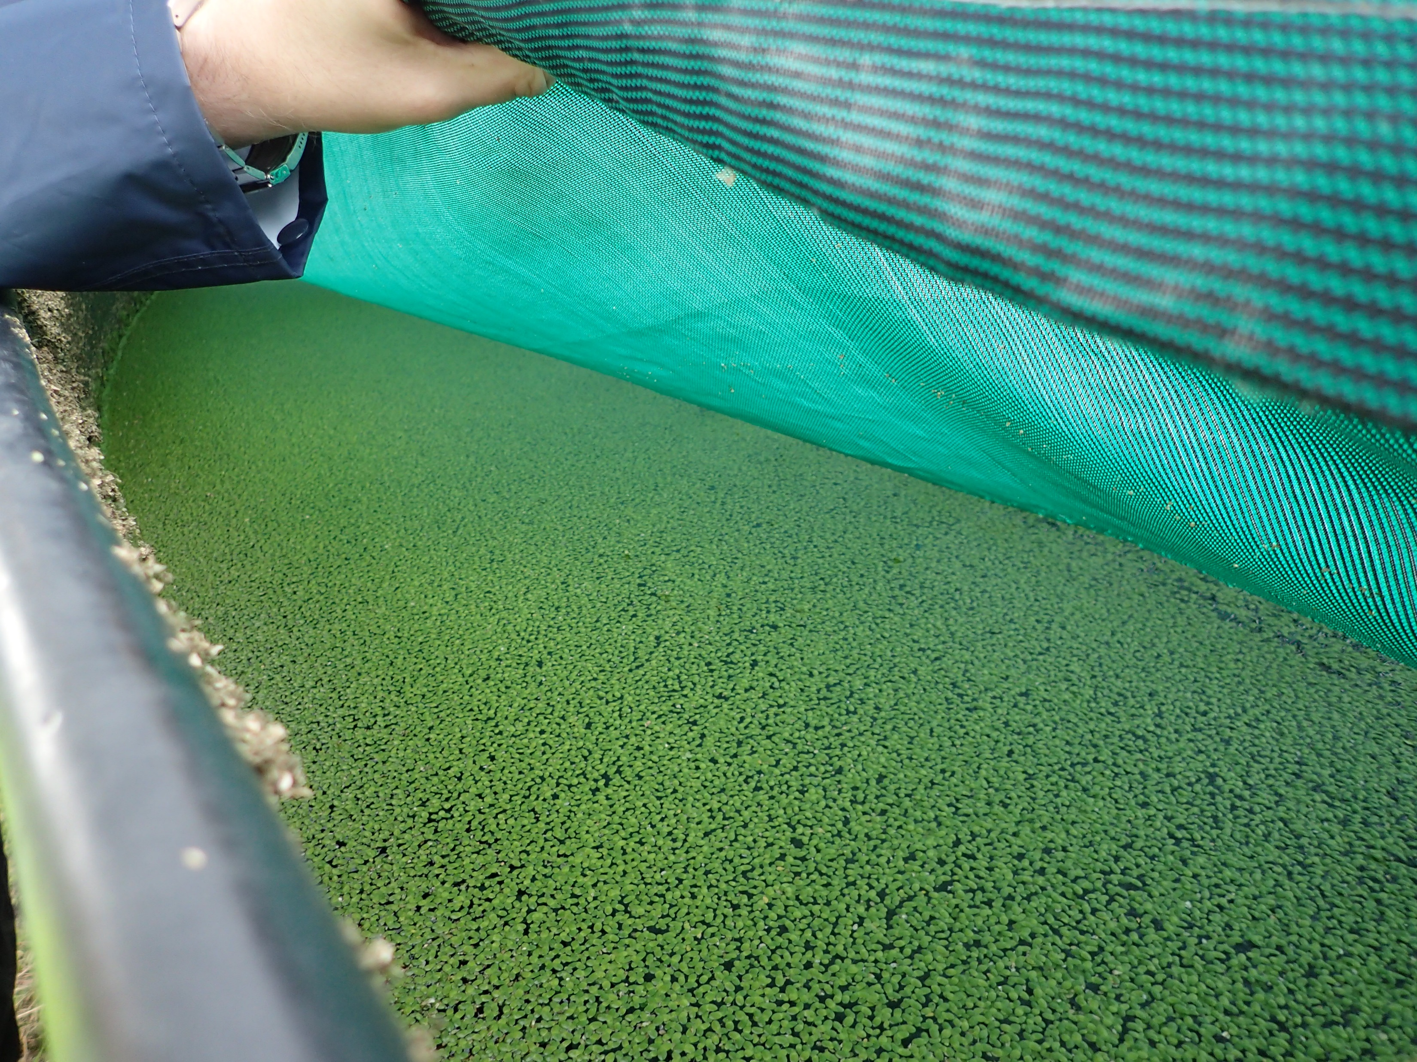
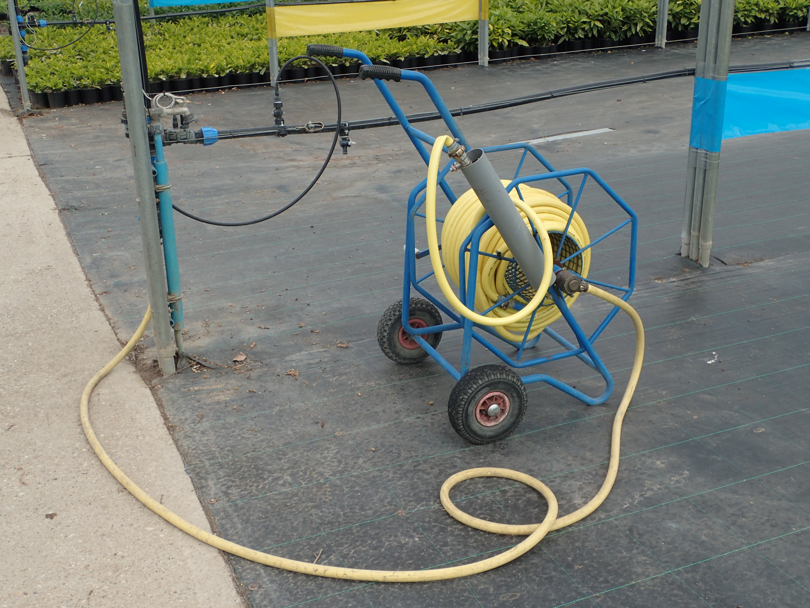
Storage and transport vitally important in keeping water clean

Slide 7
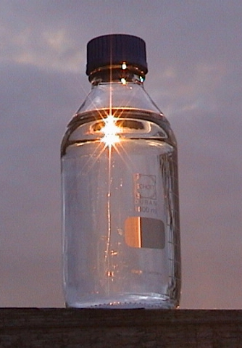
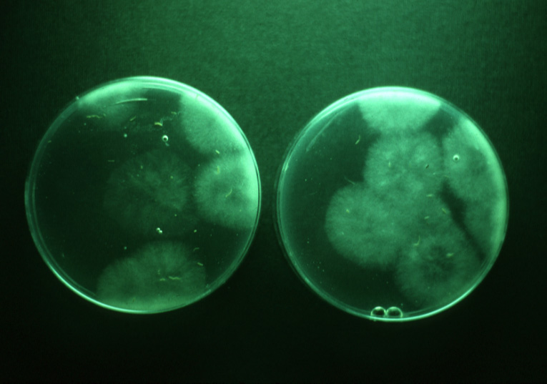
Monitoring: You can’t trust your eyes!
Pathogenic Pythium CFU (approx. 50/litre)

Slide 8
Monitoring requires Detection
‘Conventional’ detection
Baiting and ‘floats’
Direct plating
More recent methods
Immunodiagnostics
Nucleotide based techniques e.g. PCR, qPCR, LAMP

Slide 9
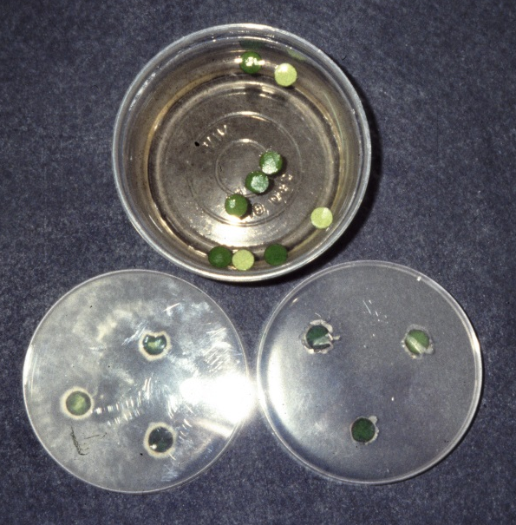
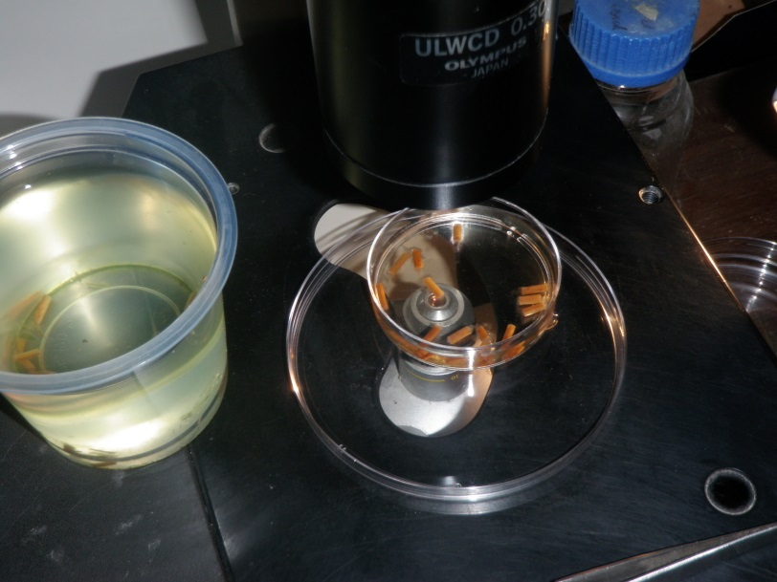
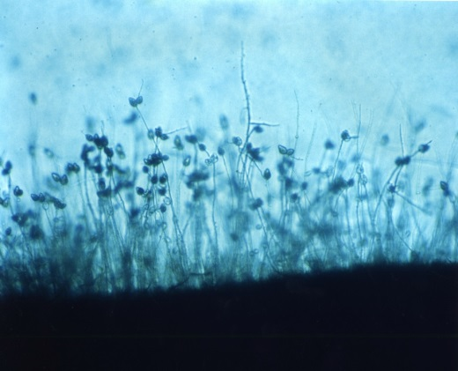
Baiting = ‘Glorified fishing’
Baits floated in water and transferred to antibiotic agar
Lupin seedlings floated in water and observed directly under microscope
Pythium (2-3 days)
Limited capacity for quantification
Used since the 1960s for Pythium and Phytophthora detection
Confirmation of live pathogen presence/absence
Takes time and skill = too slow to assist growers in useful disease management decisions

Slide 10
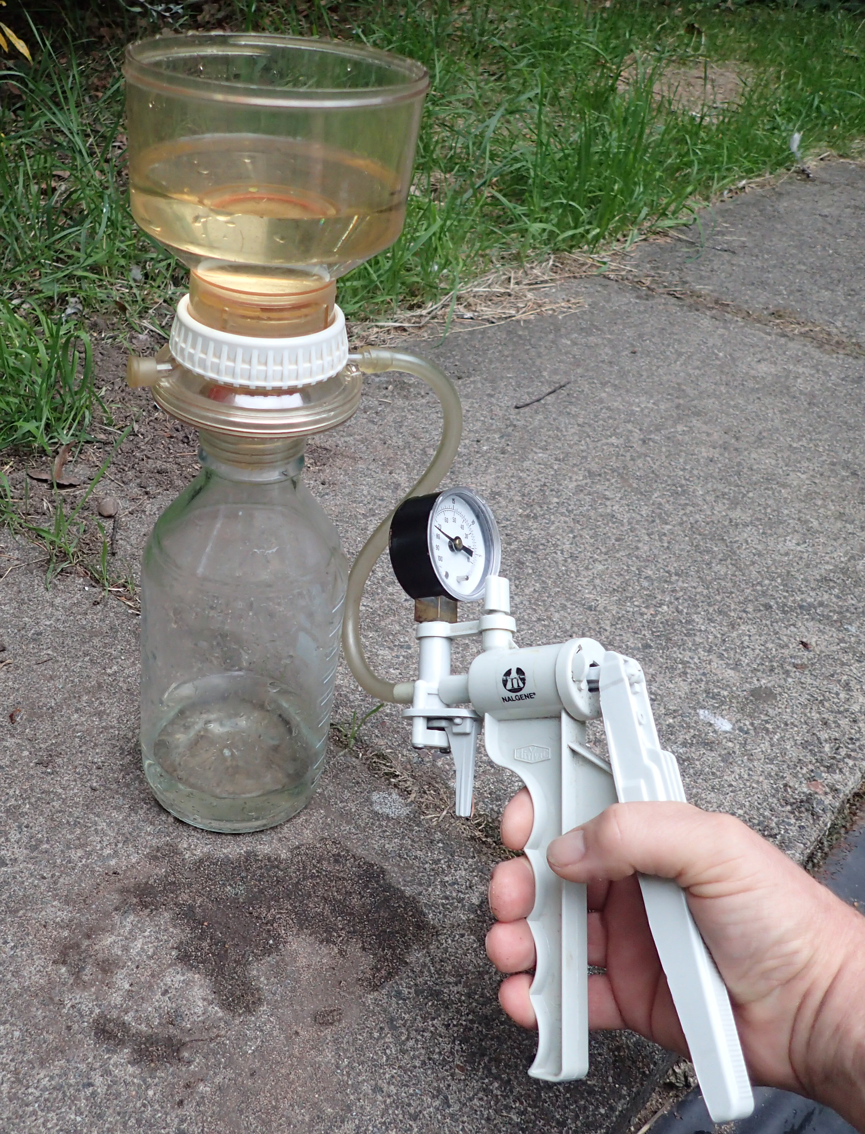
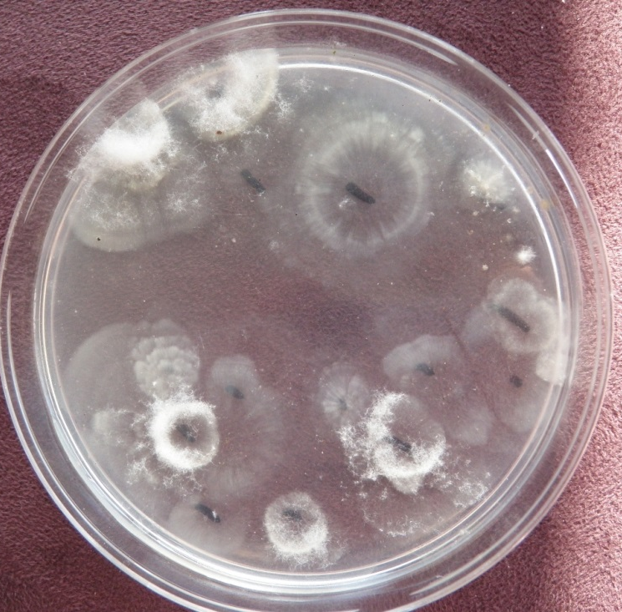
Direct isolation
Membrane filtration – colony plating
☺ Straightforward, accurate and robust
☹ Takes time and requires skill in interpretation

Slide 11

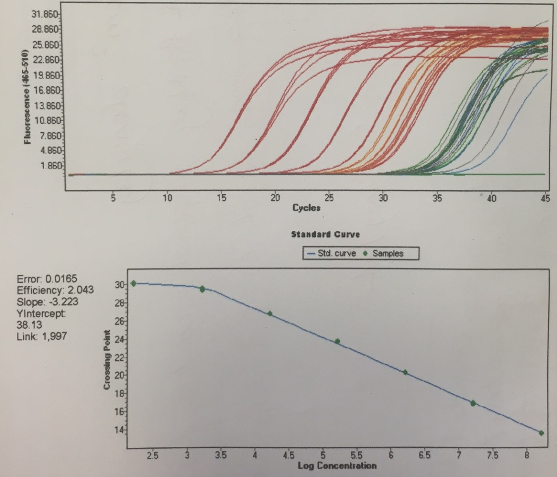
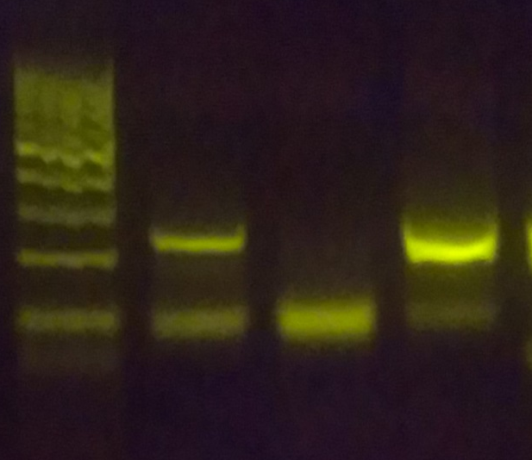
Molecular tests (DNA /RNA)
Based on specific amplification of a pathogen(s) genetic code
Can be used to detect (PCR) or quantify (qPCR) oomycetes
Tests developed for many plant pathogens and more being developed
Can be designed to detect at genus, species or pathotype level – and look at whole populations (NG sequencing)
Although as yet no really convincing test of live vs dead propagules, this technology is most likely the future

Slide 12
Immunoassays - general
Use antibodies as probes that recognise target species
Tests can be qualitative (+/-) or quantitative.
Immunoassay tests have been developed for the laboratory and on-site usage.
Four basic immunodiagnostic test formats used in water assessments:
ELISA Enzyme-Linked Immunosorbent Assay
ZTI Zoospore Trapping Immunosorbent Assay
Dipsticks Similar to baiting
LFD Lateral Flow Devices

Slide 13
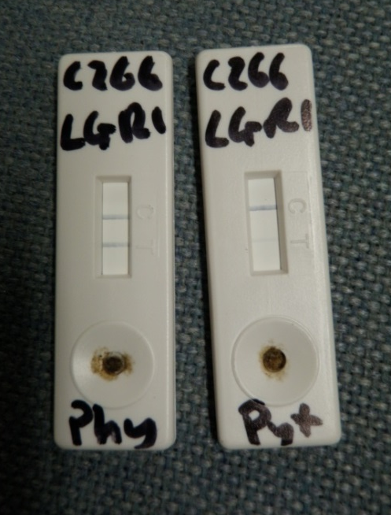
Lateral flow devices (LFD)
On-site usage
Results within 10 minutes
Specificity/Cross reactivity (false positives) ?
No information on viability
Have been combined with baiting
AHDB PO/HNS 188
New prototype Phytophthora-specific antibodies developed AHDB CP 136

Slide 14
Managing spread of disease via irrigation water
Managing water will stop disease spread:
Check it
Clean it
Keep it clean

Slide 15
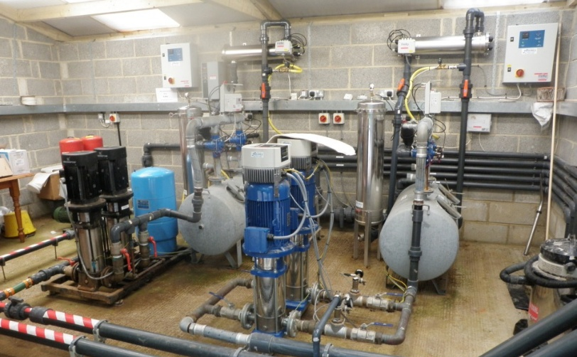
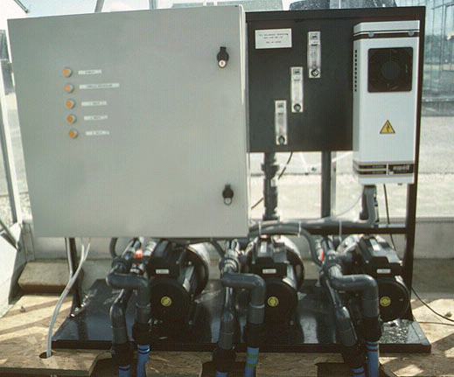
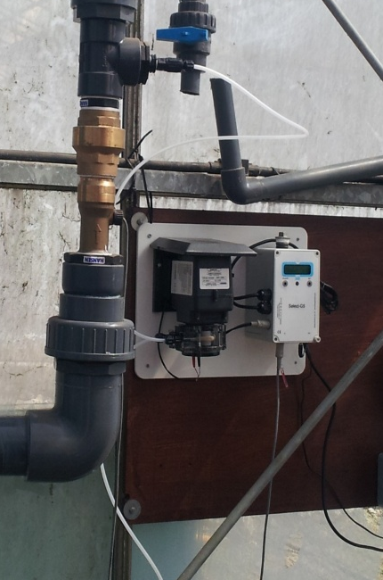
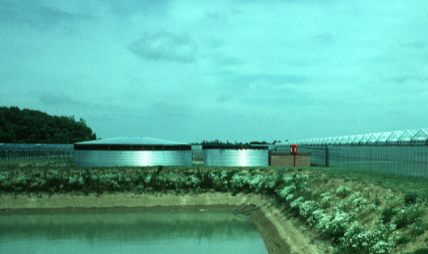
Water treatments: many effective approaches available
Pasteurisation
UV
(Photo catalysts)
Ozonation
Chemical
      Chlorination
      Chlorine dioxide
      Peroxide/peroxygens
      Copper ionisation
      ECA/EO water
Microfiltration
Slow sand filtration
(Constructed wetlands)
COMBINATIONS

Slide 16
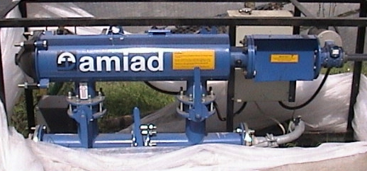
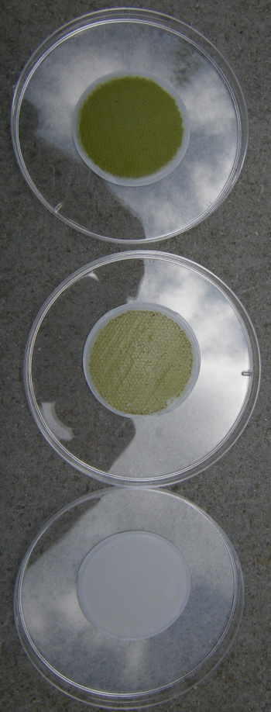
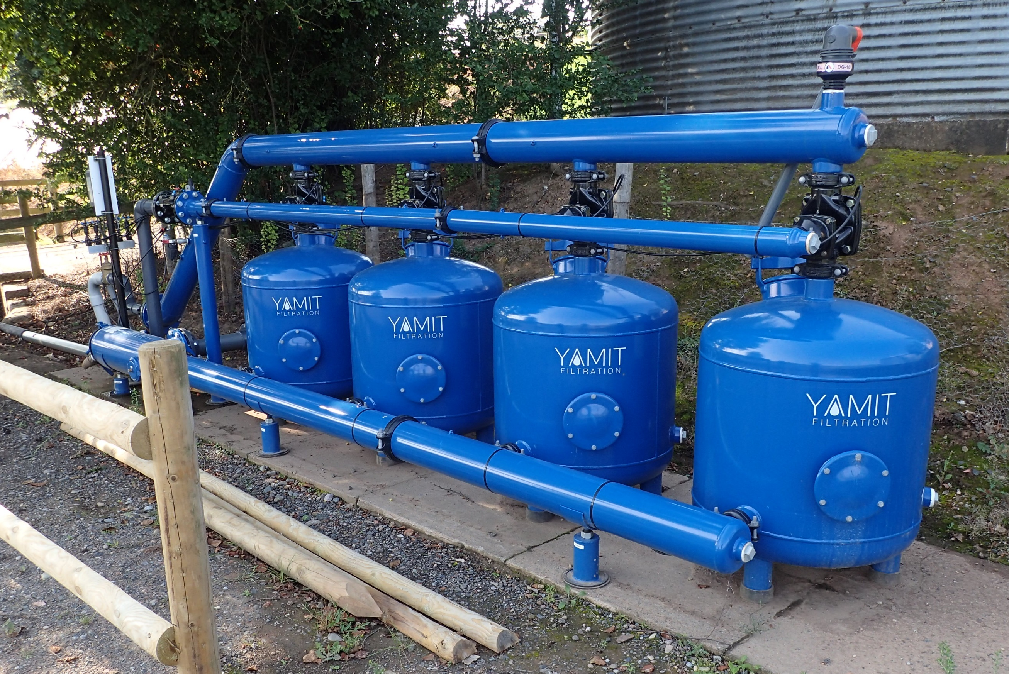
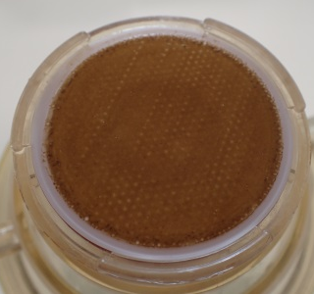
Pre-filtration improves the efficacy of all water disinfestation technologies

Slide 17
Selecting water treatment(s)
(‘horses for courses’)
Volumes to be treated
Space available
Costs – installation and running
Raw water quality
Target water quality
Presence/Absence of fertilisers
Possibility of bi-products – phytotoxicity
Need for residual effect
Philosophy of operation
Simplicity of operation/maintenance
Availability of technology, parts, technical support
Whether the technology can comfortably fit into an integrated control strategy

Slide 18
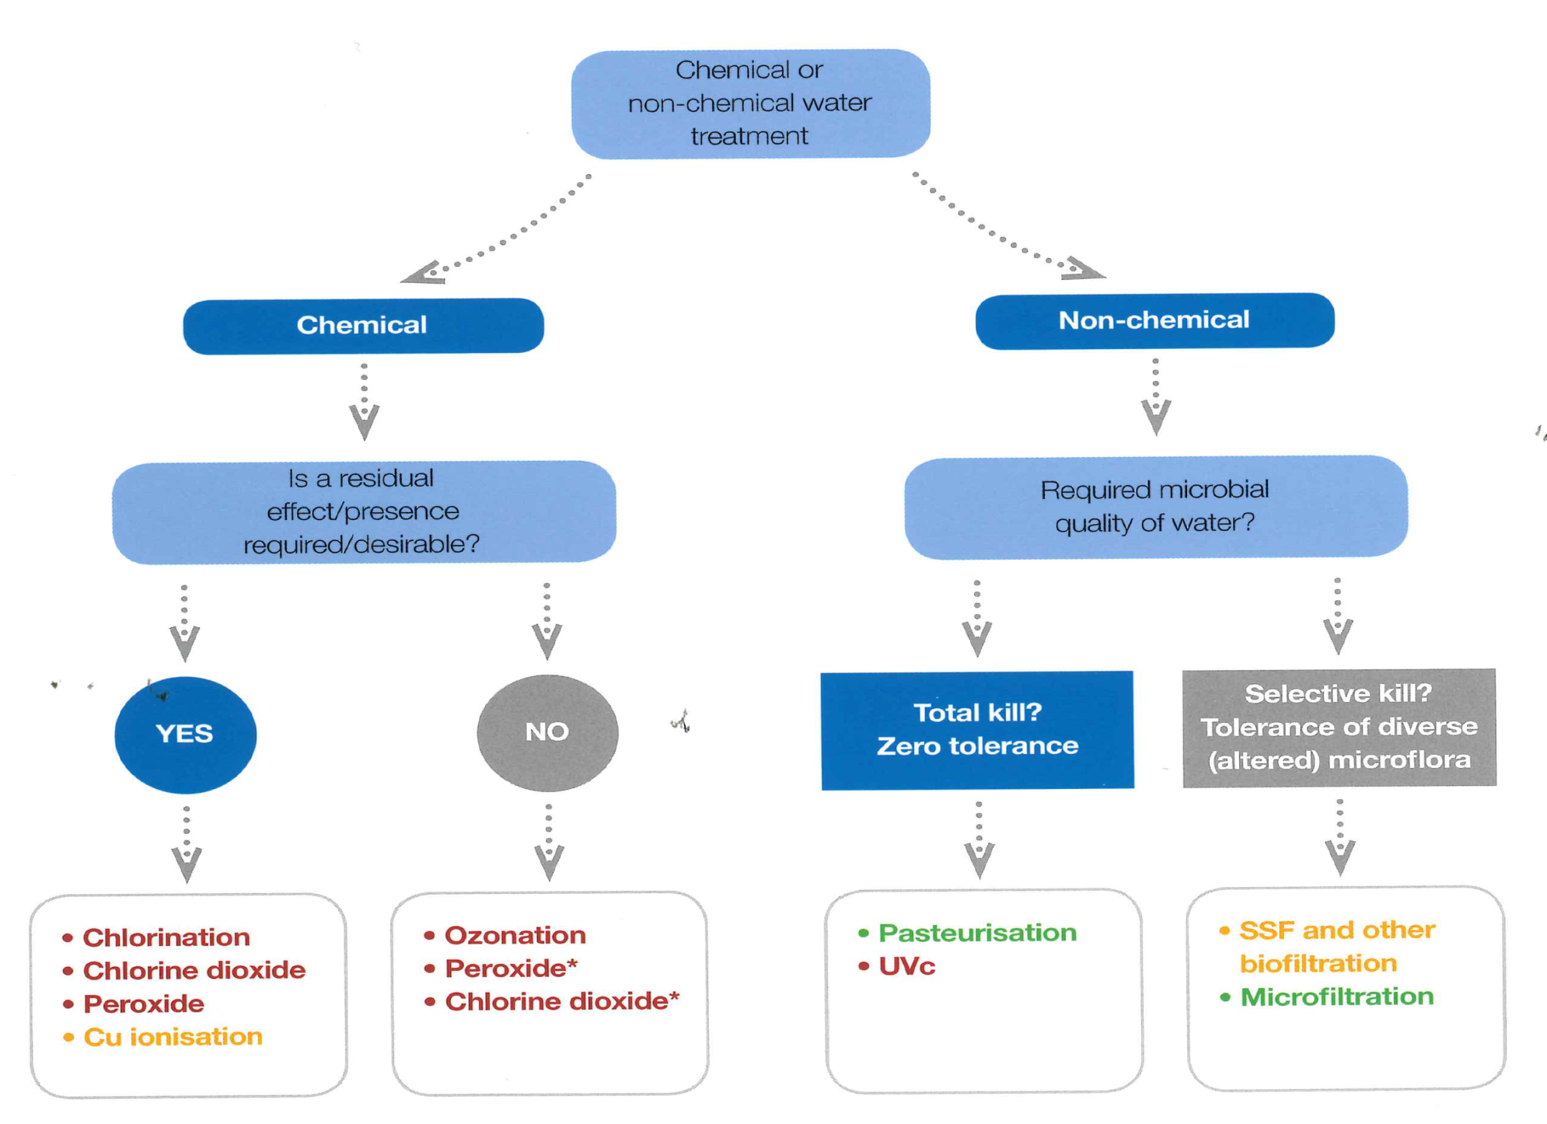
Selection - Narrowing down the options
(AHDB Factsheet 22/15)

Slide 19
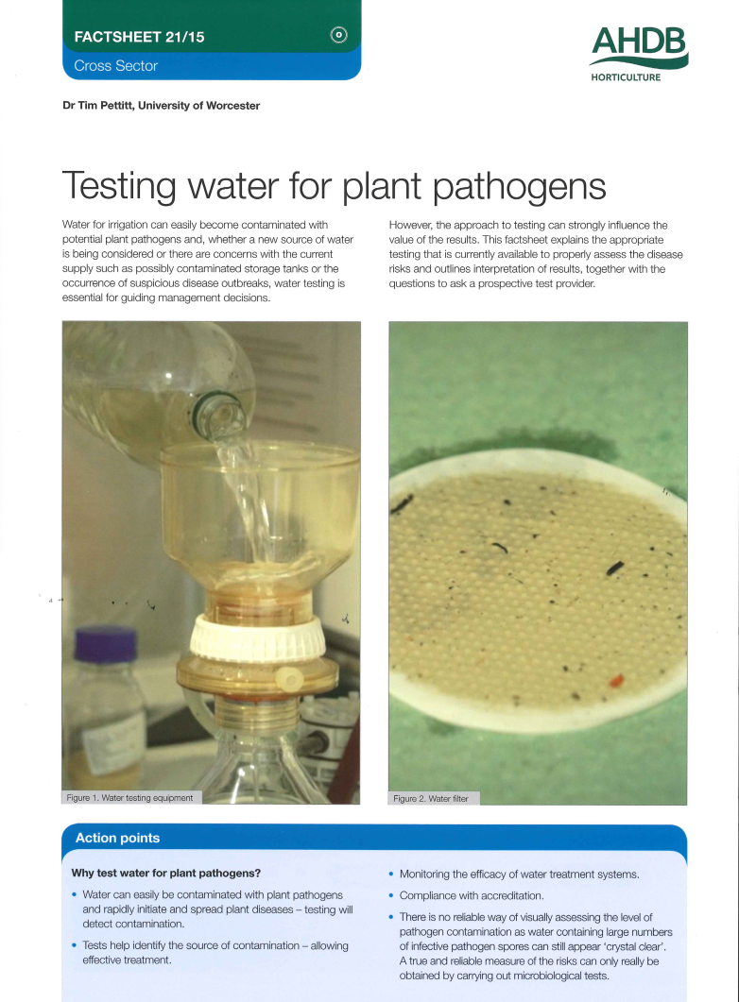
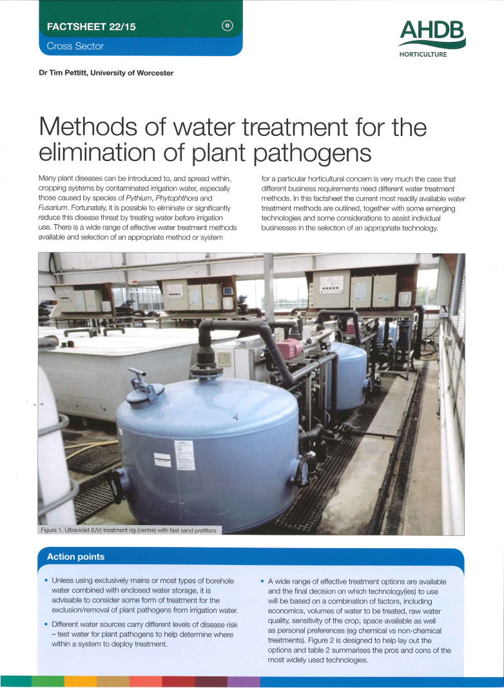
Some useful info on testing and water treatment methods in AHDB factsheets 21/15 and 22/15 plus some updated information is on its way soon

Slide 20
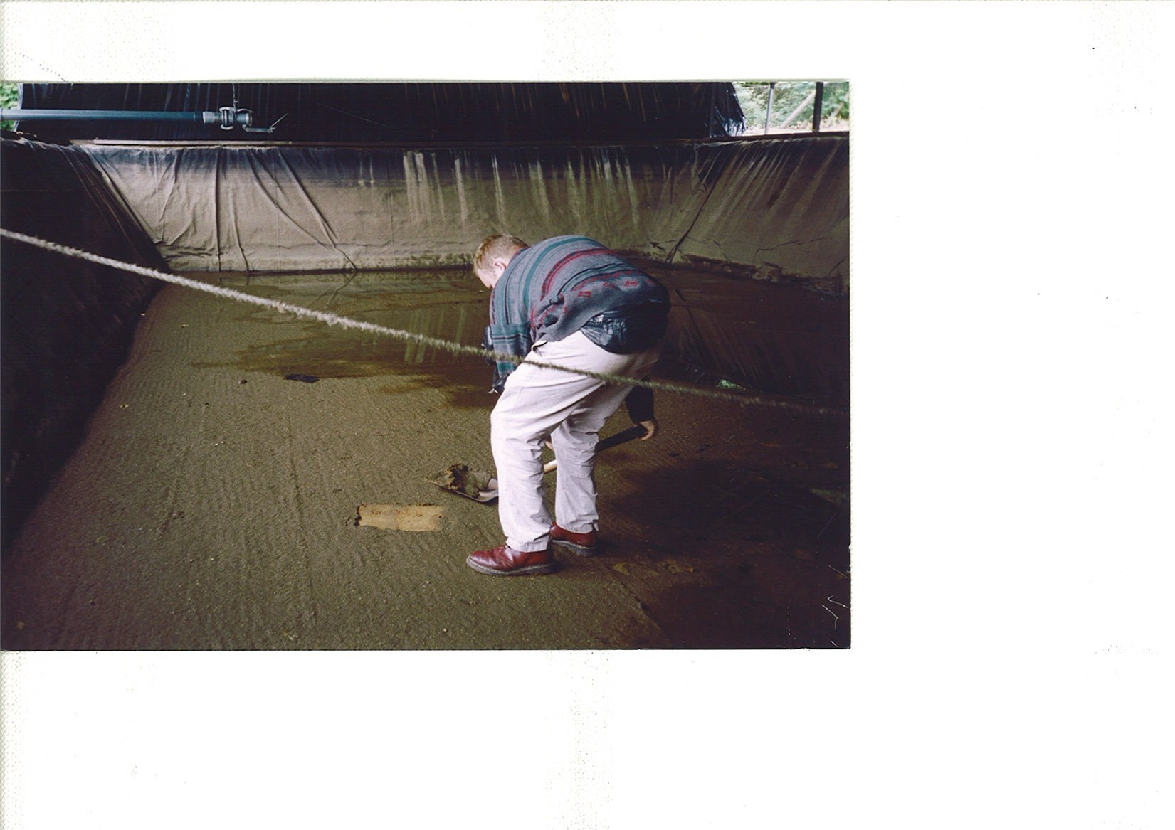
Thank you !
Dr Tim Pettitt
University of Worcester
t.pettitt@worc.ac.uk

