Slide 1
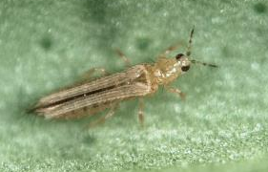
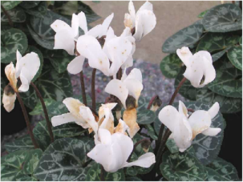
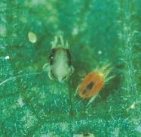
Practical plant Health – keeping your stock healthy
David Talbot, ADAS Ornamentals Consultant

Slide 2
Introduction
Agenda
Plant health concerns.
Mitigating risks through good management of bought in stock.
Few silver bullets – prevention better than cure.
Biopesticides are IPM compatible, both are essential tools.
Helping you to demonstrate compliance with the UK government sustainable use directive / demonstrate responsible pesticide use.

Slide 3
Objectives
To highlight current plant health concerns.
To help you decide what you can do to mitigate risks.
To demonstrate ways to help keep plants healthy.
To empower growers to utilise biopesticide in control programmes
To give knowledge to decide whether to use biopesticides or not
To successfully integrate biopesticides into your current programme

Slide 4
Why we are concerned about plant health
Increasing number of P & D intercepted on imported plants
Increase in pests / disases included in the plant health risk register
High risk hosts / pathways regulated
Direct, postal services / internet sales

Slide 5
Current plant health threats / concerns
Rose rosette virus (Phyllocoptes frutiphilus spreads; N. America / India via plants / cut flowers
Walnut Twig borer (Pityophthorus juglandis US/Italy); spreads fungus (Geosmithia morbida) clogs Xylem vessels
Ambrosia beetle; stem borer (Euwallaceas spp USA, Israel, South Africa) + fusarium euwallaceae = threat to Broadleafs e.g. Oak
Xylella fastidiosa (USA, introduced to Europe) spread by froghopper Philaenus spumarius

Slide 6
Inspections, certification and research helping to keep problems out
>£18M BBSRC / government support funding BRIGHT project
Focusing on bacterial pathogens; Xylella + Vector Borne diseases of plants
Building capacity to reduce chance of Xylella being introduced to UK; preventing it establishing
Improve how the bacterium is tested for
Provides the most up to date links to information to industry.

Slide 7
Xylella fastidiosa susceptibility
To date 563 species in 82 different plant families reported as being susceptible………….
including: Acer, Citrus spp, Lavandula spp, Olea, Prunus spp, Quercus spp, Rosmarinus officinalis, Ulmus spp
plus a wide range of trees and perennials

Slide 8
Xylella fastidiosa symptoms
Not all infected plants develop symptoms
Infected plants can remain symptomless for extended periods
Symptoms include:
Leaf scorching, wilting, stunting, die back; all of which may lead to death
Symptoms are produced when the plants xylem vessels become blocked

Slide 9
Xylella - a relatively new threat
Four species of the bacterium
For many years restricted to the Americas (introduced to Europe) with a single outbreak on Pyrus in Taiwan
Most spp restricted to tropical and subtropical regions
Xylella fastidiosa has a more northerly range causing disease as far north as New York

Slide 10
Xylella fastidiosa PHRA (2017)
Likelihood of establishment is considered to be moderate at worst (lot of mitigation if found)
The magnitude of the impacts of Xylella fastidiosa establishing remains highly uncertain
If the climate continues to change, risks may increase.

Slide 11
Xylella fastidiosa has the potential to have a massive impact on trade
Destruction of infected stock and known hosts liable to be infected ASAP after diagnosis (insecticide use likely) - Removal landowners responsibility
Infected zone surrounded by 1KM buffer around with a further 5KM buffer
Impractical to trade while the demarcated areas remain in place.
Absence over a 2 year period necessary before restrictions lifted – if a large outbreak could take up to 5 years.

Slide 12
What can be done to protect your business
Develop a good relationship with both plant health inspectors and reputable suppliers
Worth visiting suppliers regularly to check quality and health status of stock also builds relationships
Plants should be free of pests, disease and weeds
Agree requirements in writing with suppliers
Specify size/height, shape, health status, delivery dates and trading terms and conditions in writing
Many increasing own production to control risk

Slide 13
Arrival of bought in plants = quarantine areas
If a multi sited business direct deliveries to one site where possible to a dedicated goods inwards area
Ensure that a procedure is in place to check and document quality and health status of incoming material against specifications
May not even make quarantine!
Feedback to supplier
Worth quarantining for as long as practical possible (risk based approach) in dedicated holding area

Slide 14
Position and management of quarantine areas
Ideally away from dispatch and production areas with good access
Need to be secure, staff access restricted and clearly signed, a specific glasshouse is ideal
Give priority to imported plants particularly any known to host major pests or diseases
Monitor at least weekly – document findings even if free of P & D.
Technical manager or similar to authorise release from quarantine onto the wider nursery

Slide 15
Good management of quarantine areas gives internal traceability
Needs to be a good facility – as good as production (good drainage, irrigation, ventilation etc.)
Have specific overalls / tools (secateurs, hosepipes etc.) for use in quarantine and disinfect in/out (wellies only + foot dip)
Ideally schedule deliveries to arrive after previous batch has been released onto the nursery
Consider bagging and disposing of waste plant material via incineration / landfill
Clean and disinfect between batches

Slide 16
Plant health is not just about notifiable pests and diseases
Many native non notifiable pests, diseases and weeds that have to be managed
Fewer ‘silver bullets’ that quickly control and eradicate problems
Proactive Integrated crop management using all of the following:
- Cultural controls
- Biological controls
- Biopesticides

Slide 17
Crop management techniques that save you money – cultural controls
Growing on the dry side prevents root problems and foliar disease
Pick the bright day to water and only apply where necessary = reduced leaf wetness / disease pressure
Space sufficiently and ventilate, using fans to disperse humidity / dry foliage
Maintain good hygiene – dispose of dead plants, prunings / dead leaves swiftly
Plant tonics / Bio stimulants / foliar feeds can all help

Slide 18
Crop management techniques – Biological controls
Biological control programmes can prevent pest outbreaks; if properly managed can be very effective
Monitor, manage and react weekly
Hotspots – can firefight
Form the basis of TSSM, Thrips, Sciarid and Whitefly management and control
Excellent results are achievable

Slide 19
Why it is important to embrace biopesticides
Continuing decline in the number of registered conventional pesticides; Increasing restrictions = limited number of applications / increased resistance risk
Gaps in spray programmes filled with biopesticides, the number of registered biopesticides is increasing
Few silver bullets – prevention better than cure
Biopesticides are IPM compatible. No product residue concerns for customers
Helping you to demonstrate compliance with the UK government sustainable use directive

Slide 20
Where to start – Training skilled labour
Spray operators need an understanding of how products work
Consider limitations e.g. humidity requirements
May need to change application and working practices; communication between technical manager and spray operators
Compatibility / block biopesticides such as Serenade ASO/Amylo X together in isolation
Store correctly and read product literature carefully

Slide 21
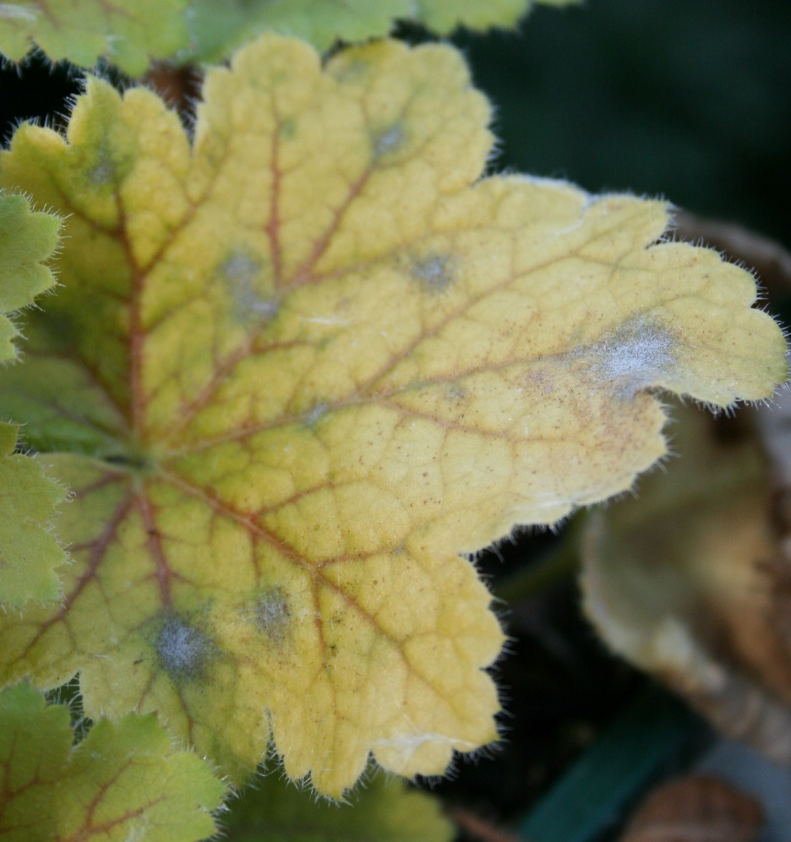
If you can see it its generally too late
Start clean, stay clean
Use preventatively at low pressure
Early season
Help prevent resistance

Slide 22
Strategies to utilise biopesticides in disease prevention and control
Top – at the start of the production process.
Body – throughout the production process.
- Zebras body; alternating chemicals and biopesticides
- Compatibilities
- Target pathogens
Tail – at the end of the production process.

Slide 23
Utilising Biopesticides – How to use at the low pressure situations (Top)
Prevent pest outbreaks e.g. Dipel / Mycotal.
Know their limitations – when they wont work.
Preventative, use when disease pressure is low e.g. Powdery mildew.
Start clean, stay clean.
Early in the season as protectant before foliar disease becomes a problem
When pests are at low levels

Slide 24
Utilising Biopesticides – How to use mid season (Body)
Help to maintain a spray programme with reduced chemical armoury.
Resistance management tools.
Alternate with compatible chemistry.
Compatibility with Biological controls not fully known for some e.g. Plant extracts.

Slide 25
Utilising Biopesticides – How to use at the end of the season (Tail)
Can be used to keep crop clean.
Use in conjunction with conventional products, largely as protectants.
Use when need to handle the crop soon after application (product residues).
Product residues on marketable product likely to be more closely scrutinised in the future.
Provide protectant activity in retail environment.

Slide 26
Products with activity against bacterial and fungal diseases
Amylo X – activity against Botrytis, Powdery mildew, (Downy mildew, Leafspot, Bacterial infections)
AQ10 – Parasite of Powdery mildew
Prestop – Botrytis and root pathogens.
Serenade – Botrytis (Leaf spot, Powdery Mildew and Bacterial infections)

Slide 27
Amylo X - activity against Botrytis, Powdery mildew, (Downy mildew, Leafspot, Bacterial infections)
Maximum of 6 applications per year under EAMU 0428/19
Between March and October outdoors
All year under protection
7 day spray interval regardless of situation

Slide 28
AQ 10 - Parasite of Powdery mildew
AQ 10 –apply with Nu-Film P adjuvant
Only works when the disease is present – short persistence if no powdery mildew
Maximum of 12 applications under EAMU 2646/15
Only under protection OPP of FN

Slide 29
Prestop - Botrytis and root pathogens
Prestop –Authorised for use in all non-edible crops under protection
No restriction on the maximum number of applications
Can apply every 4 – 6 weeks as a drench
Can apply every 3 – 4 weeks as a spray

Slide 30
Serenade ASO - Botrytis (Leaf spot, Powdery Mildew and Bacterial infections).
Serenade –Maximum of 6 applications under EAMU 2364/18 either outdoors or under protection.
Can be interspersed between applications of conventional pesticides.
Broad spectrum protectant.

Slide 31
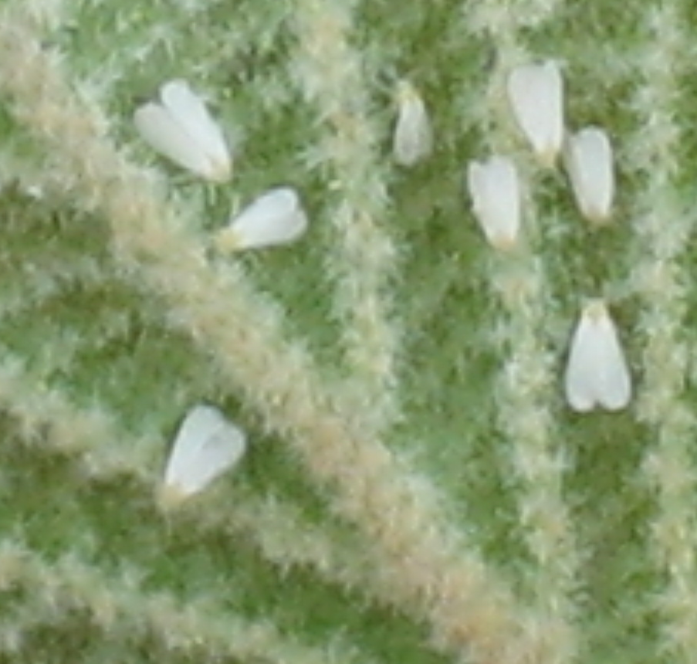
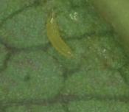
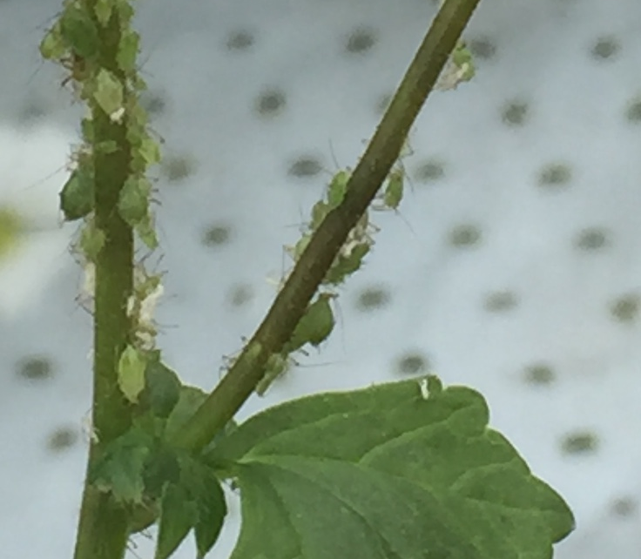
Biopesticides for pest control; Entopathogenic fungi – natural products.
Options for control of main pests of ornamentals:
Whitefly, Thrips, TSSM, Aphids.
IPM compatible with biological controls
No residue issues
Crop safe

Slide 32
Strategy for delivering Biopesticides; Entopathogenic fungi
Check individual labels / product info for:
  Optimum temperature range
  Optimum humidity range
Where possible apply at the best time of day for the product
Manipulate the growing environment if necessary

Slide 33
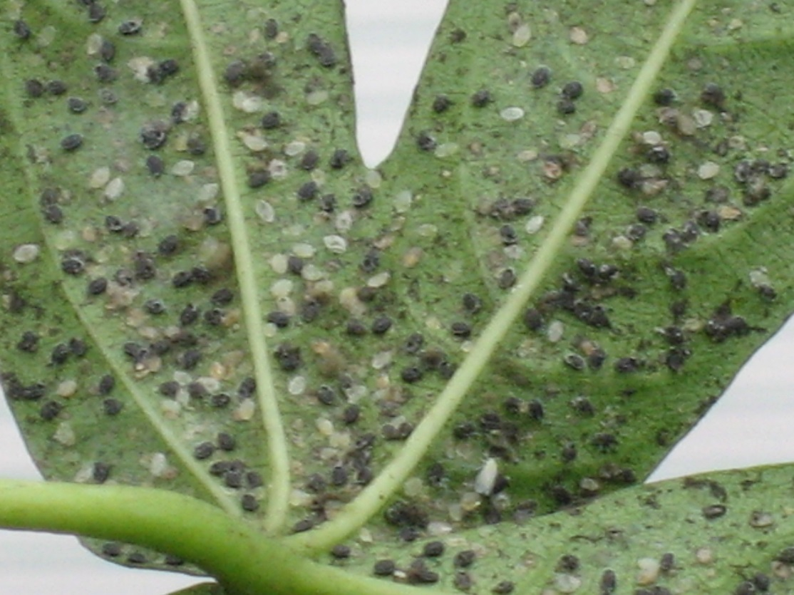
Biopesticides for Whitefly
Encarsia formosa
Naturalis – L
Botaniguard + Majestic
Mycotal
Botanicals

Slide 34
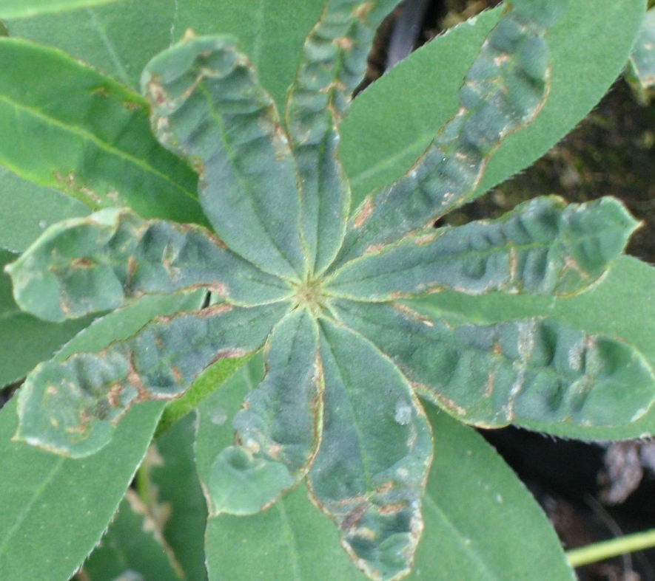
Biopesticides for Thrips
Various species of predatory mites, Orius.
Naturalis – L
Botaniguard + Majestic
Botanicals

Slide 35
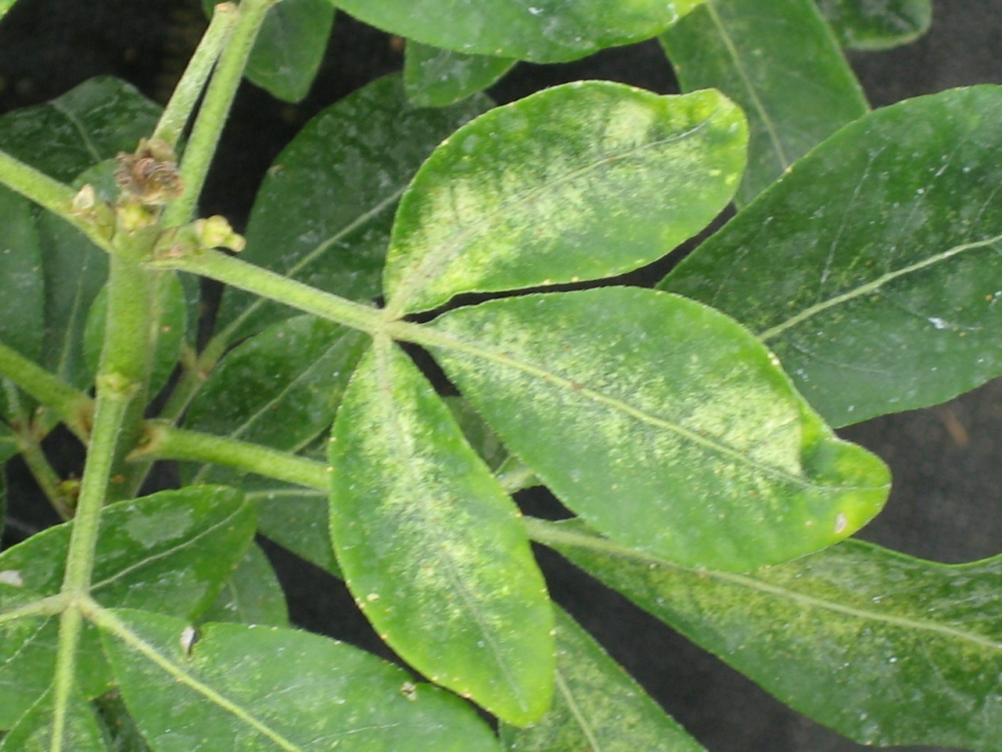
TSSM control
Phytoseiulus persimilis and Amblyseius californicus
Botaniguard + Majestic or Naturalis – L knockdown
Met 52 0D
Acaricides last resort

Slide 36
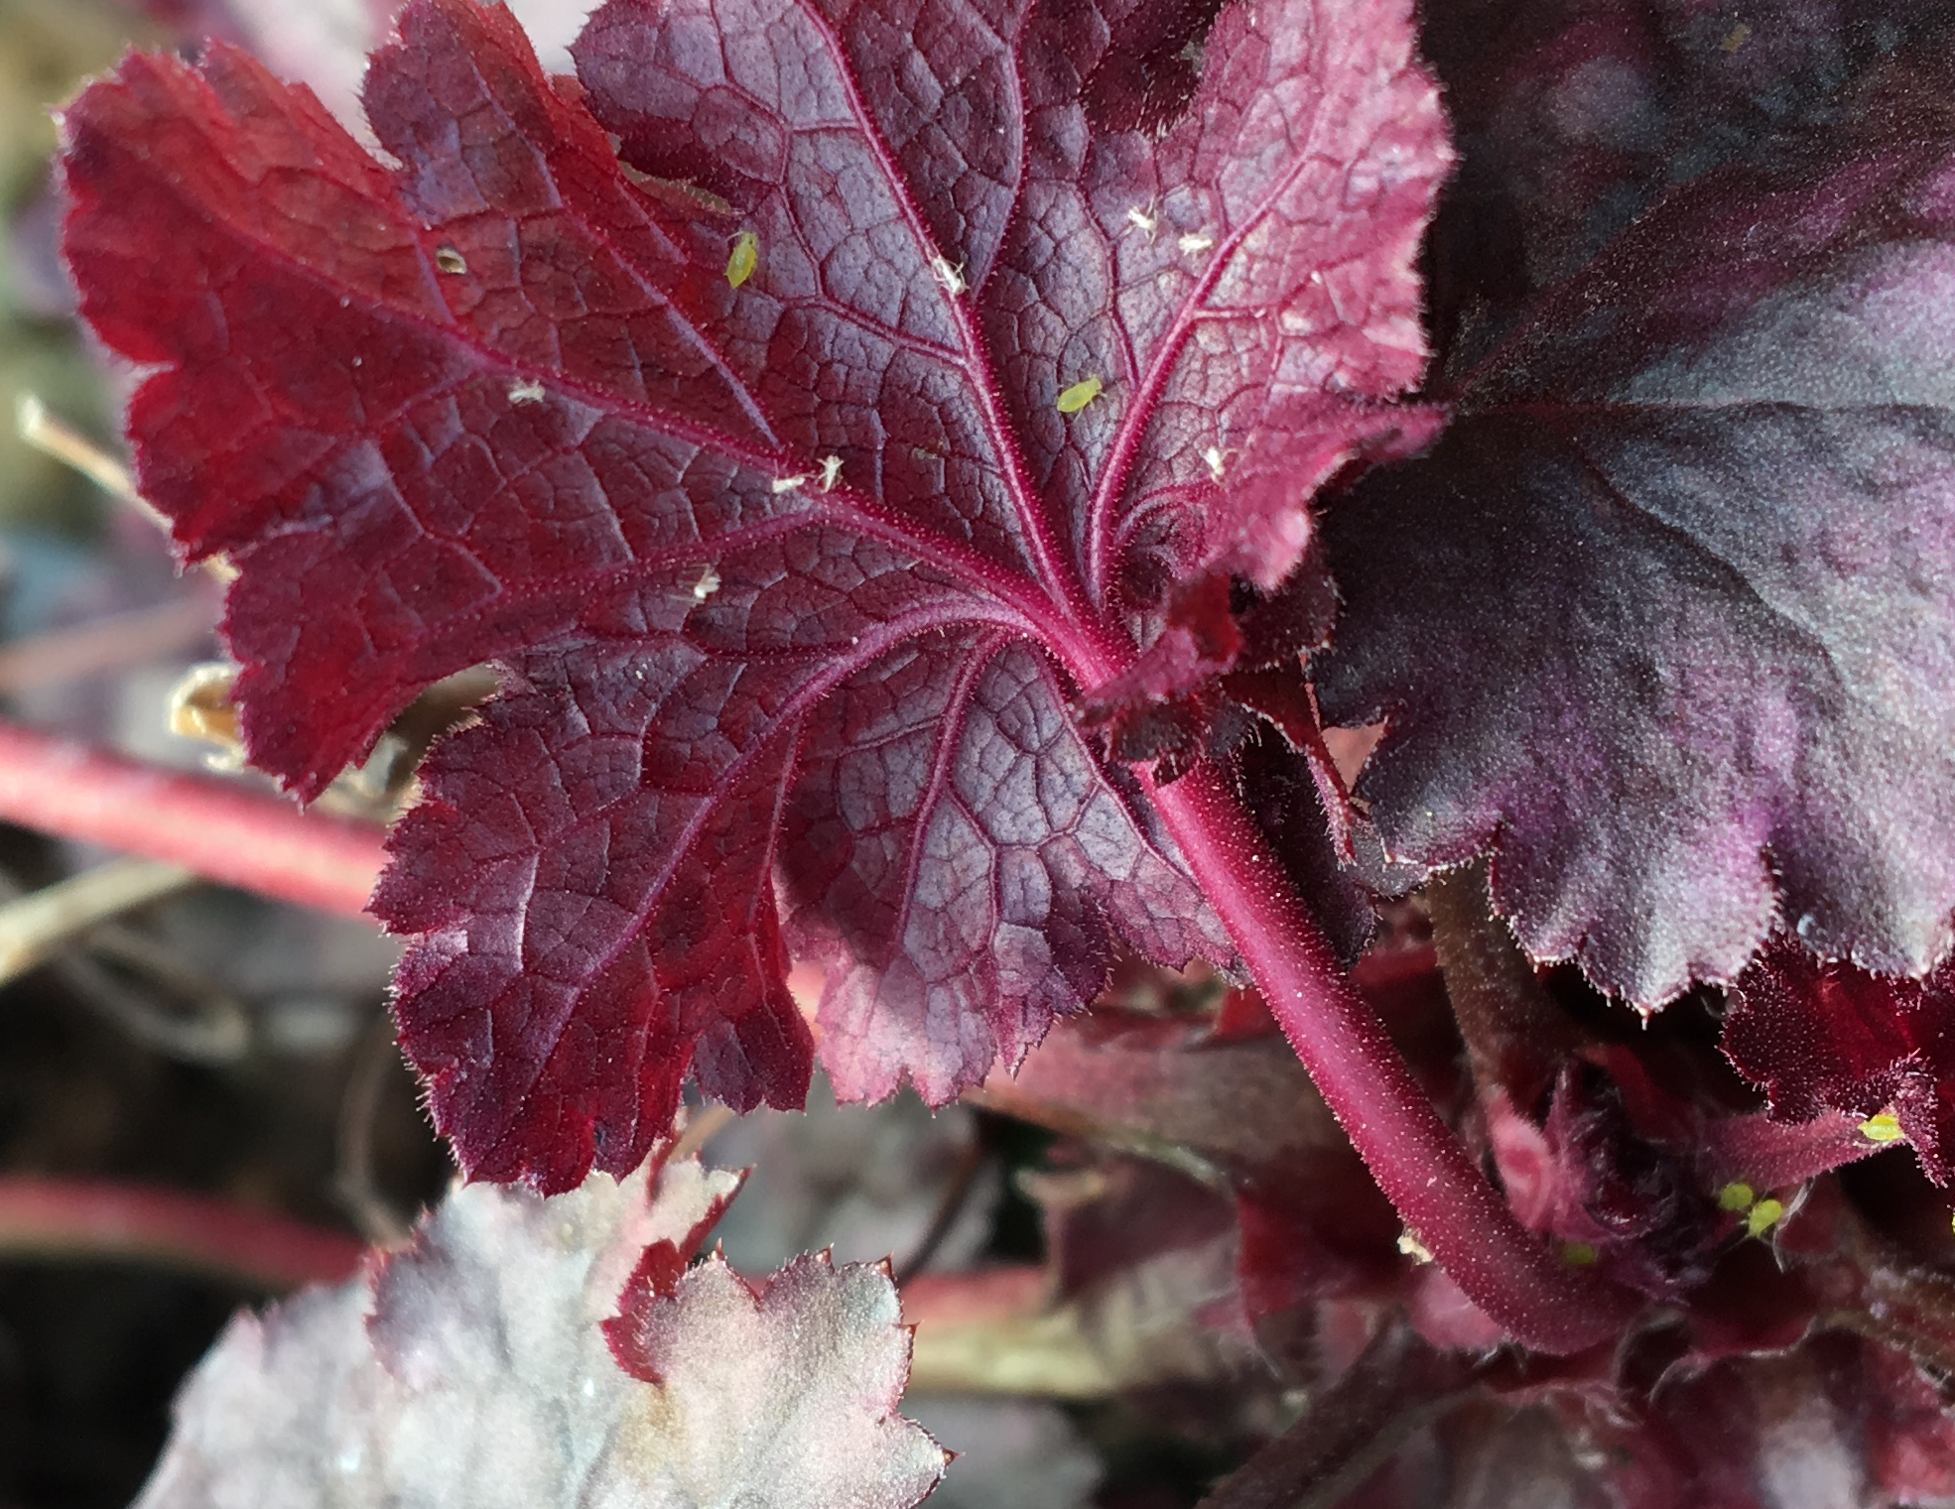
Aphid control
Parasitic wasps; various species
Botaniguard + Majestic or Naturalis – L knockdown
Need to apply when aphid numbers are low

Slide 37
Other Biopesticides for control of key pests; botanicals
Aphid control
Western flower thrips control
Coded botanical delivered promising aphid control (MOPS 2017).
Azadirachtin (Azatin) improved control of WFT damage when used as a supplement to N. cucumeris in an IPM programme (SCEPTRE Plus 2017).

Slide 38
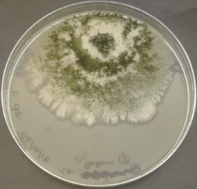

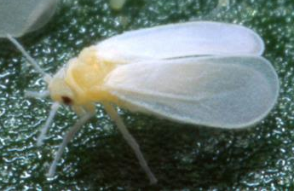
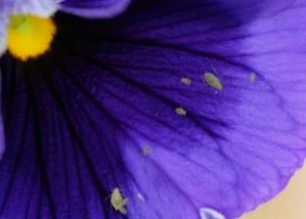



AMBER project
5 year project to identify practical ways for growers to improve performance of biopesticides
Benchmarking studies and practices that optimise biopesticide performance
Findings relevant to a wide range of crops, pests and diseases
Resources / information available on website via: bit.ly/AMBERproject.

Slide 39

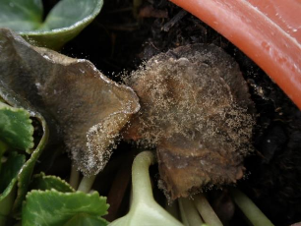
AMBER – R&D Results
Botrytis control on Cyclamen
Thrips control in Chrysanthemum
Control of Fusarium and Pythium in Choisya and Dianthus
Selected water volumes when spraying Poinsettia

Slide 40

Summary – Biopesticide efficacy
Prestop achieved 83% control of Botrytis in Cyclamen compared to standard fungicides which gave 56% control.
Botaniguard + Majestik was as effective at managing low levels of western flower thrips, aphids and leaf miner on Chrysanthemum as Entopathogenic nematodes combined with biological controls.
T34 Biocontrol performed as well against Fusarium and Pythium on Choisya and Dianthus as standard chemical treatments.
Reducing spray volume is the best way to maximise the total quantity of active substance retained on the crops leaves.
Good results are being obtained – Biopesticides can fit into production schedules for your crops.

Slide 41
Questions?

