Slide 1
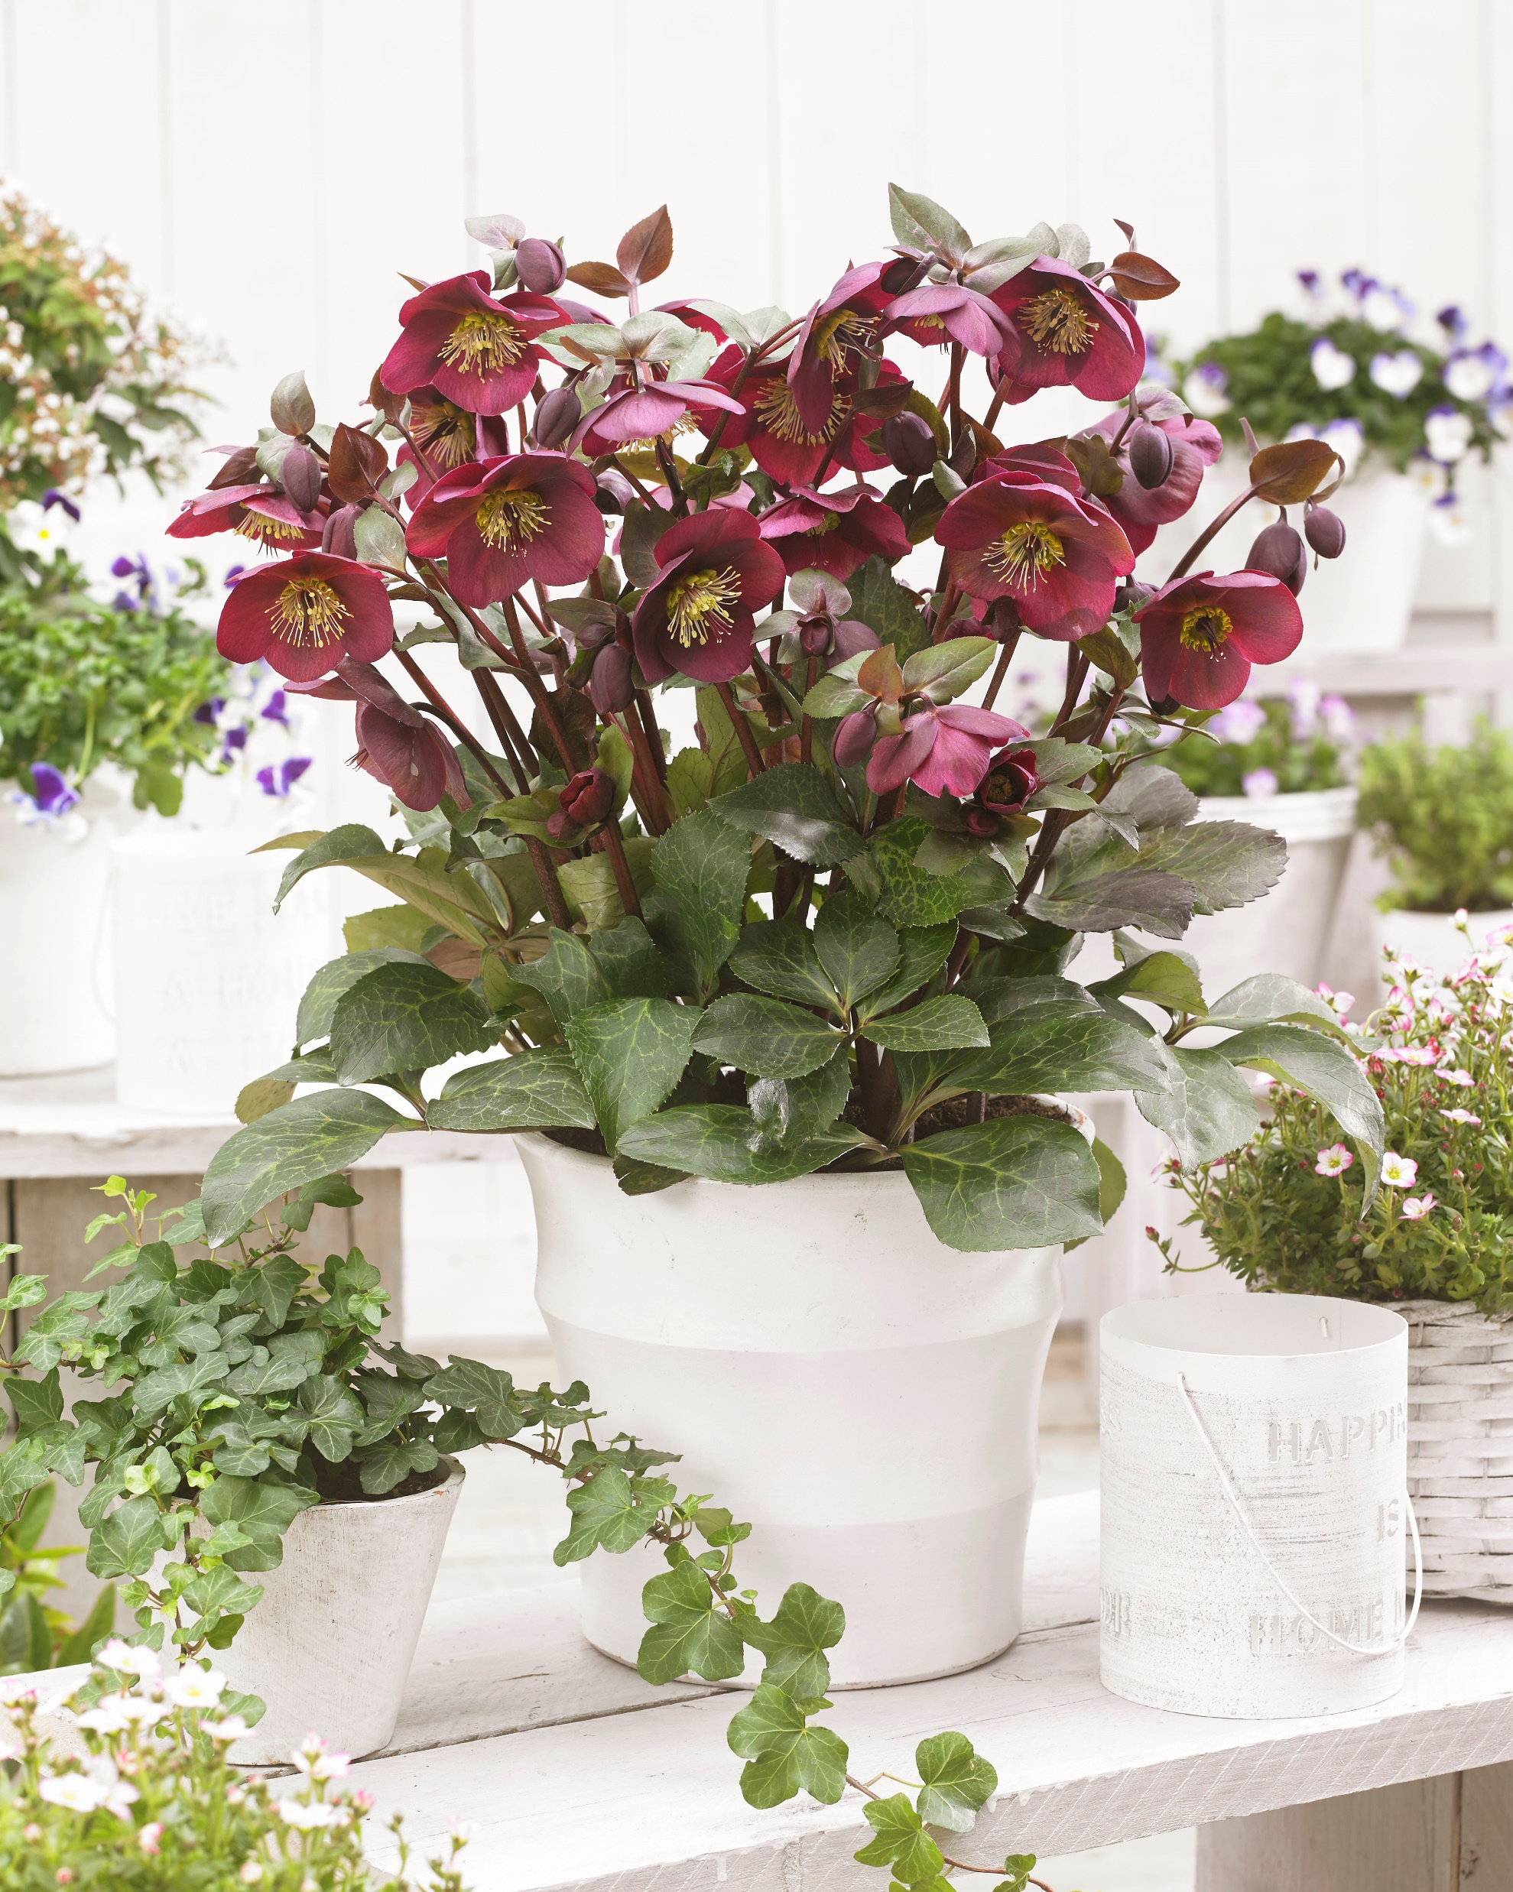
Helleborus Frostkiss Series
Made by Rodney Davey and Lynda Windsor

Slide 2
Represented worldwide by Eternal Plant Boijl,
Bart Noordhuis and Elisabeth Bisschop
Breeding and more

Slide 3
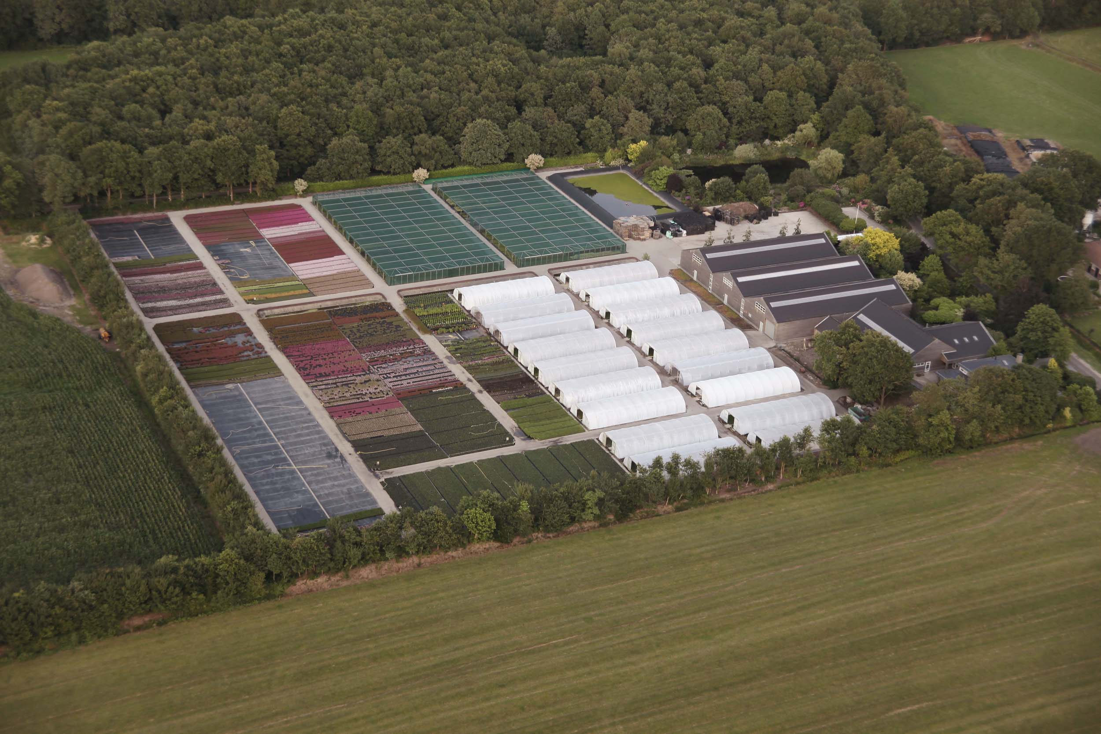
Plants are produced by Exceptio Nurseries, sister company of Eternal Plant Boijl,

Slide 4
Historie of the Frostkiss Helleborus
-Rodney and Lynda started the breeding in the late 1980’s
-Lots of trials and errors
-Finally a breakthrough in 1995, the first precursos of the Frostkiss serie
-Tests and further breeding to archieve better plants
-2003 first actual cross as we know now the FrostKiss Helleborus
-Around 2006 Eternal Plant Boijl got involved via John Massey
-Problems solved and breeding secured
-Breeding extented with combined efforts
-2013 compleet breeding bought over by Eternal Plant Boijl and sized up.

Slide 5
2006 there is a brand new Helleborus and now……?
-How to propagate a brand new Helleborus in big numbers
-Because it is a interspecific crossing, tissue culture the only way forward
-Using existing labs with the expirience of Exceptio Nurseries to start with!
-Start working closely with a lab in South Africa
-Learning to wean of tissue culture Helleborus
-Extended testing at Exceptio Nursery, how to get them to flower in a good quality

Slide 6
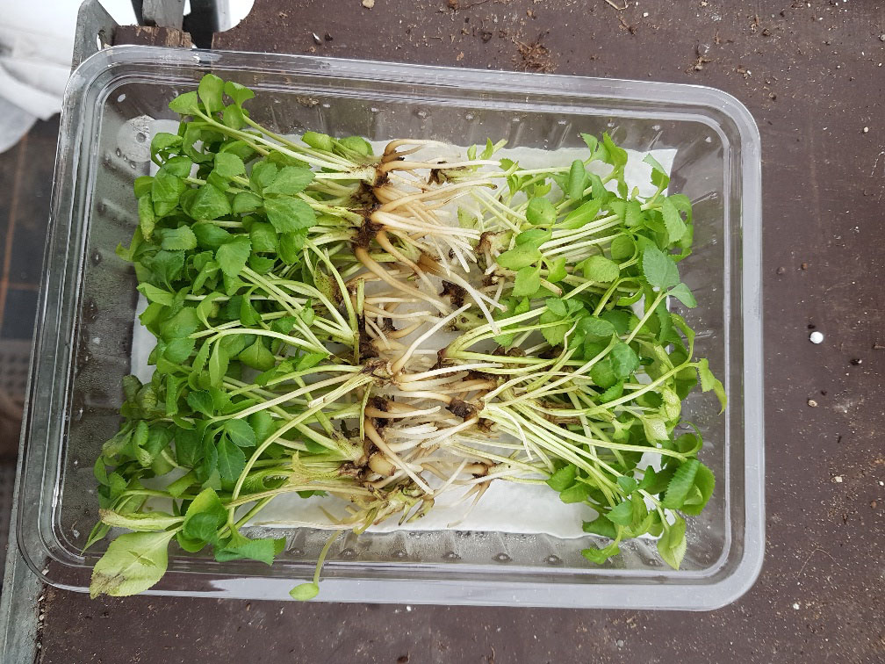
Plants comming from the lab in South Africa

Slide 7
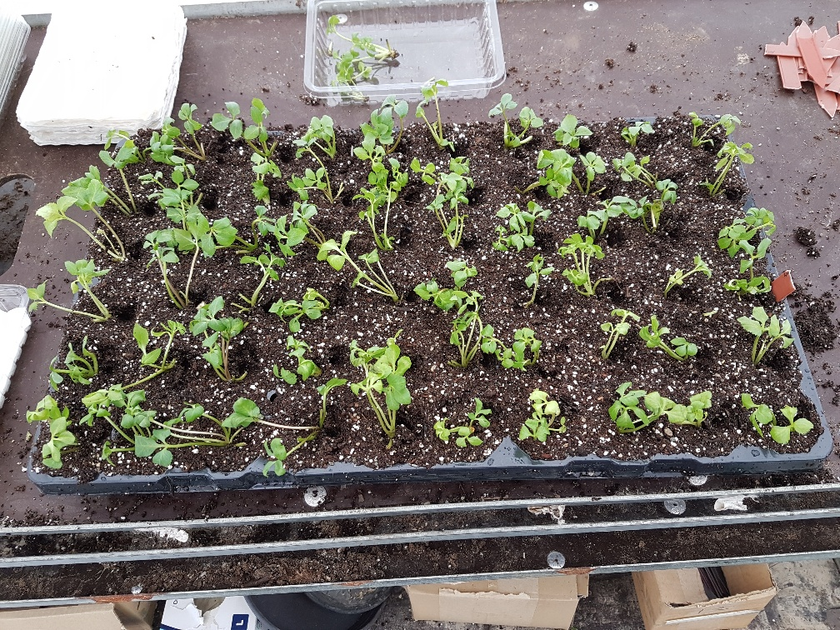
Planting out in trays

Slide 8
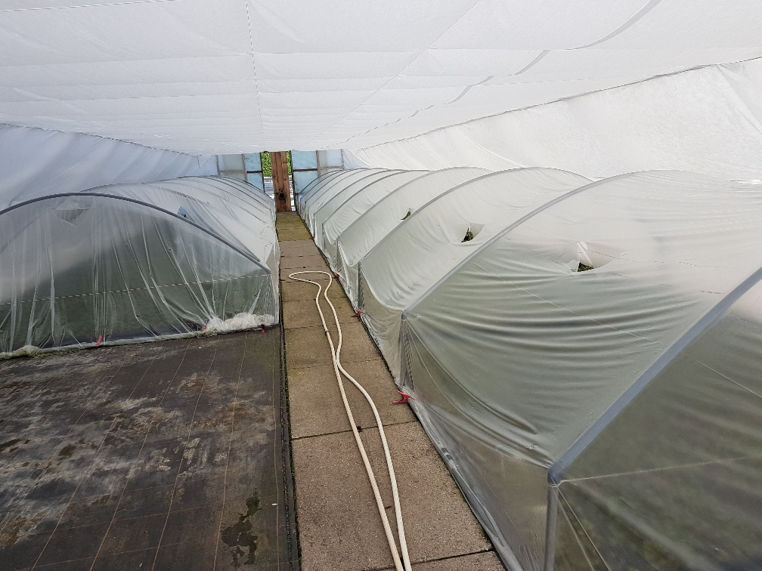
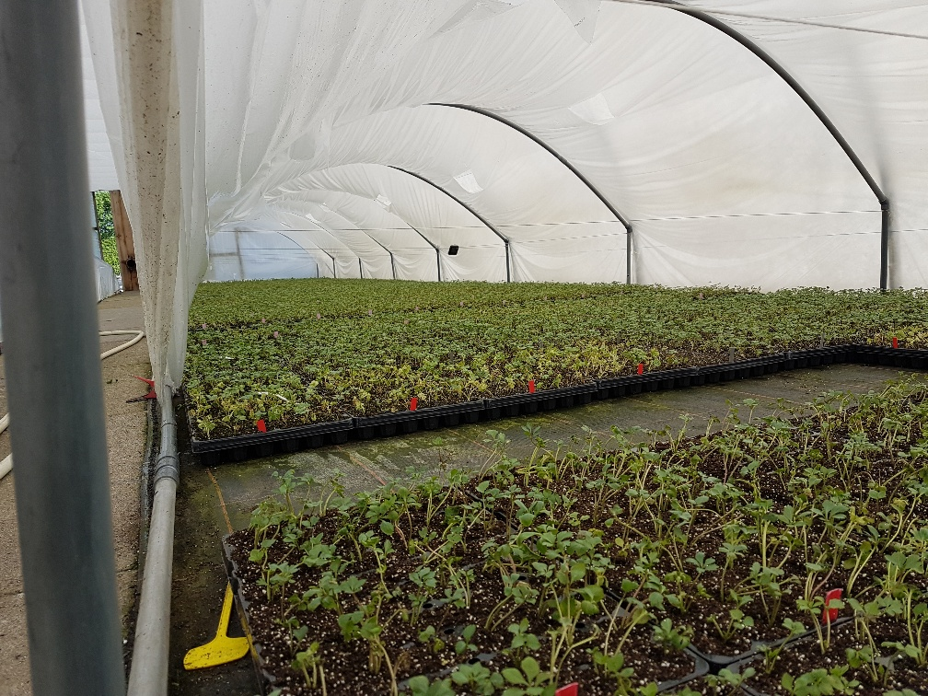
Weaning/production in greenhouses

Slide 9
How to introduce a brand new Helleborus serie into the market
-Using the network of Eternal Plant Boijl and Exceptio
-Working with exclusive licensees on 6 continents
-Work out together with these licensees a marketing plan per country/continent
-Naming of the plants
-Distribution of the young plants direct from the lab to the licensees
-Technical support of Exceptio Nurseries available for all licensees via E mail, Whatsapp, Skype and visits on the nursery sites
-Technical support at the sales side for customers of the licensees in the form of nursery visits, plant shows and conferences.
-Make good pictures available. (not made up pictures but real pictures in a good setting)

Slide 10
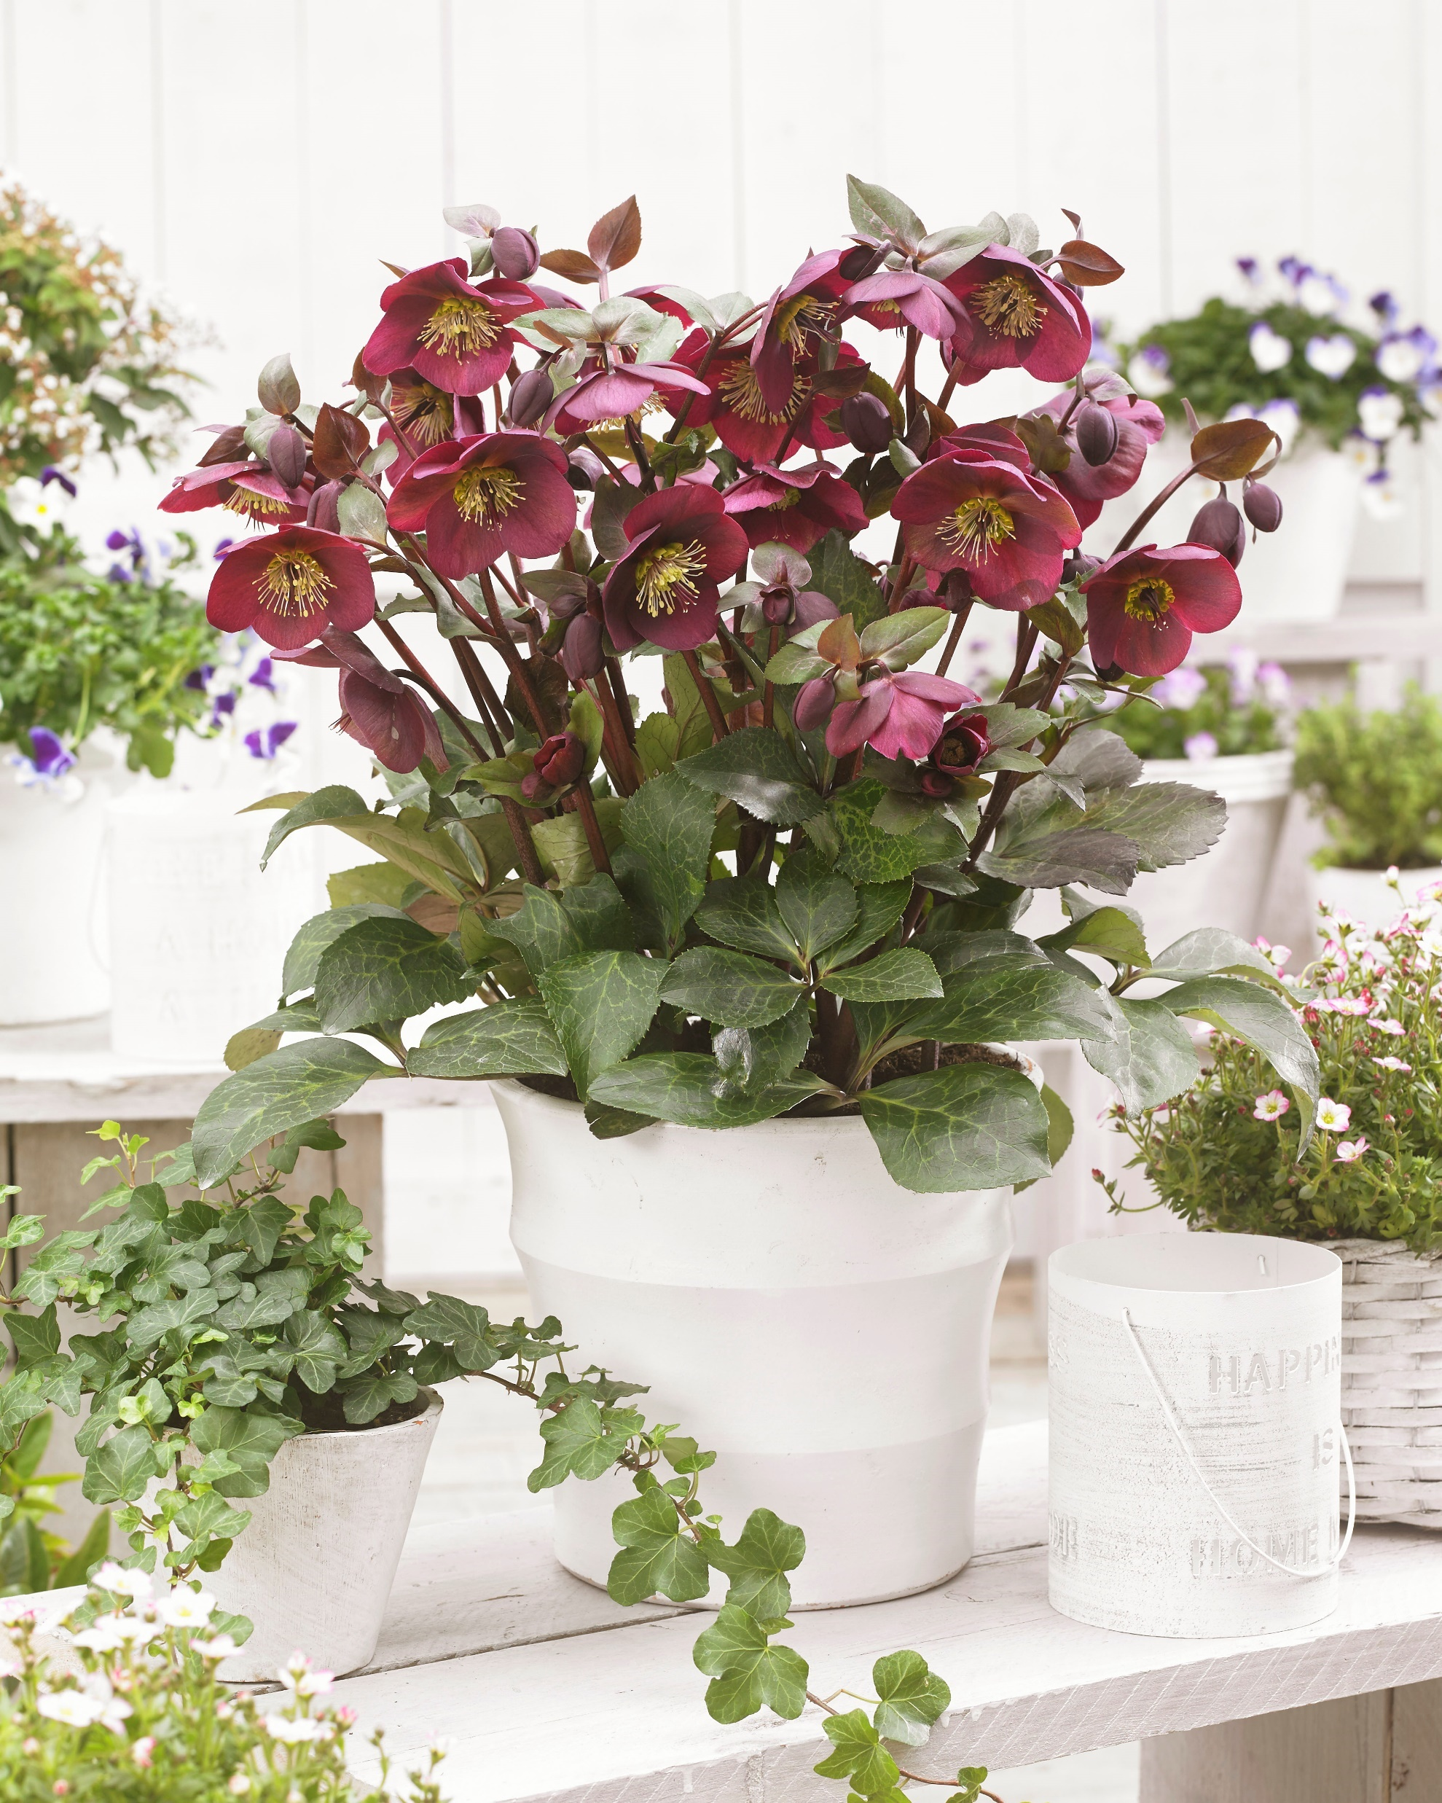
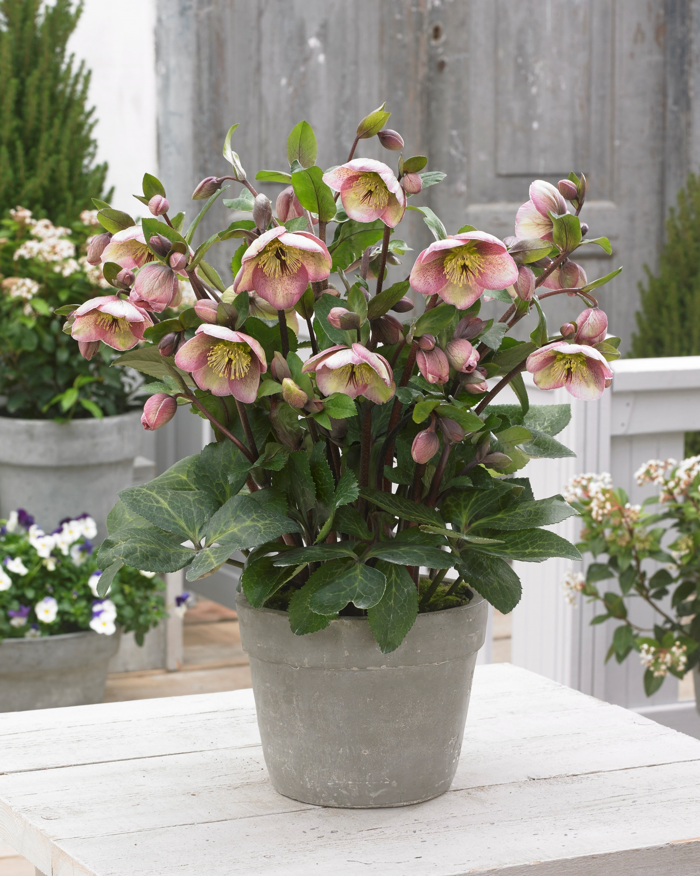
The end product, the way they can look if grown well!

Slide 11
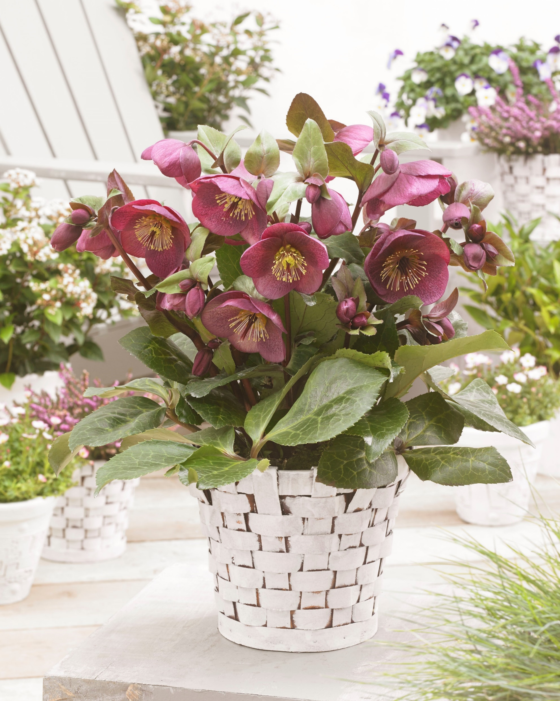
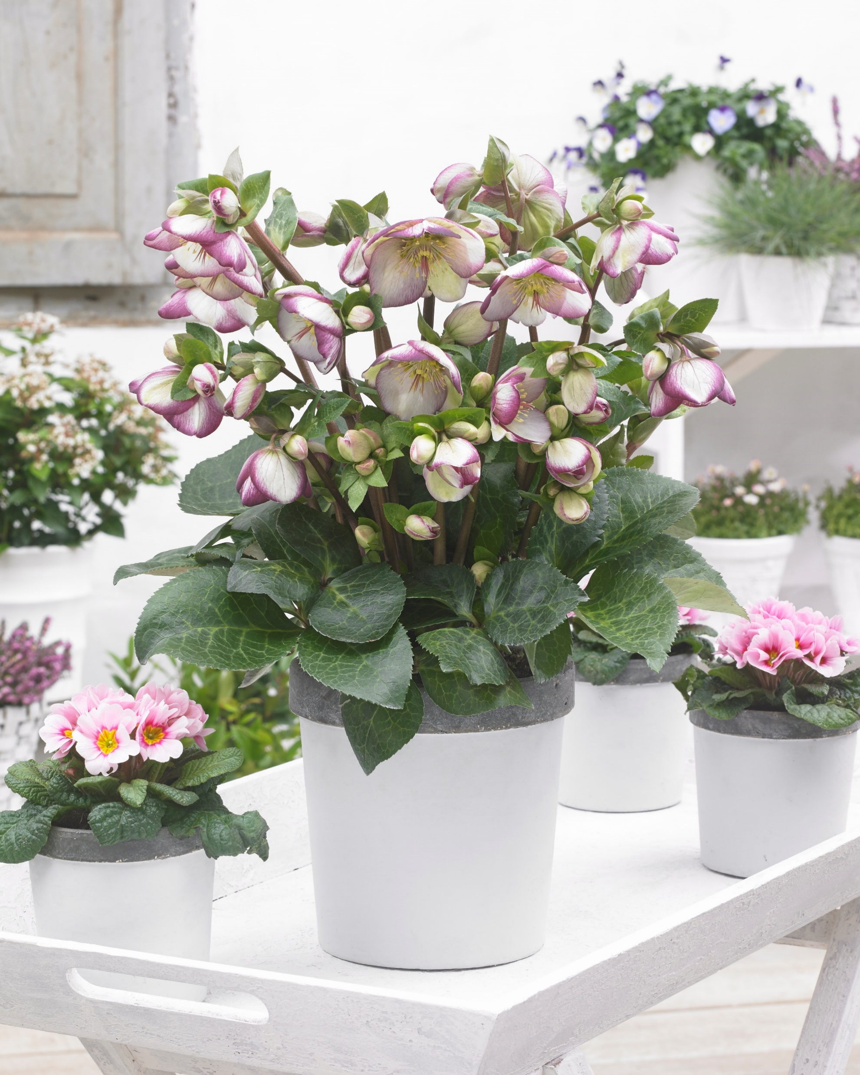

Slide 12
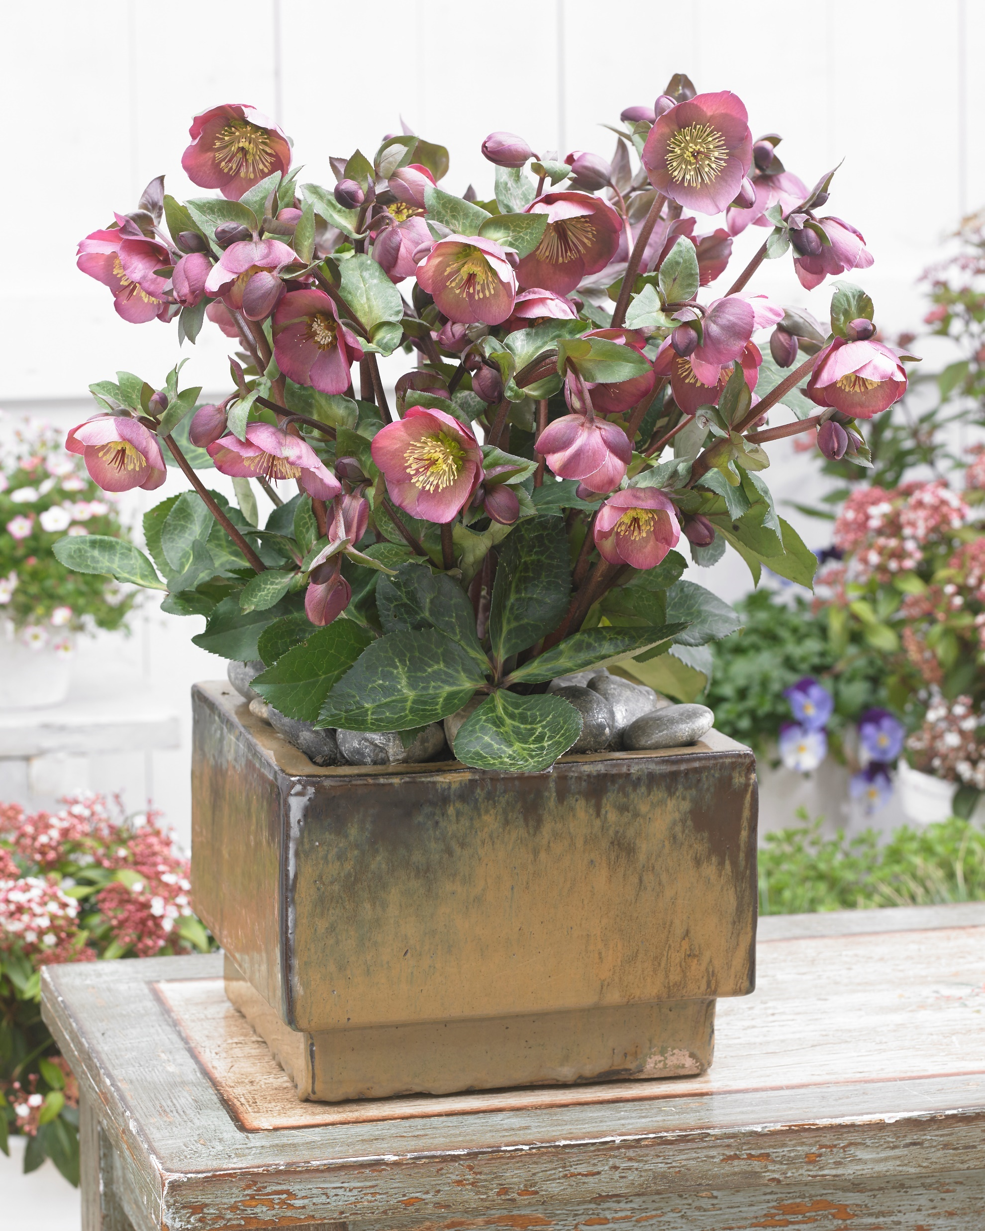
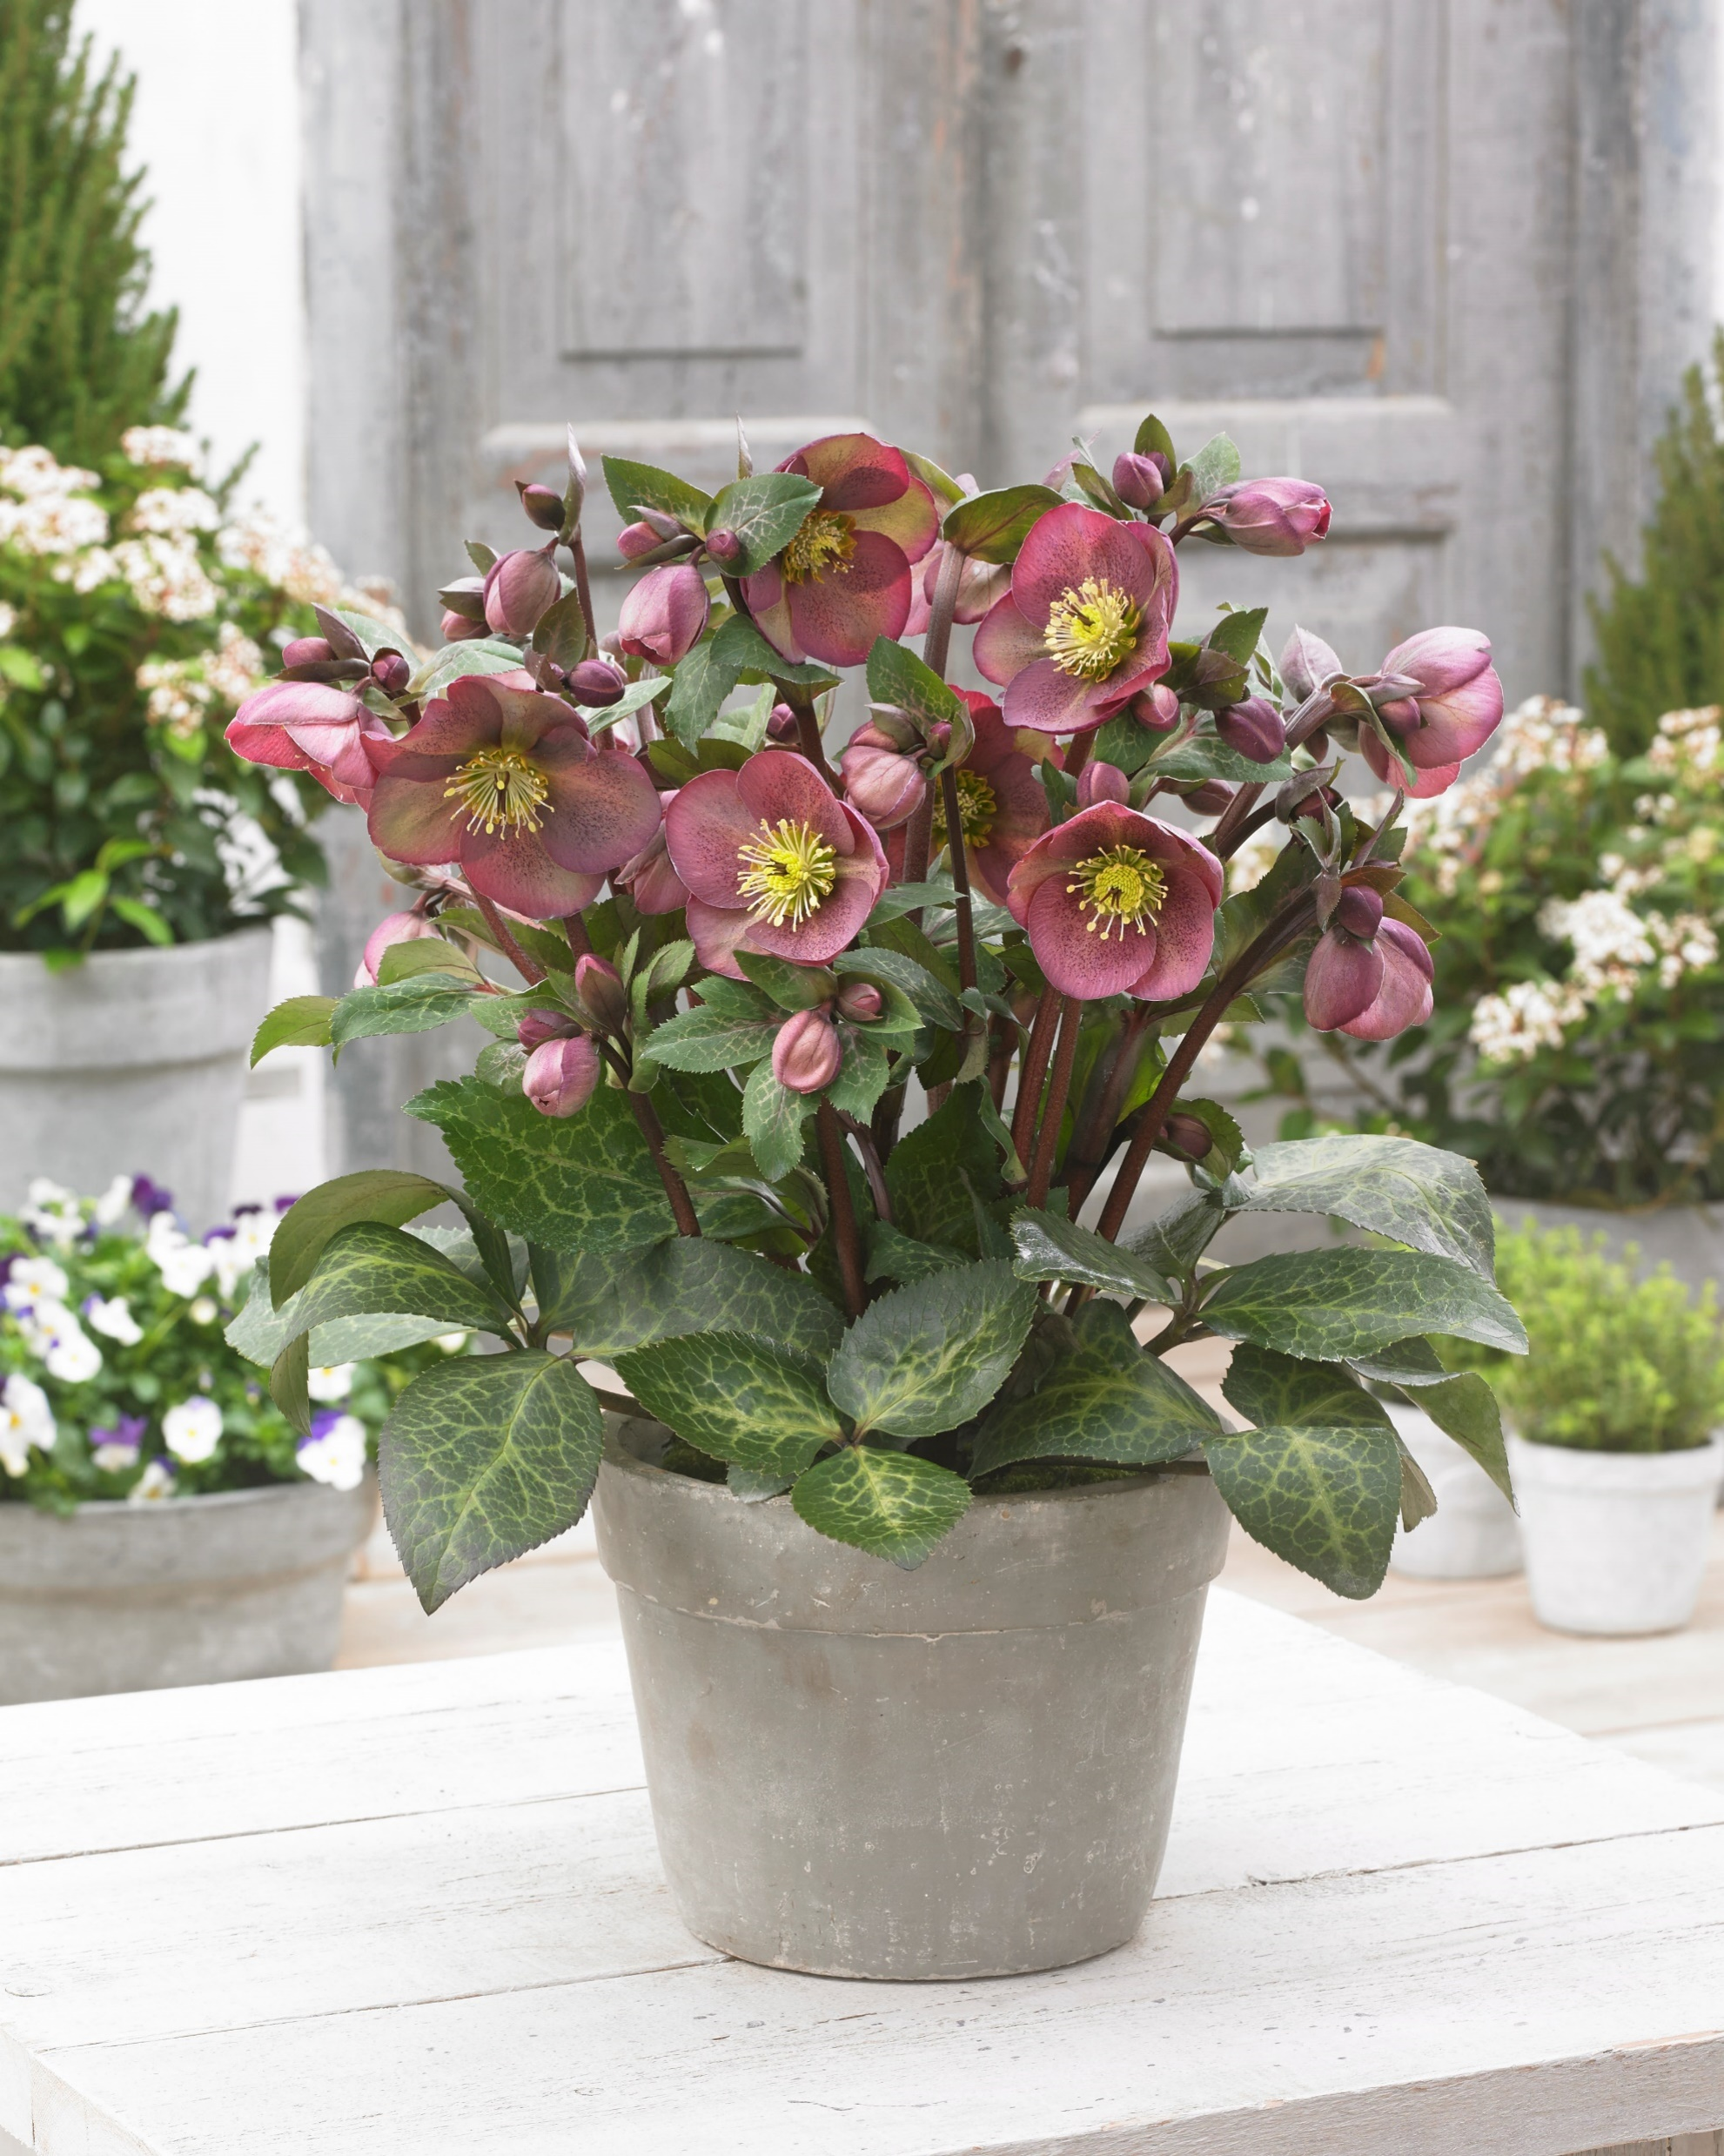

Slide 13
2015 building our own lab
The lab has build for the next reasons:
-Keeping mother stock alive, save costs
-Initiating Helleborus and other breeding of Eternal Plant Boijl
-R & D to find better growing and rooting media
-Implement new growing technics
-Faster testing possible, saves a year

Slide 14
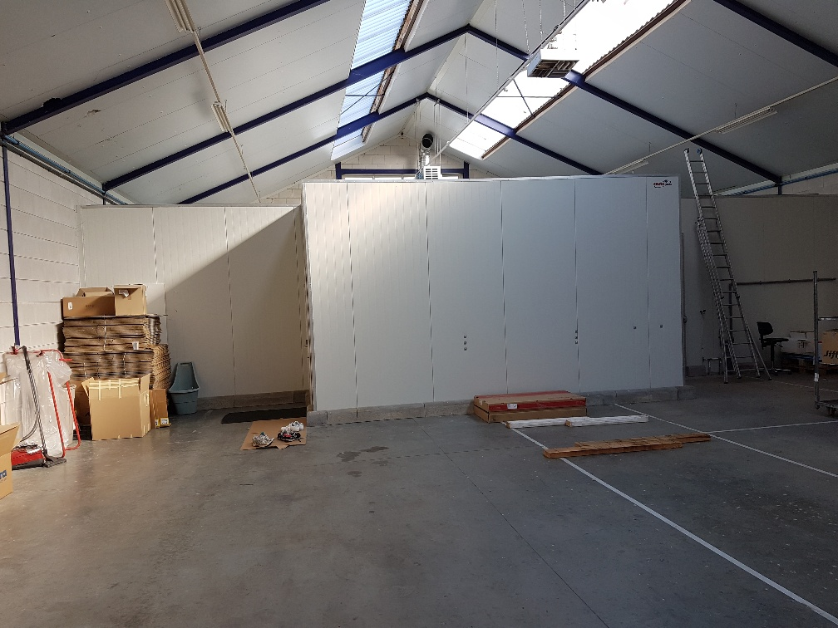
The lab at Exceptio Nurseries

Slide 15
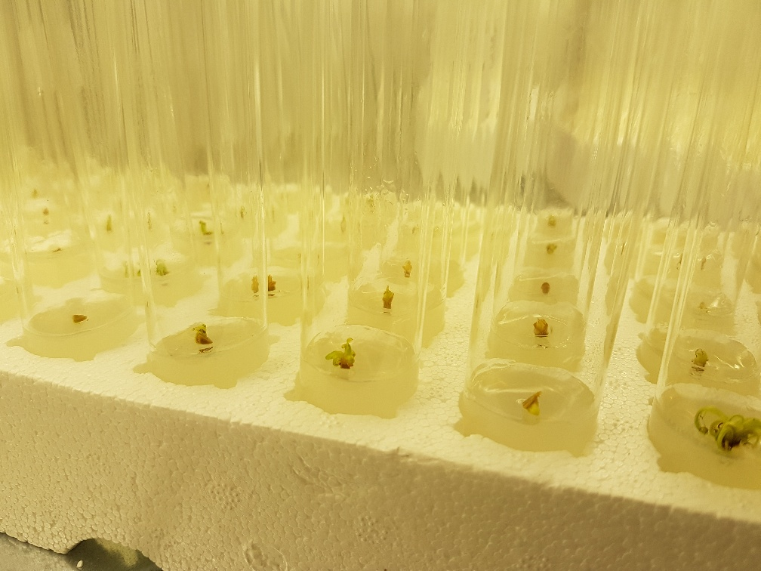
Helleborus growing tip beeing isolated and initiated in the lab, they just start to re-grow

Slide 16
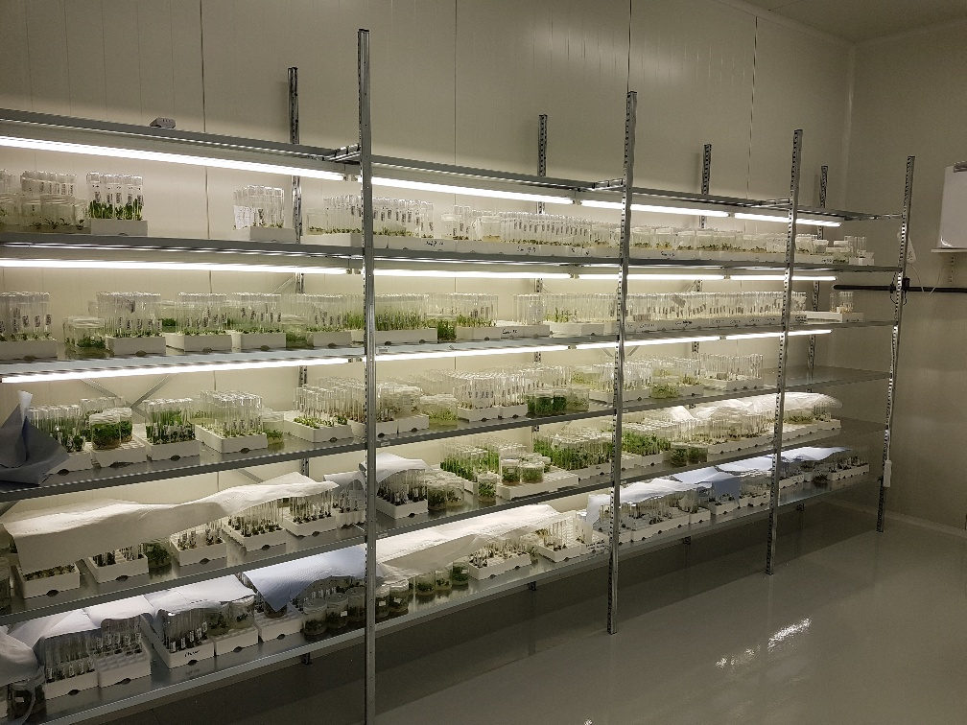

Slide 17
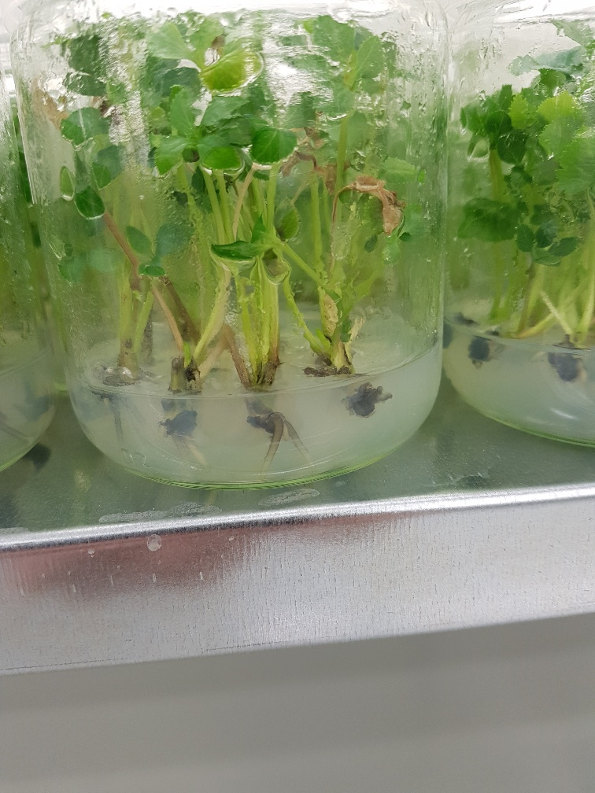
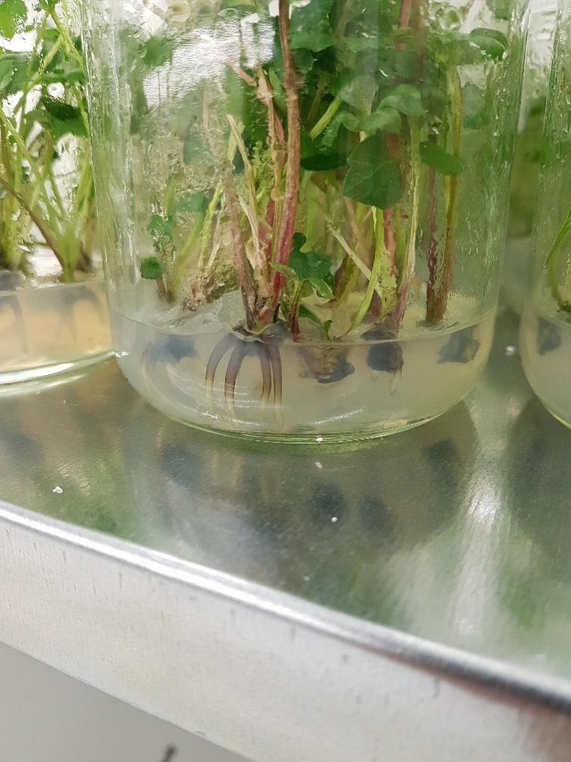
Rooting a Frostkiss Helleborus in glass jars

Slide 18
The Future
-Frostkiss Helleborus becomes a standard in the market now for spring flowering Helleborus
-Sales more worldwide using more than 1 licence per country/continent
-New breeding will come in the near future with exciting colors
-Production in the labs scaled up, using now 3 labs on 3 continents to spread risk and avoid production problems

Slide 19
Why using a FrostKiss Helleborus instead of others?
-Unique colors available from november till april
-Unique leaf partner/marbling
-Flowers reliable in one year growing, can flower extraordinary if growing well. (up to 80 flowers in 1 plant)
-Easy to grow
-No real competition from other breeders around at this moment.
-Dry tolerant
-Heat tolerant, more than any other Helleborus
-Can grow in the garden from deep shade to sunny possitions
-Deer resistant
-Can be used as cut flower, hold better than any other Helleborus.

Slide 20
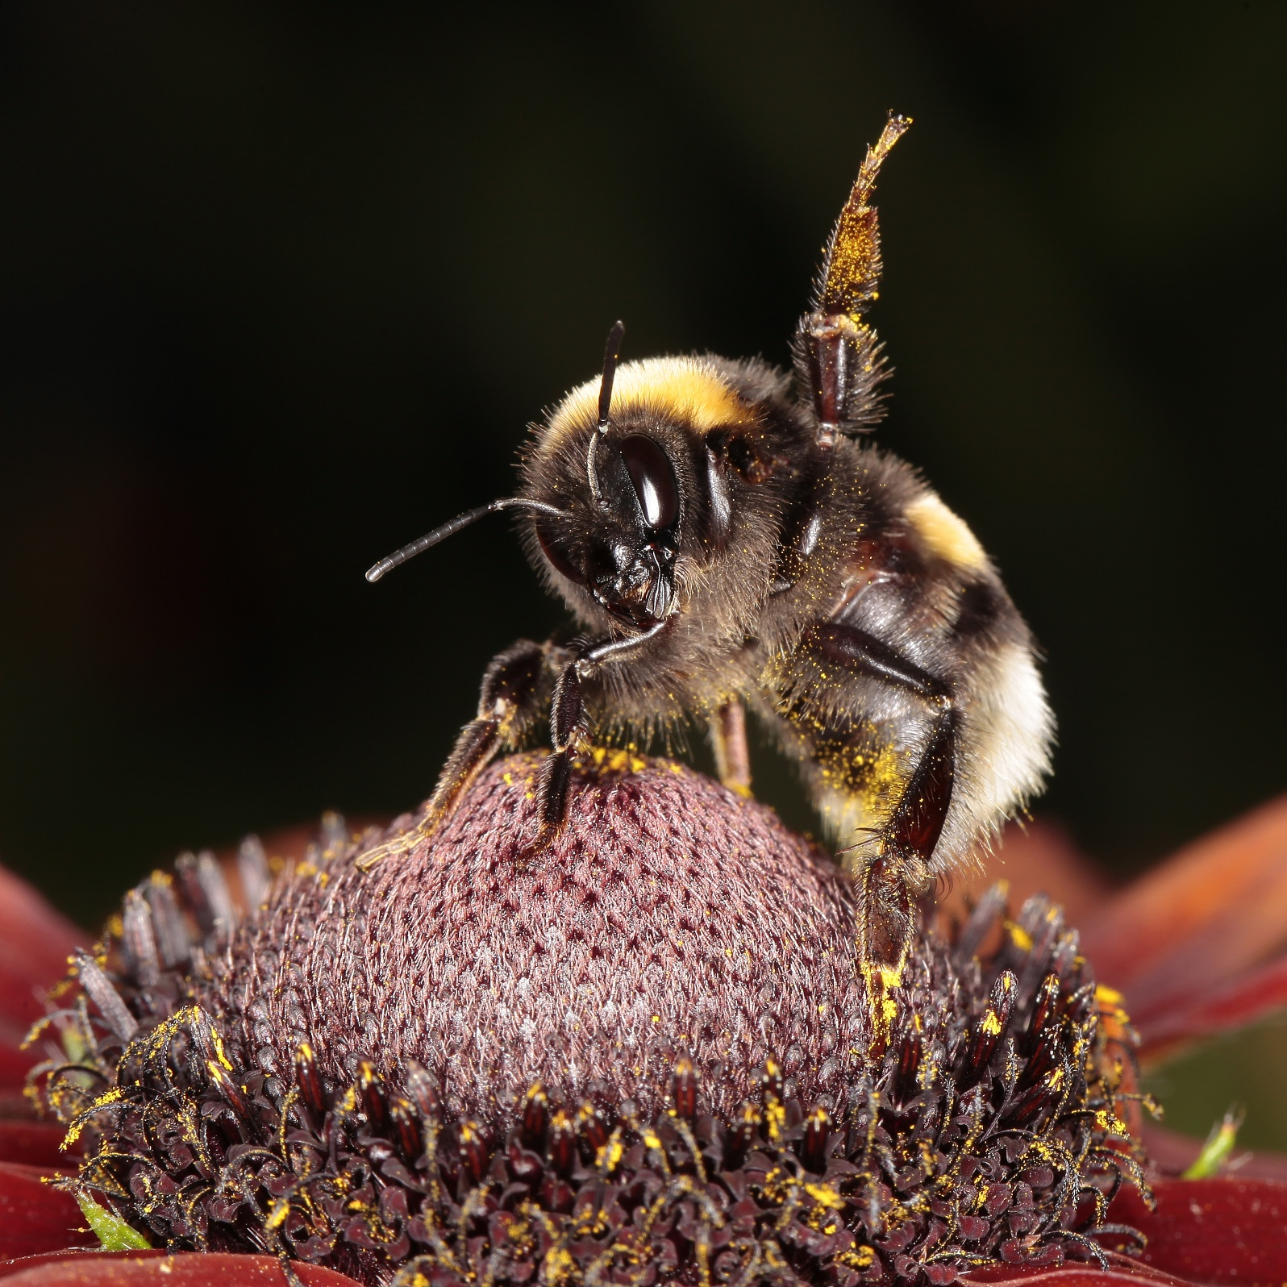
Thank you very much for your attention! Bye bye!

