Slide 1


From Ferns to Food
John Bijl - CEO

Slide 2
STRATEGY STARTS AT THE CUSTOMER.
IN COMBINATION WITH THE QUESTION:
IN WHICH DIRECTION IS THE WORLD HEADING?
Carlo van Kemenade
CEO Obvion Mortages
(scope maart 2018)

Slide 3
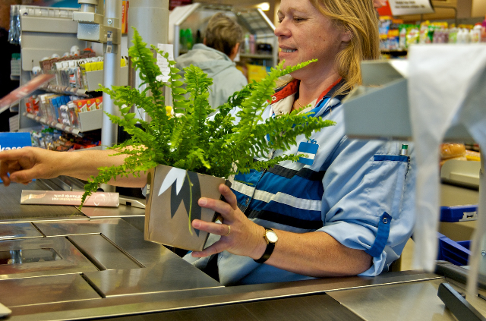
Why do people want your products?

Slide 4
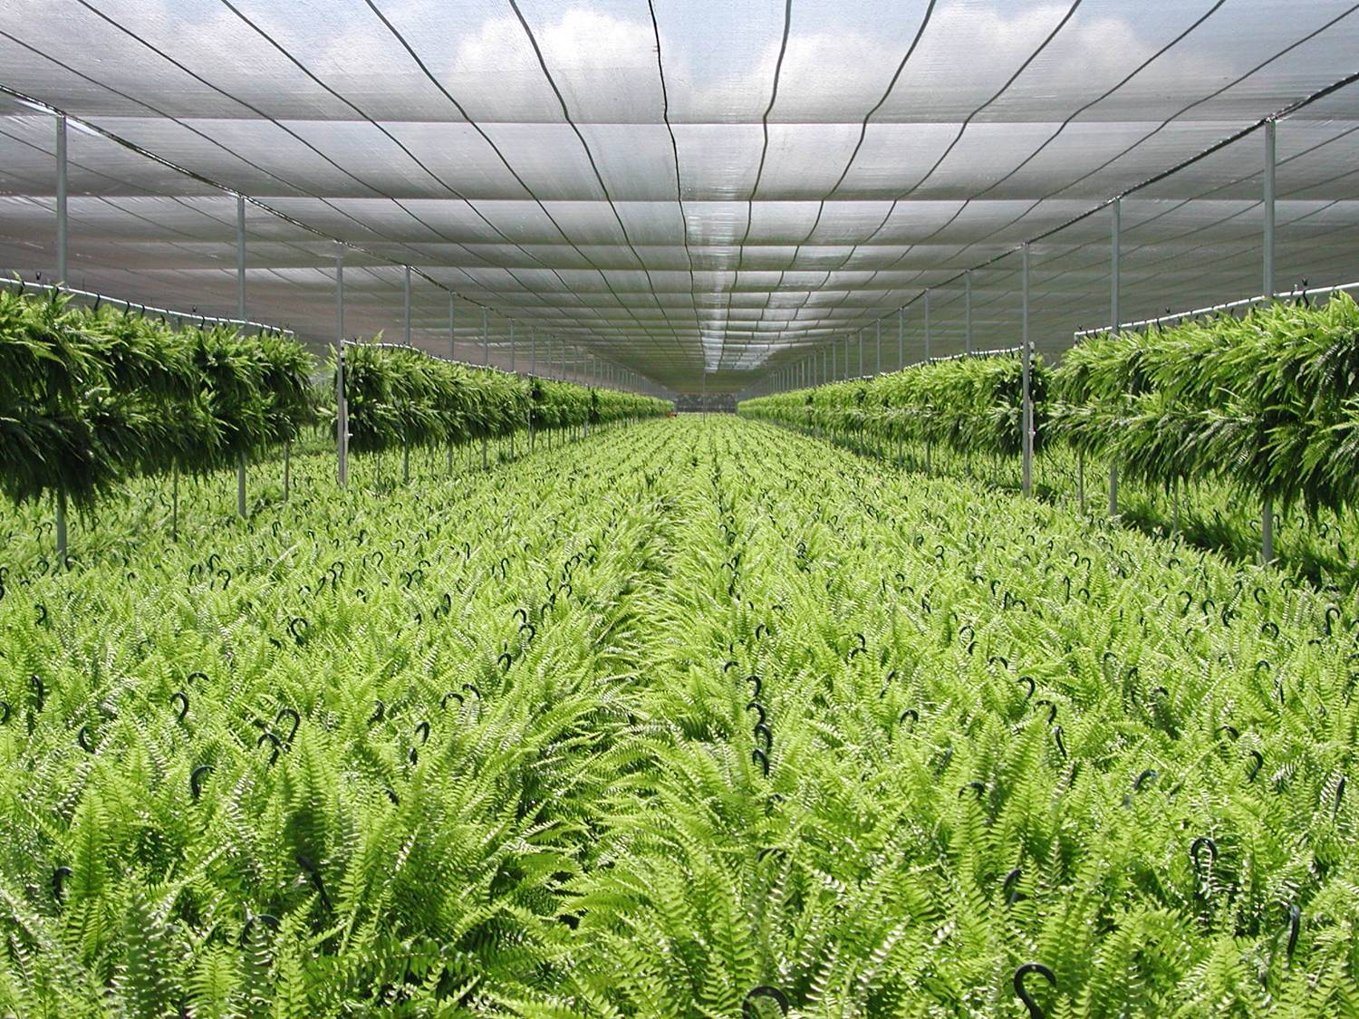

The market was asking more and more for large scale and just on time deliveries with identical looking Ferns

Slide 5
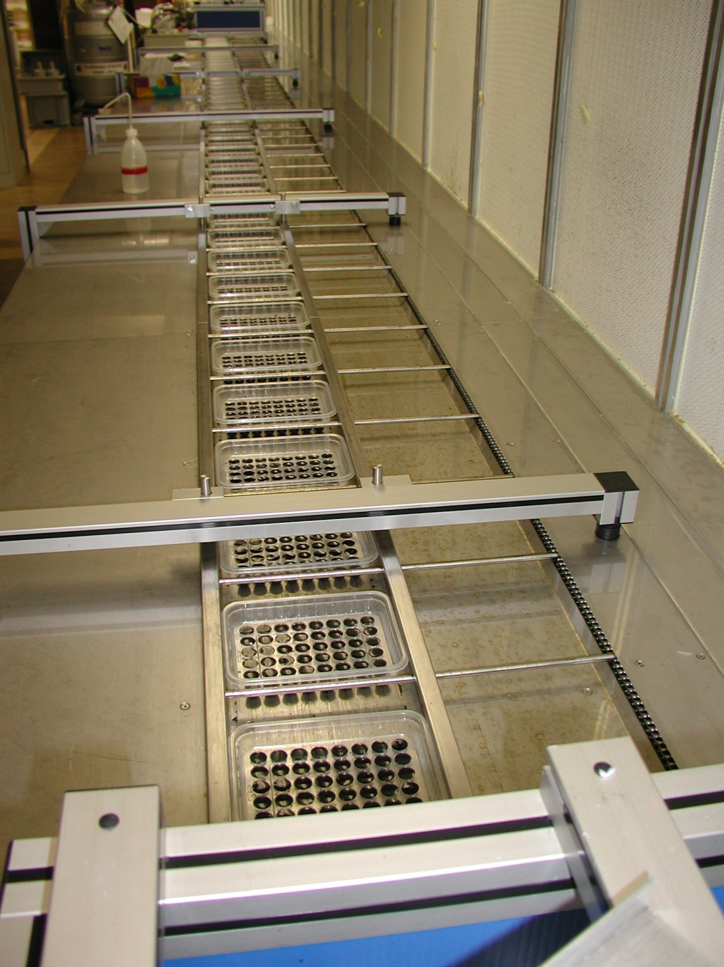
Clonal propagation combined with automation was the answer

Slide 6
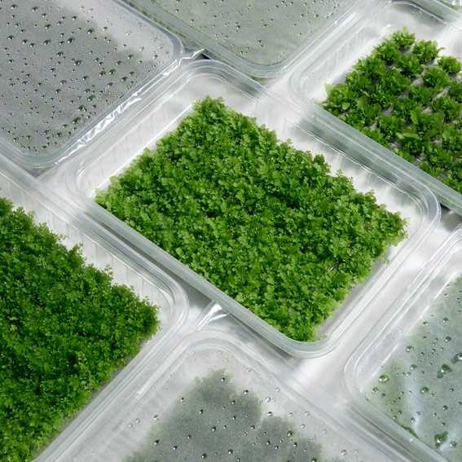
And we started to deliver as close to the market as possible

Slide 7
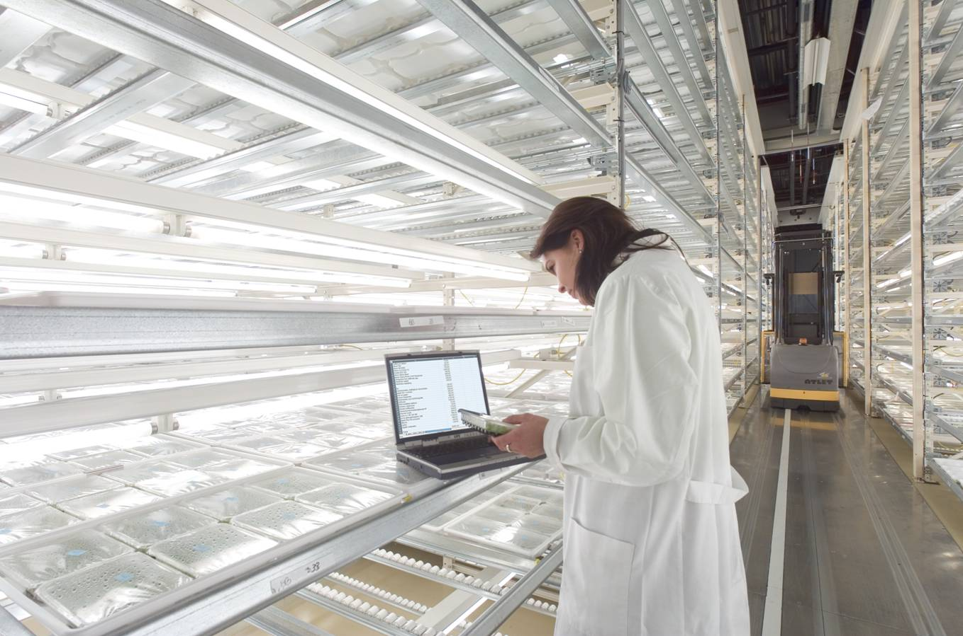
This picture was taken 15 years ago…innovation takes time

Slide 8
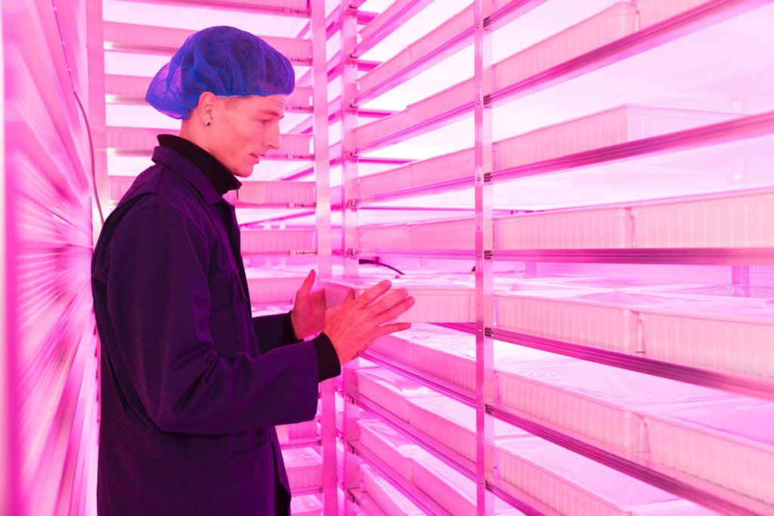
This year we doubled the efficiency and also the quality in our growth chambers by using LED panels

Slide 9
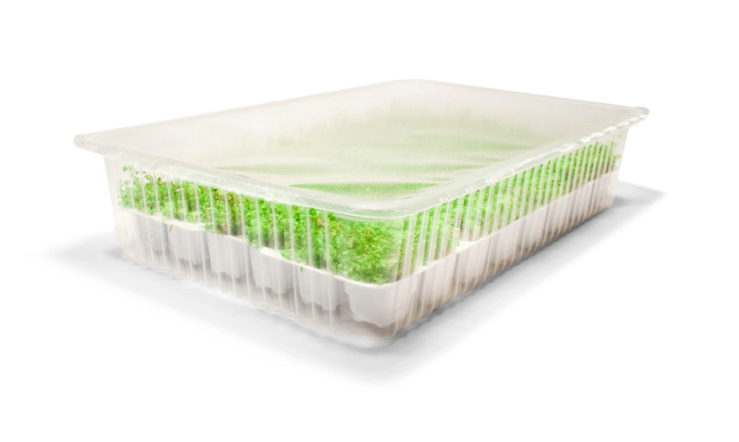
We call this: ‘Greenhouse in a Box’

Slide 10
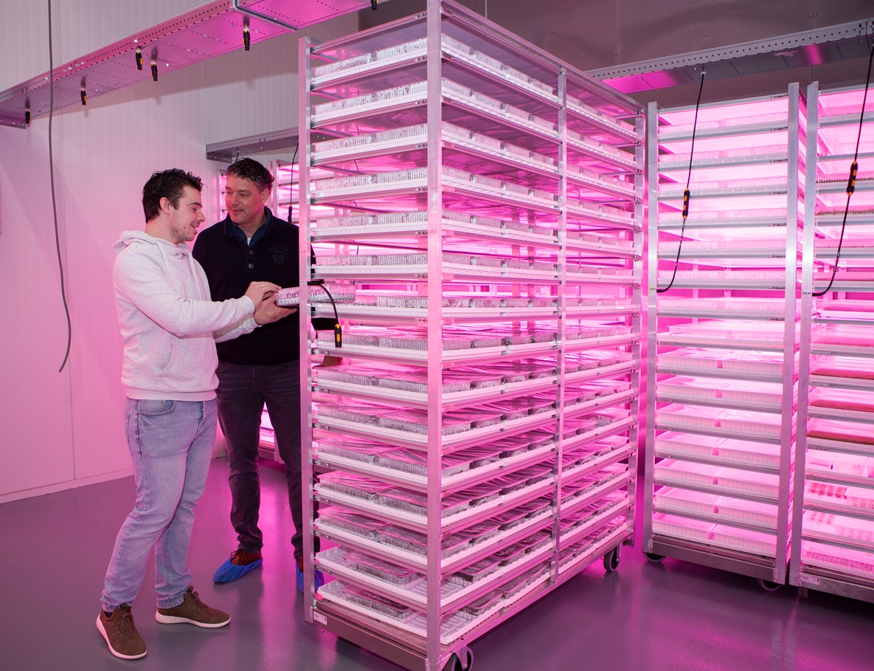
We are moving greenhouse production to growth chambers more and more….

Slide 11
My visit at google gave me new directions

Slide 12
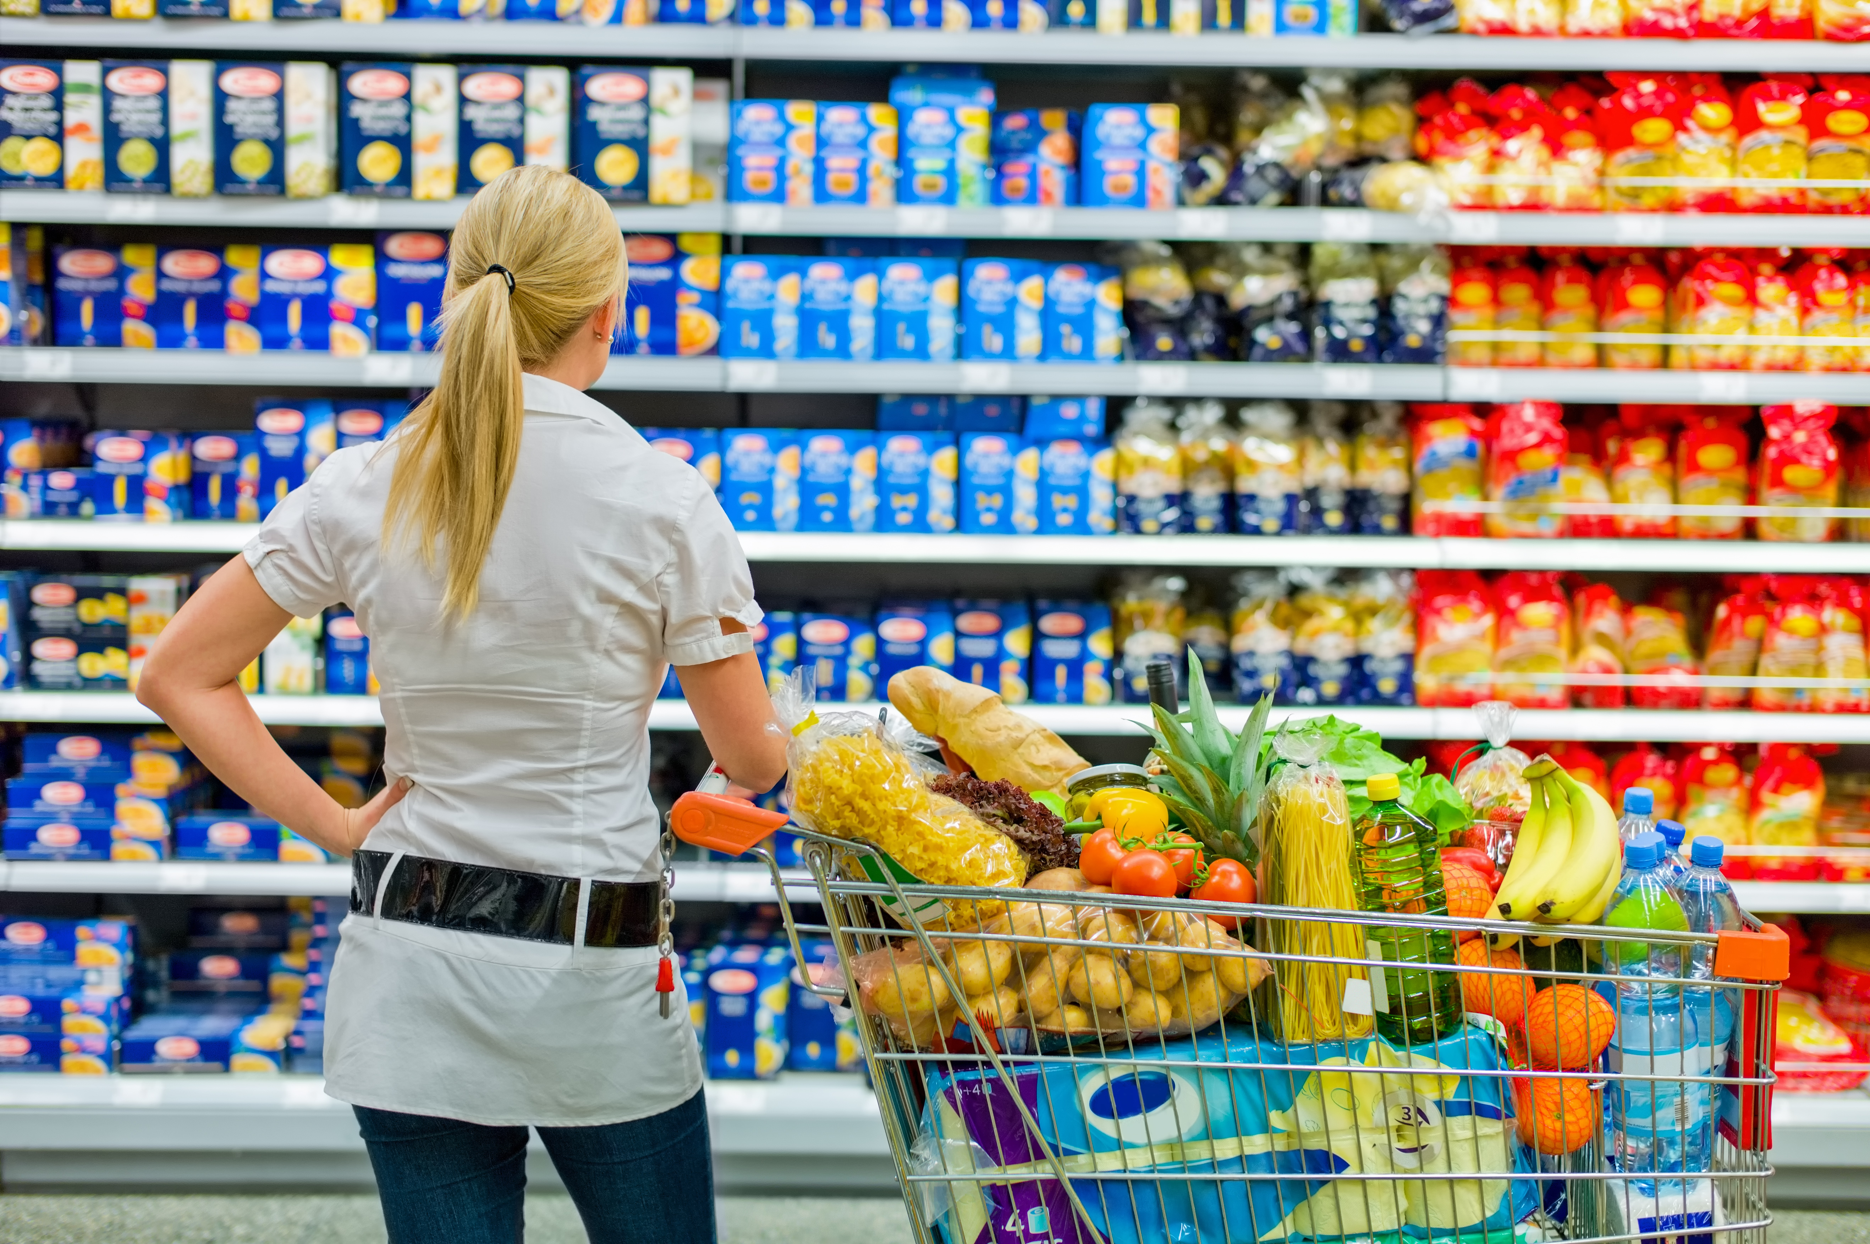
The supply chains are changing rapidly

Slide 13
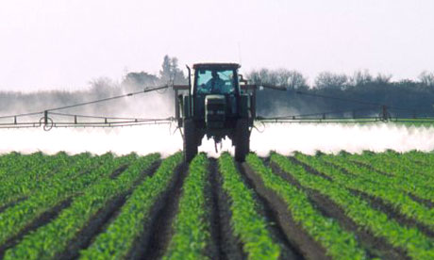
Water, Pesticides, Climate and Food Waste are real issues

Slide 14
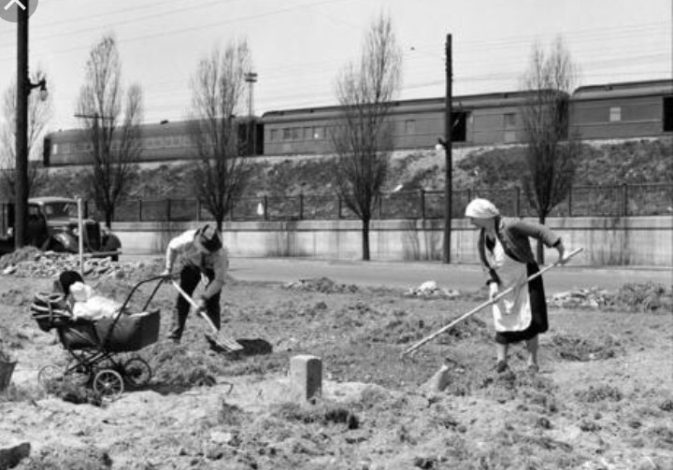
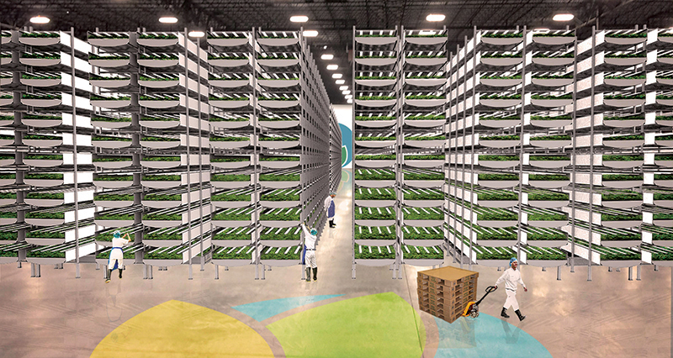

Slide 15
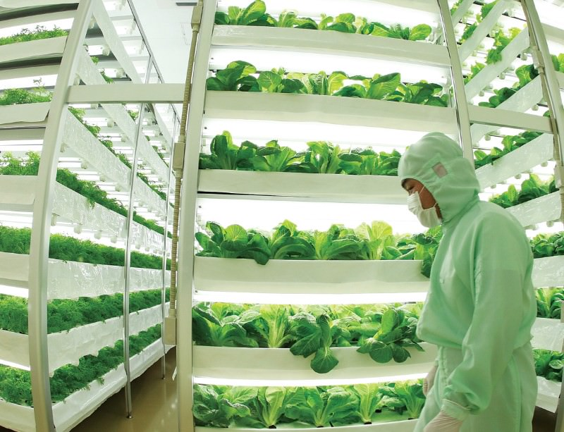
Why Vertical Farming is growing so rapidly in Japan?

Slide 16
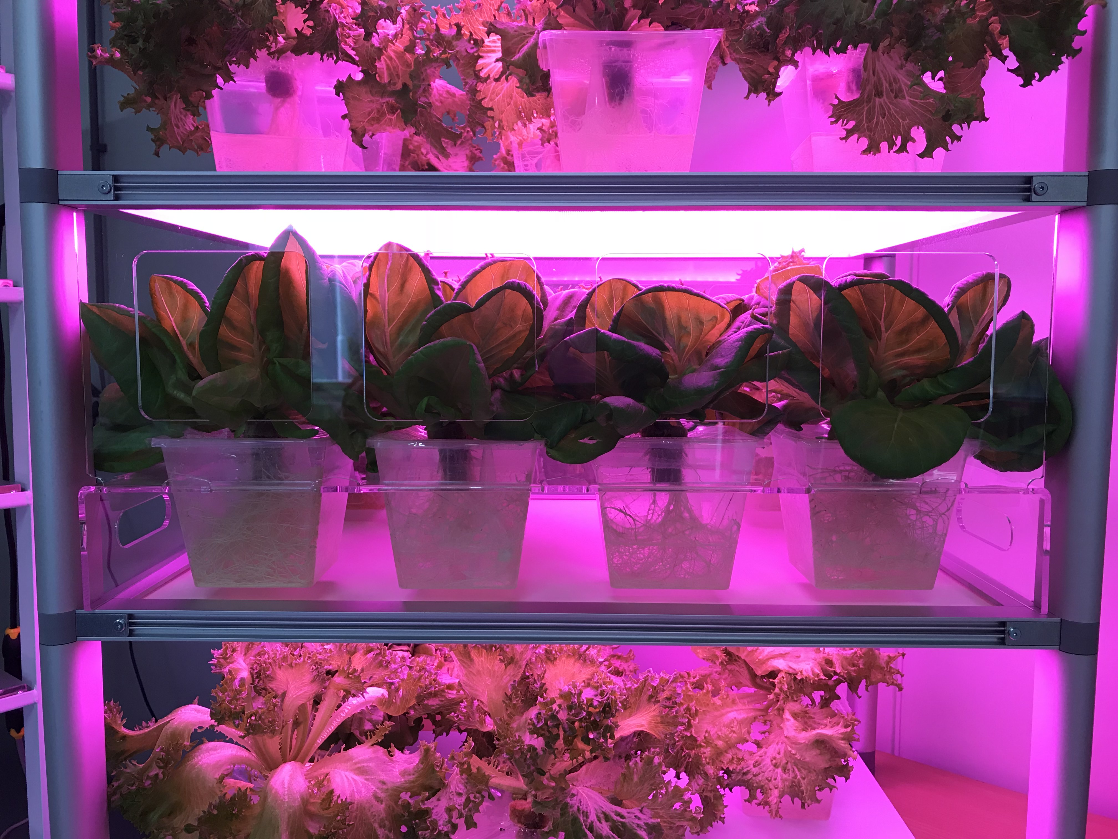
Own Greens
solves two important technical issuses for big factories:
Cross-contamination
Automation

Slide 17
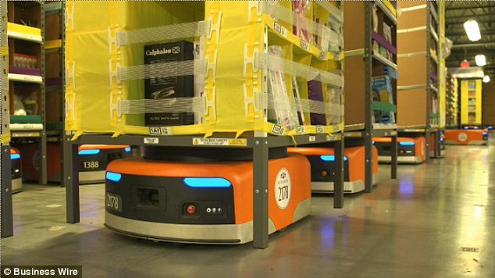
What about Amazone growing Fresh Food?

Slide 18
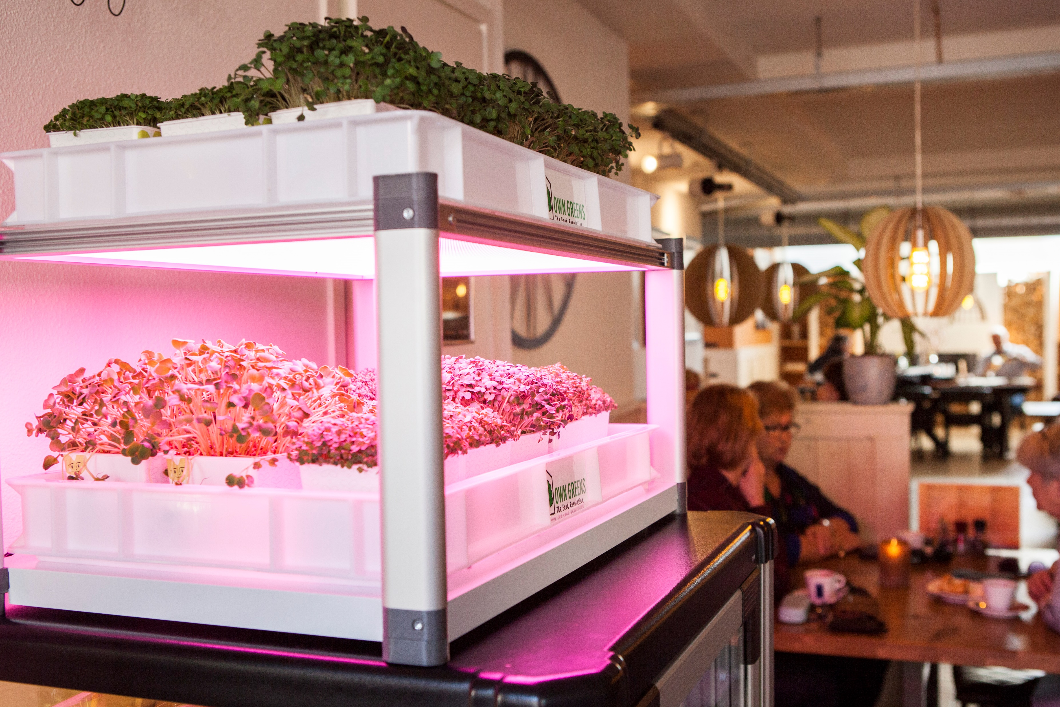
With own Greens we start at consumer level to hear and feel if we are moving in the good direction

Slide 19

What is your dot on the horizon?

Slide 20
Thanks for your attention!
www.owngreens.com

