Slide 1
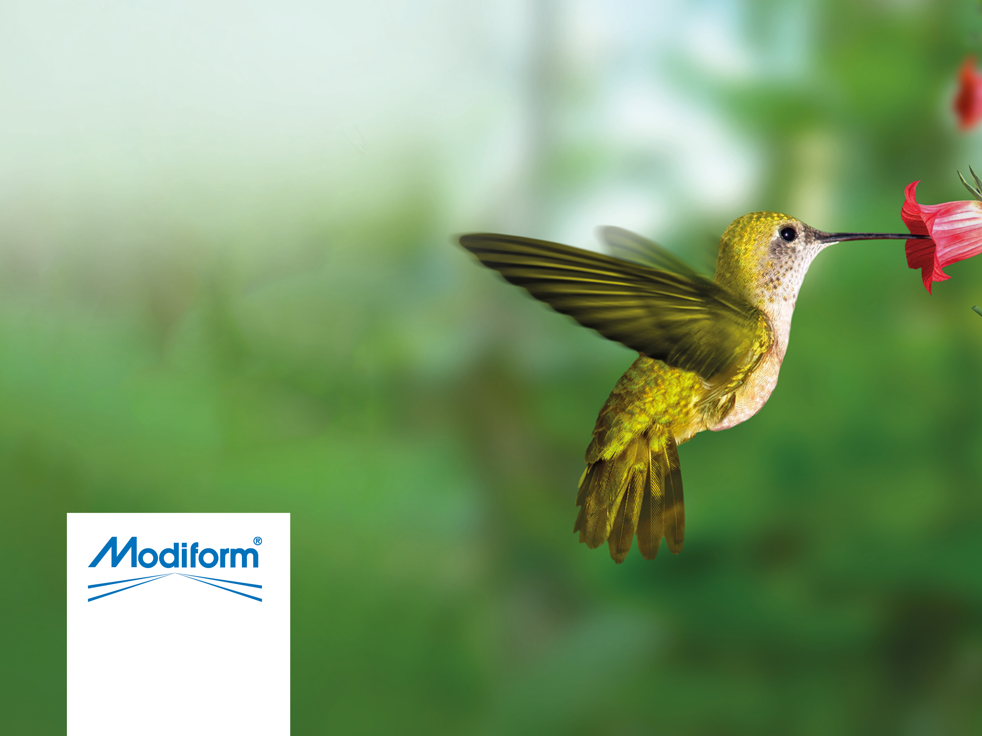
Plastic in
Horticulture

Slide 2
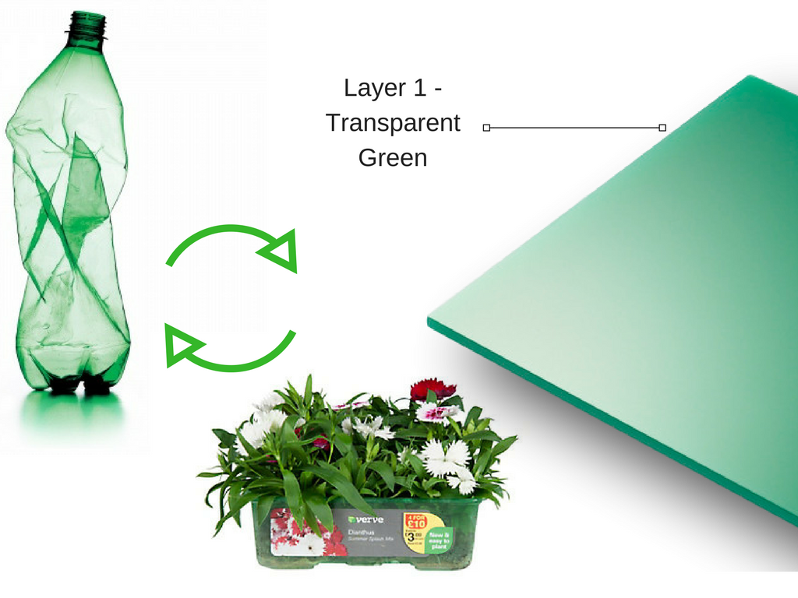
B&Q’s Easy Grow – By Modiform
Notes:
This is where it all started for me and Modiform. The journey began with a question from B&Q to change their EPS packs to another material. I knew other companies would provide products in standard horticultural black plastic. We wanted to be different, we researched the market and found out what would be recycled. We ended up with transparent green PET made from recycled drinks bottles. We won the order.

Slide 3
PLASTICS IN HORTICULTURE
FACTS ABOUT PLASTIC
PLASTICS IN THE ENVIRONMENT
PLASTICS CURRENTLY USED IN HORTICULTURE
WHAT HAPPENS TO HORTICULTURAL PLASTICS?
UK RECYCLING SYSTEMS
THE FUTURE OF HORTICULTURAL PACKAGING

Slide 4
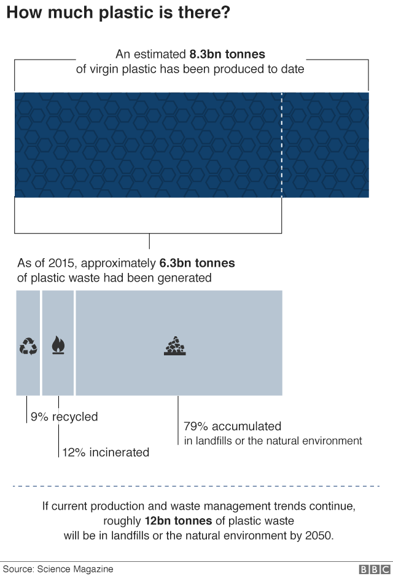
Notes:
Based on these trends there will be 12billion tones of plastic in landfill or in the natural environment by 2050

Slide 5
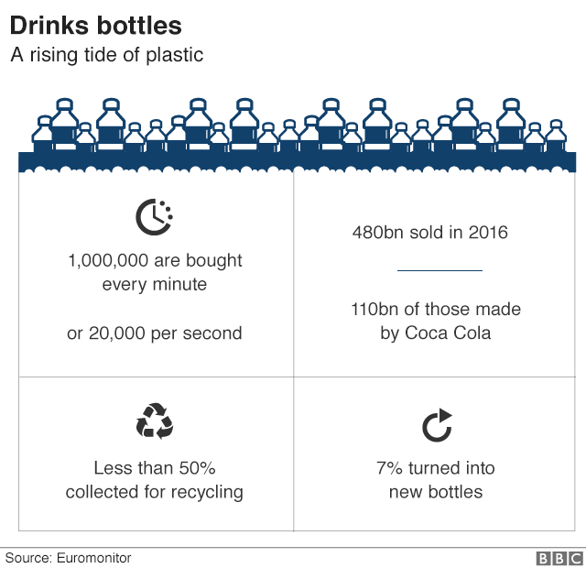

Slide 6
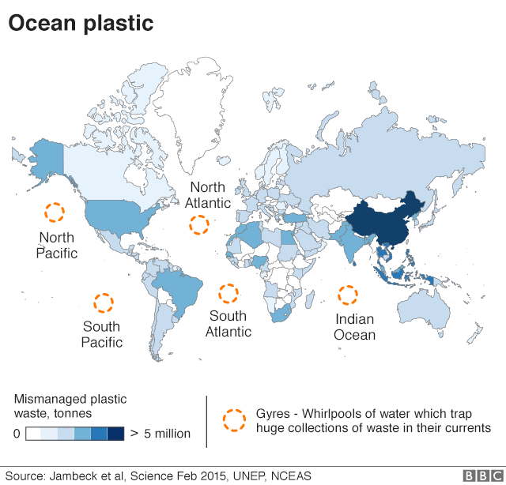
Notes:
One of the gyres is three times the size of France!!!!

Slide 7
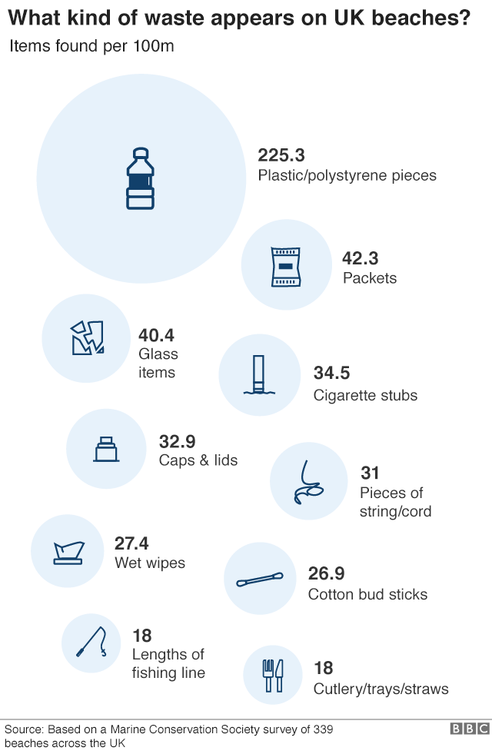

Slide 8
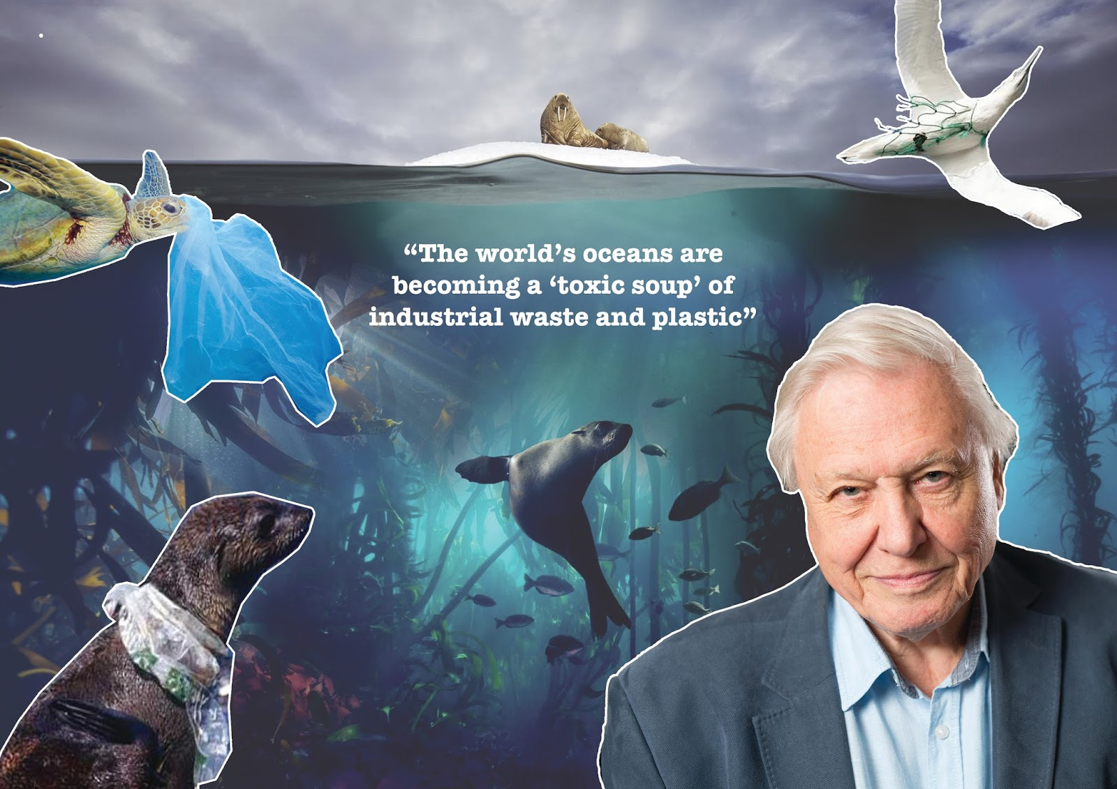
PLASTICS IN THE ENVIRONMENT

Slide 9
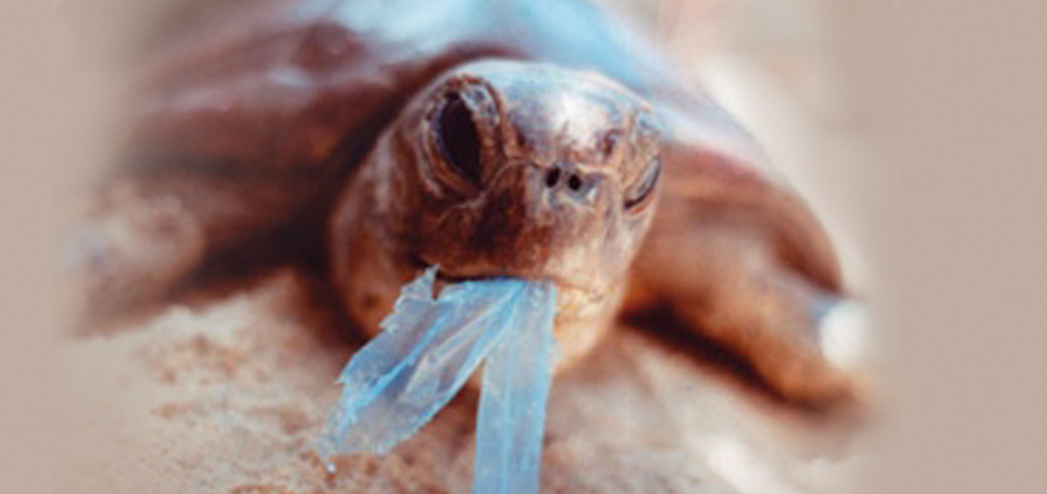
PLASTICS IN THE ENVIRONMENT

Slide 10
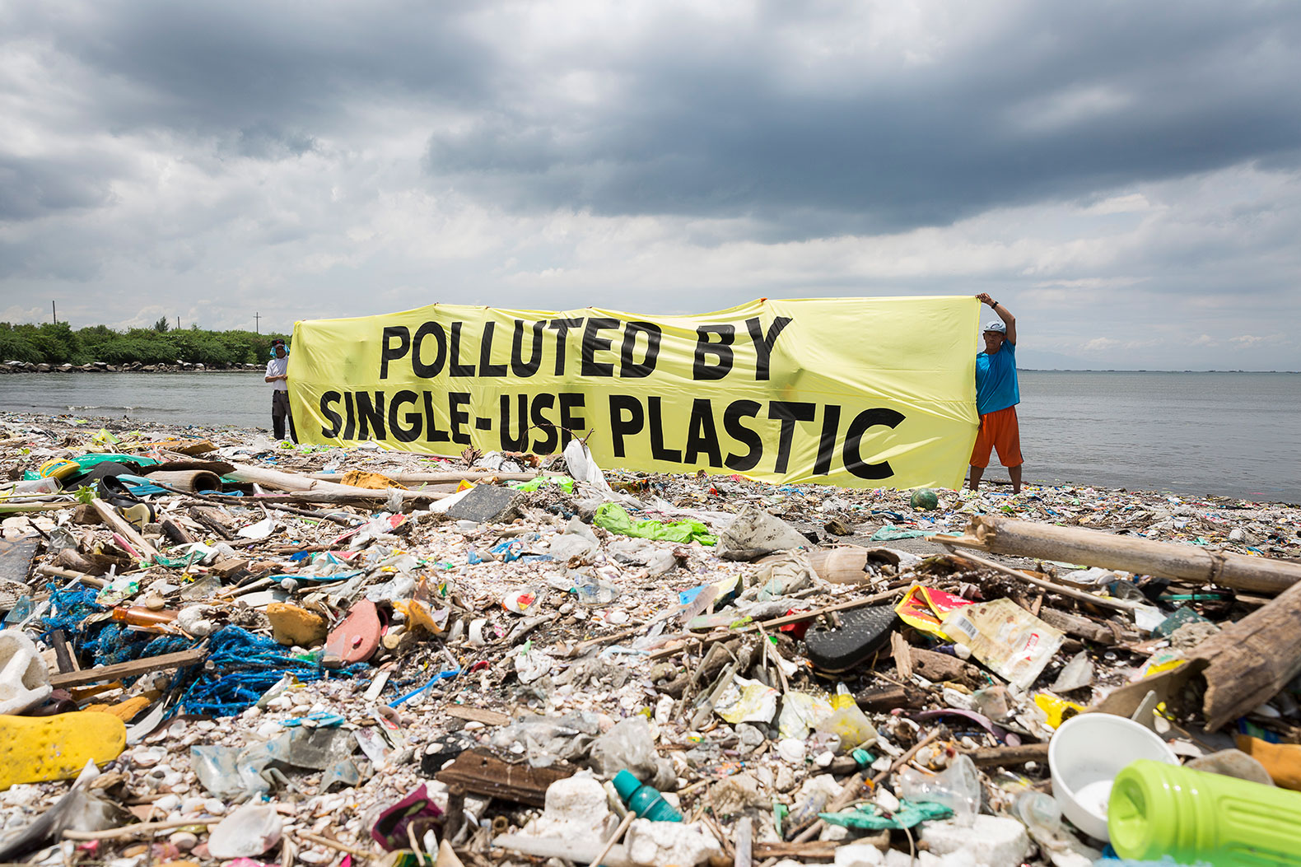
PLASTICS IN THE ENVIRONMENT

Slide 11
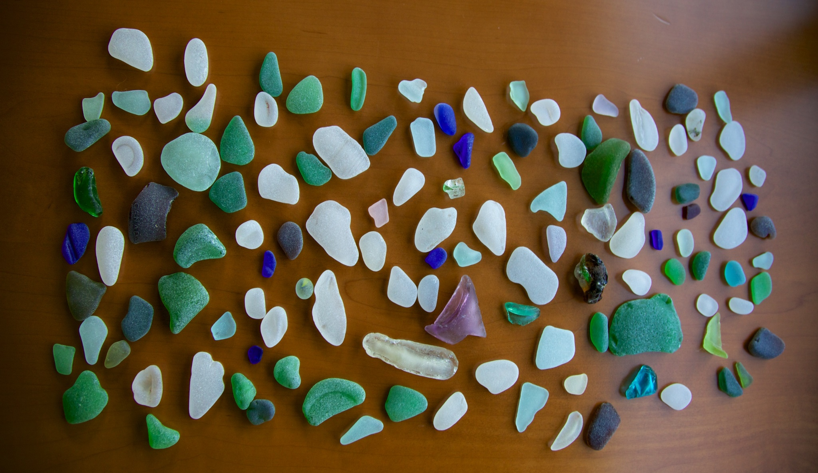
PLASTICS IN THE ENVIRONMENT
Notes:
These are called Mermaids tears. The plastic in the sea breaks up and gets smaller. The fish and other sea creatures eat the small pieces and we eat them. Sea birds are also affected with up to 200 pieces being found in a single bird.

Slide 12
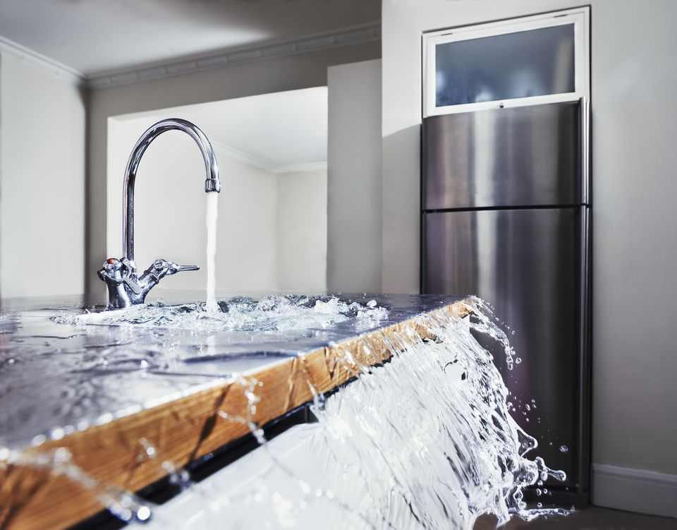
PLASTIC FACTS
Notes:
This is an analogy typically used to describe the plastic in the ocean. If you walk into the kitchen to find a blocked sink with the tap on full. Do you start mopping up the water on the floor or do you turn the tap off?

Slide 13
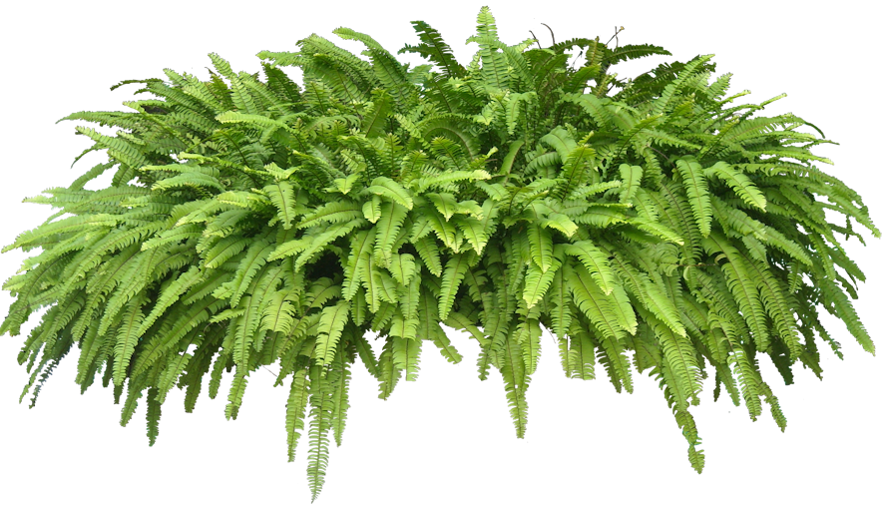
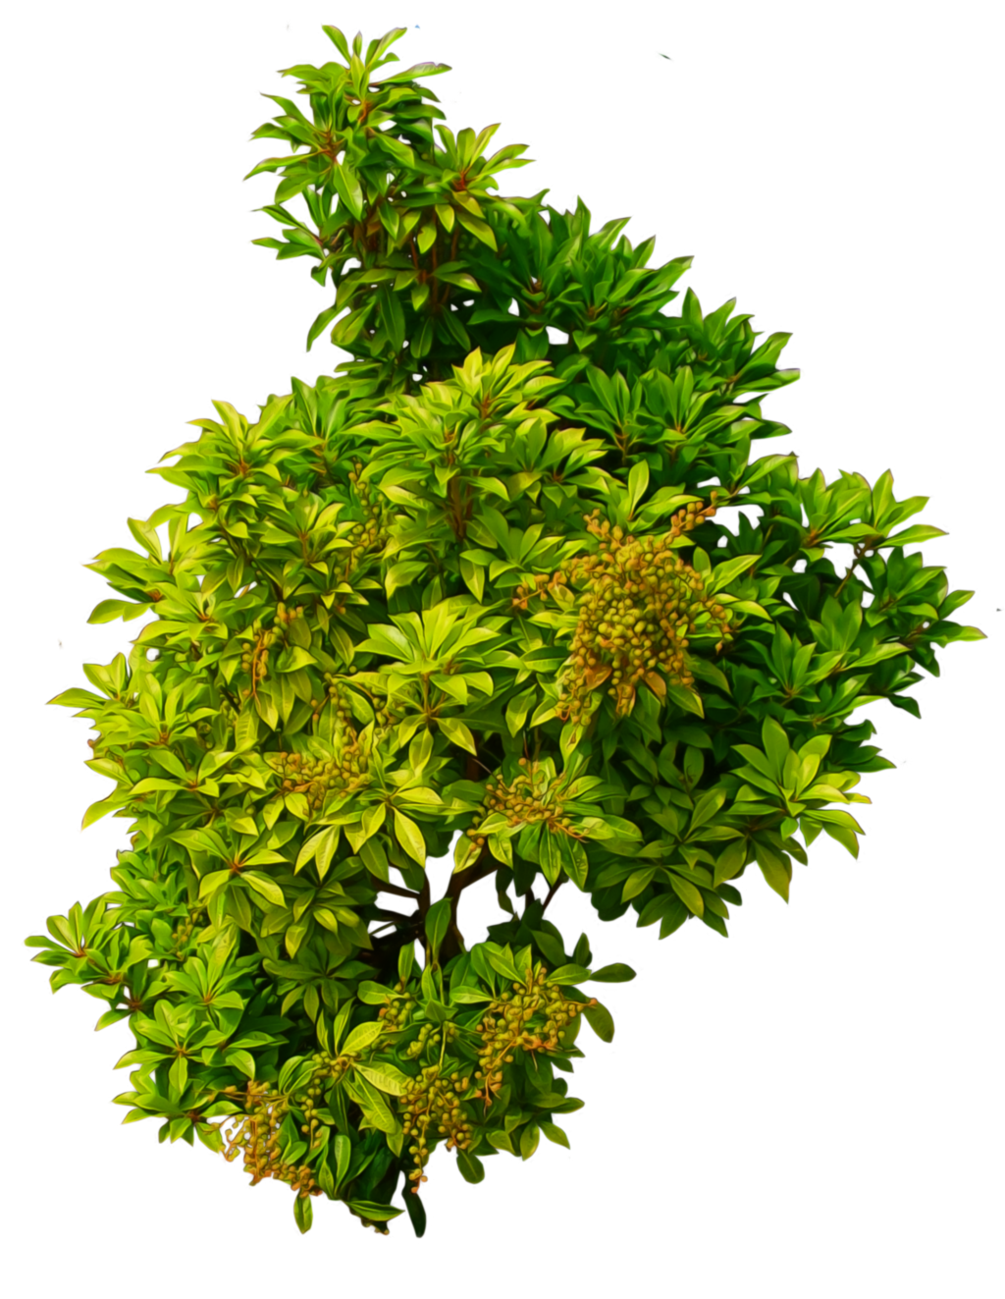
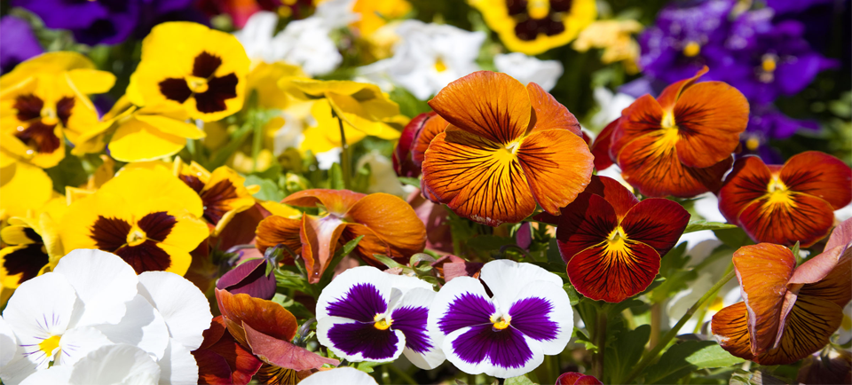
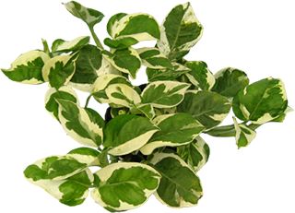
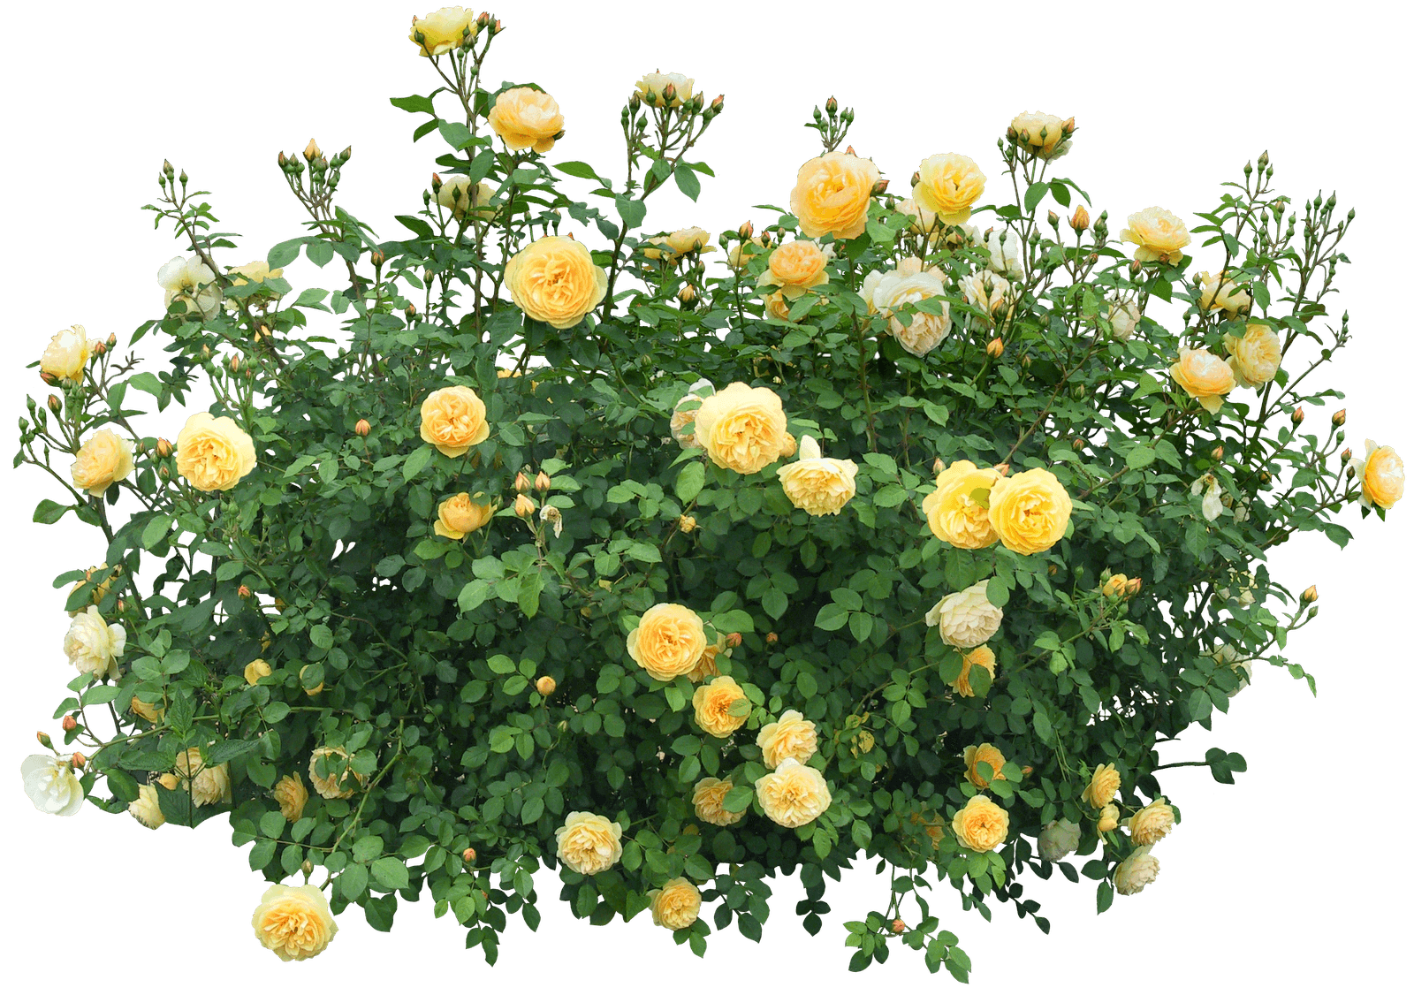
PLASTICS CURRENTLY USED IN HORTICULTURE
Notes:
We are a green industry and yet everything is delivered in plastic…or the wrong type of plastic.

Slide 14
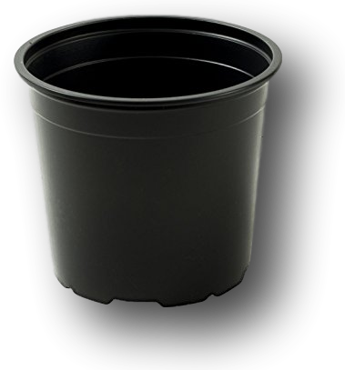
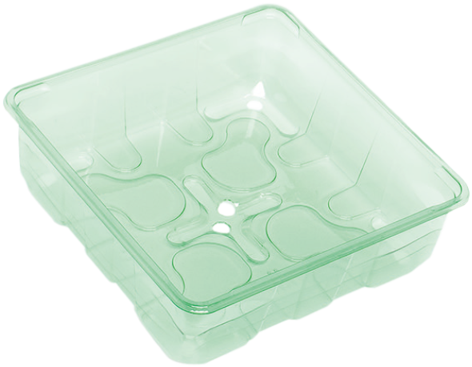
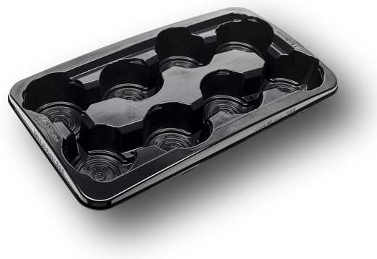
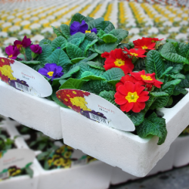
PLASTICS CURRENTLY USED IN HORTICULTURE
WHAT ARE THESE MADE FROM?
Notes:
EPS. PS. PP. PET.

Slide 15
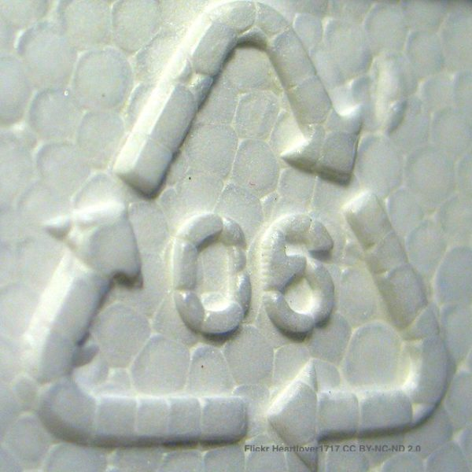
EPS – Expanded Polystyrene - Styrofoam

Slide 16
EPS – Expanded Polystyrene - Styrofoam
EPS does not biodegrade. It may break into small pieces, even minuscule pieces. But the smaller EPS gets, the harder it is to clean up.
It is made of fossil fuels and synthetic chemicals. Those chemicals may leach if they come in contact with hot, greasy or acidic food. Yes, they keep your coffee hot – but they may also add an unwanted dose of toxins to your drink.
Animals can eat it. Turtles and fish seem to mistake EPS for food, and that can kill them. Not only can they not digest it, but the foam could be full of poisons that it has absorbed from contaminants floating in the water.
It can’t be recycled. Some commercial recycling centres may accept waste EPS, but for the most part kerbside recycling centres do not accept throwaway foam food containers.
Notes:
EPS should be stopped. It will never be recycled through the kerbside collection system.

Slide 17
ADVICE FROM WRAP: EPS & BIO-POLYMERS
Avoid the use of expanded polystyrene (EPS), oxo-degradable or bio-degradable polymers as they are not currently compatible within existing household plastic sorting or reprocessing systems.

Slide 18
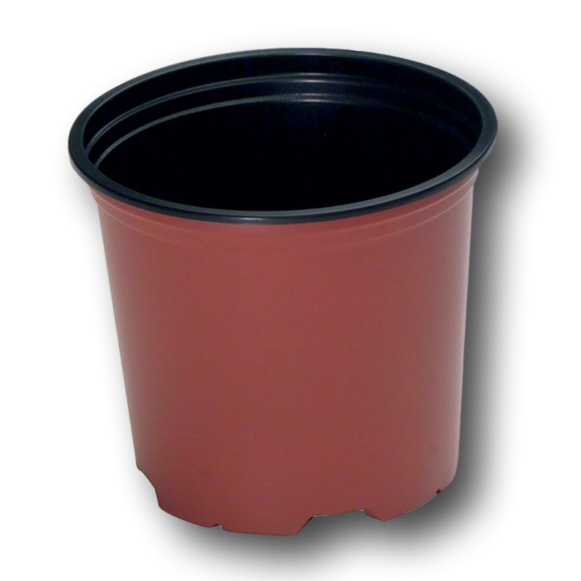
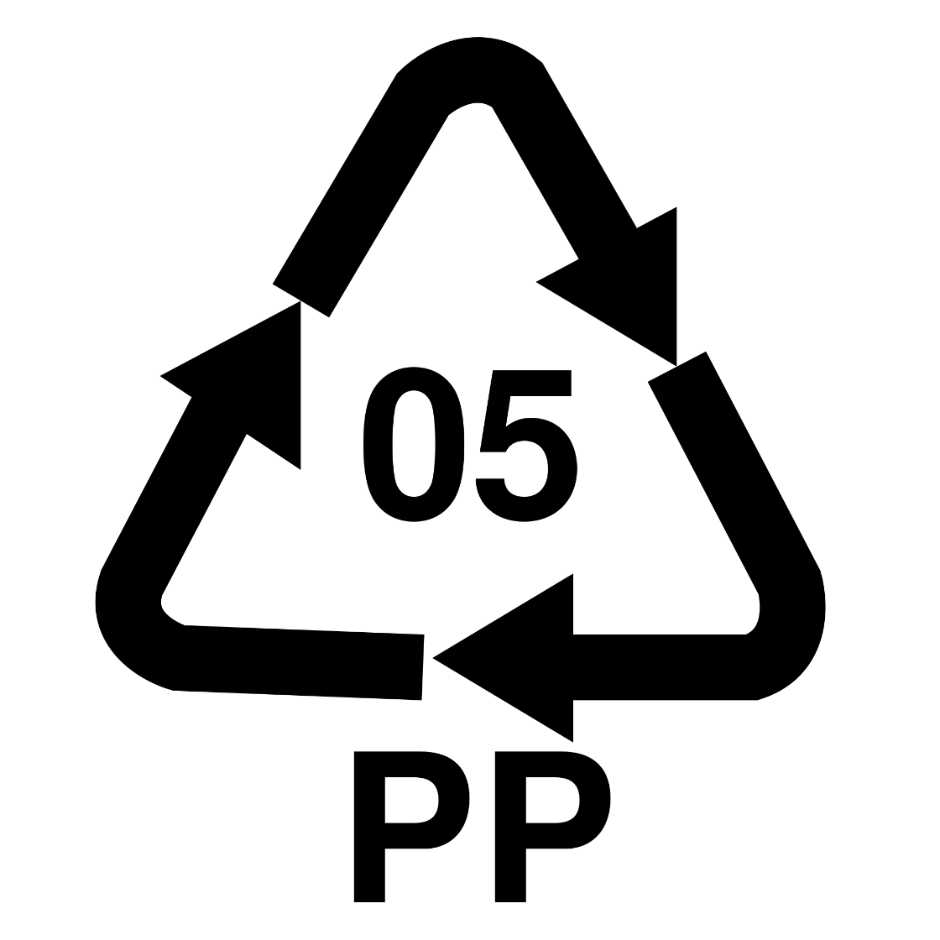

POTS – PP - Polypropylene
?
Notes:
Pots are made from PP. Black will hardly ever get recycled, terracotta pots (or any other colour) have a slightly higher chance of being recycled.

Slide 19
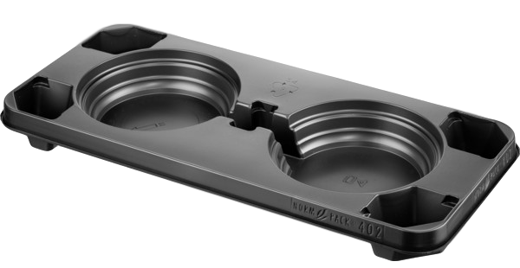
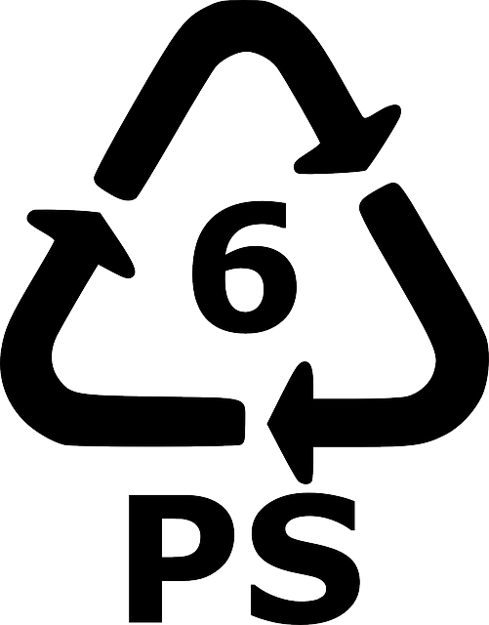
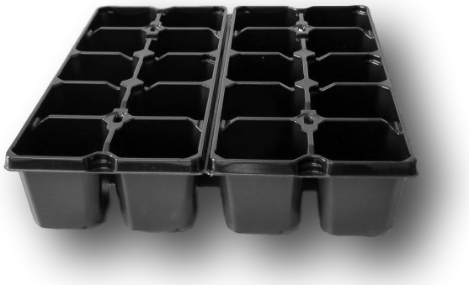
TRAYS – PS - Polystyrene
Notes:
Historically trays and packs are made from PS. In the UK kerbside recyclers reject all PS packs.

Slide 20
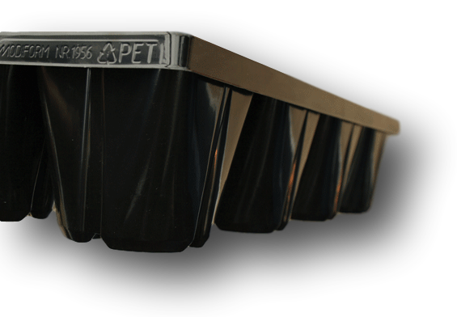
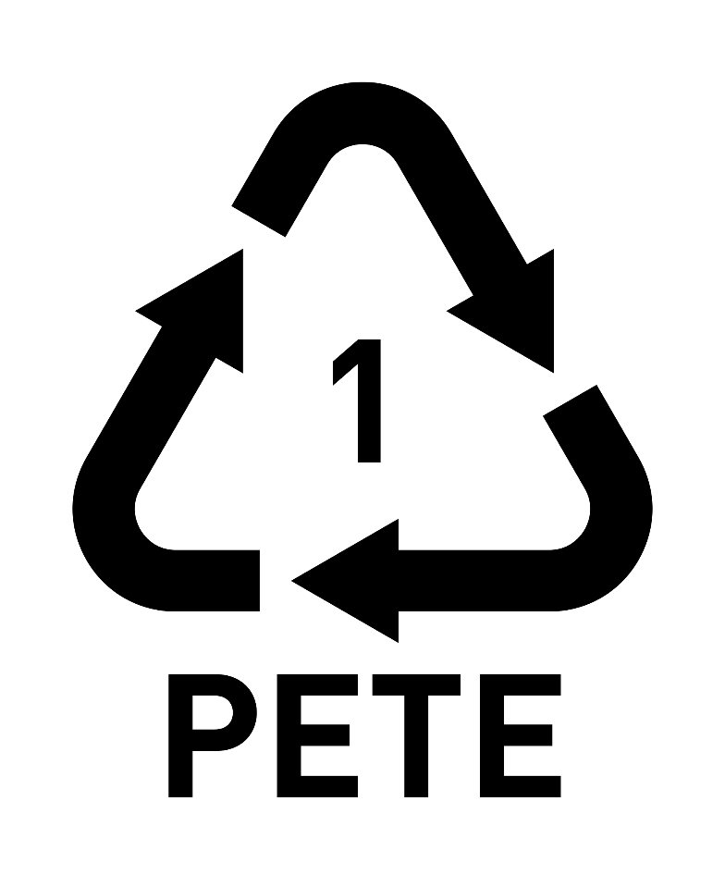
Notes:
Black PET, with carbon black pigment colouring won’t get recycled, but Transparent Green PET (made from recycled drinks bottles) is in high demand and the recyclers want it. It commands over £300/tonne through post-consumer recycling.

Slide 21
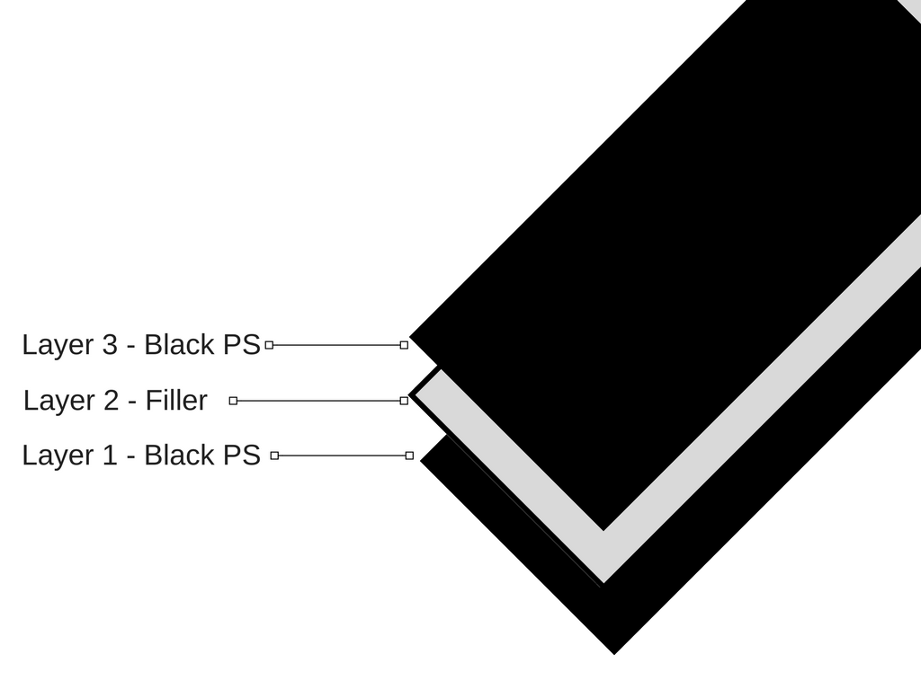
HORTICULTURAL PLASTIC
Notes:
Plastic is made up of layers. The less number of layers makes it easier to recycle. That is why food packaging, especially microwave punnets, is very hard to recycle. Most plastic used in horticulture is made up of only a few layers. The TG PET is a mono-polymer, single layer.

Slide 22
ADVICE FROM WRAP: BLACK PLASTIC
Where plastic packaging is required to be black
in colour, WRAP encourages retailers, brand
owners and packaging manufacturers to use
detectable black colourants to enable the
environmental benefits of recycling black plastics
to be fully realised.

Slide 23
WRAP: POTS, TRAYS AND PACKS

Slide 24
B&Q’s Easy Grow – By Modiform

Slide 25
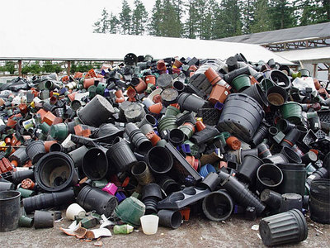
KERBSIDE RECYCLING IN UK
What happens to horticultural
Plastic once it is used?

Slide 26
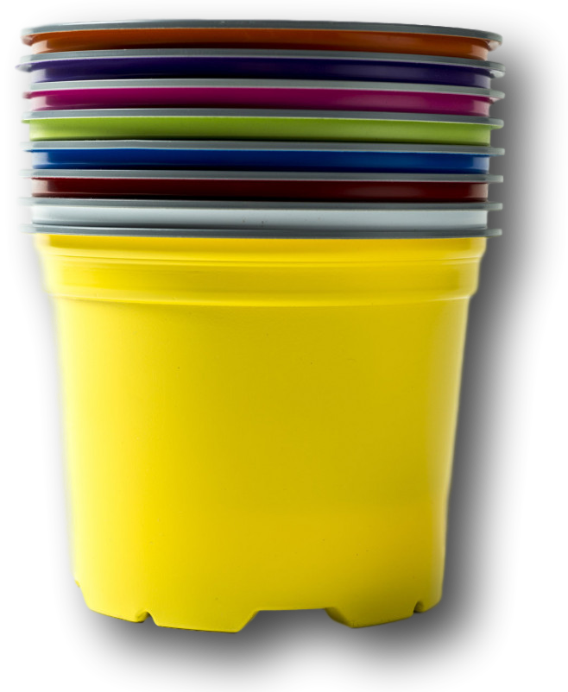
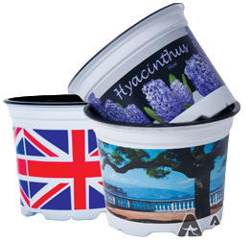
PLANT POTS – OTHER THAN BLACK
Notes:
Black plant pots won’t get recycled. Any other colour has a slightly higher chance of being recycled, but maybe only around 10% will ever get recycled no matter what ever the colour.

Slide 27
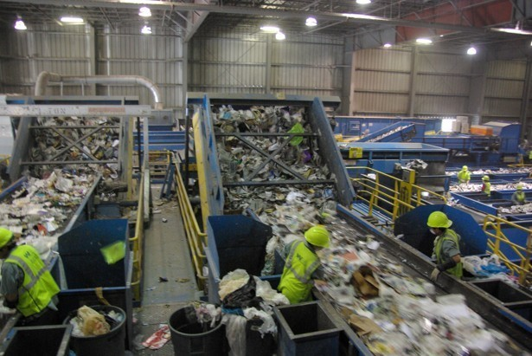
MRF – MATERIALS RECOVERY FACILITY

Slide 28
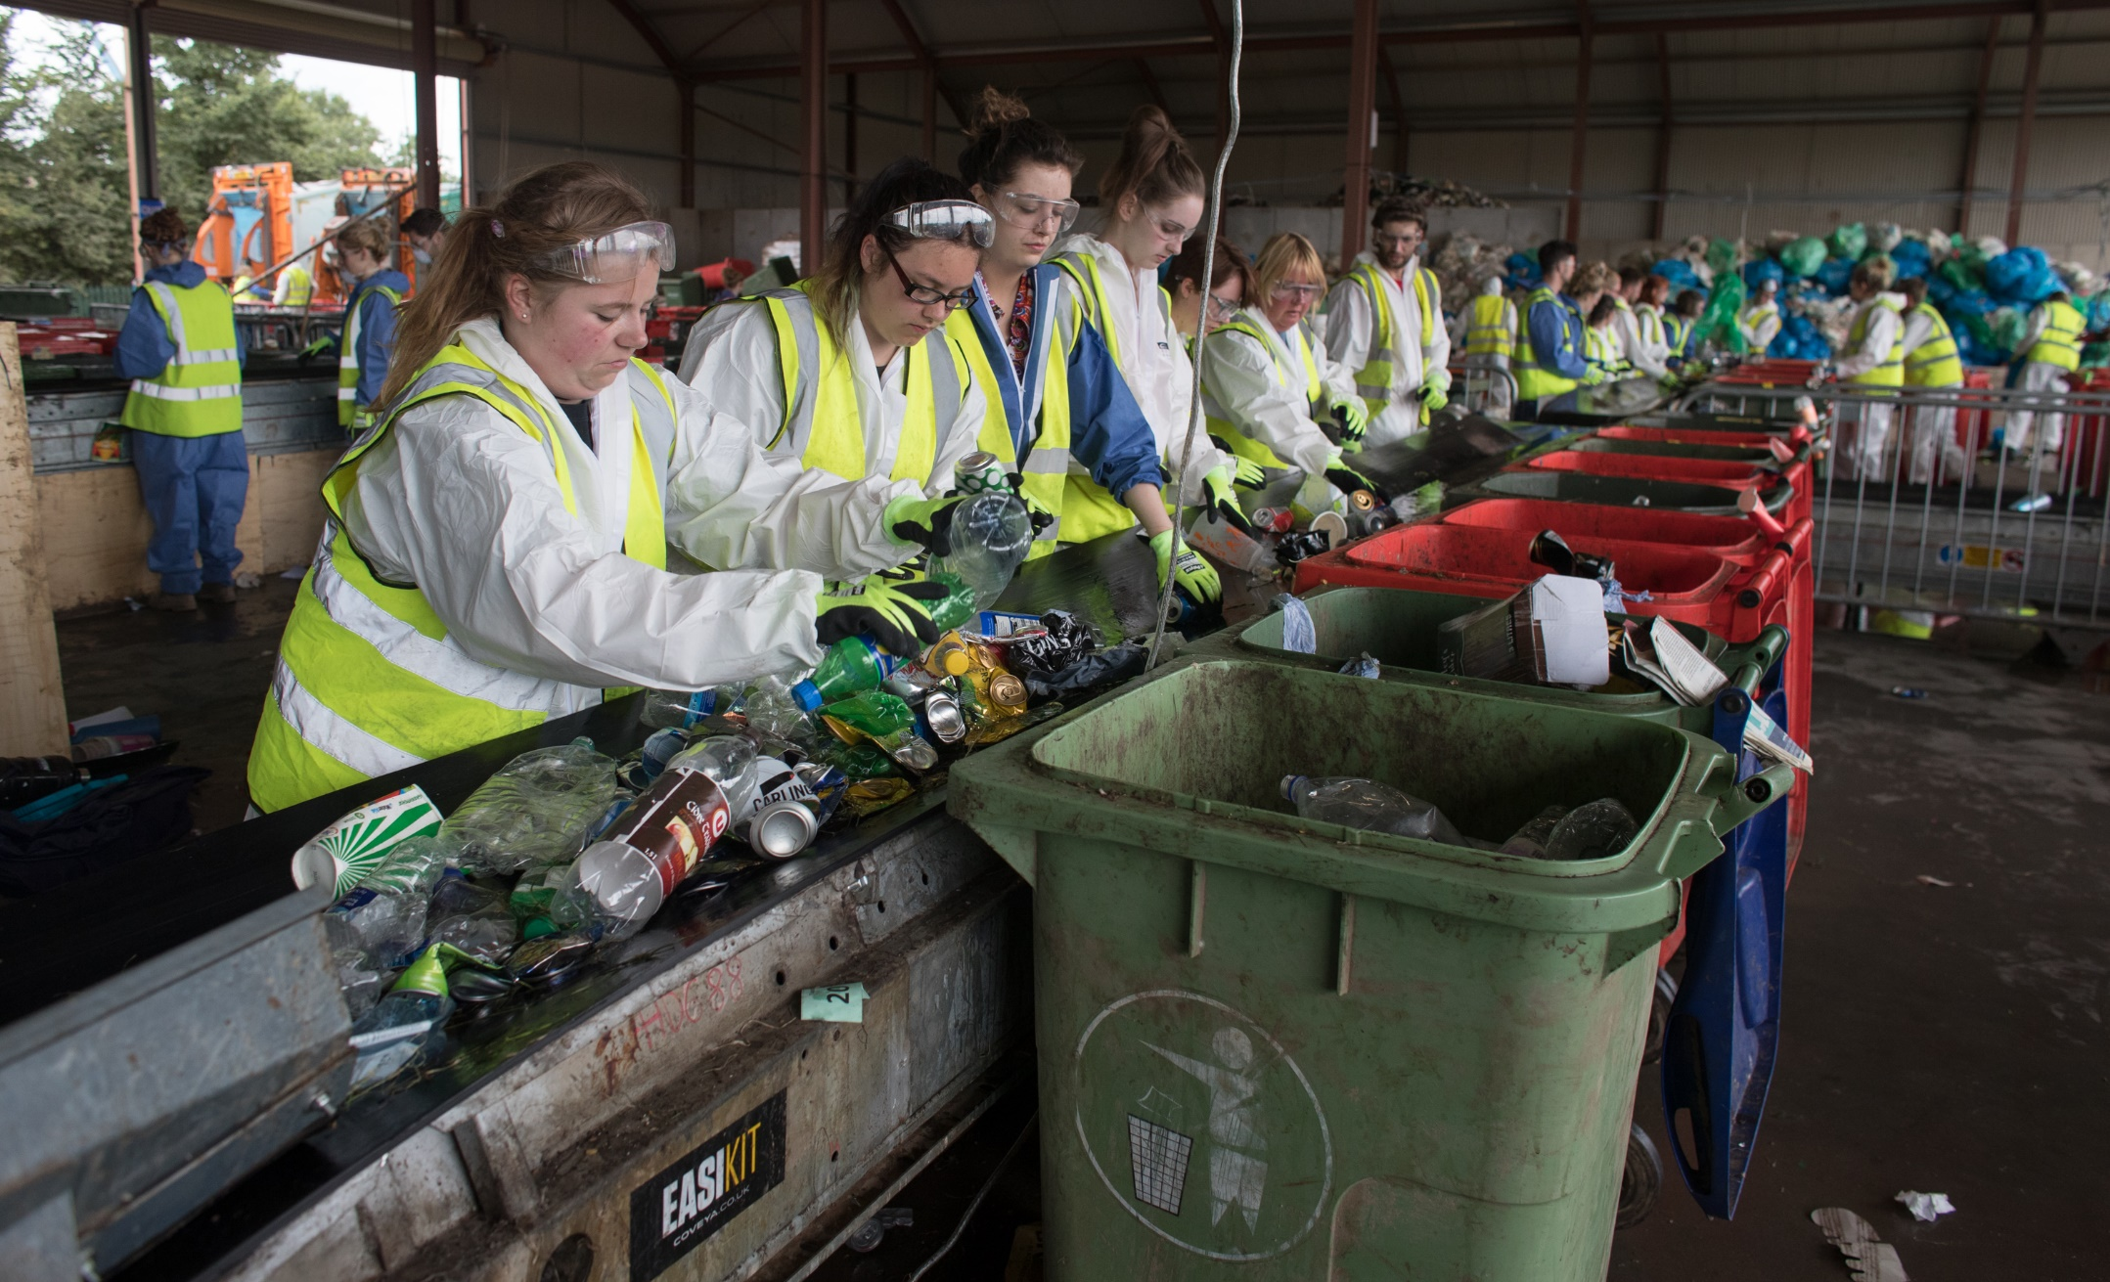
MRF – MATERIALS RECOVERY FACILITY
Notes:
Materials Recovery Facility. This is where household waste gets sorted.

Slide 29
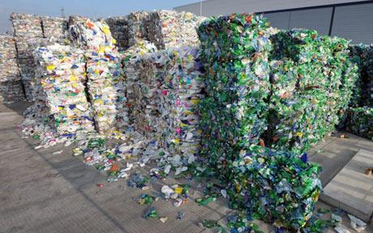
PRF – PLASTICS RECOVERY FACILITY
Notes:
The mixed plastic from MRF’s end up at PRF’s. The PRF will sort out the different polymer types and sell. They are ideally looking for HDPE (milk bottles) and PET (drinks bottles).

Slide 30
THE FUTURE OF HORTICULTURAL PACKAGING
“Modiform aims to supply the right material, using the right manufacturing technique for the right situation. This way we can have the least impact on the environment.”

Slide 31
WRAP: PAPER FIBRE PULP

Slide 32
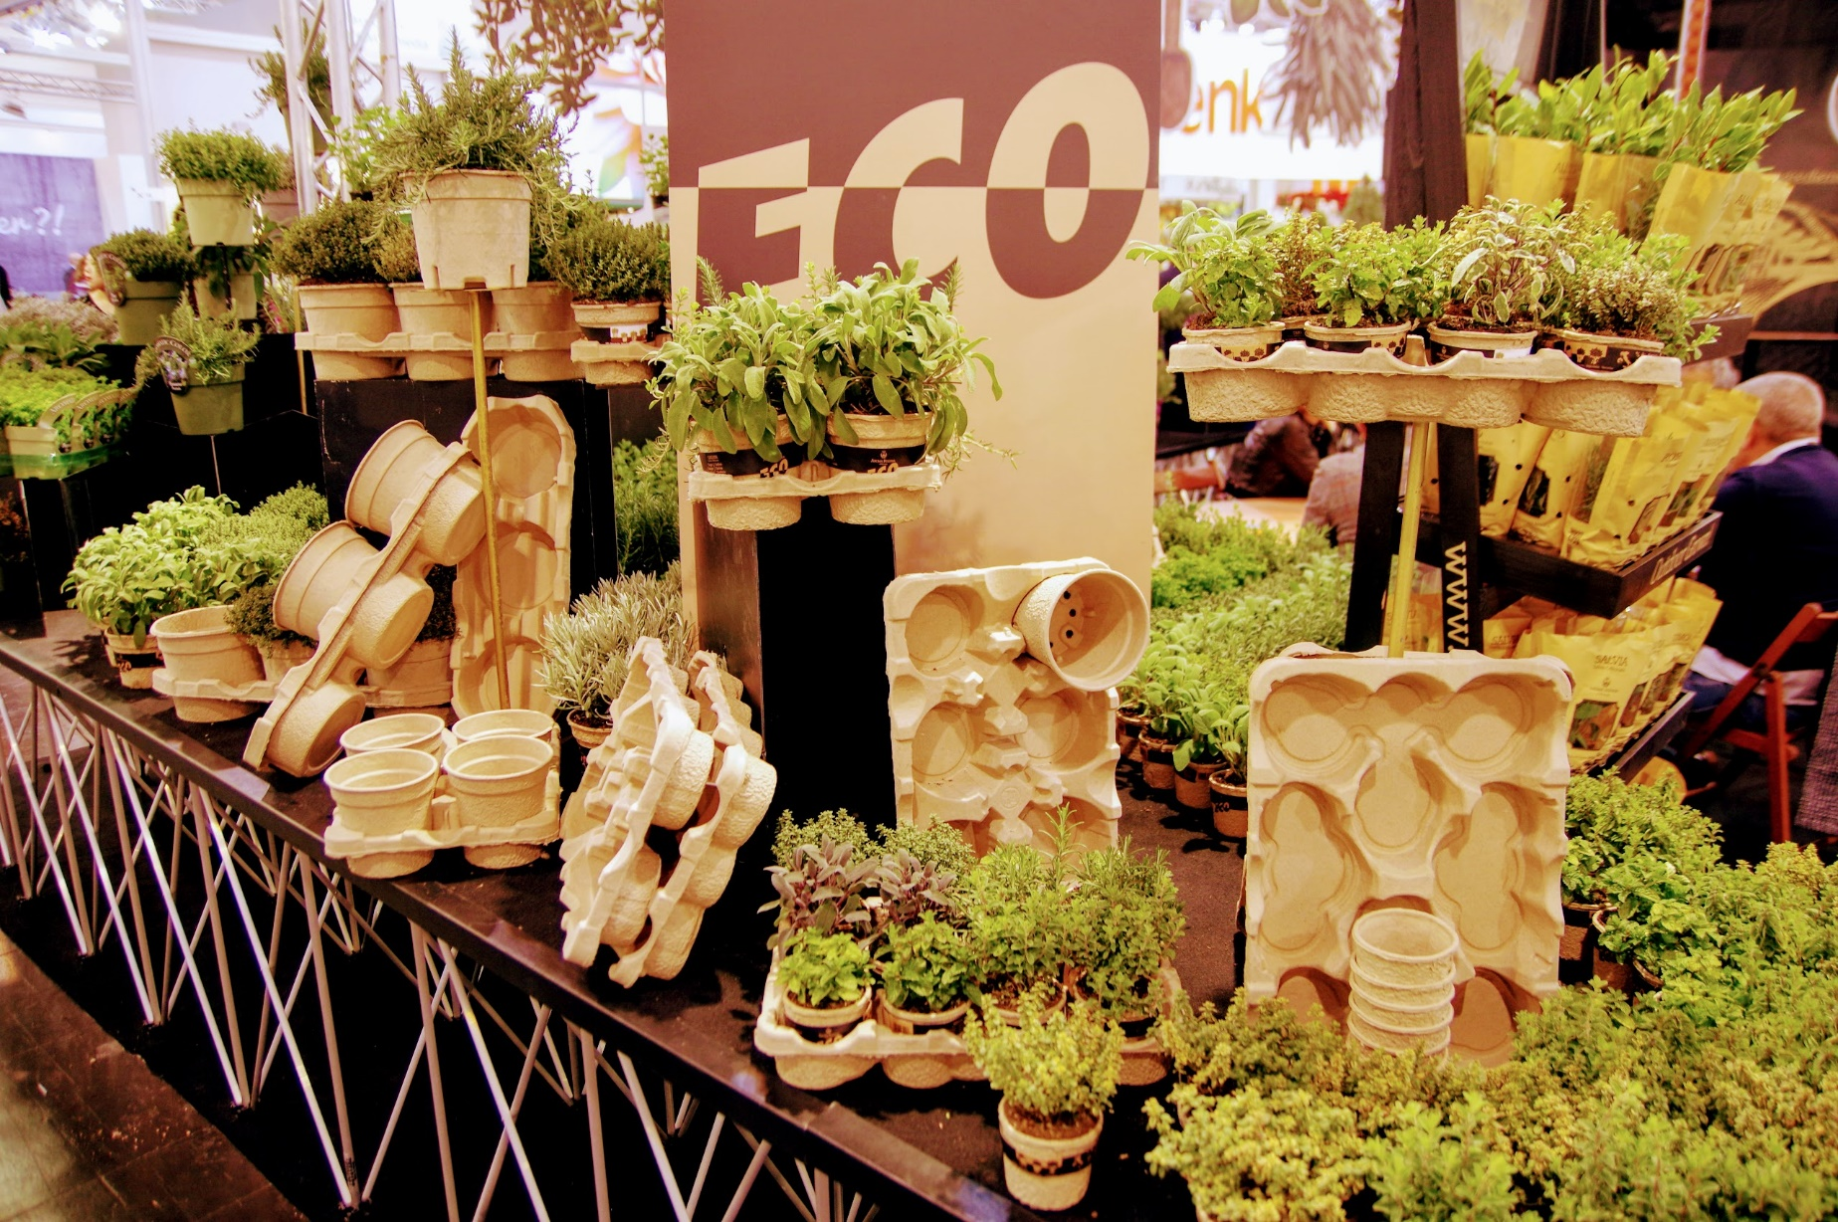
Modiform’s EcoExpert
Notes:
EcoExpert is made from recycled cardboard. It is fully recyclable or will degrade in the natural environment.

Slide 33
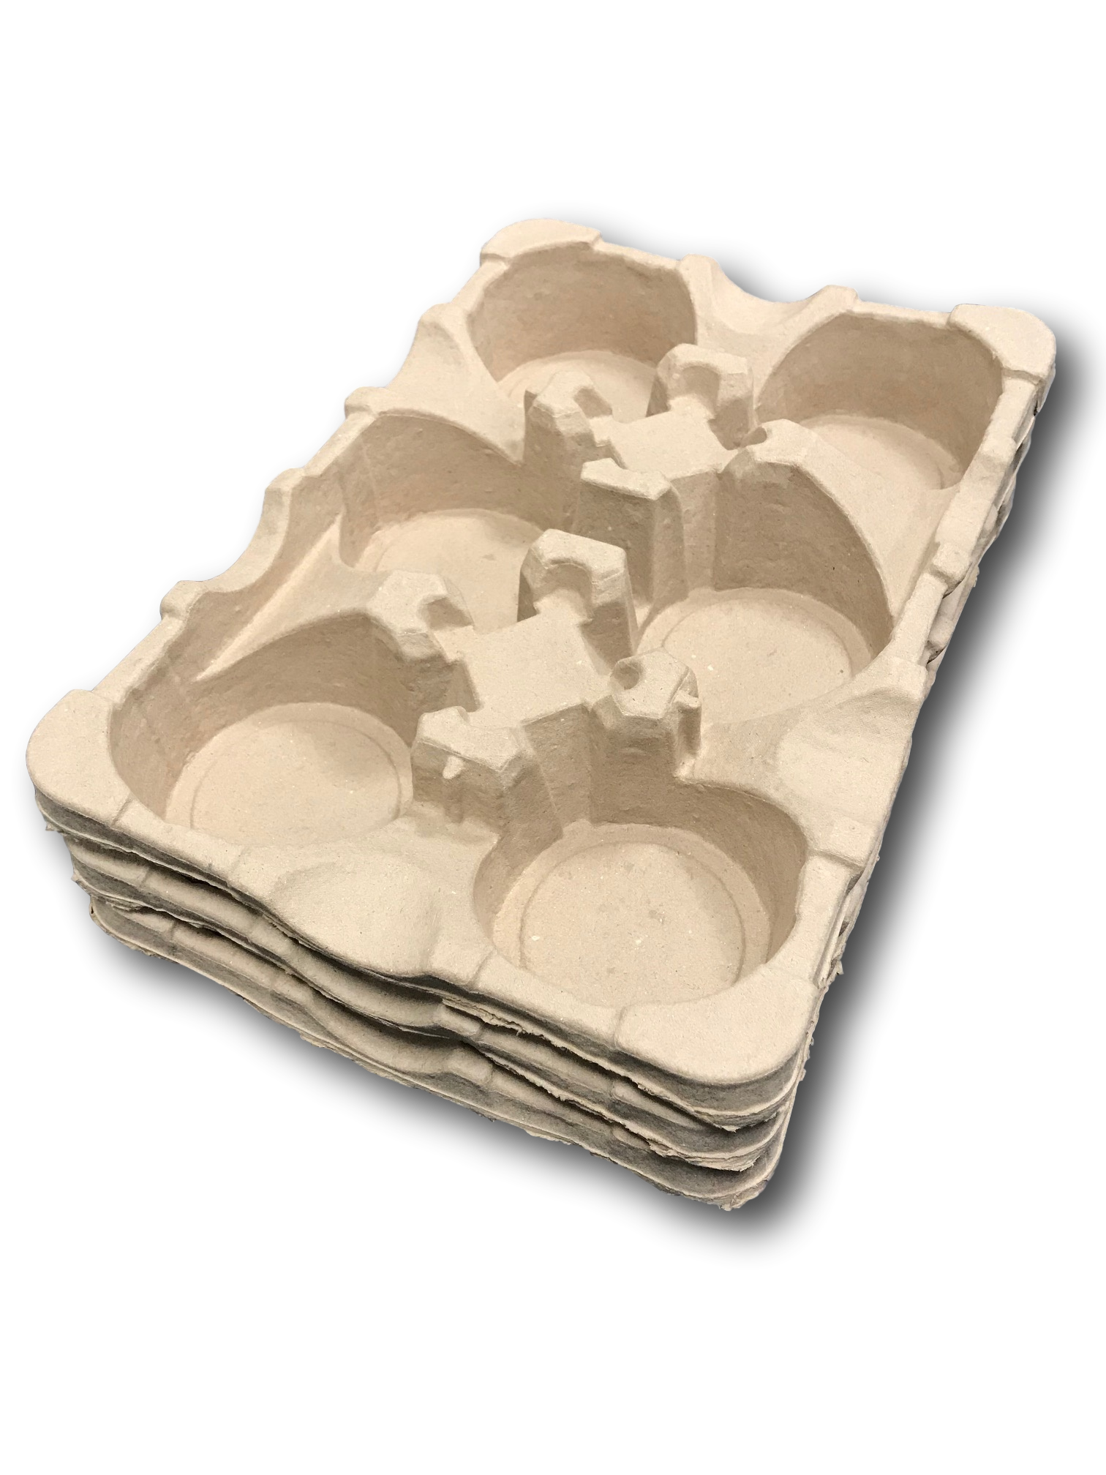
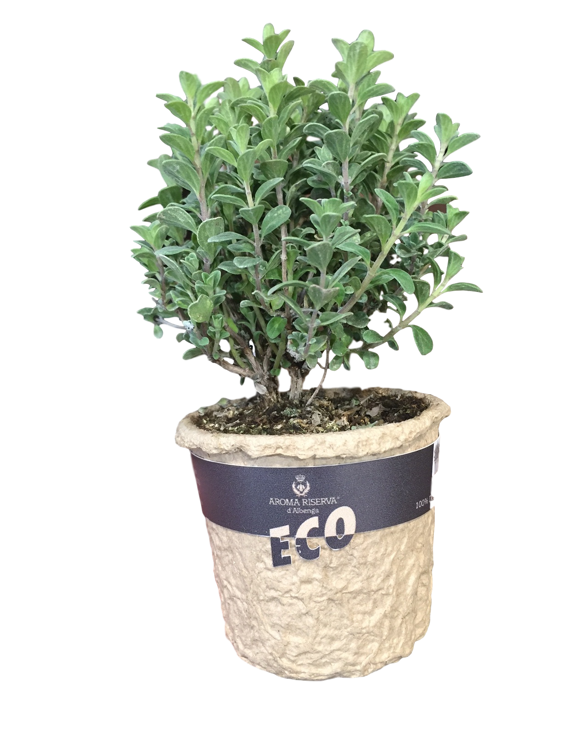
Modiform’s EcoExpert

Slide 34
Is the product re-used on the nursery or somewhere else?
NO
YES
Can the product be returned to Modiform after use?
Use injection moulded, hard plastic
YES
NO
Use BLACK PS
Use COLOURED PET or COLOURED PP
Use EcoExpert
Probably won’t get recycled
100% Recyclable or compostable

Slide 35
• Tesco intends to make all packaging fully recyclable or compostable by 2025.
• Sainsbury’s aims to reduce own-brand packaging 50% by 2020, and says it has already cut this figure by 35% since 2005.
• Asda aims for all its packaging to be recyclable by 2025.
• Morrisons’ most recent corporate responsibility report does not mention plastic waste.
• Aldi says it will "implement packaging weight reductions and optimisation and introduce material substitutions to increase the recyclability of packaging".
• Lidl says it charged for plastic bags long before it became mandatory, although its current sustainability commitments do not mention plastic.
• Waitrose says that by 2025 all its own-label packaging will be "widely recyclable, reusable or home compostable".
• The Co-op says its long-term ambition is for all packaging to be recycled "where it can be", and that by 2020 80% of its products will have packaging that is "easy to recycle".
• Iceland has vowed to remove plastic packaging from its own-label products by 2023.

Slide 36
Modiform’s EcoExpert

Slide 37
Thank you for listening

