Slide 1

ERP Software going Mobile
Save Time by Skipping Steps

Slide 2
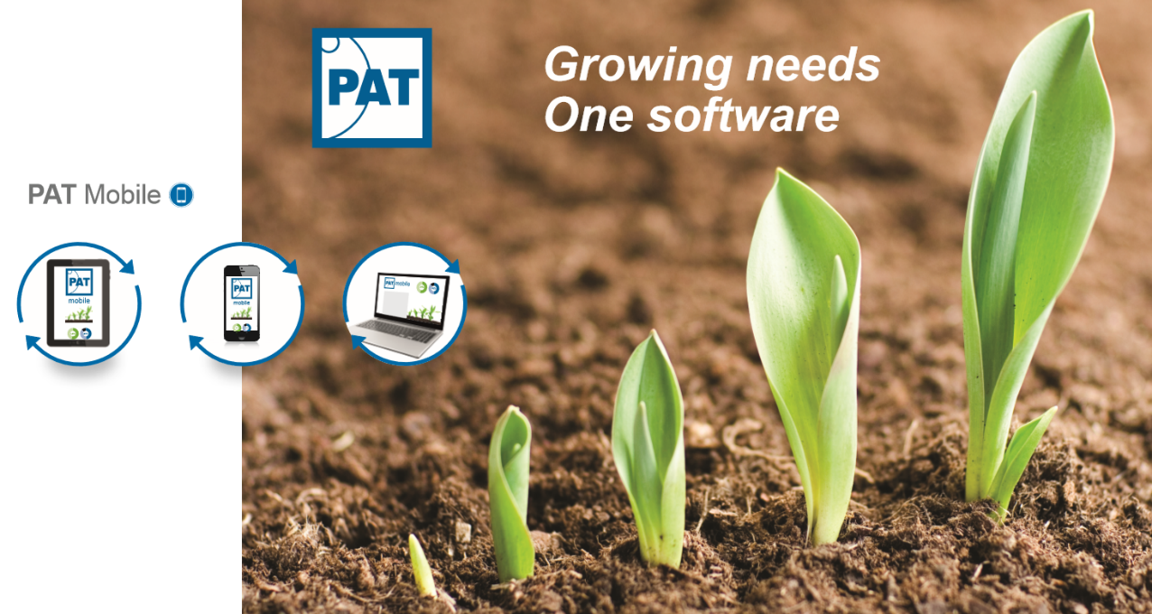


Concept Data Systems

Slide 3

PAT Standard Software
Especially designed for Horticulture
Multi Company Structure
EDI Technology
The ERP Solution for Horticulture
Real Time Availability
Process Streamlining
Multiple Languages

Slide 4
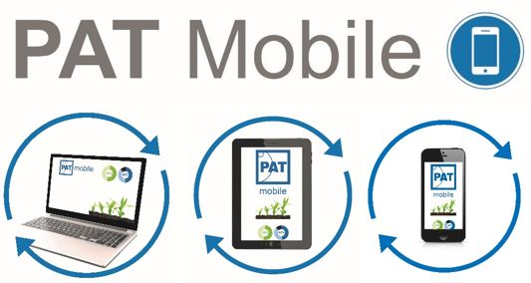
PAT Mobile
Real Time Calculated Availability
Ordering from Availability
Order Management
Production Information
Mother Plant Management
Integrated Barcode Scanning
Manage Activities such as Moving
…
Fast. Secure.
PAT - www.horticulturalsoftware.com

Slide 5
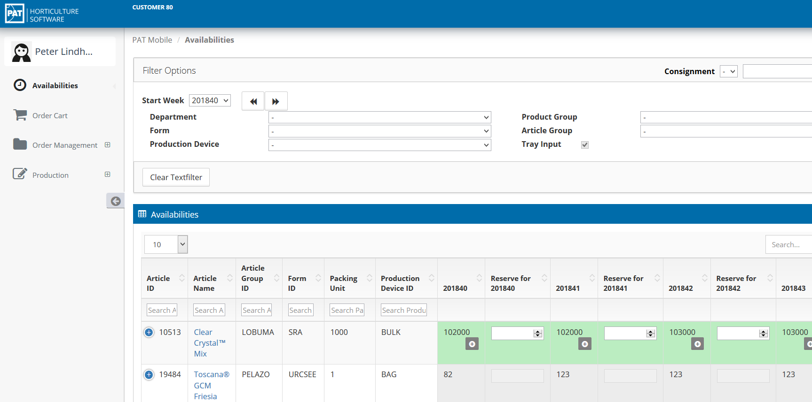
Real Time Calculated Availability

Slide 6
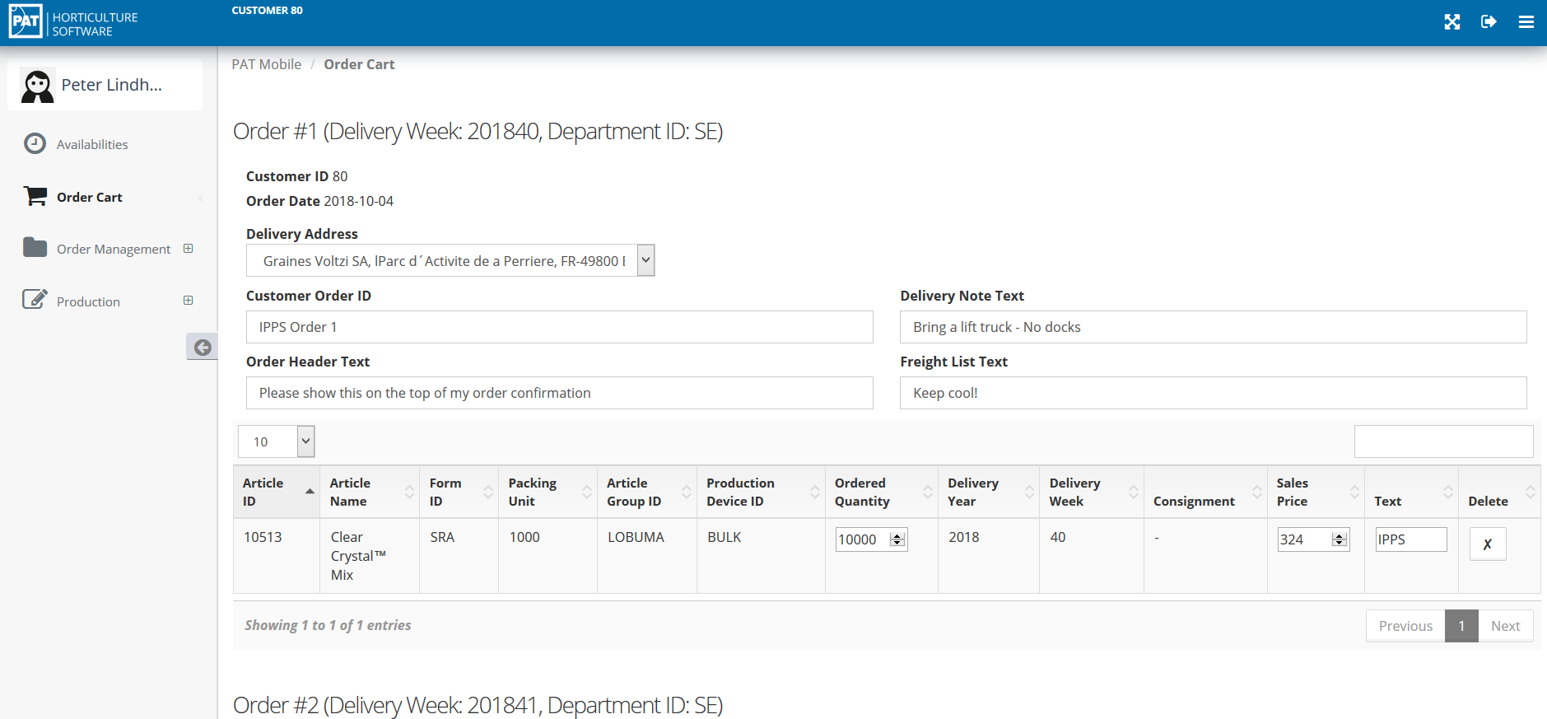
Ordering from Availability

Slide 7
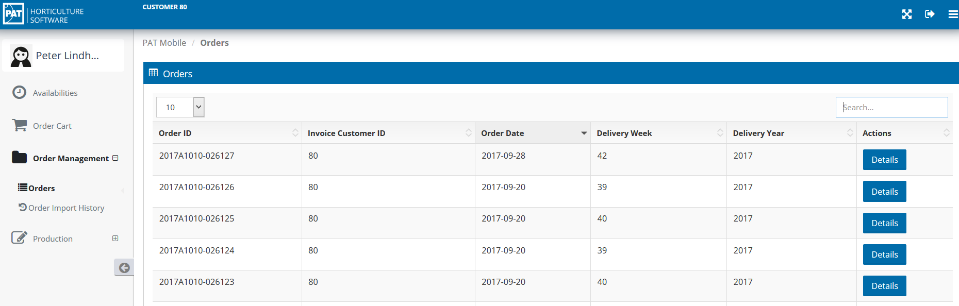
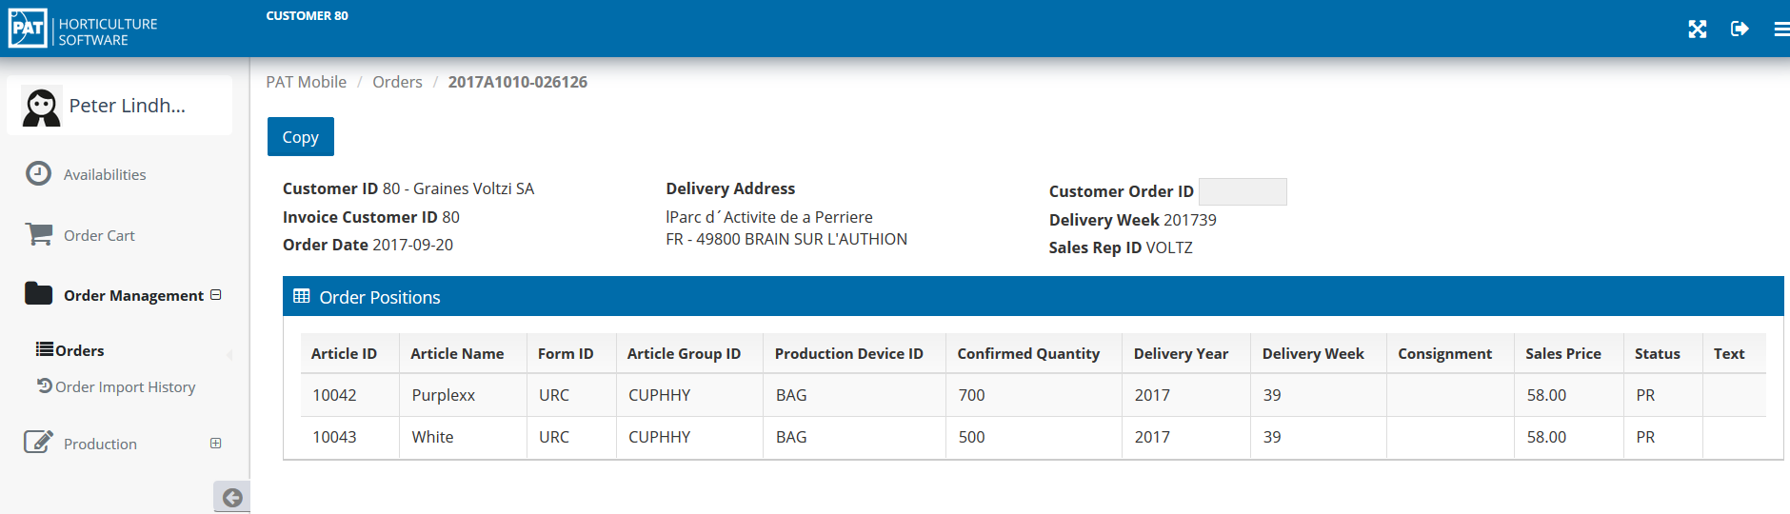
Order Management

Slide 8
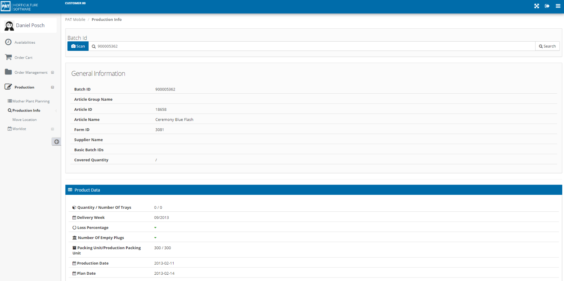
Production Information

Slide 9
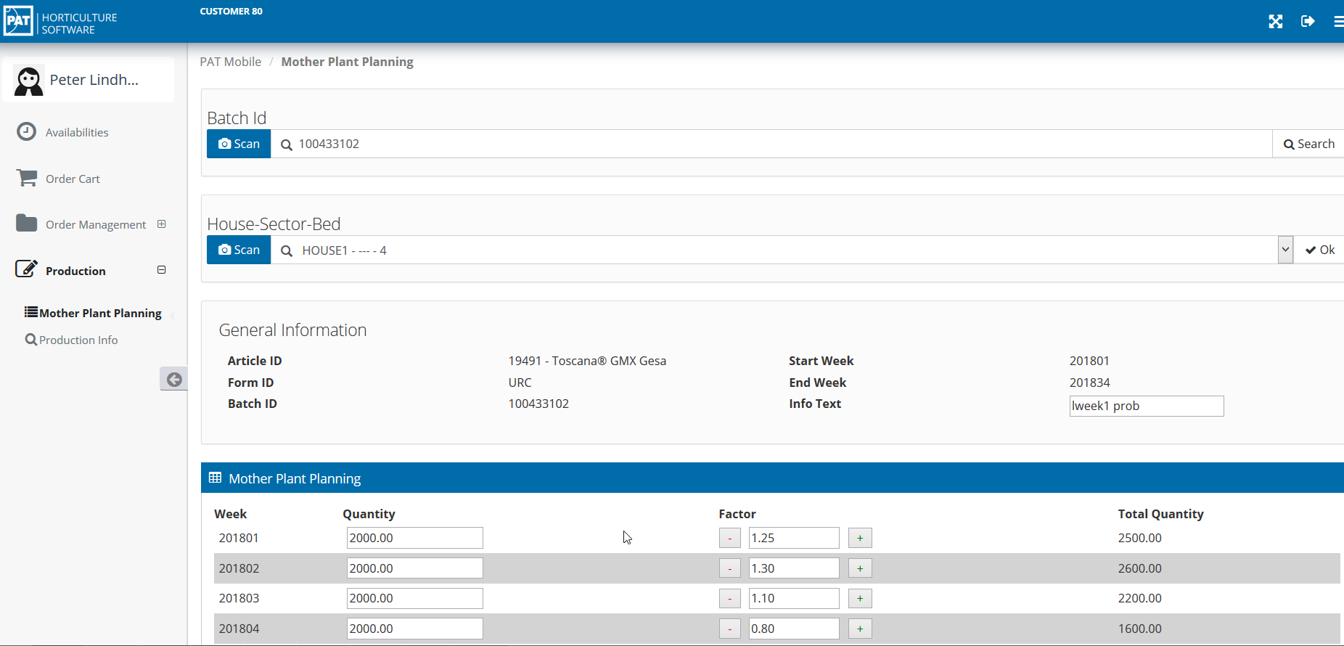
Mother Plant Management

Slide 10

Questions
Thank You
Read more on www.horticulturalsoftware.com

