Slide 1
Plant Growth Promoting
Bacteria -
The Future of Horticulture
IPPS, Breda, The Netherlands
12th October 2018
Dr. Karen O‘Hanlon
© by nadicom

Slide 2
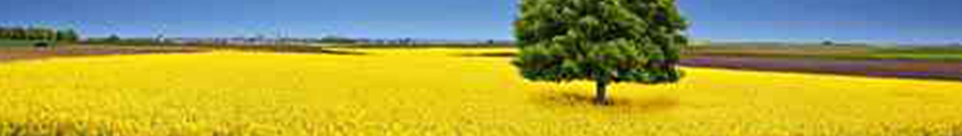
nadicom GmbH Microbiology Experts
Our Vision
Offer alternative solutions to pesticides for crop management
Prove that we have alternatives and that they work
Indigenous solutions for indigenous soils

Slide 3
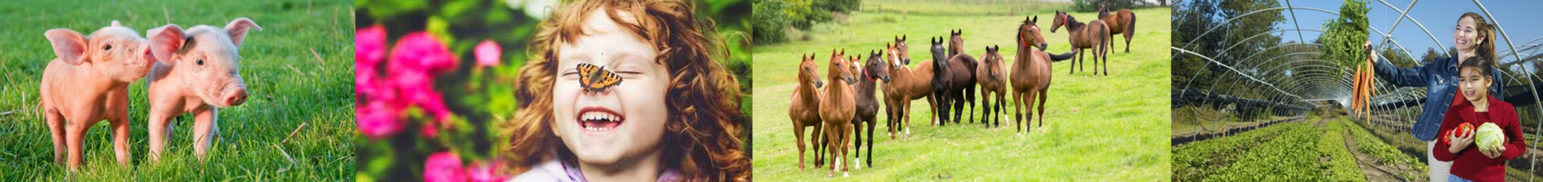
Motivation
We believe in what we do
Tighter control on pesticides/Restrictive risk assessments
In Europe, Endocrine disruption, carcinogens Ban. Highly hazardous edging towards being phased out. PBT pesticides for substitution
We need to keep up with alternatives

Slide 4
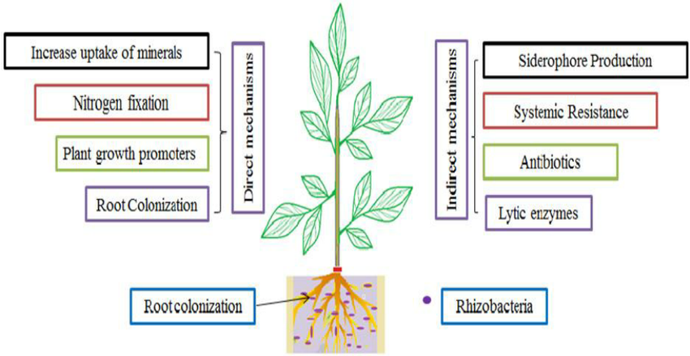
Properties of PGPB

Slide 5
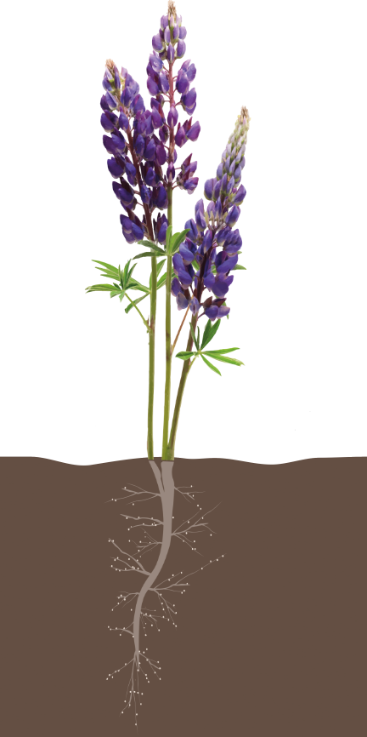
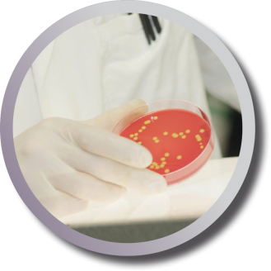
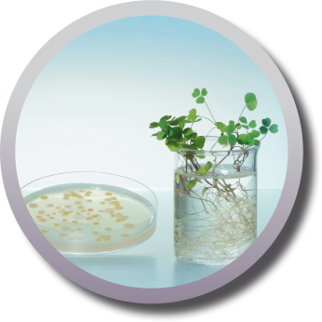
What is in rhizo power® ?
A collection of Plant Growth Promoting Bacteria (PGPB). All strains were isolated from uncultivated soil
High Bloom product
2 different species of Pseudomonas
3 different species of Bacillus
Other rhizo power ® products
Rhizobia, Azotobacter – nitrogen producers
Bacillus mix – Anti-fungal agent
Notes:
So rhizo power, what is it? It is a collection of PGPB isolated from uncultivated soils. We‘ve a High Bloom product contain 8 different strains containing 2 different types of Bacillus and 2 different types of Pseudomonas. We also have other products eg a rhizobia/azotobacter mix for nitrogen fixing. A bacillus mix containing 5 different species of Bacillus as a foliar spray for fungal pathogens.

Slide 6
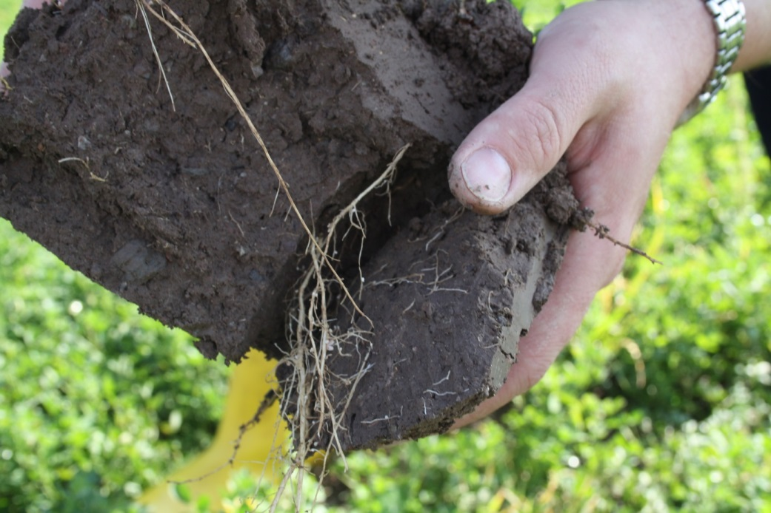
Isolating Plant Growth Promoting Bacteria

Slide 7
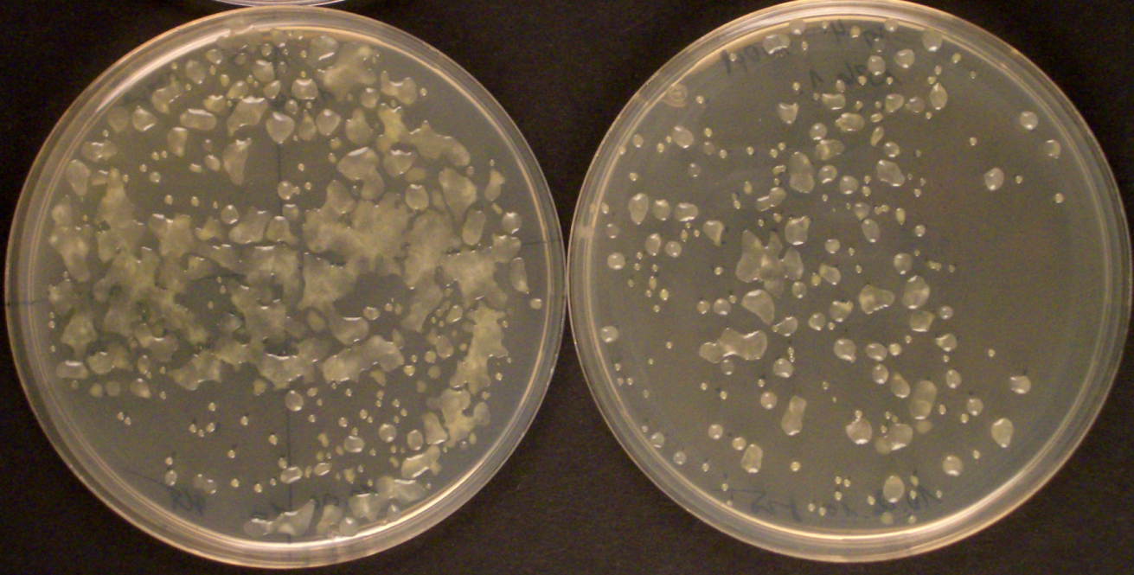
Isolating Plant Growth Promoting Bacteria

Slide 8
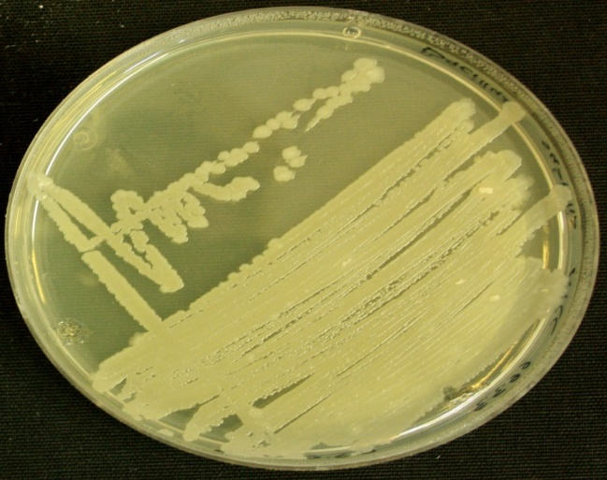
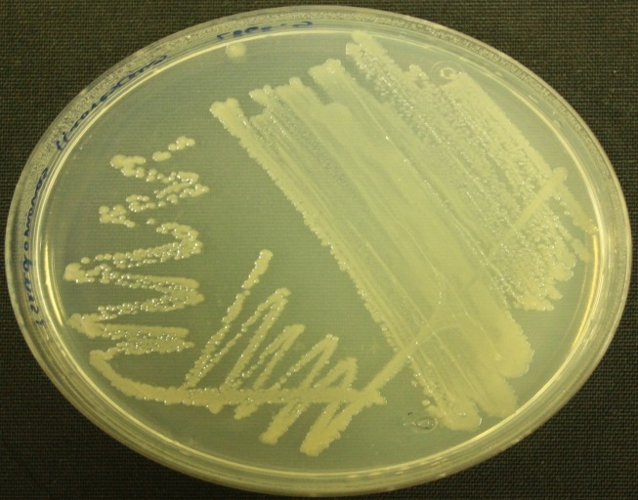
Isolating Plant Growth Promoting Bacteria
Bacillus
Pseudomonas

Slide 9
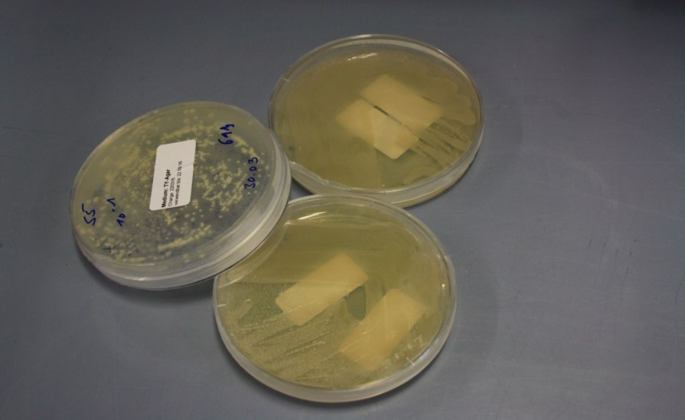
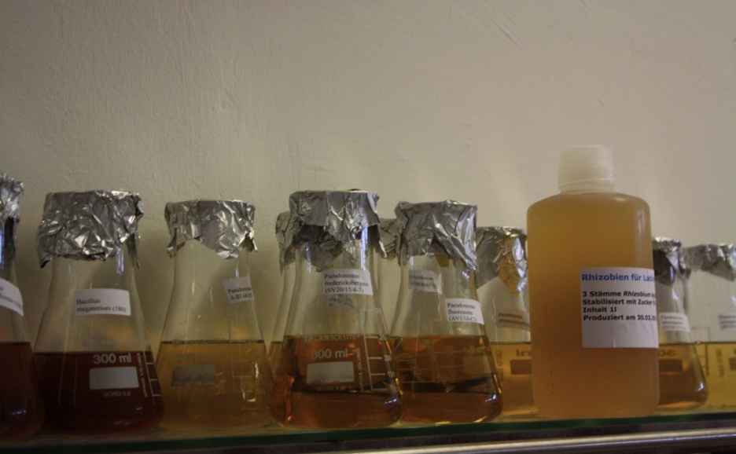
Production of Plant Growth Promoting Bacterial Products

Slide 10
rhizo power® Trial Work- Horticulture Wholesale Growers in Ireland 2018
Notes:
The following slides will show some horticulture trial work we are currently carrying out with wholesale growers in Ireland. Trials will overwinter.

Slide 11
Phormium
21 days -Phormium - Difference in root, more root in treated. No difference in top growth. No phytium in treated.

Slide 12
Astelia
21 days – Slightly smaller in treated than control, no difference in disease.
46 days – less roots in treated but thicker roots. Shoots still slightly smaller.

Slide 13
Griselinia
21 days – no difference yet, possibly more leaves in treated.
46 days – more leaves in treated, bushier, more vitality and sheen on leaves. More compact plant, smaller spacing between nodes.

Slide 14
rhizo power®
High Bloom in Comparison to a Biostimulant
Heuchera, Agapanthus Blue, Heuchera Lime Marmalade, Parsley, Lavandula, Lupinus, Libertia Gold leaf, Heuchera, Acanthus Whitewater, Carex Bronco, Helichrysum Ruby Cluster, Doronicum, Geranium Midnight Reiter, Ophiopogon, Delphinum, Dierama, Astantia Major Venice, Astrantia Haspen Blood, Physalis Franchetti, Heuchrac, Dianthus.
Notes:
Another grower didn’t use untreated controls but instead compared to a positive control a well known biostimulant. He sprayed on the following crops to see how they overwintered. To date, all looking good, but the winter will be the true test.

Slide 15
Other Ongoing Work October 2018
32 Bacillus strains being tested against pathogenic fungi, Rhizoctonia, Fusarium, Phytophtora, Diplocarpon, mildew etc.
Rhizobia/Azotobacter (nitrogen fixing) used on laurels.
Grass seed coating trials with Bacillus, Paenibacillus, rhizobia and Azotobacter – 2 year yield analysis.

Slide 16
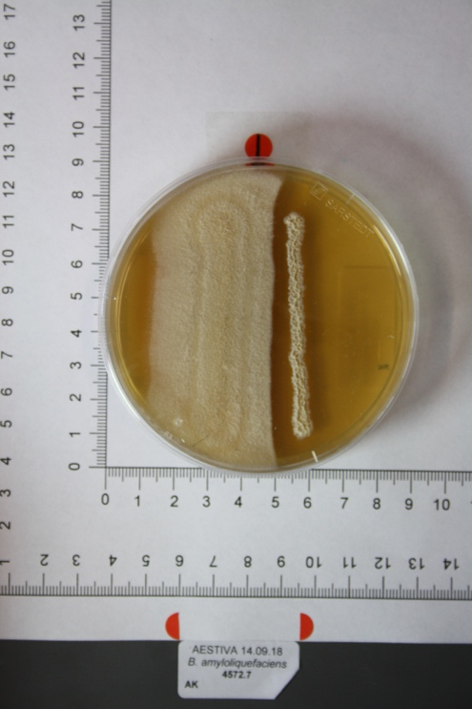
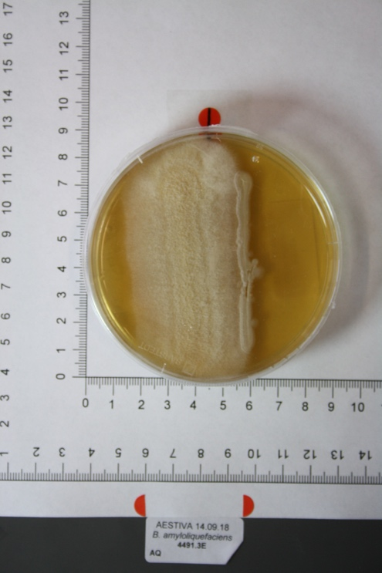
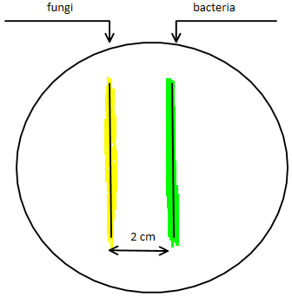
Bacillus Project
Inhibition of Fusarium solani

Slide 17
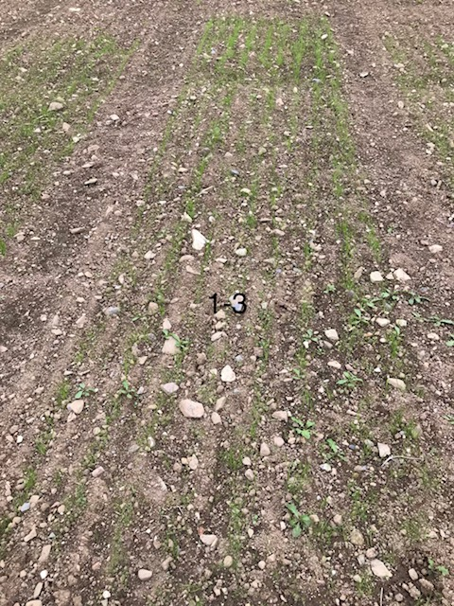
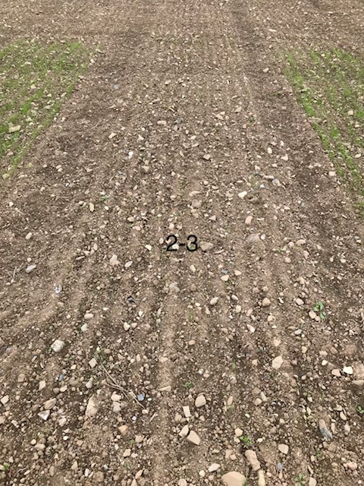
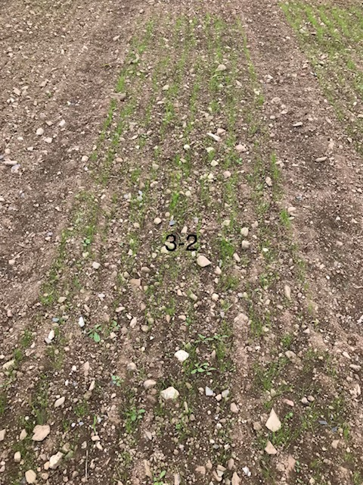
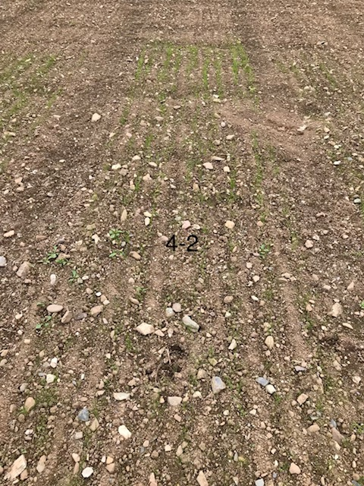
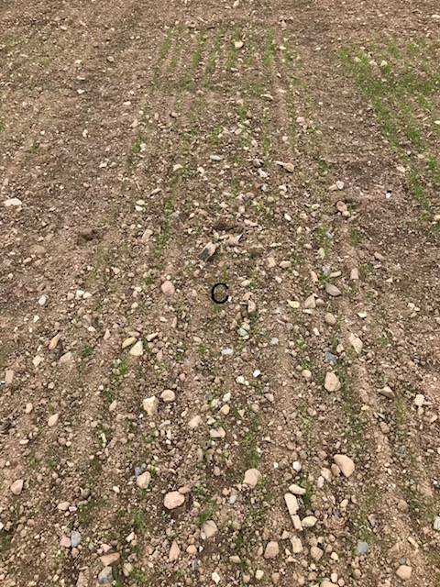
Grass Seed Germination – October 2018
Bacillus Mix
Rhizobia Mix
Paenibacillus
Azotobacter
Control

Slide 18
Trial Work 2016/2017 Edibles
Paul Brophy Grower – Broccoli
Teagasc –Beans and Alfalfa (Lucerne)
Stuard Parma, Italy - Organic Tomatoes

Slide 19
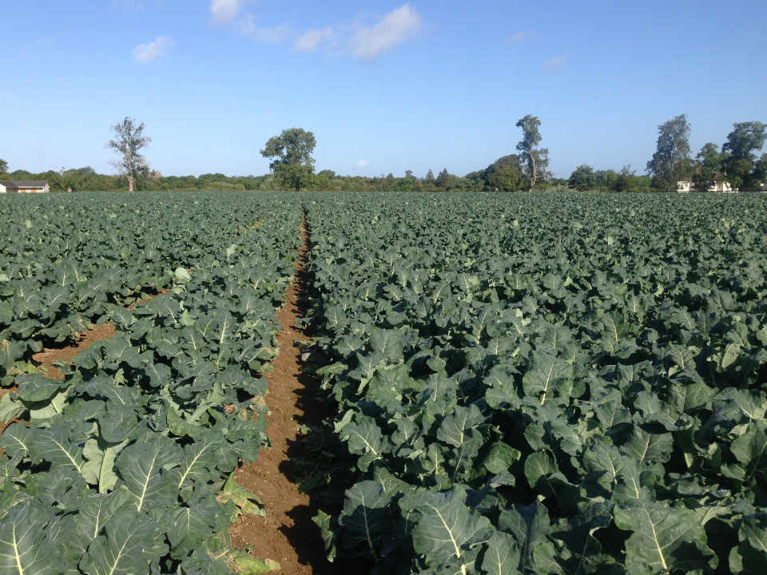
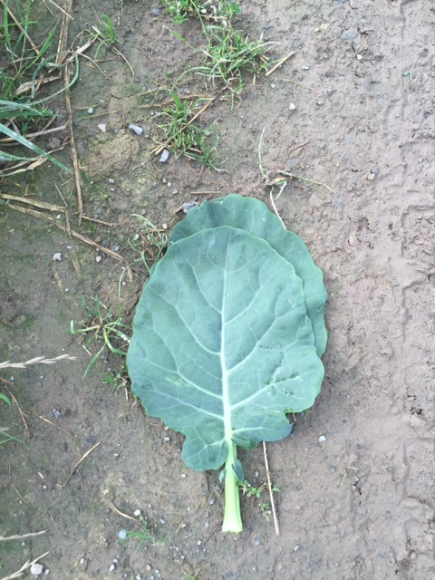
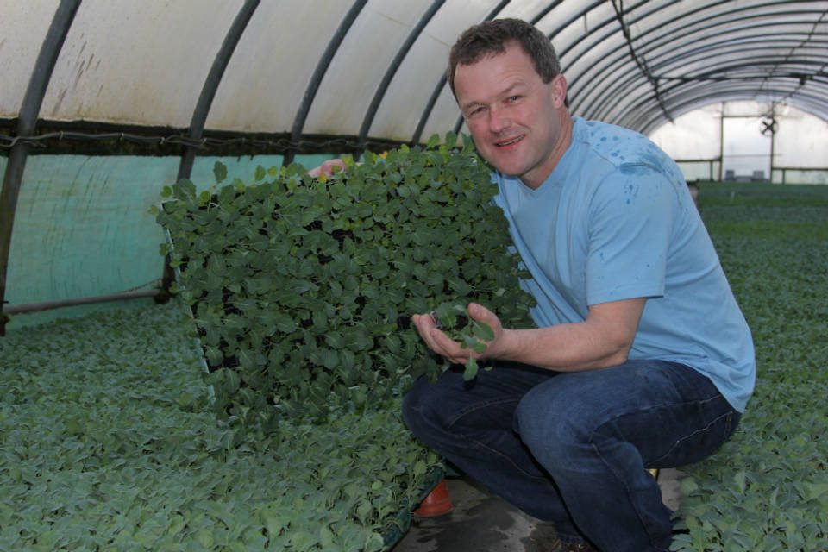
rhizo power® Broccoli

Slide 20
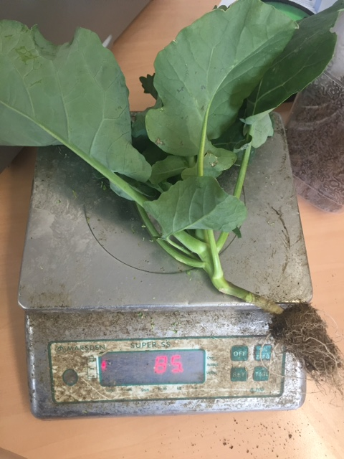
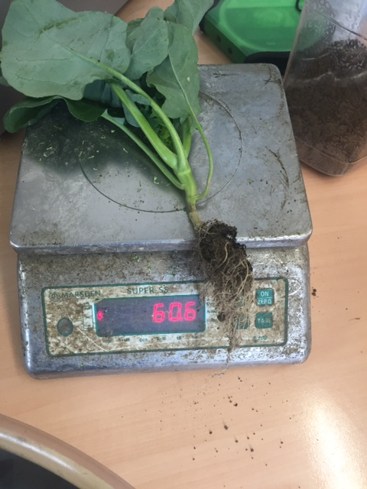
rhizo power® Root Development

Slide 21
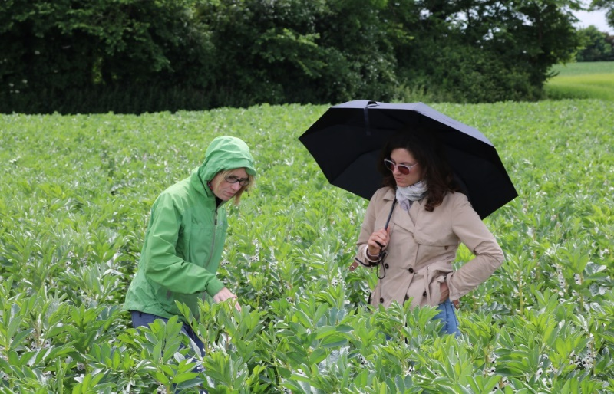
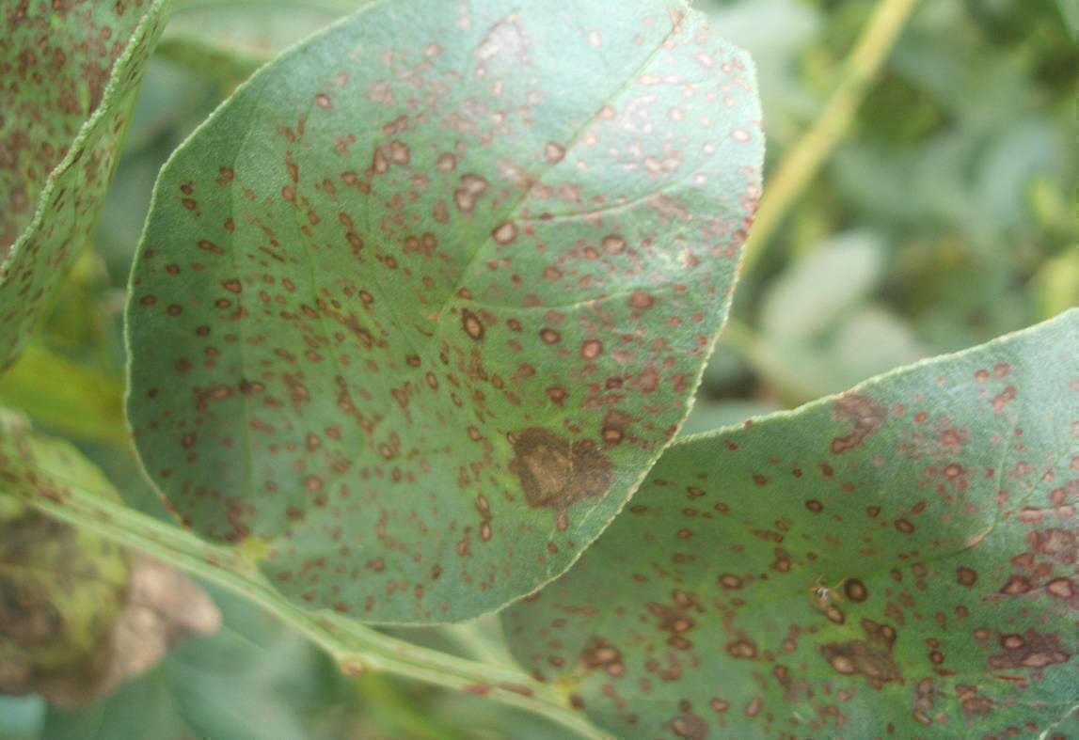
Bacillus subtilis on Chocolate Spot – Beans
FT 7.42 t/ha - T 7.15 (-4%)-UT 6.74 (-9%)

Slide 22
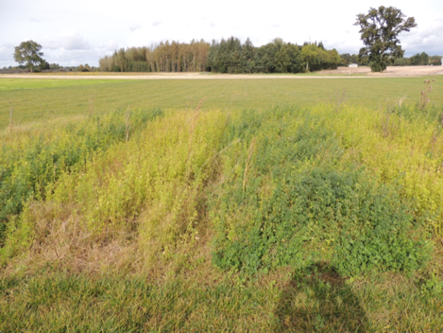
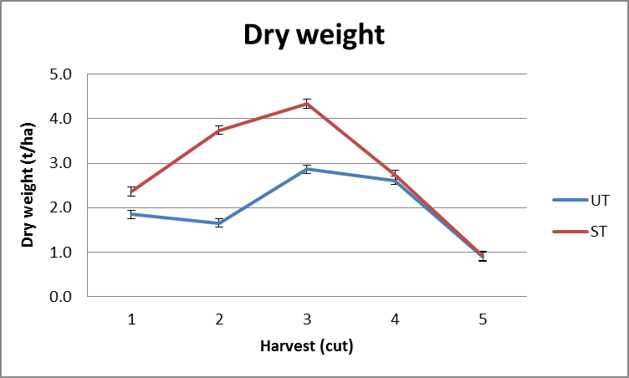
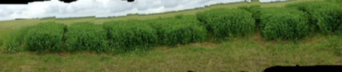
Rhizobia ® Trial Work Alfalfa

Slide 23
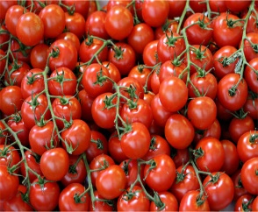
Organic Tomato Trial – Italy
 | Solids | Ton/ha) Marketable | Ton/ha) Total | Health (P:5-1) | Fruit coverage (P:5-1) | Lycopene
Treated | 5,527 | 120.8 | 138.2 A | 2.6 | 2.6 | 11.41
Not treated | 4,855 | 108.0 | 125.6 B | 2.1 | 2.1 | 11.28
Coefficient of variation | 3.68 | 4.68 | 3.57 | - | - | 9.56
Sig | * | * | * | - | - | n.s

Slide 24
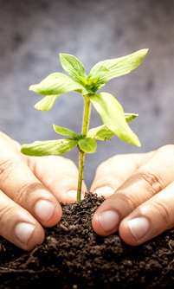
The Future for PGPB?
IPM and Sustainable Use Directive is encouraging for non-chemicals. PPP restrictions, bans in Europe.
Up to companies like nadicom to prove we have alternatives and that they are viable alternative to pesticides. Show increased yields, reduce disease, storage ability (edibles), abiotic stress resistance.
Need for horticulturists and microbiologists to plan field work trials together – so many specific micro-organism/plant interactions.

Slide 25
Contact:
Karen O’Hanlon
Telephone Ireland: +353 (0)87-9816569
Email: Karen.ohanlon@nadicom.de

