Slide 1
Insight in nursery production in Belarus.
Alexei Kovalenko, FH Evroplant

Slide 2
Belarus is a landlocked country in Eastern Europe bordered by Russia to the northeast, Ukraine to the south, Poland to the west, and Lithuania and Latvia to the northwest. Its capital and most populous city is Minsk. Over 40% of its 207,600 square kilometres (80,200 sq mi) is forested.
Its major economic sectors are service industries and manufacturing. Until the 20th century, different states at various times controlled the lands of modern-day Belarus, including the Principality of Polotsk (11th to 14th centuries), the Grand Duchy of Lithuania, the Polish–Lithuanian Commonwealth, and the Russian Empire.

Slide 3
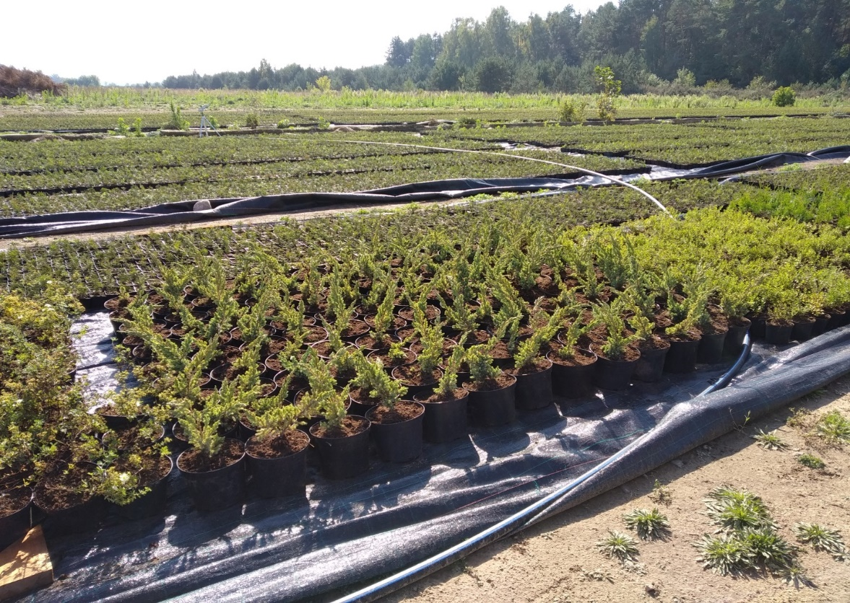
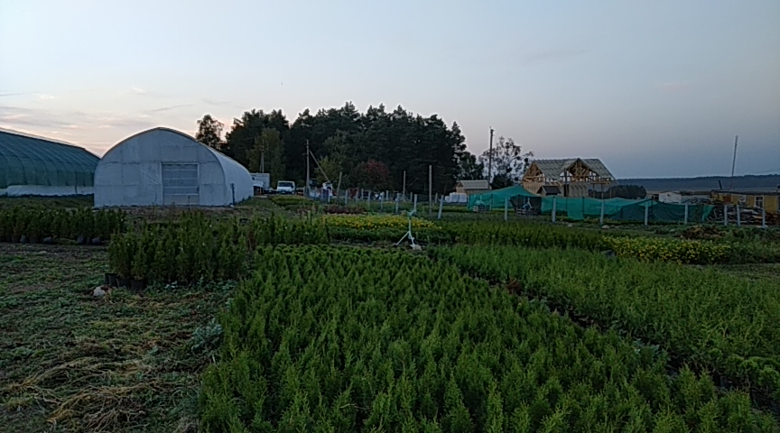
Our nursery is located in the Grodno region near the Polish and Lithuanian borders. The main activity of our enterprise is the cultivation of decorative coniferous plants.
The area of our land is 42 hectares, of which 15 hectares is used for field grown crops and 1 hectare for container growing.

Slide 4
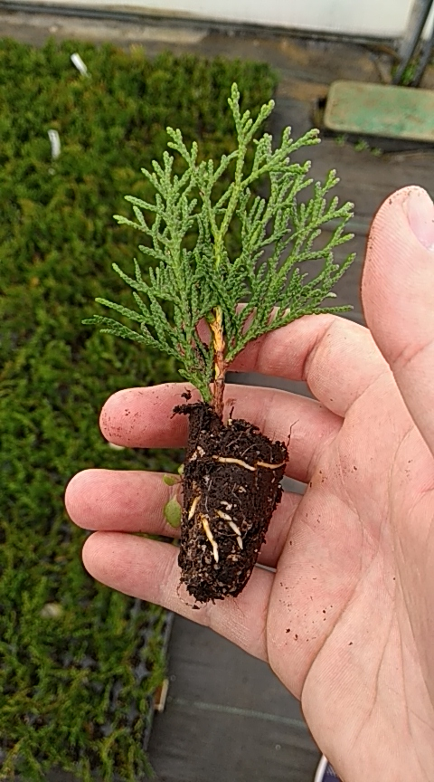
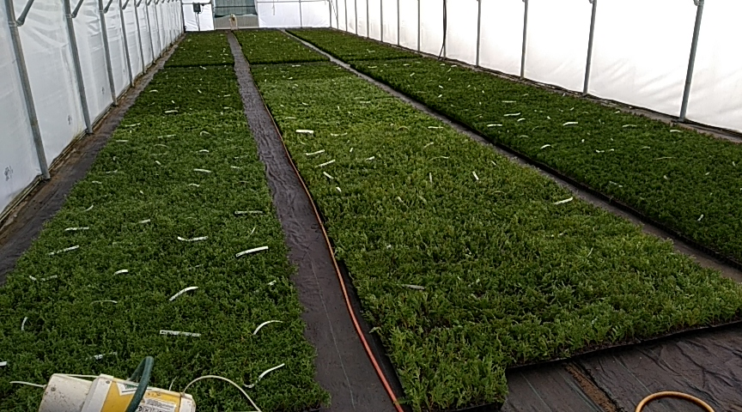
In the same way, we have 0.15 hectares of greenhouses which we use as our propagation area.

Slide 5
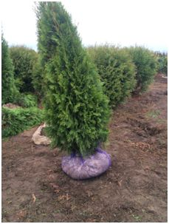
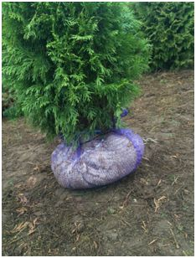
The soil in our area is very sandy, which creates some difficulties in packing the root system when lifting the field grown plants.

Slide 6
In agrotechnology, we still use pesticides, but gradually we try to reduce their use by replacing them with more natural options.
We produce about 350 thousand plants a year. Most of them we sell at a young age.
Our main customers are small nurseries, which grow plants from p9 pots. We also cooperate with Russian trading companies, which are usually interested in large plants. A huge share of sales falls on Thuja occ. "Smaragd" and this is about 70% of the demand for ornamental conifers in Moscow.

Slide 7
In conclusion, I would like to highlight the strengths and weaknesses of the nursery industry in Belarus:
+ Cheap labor force.
+ Logistics when trading with Russia.
+ Huge potential of the Russian market.
+ A suitable climate zone for the Russian market.
- Not developed nursery technologies
- There is no developed lending system for private nurseries.
- Weak domestic market.
- Investments are at risk.
- Not a stable economic situation.
From the above, one can conclude that the placement of a nursery in Belarus has a great potential if it is applied to European nursery technologies and to target sales on the Russian market.

