Slide 1

WORLD FLORAL SUMMIT
The world’s champion for the power of plants
11 October 2018, Bernard Oosterom & Joep Hendricks
Notes:
Ladies and gentlemen, it is my great pleasure to address you today at the IPPS Conference. My name is Bernard Oosterom and I am the President of the International Association of Horticultural Producers. AIPH – the acronym makes sense when you say our name in French!
I am pleased to have the opportunity to introduce you to AIPH and give you our perspective on a changing industry.

Slide 2

AIPH PURPOSE
‘The world’s champion for the power of plants’
To stimulate increased demand for ornamental trees, plants and flowers worldwide.
To protect and promote the interests of the industry.
To be the place where growers come to for international industry information and knowledge exchange.
To promote best practice in ornamentals production.
Notes:
AIPH was formed in Switzerland in 1948 to promote horticulture between different nations and between the profession and the final consumer.
We are focused on ornamental horticulture. We exist to be ‘the world’s champion for the power of plants’ and our purpose is:
To stimulate increased demand for ornamental trees, plants and flowers worldwide.
To protect and promote the interests of the industry.
To be the place where growers come to for international industry information and knowledge exchange.
To promote best practice in ornamentals production.

Slide 3

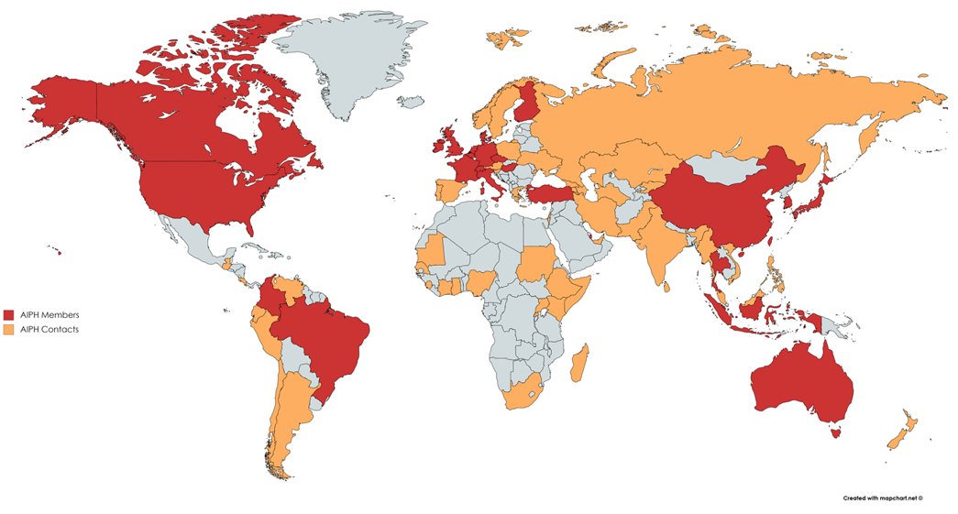

Notes:
Our members are typically national associations or organisations that represent the horticulture industry in their country or region. Therefore we do not have many members in each country but those that we do have represent many thousands of ornamentals growers.
The red areas show countries represented in our membership and the orange areas show where we have supportive contacts and opportunities for our work.
It also possible for businesses and other organisations, related to our industry, to become AIPH members as Affiliates.
We keep the cost of membership low so I would encourage all of you to join us in support of our aims.

Slide 4





AREAS OF ACTIVITY
Committees:
  International Horticultural Exhibitions
  Green City
  Ornamentals Production
Notes:
Through our committees and working groups AIPH has a key role in supporting the international ornamentals industry and in particular for the benefit of growers.
Through an international convention AIPH has the role of approving International Horticultural Exhibitions like the Floriade that takes place in the Netherlands every ten years. Over the next five years over 20 million people will visit an AIPH-approved Expo and be exposed to the world of horticulture somewhere in the world. These events create a powerful showcase that the industry can use to promote its product.
Since 2008 AIPH has taken the lead international role in driving forwards the Green City agenda. We believe it is critical for the industry to promote the role of plants in improving the environment and economy of cities as well as the health and wellbeing of citizens. Through the publication of the Green City guidelines and annual Green City conferences we get this messages to the decision-makers that need to hear it.

Slide 5

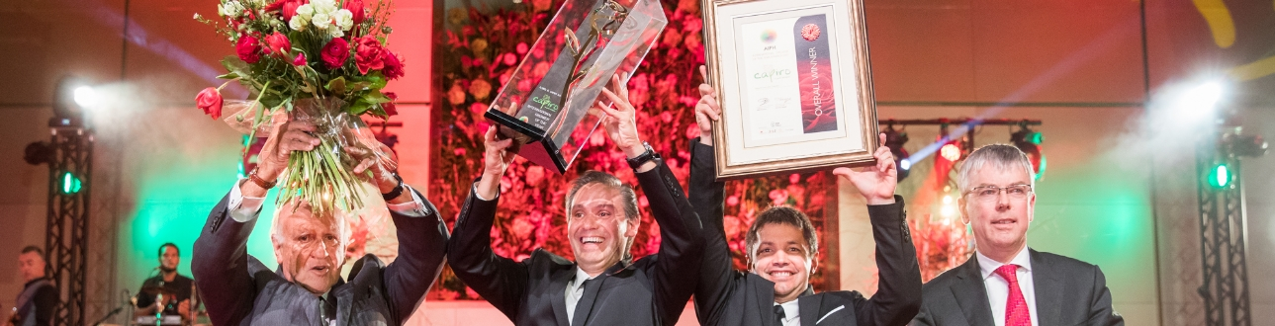
AREAS OF ACTIVITY
Projects / work areas:
  Statistics and International Vision Project
  International Grower of the Year Awards
  Novelty Protection
  Flower Auction Markets
  Plant Health
Notes:
For growers also we share and develop initiatives on plant health and lobby on plant breeders rights.
We celebrate the best of our industry through the International Grower of the Year awards and I hope you will want to celebrate with us at our next awards gala dinner on 22nd January at IPM Essen.
Most recently we launched a new group for flower auction markets.
Our annual Statistical yearbook, published in association with Union Fleurs, is now in its 66th edition and still contains the best available data on production and trade in our sector. We have just published the latest edition.

Slide 6

AIPH EXECUTIVE COMMITTEE
Notes:
AIPH has a Board of eleven members from around the world. The Board sets a clear strategic plan which is implemented by the Secretariat led by Tim Briercliffe in the UK.

Slide 7

MEETINGS AND CONGRESSES
Notes:
The members meet twice a year to exchange ideas, share best practice and progress initiatives that will really drive our industry forwards.
Next year we will meet in Amsterdam in April and in Beijing in September. You are all very welcome to join us.

Slide 8

THE CHANGING GLOBAL MARKET FOR ORNAMENTALS
AIPH International Vision Project
Notes:
AIPH has led a research to develop a vision on the future of global demand and production of ornamentals. This International Vision Project has involved the entire value chain across the entire globe and took three years to execute.
The main objective of this Project is to identify the future drivers and inhibitors which will shape the global tradeflows between production and demand.
We believe that the demand side of the global ornamental market will determine the developments on the production side. So production will follow demand.
As such, demand for ornamentals is an interesting and relevant area for further research. The relevancy for AIPH is evident, as members are grower’s associations who can develop policy to anticipate on shifts in demand.

Slide 9
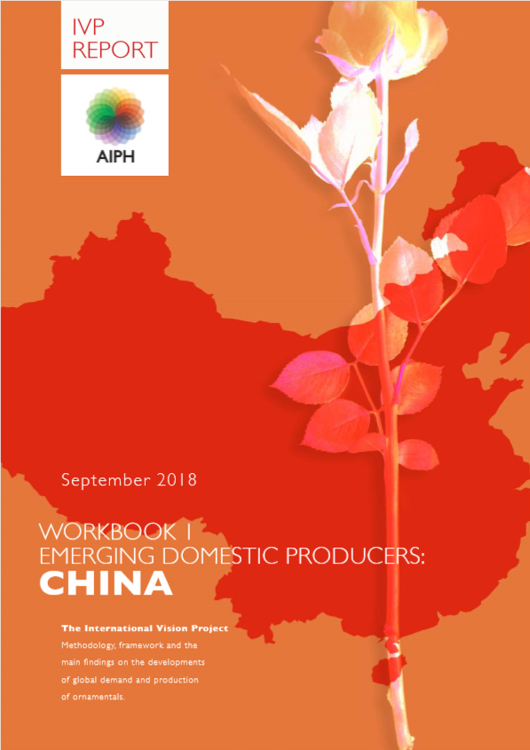

WORKBOOKS TO BE RELEASED:
North America
Japan
Europe
Brazil, India, Mexico
Colombia & Ecuador
East Africa
Emerging Exporting Producers
Notes:
The Vision Project ad to answer questions like:
Where will the growing consumption markets be;
Which (economic) characteristics can indicate the growth and development of consumption and production markets;
What are major drivers (trade channels, consumer preferences etc.) for growth in the emerging consumption markets;
How will the trade flows run (where is the product grown and how does it get to the markets);
Where will the new innovation clusters be situated;
How will the current leading countries (production and consumption) and their players develop;
How can we generally increase per capita consumption of ornamentals?

Slide 10
THE REPORT
Summarizes the drivers and inhibitors of global supply and demand of ornamentals
Forecast period till 2030
Identifies demand opportunities at the level of specific cities and key consumer groups
Key Finding: only three key groups will shape global demand by 2030:
  China’s Urban Billion
  Working-agge population in North America
  Old and retired in the western world
Notes:
Summary of the Main Report:
In the world as we knew it, economic growth was primarliy driven by growth of population. Today, a variety of factors indicate that growth of consumption seems to be a more important driver of growth than growth in population. Although the world population continues to grow, the pace of growth is slowing down over the forecast period and the areas where growth occurs are clearly in and around urban areas rather than countries as a whole. Urban consumers will generate the lion share of global consumption growth.
Research has identified three target groups which have the scale and spending power to reshape global demand and impact the world economy. These three groups are to cover nearly half of the projected total € 20 trillion global consumption growth till 2030.
1) The working middle class in China;
2) the working-age population of North America;
3) the growing population of retiring and elderly people of the western world.
Their combined weight in global consumption growth reflects both their large numbers and their high (or growing) per capita consumption.
In the case of the identified three large consumer groups the question for ornamentals is how supply can connect with that demand. All identified target groups are concentrated in areas that are home to a significant domestic production base and large external trade flows of ornamentals. The question is if the growing and changing demand can be satisfied by the current value chain, or do we need different products, service propositions and other value chains? It is a shift in demand profiles and consumer buying behaviour that is likely to influence the propositions of the ornamentals industry in the future.
OECD, World Bank

Slide 11
WORKBOOK I : CHINA
Collaboration with a local expert committee
Including an in depth, 3-month consumer research
Multi-channel retail survey
Resulted in profiling of consumer target groups
Developed case studies for the four largest metropolitan clusters
Notes:
Main observations for China:
1) China’s Urban Billion; the group of the working population aged 15 to 59 and of which approximately 521 million live in urban areas, will increase with nearly 20% to over 628 million urban workers in 2030. Impressive numbers, but the real growth will be in the doubling of the per capita spending.
Growth occurs mainly in the peripheries and inland cities, encouraged by government policies to control the population in the coastal cores of Beijing and Shanghai.
From now till 2030, around 40% of Chinese urban households will move out of the poor / low middle class into the middle class and some into the rich groups.
The middle class will be the engine for growth;
Increasing population density and soaring cost of living is affecting the liveability in cities
China’s cities have an increasing cost of living and an enormous surge in housing prices

Slide 12
Workbook II: PRODUCTION
General outline for global production trends; new workbooks with country deep dives are underway
Presents developments in production areas of our own classification model
Notes:
This research has established that change in demand and production is inevitable. In the next decades a variety of macro factors will cause consumers to live different lives than the generations before them and they will develop different behaviour leading to different purchase decisions which are likely to impact ornamentals. That change in demand raises the question if the ornamentals industry should reconsider the way it positions itself.
It is taken for fact, that the world is urbanising in an increasing pace, and that we humans have an innate tendency to connect with nature (which is called biophilia). The irony of these two is that they result in a paradox that may hold the greatest opportunity for growth of the ornamental industry.
While the world as a whole will see a tremendous increase of consumer spending, it is the challenge for the ornamentals industry to capture its fair share of this growth in the following segments:
a) Governments, stimulated by the general public, will develop an increased demand for urban green space, which will affect government
policies on all levels from national ministries to city councils and even local neighbourhood action committees. As an example: areas with green space are seeing lower crime rates, increased property value, and lower demand on health services.
b) Consumers themselves will recognise the economics and health and well being benefits of greening their own living space. Examples are; reduced costs and loss of life quality by illness, less anxiety or mental stress, an increase in property value and better performance of children at school.
c) A broad range of private sectors is expected to recognise the economic benefits of green space and integrate flowers and plants into their business models. As an example, the recovery rate of patients in a green surrounding inside a hospital is shorter because of the connection to nature.
When assessing options to capture that demand it is obvious that the industry will face opportunities and constraints on the supply side and production base. The main question is if the production side of the current value chain is resilient
enough to deal with the changes ahead. For this assessment we have taken the country selection model as a framework. Each of the four categories has a different stake in the global ornamentals market, but they generally can be divided in two: a net importer or a net exporter. The importers will see a value chain with economic benefits concentrated in retail, wholesale and services, whereas the exporters see a value chain around growers and farm inputs. The obvious exceptions are the mature domestic producers who by tradition have grown to be home to the entire value chain.

Slide 13
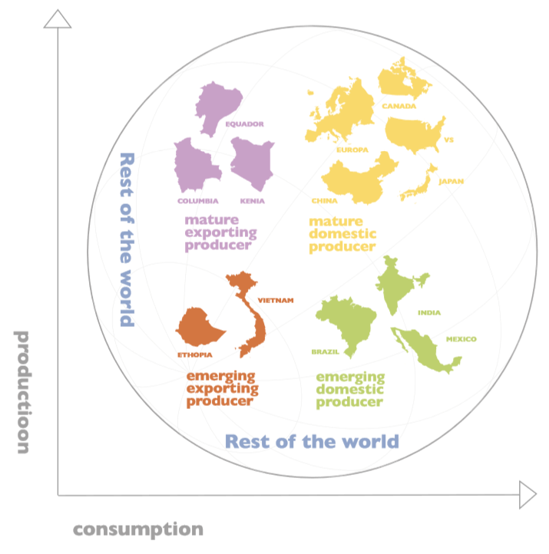
AIPH COUNTRY CLASSIFICATION
Notes:
PRODUCTION OF ORNAMENTALS
The research revealed that sociodemographics are a shared commonality between the world’s largest ornamentals markets. The countries with the largest ornamentals production are all home to the largest consumer demand.
In other words, they are highly self-sufficient, with the exception of specific products or seasonal external trade flows.
For example, The USA is highly self sufficient in plants, trees and shrubs, but over the past decades the domestic production of cut flowers eroded and the USA became reliant on imports. Colombia was ideally positioned to capture that market, and historically Colombia’s market share in the USA hovers around 60%. This created a mutual dependency of that trade flow but the question is if such traditional trade flows will weather the changing times ahead.
While some countries stand out as massive and excellent growers; they export the lion share of their output to one or more of the mature demand markets. This lead us to investigate the feasibility to build the research of the demand side on specific consumer target groups in specific urban areas rather than a traditional approach of countries. However, because most data are available at a national level, we had to start with a classification of the countries of interest and established a basis of their commonalities as follows:
MATURE EXPORTING PRODUCER
Countries that have attracted ornamentals production mainly because of their natural or economic resources. Typically, the flowers (or plant material) find their way all around the globe but mainly flow into the world cores where the mature domestic producers complement their demand with products of these countries. They have shown stable volume and value growth and have been in business for decades. For example, Ecuador and Colombia stand out for their high altitudes at which highquality crops as large bud roses thrive well. In East Africa, Kenya and Uganda can provide locations at altitude, good climatic conditions and strong workforces
MATURE DOMESTIC PRODUCER
Mature Domestic producers are markets like North East Asia (China and Japan), North America and Europe which have a strong domestic production base and demand for ornamentals is at the heart of their society’s cultures.
They are all in the current world cores and are the largest consumption markets now and remain so by 2030.
It is in these markets that during the forecast period the biggest absolute demand growth is expected, hence it makes sense to question their ability to increase production volume.
EMERGING DOMESTIC PRODUCER
Worldwide the general expectation is that future demand will be met as local as possible, it is possible that countries like Brazil, Mexico and India have invented that statement because their large local production base can barely satisfy their own population’s appetite for ornamentals and hence hardly see any export flows.
In Brazil, Holambra has developed a value chain with well-connected logistics, fast information flows and reliable financial transactions. Growers and their industry bodies have put all in place to serve the upcoming demand of the large metropolitan clusters of Sao Paolo and Rio de Janeiro.
Mexico is seeing a comparable situation; a strong potential, but not kicking off yet. Their production base of over 16.000 hectares of ornamentals mainly serves the domestic demand with a relatively small export of € 26 million to the USA. Over Brazil they have the benefit of bordering a mature demand market which could trigger an increase in production in Mexico. India is a very clear example; over 2 million hectares of ornamentals production but hardly any external trade.
In India, ornamentals and specifically cut flowers are strongly embedded in society and demand is gigantic. Nearly 90% of the production base is grown for so-called loose flowers which are used in religious rituals. The external trade is negligible at € 20 million imports and € 100 million exports.
EMERGING EXPORTING PRODUCER
These are the upcoming markets which have the same natural and economic enablers as the mature exporting markets but are successfully increasing their competition for a share of the export markets.

Slide 14

DEMAND WILL DRIVE SUPPLY
In the changing world; socio economic and demographic factors will determine demand: expenditures rise to meet income
Ornamentals are perishable; supply cannot be kept in stock or pushed at any price.
Notes:
Demand will drive supply; not the other way around:
1) The primary drivers for ornamentals demand are influenced by socio economic and demographic factors. For instance, as disposable household incomes rise, consumption of non-necessity consumer goods will start to take off, and this includes ornamentals. So, the total aggregated category of cut-flowers, indoor plants, outdoor plants, garden and lawncare services and even public green space is primarily dependant of an economy’s purchasing power followed by a changing consumer demand and changing buying behaviour.
2) Simply, because we believe that for the generic ornamentals category, and the perishable nature of it, supply cannot be pushed at any price. Ornamental plants and flowers cannot be kept in stock for extended periods to wait for an optimum market price. They need to be moved quickly and effective planning of production to meet (seasonal) demand peaks is a key driver for profit or loss.

Slide 15

WHY
WE BUY WHAT WE BUY
Notes:
There is no such thing as an average consumer in an average market. Mature developed markets all contain cities which are already very different from each other and which will continue to diverge further from one another as consumption and population develops.
It is tempting to explain changes in consumption by pointing to shifting trends in preferences and taste, just as the ornamentals industry has done so often. Certain colours, shapes and applications of plants and flowers, or even specific varieties, allegedly lost appeal among consumers and disappeared from the category, while others were introduced.
Extensive research has been done on consumer groups and their behaviour, such as for the millennials in North America. Yet focusing on evolving consumer attitudes could imply that the only thing companies need is a strong marketing machine that eventually can force a consumer to buy anything. The truth of the matter is that much deeper forces are at play in consumer behaviour, and that these underlying forces are the true drivers that shape future consumption.
For example, if two generations have different consumption patterns although they share similar heritage, culture and socioeconomic conditions, the reason is likely to be an evolving consumer preference or a change in the product or service offerings provided. But if those same two generations with the same heritage and culture, faced different socioeconomic conditions, then changes in behaviour may be in response to those conditions.
Take the youngest group of North America’s working-age population as an example. The fact that fewer of them own cars or houses than earlier generations did at the same age does not necessarily mean that they have less demand for a car or home ownership. Other factors are in play. The fact that they have lower average incomes and more student debt than previous generations means that these individuals are less able to afford to own such assets. The fact that this generation is getting married later is another reason why the rate of homeownership is lower than it was for the same age group in previous generations.
We are more likely to be able to predict consumption trends if we focus on understanding the underlying reasons for consumer choices. We drafted a methodology that connects with the changes in behaviour we have observed in the past decades to provide an understanding of changes in consumption over time. It considers four sets of variables that influence consumers’ behaviour and specifically their motivation to purchase ornamentals. In this research we have covered all four factors, but not treated them as equally important in order to establish a foundation to build further research on.

Slide 16
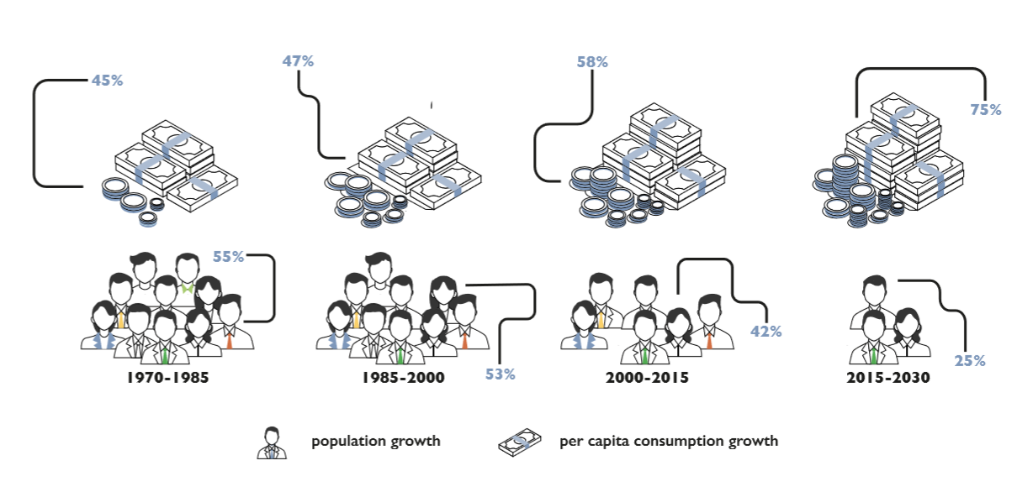
SO…WHERE IS THE GROWTH?
Notes:
Cities are key; by 2030 consumers in large cities will generate over 90% of the € 20 trillion growth of global consumption till 2030.
Global urban consumption is extremely condensed: Only 32 cities generate a quarter of the growth, while the world’s top 100 cities will account for almost half of the growth.
This exhibit shows that until the turn of the millennium, more than half of the total growth was driven by the growth in population But, for the decade to come, growth of consumption seems to be a more important driver of growth than growth in population or GDP. Although the total world population continues to grow, the pace of growth is slowing down over the forecast period.
In the forecast period population growth will only contribute 25% with the remainder coming from each individual spending more.

Slide 17
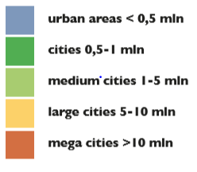
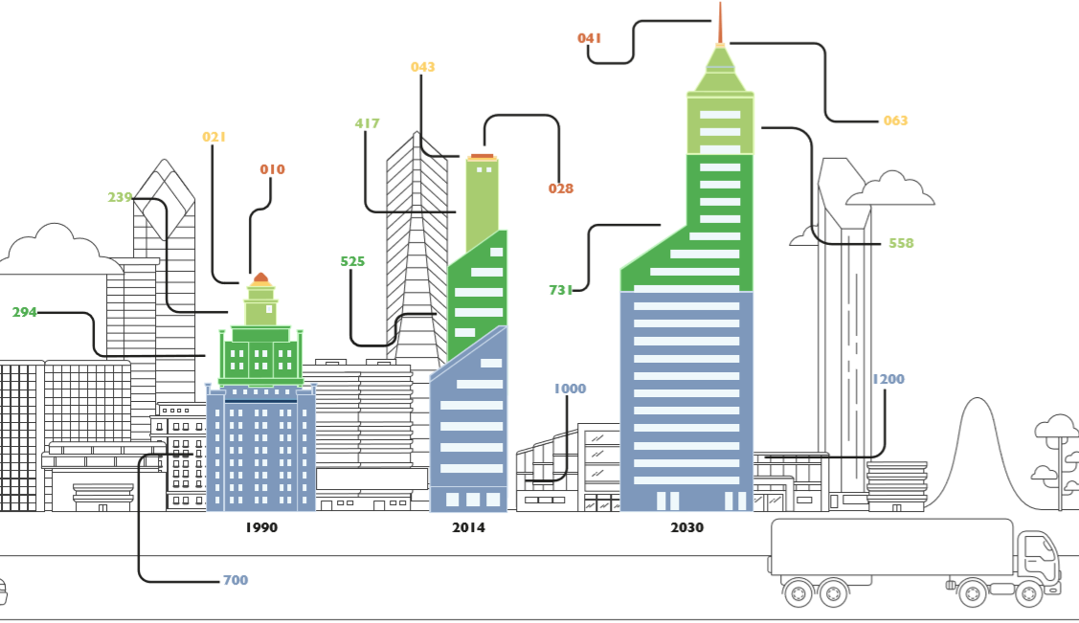
GROWTH PATH OF THE WORLD’S CITIES
Notes:
Cities like Seoul, Budapest and Bogota account for 50% of their countries GDP. Alpha cities like Tokyo and London, account for around 20% of their nation’s GDP. But if we consider an Alpha city as a megalopolis ( a large urban area of connected cities) the megalopolis of Tokyo/Osaka in Japan is likely the world champion and contributes around 79% to the Japan’s GDP.
In sync with the UN forecast that in 2050, 70% of the world’s population will live in cities13, we trust that our methodology for this research will be effective to meet the research objectives. By focussing on cities rather than nations, the outcome will provide more specific insights to feed further research and policy development.
Global population growth does not distinguish between the size of a city; growth is very evenly distributed among the various sizes of cities. Consumption and growth are under increasing pressure in many countries as population growth slows and urbanization rates are maturing. 6% of the large cities we have studied (most in the developed world) are seeing a decline in their population. Others, mainly in emerging countries are growing. In China alone, nearly 700 large cities
(> 150.000 inhabitants) will account for 30% of the total global urban consumption growth till 203014. Cities are crucial in this research and may hold keys to unlocking a reliable statistical model to predict developments in demand for ornamentals in and around cities. After all; Cities are at the heart of where demand for ornamentals originates from. Not only from an economic principle of purchasing power, but also from a perspective of logistics and infrastructure for these highly perishable products.

Slide 18
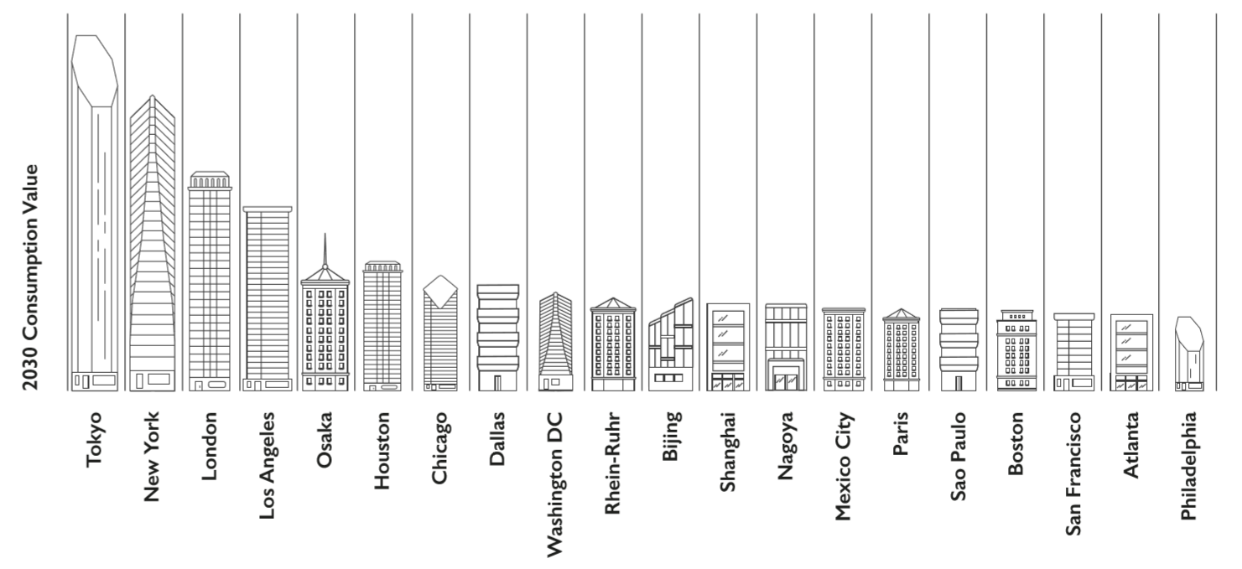
TOP-20 BY CONSUMPTION VALUE IN 2030
Notes:
Global consumption is concentrated in just a few hundred cities; the top 100 cities are expected to generate 45% of global consumption growth. Of these only 32 take 25% of the total global consumption growth. This ranking shows the top 20 of cities for the most consumption growth till 2030 in absolute figures and Billion-euro values. Note that the top 20 in 2015 only includes two cities of the emerging world and that the ranking with the highest absolute growth includes 10 cities from the emerging world of which 6 can be found in China.

Slide 19
31 years, 251 days, 7 hours, 46 minutes, and 40 seconds
Notes:
We have just been throwing around the millions billions and trillions…..like they have little meaning and are just meaningless large numbers, which frankly they may be… however to get a grasp of the sheer size of the world’s economy and the projected growth the screen now shows the time one would need to count to one billion.
And that’s continuous; 24/7 without a break, and compensated for leap-years….
So…the world and the future indeed is massive

Slide 20
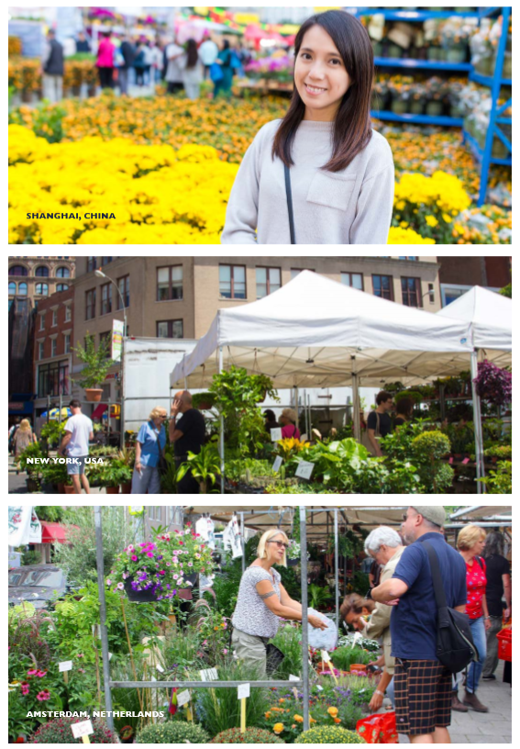
THEY WILL SHAPE DEMAND IN 2030
1
2
The working middle class in China who by 2030 will have grown up in a China with a more liberal open economy than generations before them.
The working-age population of North America, a large group of consumers who generally have a tendency to keep spending despite facing income pressure.
The growing population of retiring and elderly people living in ageing developed economies of the mature domestic producers in the western world.
3
Notes:
We have established that rising consumption by each consumer is the key driver of growth and that consumer behaviour will continue to further disperse, even within the classical segmentations like income, age and geographic cohorts.
To capture future demand, industry players will need a deep understanding of the consumption patterns of these target customers. They will have to identify -in much more detail- where growth will occur and understand the motivation of the individuals behind the demand figures.
Equally important will be the tactics on how to address the demand by investigating the geographic markets, their segments and the trade channels that will lead to the right consumers.
In the case of the identified three large consumer groups the question for ornamentals is how supply can connect with that demand. All identified target groups are concentrated in areas that are home to a significant domestic production base and large external trade flows of ornamentals.
Can the growing and changing demand be met by the current value chain, or do we need different products, service propositions and other value chains? The enormous size and value of the target groups justifies getting to know them much better.
How is their spending changing, and why? How are their income, household structure, and ethnic composition affecting purchasing behaviour? How are their choices different from those of today’s consumers? How will the needs and wants of these large groups evolve?
We do not even remotely have all the answers to these questions. Luckily that was not the objective of our research. We present drivers and inhibitors that will impact the ornamentals industry where the most determinate factors are found on the demand side and more specifically within the socio-economics

Slide 21
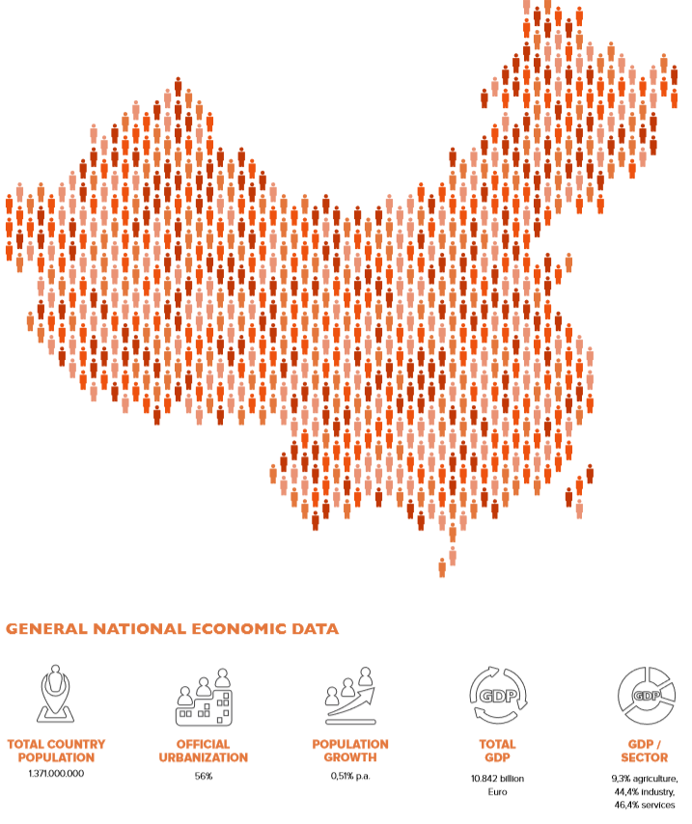
WORKING MIDDLE CLASS IN CHINA
Notes:
TODAY we will give an example of one key consumer group; The Working Middle Class in CHINA.
The consumption of this group, of around half a billion people, is expected to increase from €2 trillion in 2015 to €8,3 trillion in 2030. This means that just 6% of the total world population of 8,5 billion in 2030 is contributing to 28% of the total global urban consumption growth over this period.
The key driver of this is the rapid growth of the Chinese middle class, and especially for ornamentals the growth in the share of the upper part of the middle class is relevant; this is expected to rise from 4% today to 54% by 2030.

Slide 22
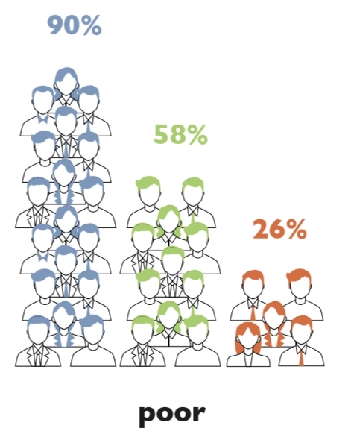

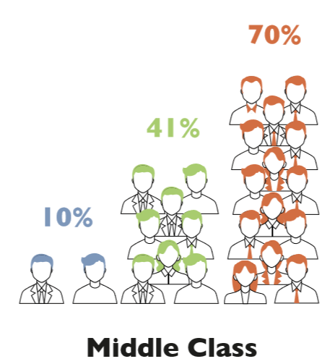
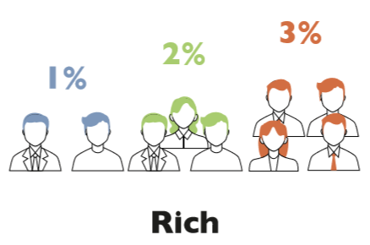
CHINA’S MIDDLE CLASS GROWTH
Notes:
The figure depicts the development of the income levels across all age groups.
To differentiate among Chinese households on the basis of their income levels, we use poor, middle class, and rich.
From now till 2030, around 40% of Chinese urban households will move out of the poor / low middle class into the middle class and some into the rich groups.
This growth is concentrated in the smaller periphery cities (tier 3 and tier 4) around the well-known cores.
The share of the middle class by geography illustrates the weight we attach to the methodology of cores and their peripheries. For ornamentals this implies that attention to government planning for urban green space in and around these growth clusters will really take off in the decade to come

Slide 23
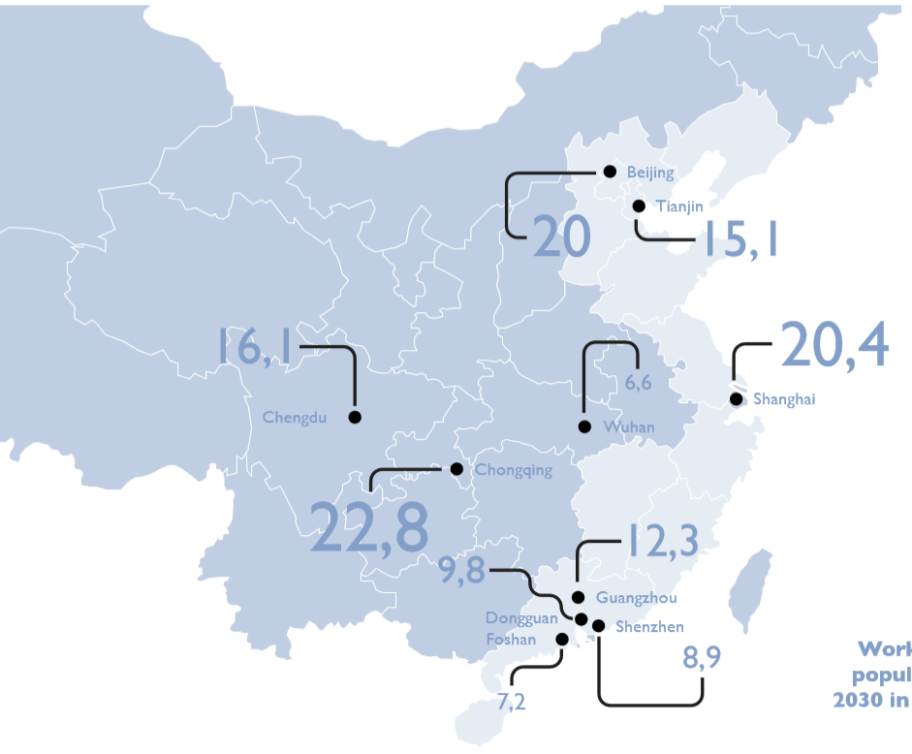
TOP 10 CITIES BY WORKING AGE POPULATION
Notes:
Nearly 80 percent of the Chinese economy pivots around three economic cores: Beijing, the Yangtze River Delta (Shanghai) and the Pearl River Delta (Guangzhou and Hong Kong).
However, if we look at where the growth of the working class is to be expected, the smaller cities around the cores of these deltas that stand out.
Three inland cities also attract attention with their growth of the target group: Chengdu, Chongqing, and Wuhan, mainly caused by large numbers of migrant workers.

Slide 24
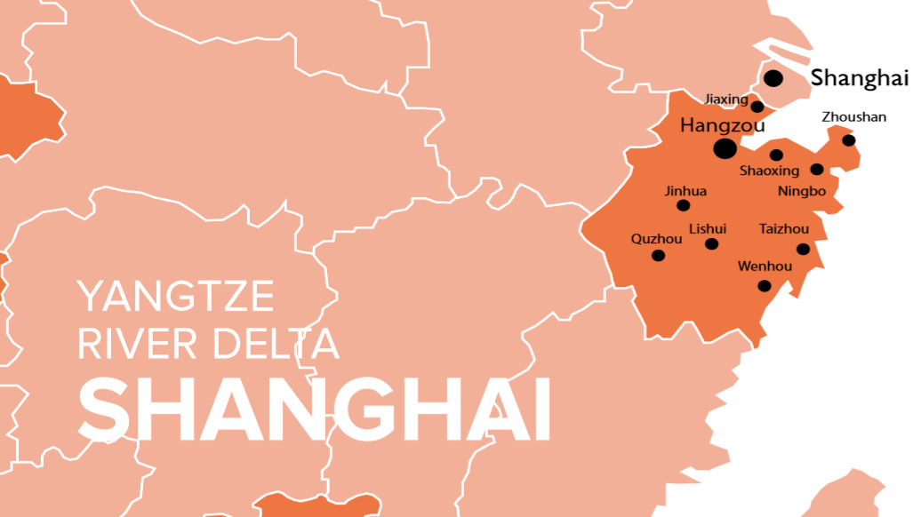

Slide 25
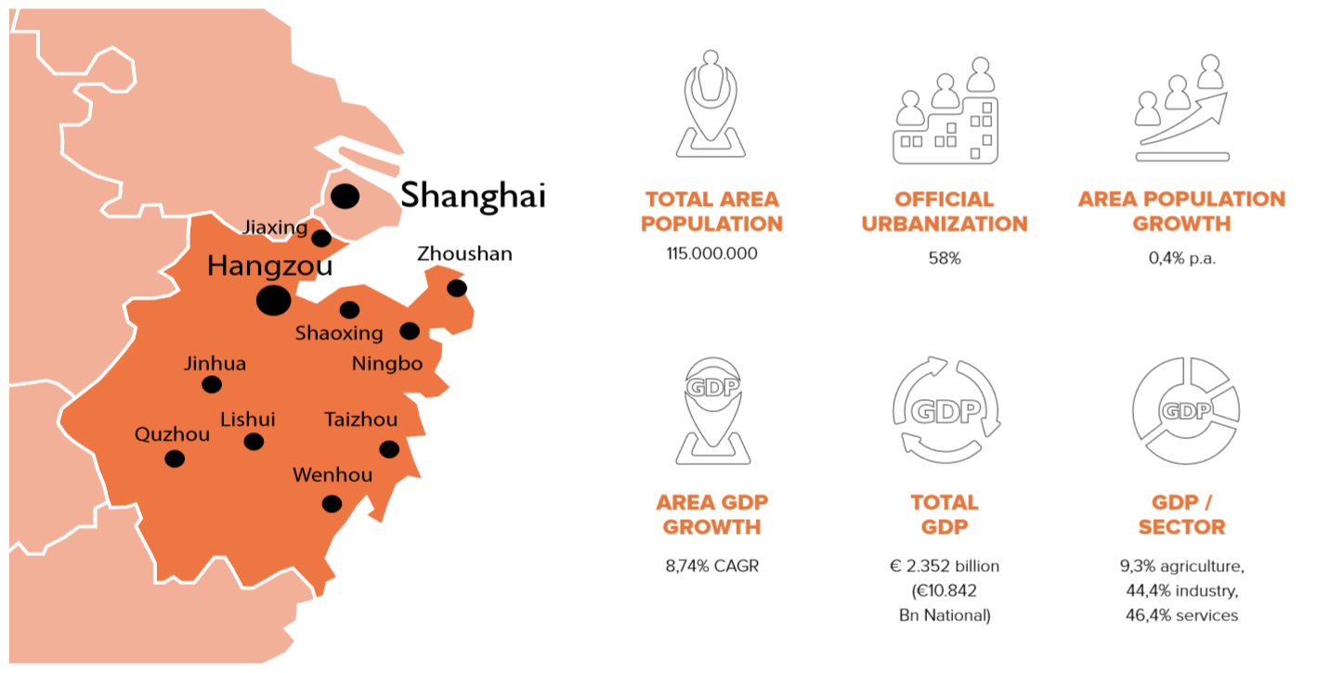

Slide 26
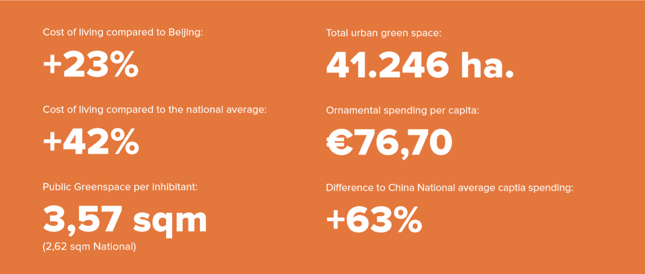

Slide 27
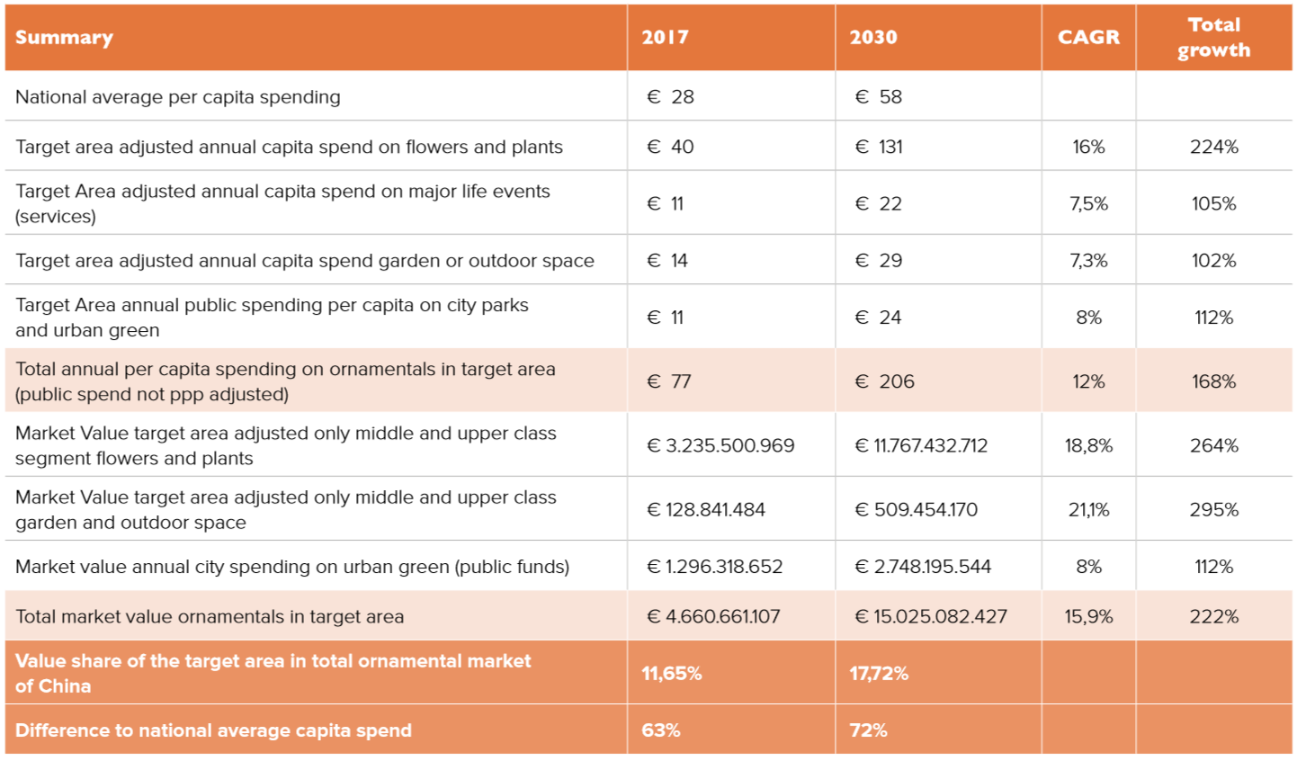

Slide 28
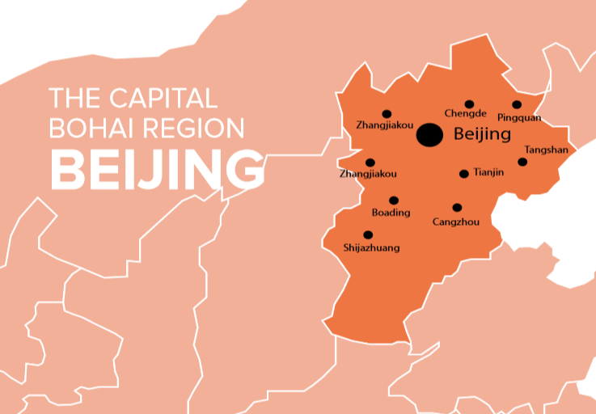
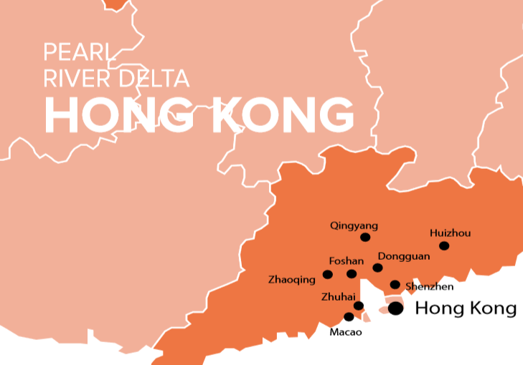
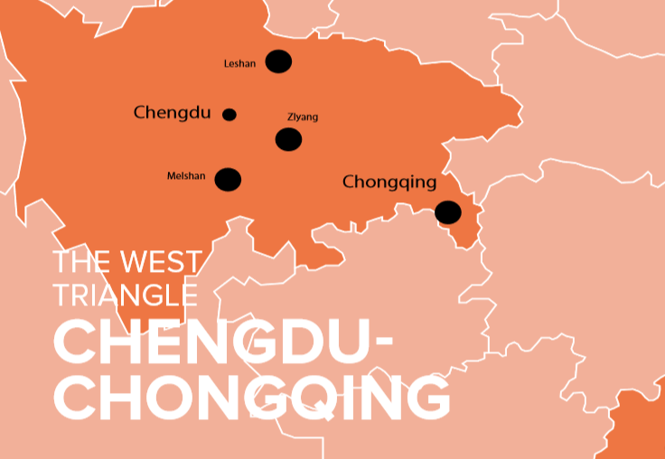

Slide 29
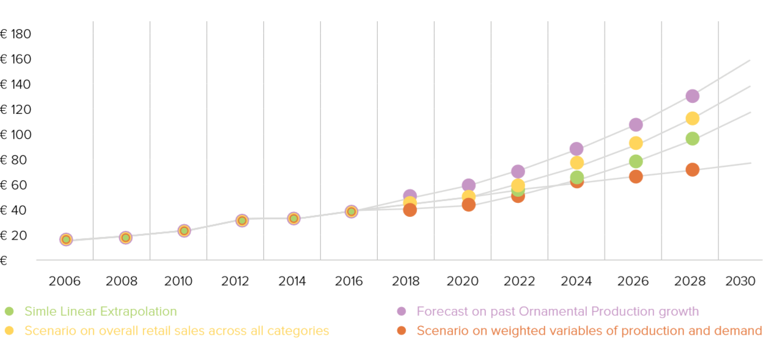
RETAIL VALUE
Notes:
ORNAMENTALS FORECAST CHINA
Previous researches often showed a linear growth for the forecast period. We developed a model which allows for a variety of variables and attributed weights. This is summarized in four scenarios:
A simple linear extrapolation based on data of the past farm gate value across all ornamentals growers between 2006 and 2016. Data were obtained via the China Flower Association from databases of the Chinese Ministry of Agriculture
A growth scenario based on compound annual growth of the industry which is at nearly 22%. Based on the same dataset as in scenario 1
A scenario fully based on the average consumer spending increase over the past 20 year period which is at 12,98%
A scenario based on a combination of the above plus a weighted average of both the variables that affect production (such as farm inputs and the producer price index)

Slide 30
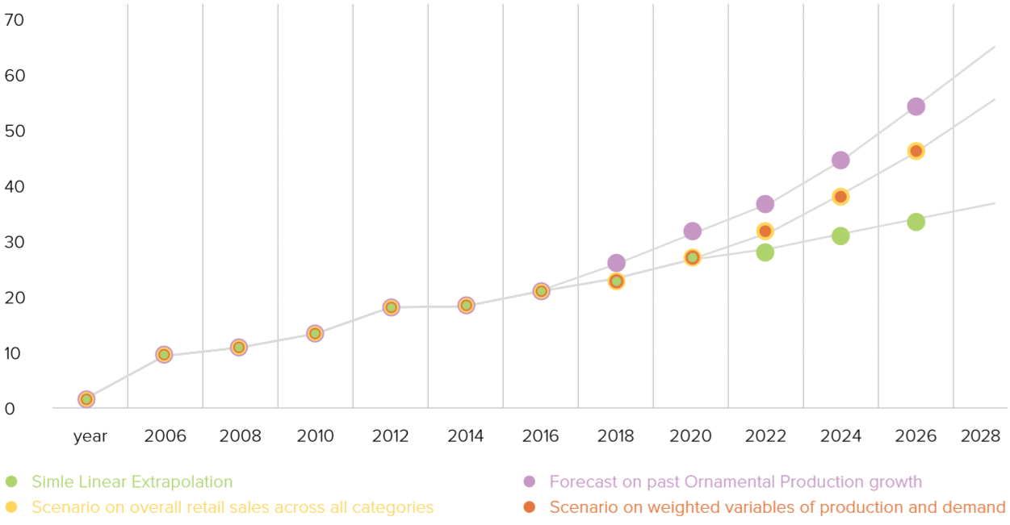
FARMGATE VALUE
Notes:
A forecast based on the same dataset as afore, but now further upstream the value chain at the grower level

Slide 31
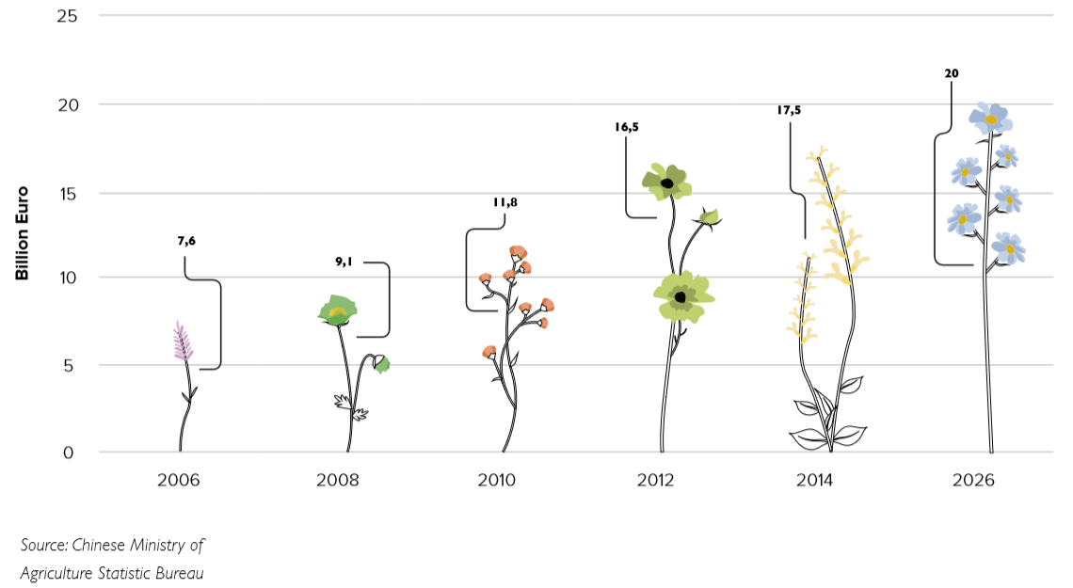
DOMESTIC PRODUCTION IN CHINA
Notes:
Over the past ten years China has seen a sharp increase in demand for ornamental crops.
Production is fragmented over the large number of 85.000 flower growers of which only 15.000 are medium to large sized farms; the remainder being small holdings.
All are feeding into one of the 3.286 regional wholesale markets. Production and trade is not privately organised as it is in other markets.
On top of the commercial growers, China also has about 1,8 million so -called farmer growers who are private individuals who sell direct to consumers.
The total armgate value increased from around €8 billion in 2006 to nearly €20 billion in 2016. In the same period the production area grew at a slightly lower pace doubling to 1.300.000 hectares in 2016.
Although the value of imported ornamentals also grew, the impact is relatively low. In 2016, China reported an import value of nearly €200 million. However, when analysed, the lion share of that consists of flower bulbs (sourced from The Netherlands, New Zealand, and Chile) and other starting material, like young plants from the USA and Japan. The share of imported fresh cut flowers is only 10% of that value and originates from The Netherlands, Ecuador and Thailand.

Slide 32
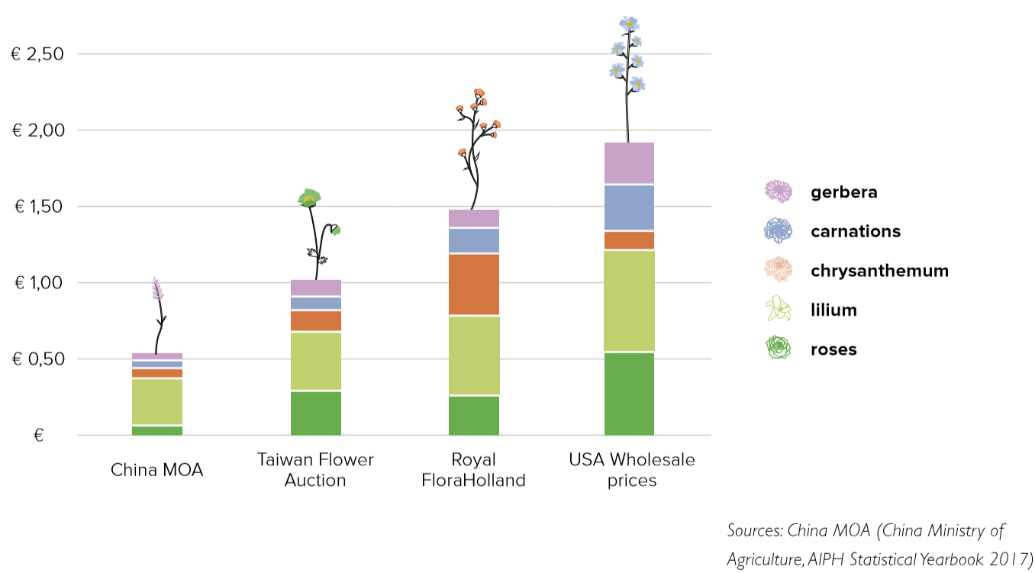
BASKET VALUE TOP-5 FLOWERS
Notes:
The question remains where the supply will come from?
Without doubt, China will continue to develop domestic production to be optimally self-sufficient. This will leave a gap between supply and demand due to seasonality, climatic and resource constraints or simply the economics of production. Most of these variables cannot be reliably predicted, so we have taken production economics as a benchmark to assess where supply is likely to come from. We have taken the average 5-year unit values at wholesale level of each of the top 5 cut flowers in a combined basket. This shows a significant difference and illustrates the barriers for global competition with China’s domestic production.
In the light of the highly competitive advantage on price that local Chinese growers have nowadays, addressing the mainstream demand of China with imported ornamentals will be difficult. Based on the Producer Price Index, Chinese growers are likely to retain that advantage throughout the forecast period.
For the higher-value and niche products there will be more opportunity for other countries to export to China.
The supply and demand gap is theoretically two-fold as China could further develop into an exporter of ornamentals. This is an ambition of respondents, however other inhibitors like plant breeder’s rights, trade agreements, phytosanitary regulations or logistic interconnectedness are important prerequisites to enable a strong export position. This is not developing quickly so we do not expect to see a significant increase in export volume in this forecast period.

Slide 33
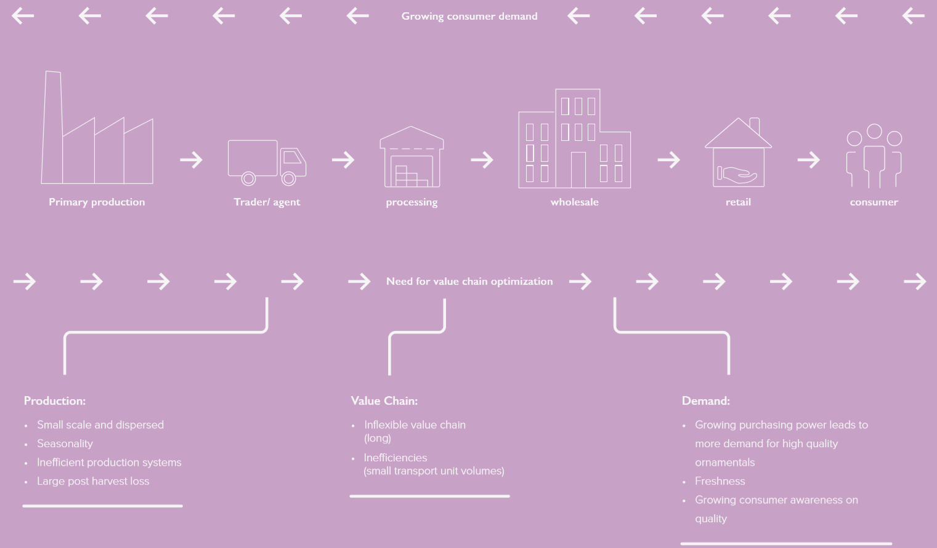
Notes:
SUPPLY CHAIN CHALLENGES:
In ornamentals; the growing demand raises the question if the current supply chain and its players are equipped to deal with the increasing volumes.
They will have to face the tremendous volume growth in not only product flow, but increasingly in the information flows due to the shift towards online platforms that tend to rely on traditional players for order fulfilment. The value chain will need to optimize.
Moreover, China’s demand hotspots for ornamentals are not within easy reach of the current production centres. We only have production data at a provincial level, but these indicate that there are opportunities for improving the logistics, in particular the transit time, and improvement of the cold chain. Reduction of waste could be a key to satisfying rising demand whilst preserving input resources.
Localizing production closer to future demand is not always feasible, but could be an opportunity for specific propositions such as a hybrid garden centre and nursery operations. China’s industry players and various government bodies are working hard to develop solutions and policies to grow domestic production for the growing domestic demand.
Meanwhile, the Chinese market offers ample opportunities for foreign growers and traders to feed that demand. The presented findings on China’s current challenges suggest that the economics of a comparison between domestic grown flowers, possibly could be less advantageous than foreign grown imports shipped directly to the demand centres.

Slide 34
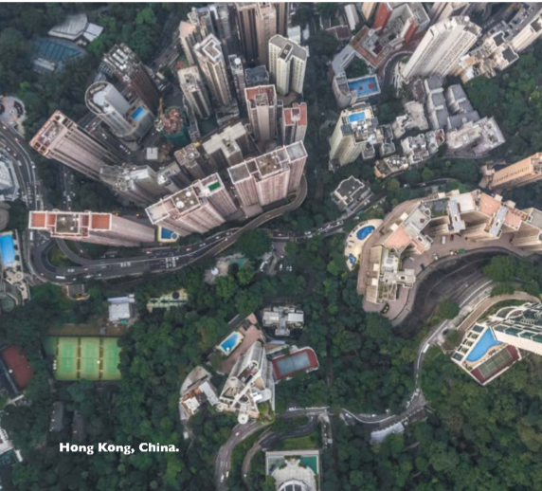
SUMMARY
The combined total consumer spending in the four metro clusters flowers and plants amounts 16 billion euro in 2017 (40% of total China) which is expected to grow to € 57.5 billion in 2030
Additionally, the local governments of these four areas spend € 4,6 billion per year on City parks and urban green, for maintenance as well as new installations and replacement. In 2030 we project this to be € 9.8 billion per year.
The combined forecast market value for China will be in the range of € 100 billion in consumer and public spending.

Slide 35
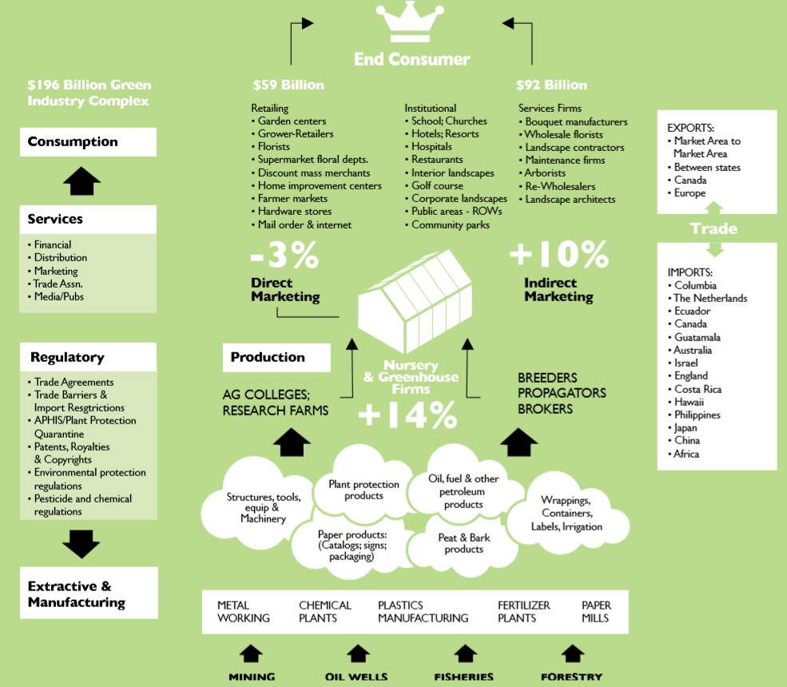
ORNAMENTALS: A 200 BILLION BUSINESS?
Notes:
A market value of 100 billion euro’s may sound unrealistic, but be aware that your industry already passed that mark a long time ago.
In the USA the combined value of the ornamental industry is nearly double that figure at 196 billion
This includes all inputs along the value chain (so in essence inputs with dependency on ornamentals)
In particular the service components stand out. These are traditionally not accounted for in

Slide 36

WORKING AGE NORTH AMERICA
Age 15-59
191 million consumers by 2030
Account for 16% of global growth
The majority is concentrated in urban clusters
US$ 1,5 trillion in student debt
Strong differentiation of demand due to cultural / ethnic background
Notes:
This group of consumers illustrates North America’s working-age population, which comprises people aged 15 to 59 in the United States and Canada.
This is a large consumer segment whose numbers and per capita consumption are continuing to increase. By 2030, consumers in this age group will include generation X consumers (born between 1970 and 1985), millennials (born between 1985 and 2000), and digital natives (born after 2000).
This group includes the first generation that risks not doing as well economically as its predecessors. Millennials were hit hard by the 2008 recession. Average income among these consumers is somewhat below the average of the generation immediately before them. With the rising cost of education, they also have the highest –ever levels of student debt of 1.5 trillion Dollars in 2017.
All of this adds up to lower than average purchasing power and for many individuals, cost consciousness in decisions, from where they live to how they watch television and how they consume health care. These individuals are marrying later and becoming parents at older ages than their own parents.
CORE DRIVERS
The North American working age population is a large group whose numbers are expected to expand from 180 million in 2015 to 191 million in 2030
North America’s working-age individuals will account for more than 16% of global consumption in 2030, ahead of their Chinese and Western European counterparts and second only to the retiring and elderly population in developed regions
However; this group is all but uniform and may be poorer than their parents

Slide 37
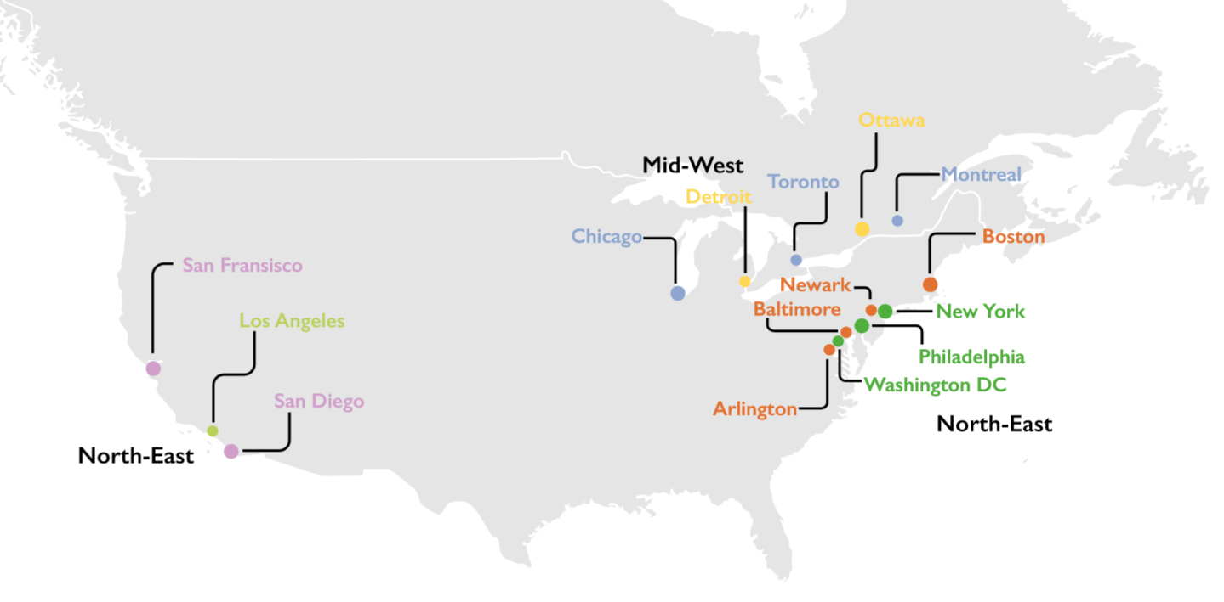
SPATIAL DISTRIBUTION
Notes:
We have conducted three case studies into the top-3 largest urban clusters and detailed each case in so-called the Metro Sheets.
At this stage we highlight the largest urban area in North America; the North-East Corridor, also known as the Bos-Wash megalopolis. This urban area stretches from Boston, MA south to Washington DC. It is home to 48.7 million inhabitants (15% of the USA) and is responsible for 18% of the national GDP, on less than 2% of the land area. This metropolitan area is characterized by a higher level of education (22,6% have a bachelor’s degree or higher), higher median incomes (8,4% higher) and is generally younger with a median age of 34.2 years compared to the national median of 37.9 years.
The region can be considered an economy in itself with its own characteristics for supply and demand dynamics. Such urbanized areas have different socio demographic compositions than the country they sit in. This directly affects the consumer behaviour and their spending on ornamentals.

Slide 38
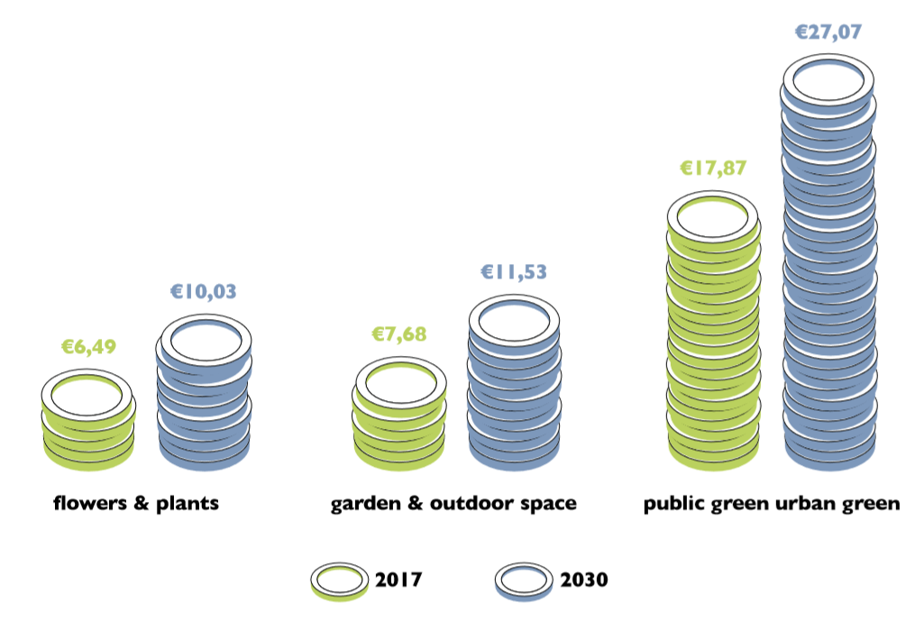
CAPITA SPENDINGS IN URBAN CLUSTERS
Notes:
GENERAL PER CAPITA SPENDING
Traditionally, the per capita spending figure is calculated by the total consumption value divided by the total population. It is an aggregated indication on the annual consumer value per person, across all age groups, income classes, gender, background, and area. We found two reported per capita spending values: One is € 83 and is provided by the US department of Commerce, which includes cut-flowers, plants and garden (products and services), the other is calculated at € 28,84 by Royal Flora Holland and only pertains to cut-flowers and pot plants
When we place that second figure of cut-flowers and pot plants in the context of the specific demographic and economic situation and outlook of the area, the calculations reveal new insights that can be relevant to players addressing this, or comparable metropolitan areas. The per capita spending in the Bos-Wash Area is at € 49,00, more than double that of the national average. This excludes public spending
The two researched major life events (WEDDINGS AND FUNERALS) combined result in an additional per capita spending of € 25,85 in 2016 and are estimated at € 35,26 in 2030. This is an additional spending, since the main component is based on service rather than product-cost. As such this service segment is not included in the common industry figures, which are based on a sum of the product’s domestic farm-gate value plus total import value which is then increased with standardized margins for players further downstream along the value chain. Moreover, this market is served by the event-industry which is not consistently included (or excluded) from the prevailing data.
PUBLIC SPENDING ON URBAN GREEN SPACE
The urban greening revolution is on its way worldwide to shape the cities of tomorrow, but established cities are doing their best to keep up the pace by ensuring that their populations all have easy and close access to public parks. Design, build and maintenance costs are typically covered in city budget plans and reliable data are available. We have collected the total and per capita spending of the major core cities in the target area and from there extrapolated to the total Bos-Wash area. The current market value of public spending in urban green spaces is € 5.9 Billion28 and projected to grow to € 10.2 Billion. This comes down to a per capita spending of € 121 in 2016 and € 165 in 2030, equal to double the highest present day value of €8

Slide 39
CONCLUSIONS FOR THE URBANIZED NORTH-EAST OF THE UNITED STATES
The demand growth till 2030 will be driven by an increase in purchasing power (36%) rather than population growth (9.66%)
Specific consumer groups show steep increases such as the 60-plus age group and the working class.
The per capita spending in the studied area is higher than the national averages presented in other research. This is likely due to the demographics and economics of an area specific demand profile, consumer behaviour, a service industry catering to major life events, and relatively high public spending on urban green space.

Slide 40

PRODUCTION USA
Notes:
The United States is seeing year on year increasing consumer spending and higher demand volume in ornamentals, yet the two major inhibitors for further growth are not seen at the demand side, but are government policy and industry constraints: Labour shortages and logistic challenges is what keeps North American growers awake at present
LOGISTICS are an issue in itself and an indirect consequence of work force shortages. It is estimated that the United States alone currently lack 350.000 truck drivers. An extreme example can be found in the state of Oregon where the entire backbone of logistic road linkages has been lost due to the bankruptcy of the Portland Port. This has exponentially worsened the already substantial challenges for Oregon growers. The state of Oregon is a relatively large producer of cut flowers and foliage of which 80% was sold into other states. Their competitive position is now highly uncertain due to the double challenge of a lack of drivers and a lack of logistic linkages, resulting in an upward cost spiral.
WORKFORCE
The USA is facing major challenges to align the work force with the demand developments. Industry Association AmericanHort indicated that 72% of the entire agriculture and livestock workforce (including horticulture) is foreign documented. It is estimated that over 50% of that foreign workforce is creatively documented, meaning that the individual workers are not allowed to either live, work or both in the Unites States. Labour shortages are the current main concern among growers. The shortage is caused by stricter federal immigration policies and stricter enforcement on illegal workers (heavier penalties for employers and workers). We have seen numerous cases of growers who cannot expand their operations due to the lack of workers even though they have the money to invest.

Slide 41
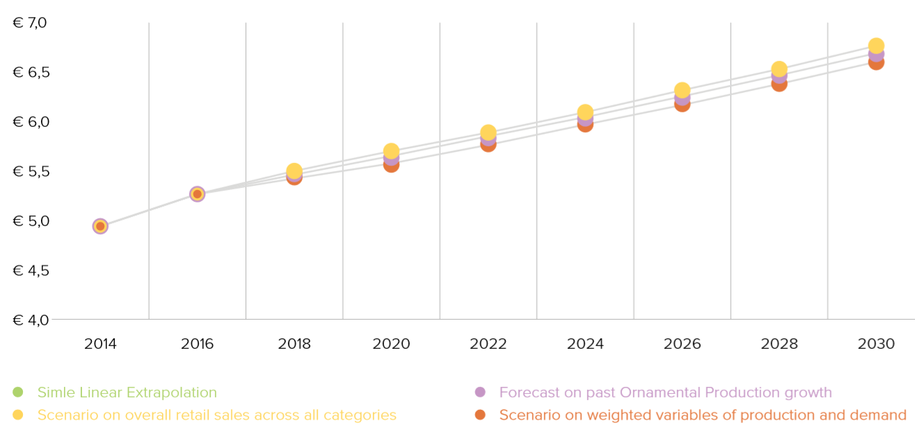
PRODUCTION VALUE FORECAST USA

Slide 42
CONCLUSION UNITED STATES
- The market is mature, but massive and with growth in specific segments which brings opportunities for new propositions.
- During the forecast period the ornamentals market for flowers, plants and gardening is expected to grow 54% by 2030 in the USA
- For exporters to the USA, opportunities arise particularly for cut flowers from Colombia and Ecuador who are expected to benefit most from this demand growth which will be over 54% by 2030.
- Also, Canada is positioned well to take advantage of this, to increase their current export value of €250 million in mainly pot plants.
- The number of working-age people in North America is not growing as fast as either of the other two groups of consumers but they represent a growing value. Cost consciousness and rising inequality need to be factored into companies’ strategy for capturing the purchasing power of these consumers. The unique needs of these consumers are creating opportunities. Looking ahead, if their fortunes improve through wage growth that is higher than expected or through lower debt, it will be interesting to see if their cost-conscious choices endure.
- Even in North America, inhibitors for growth are on the horizon. The challenges growers are facing on logistics and labour cannot be solved overnight and are likely to bring some scarcity and raise retail prices as a consequence.

Slide 43
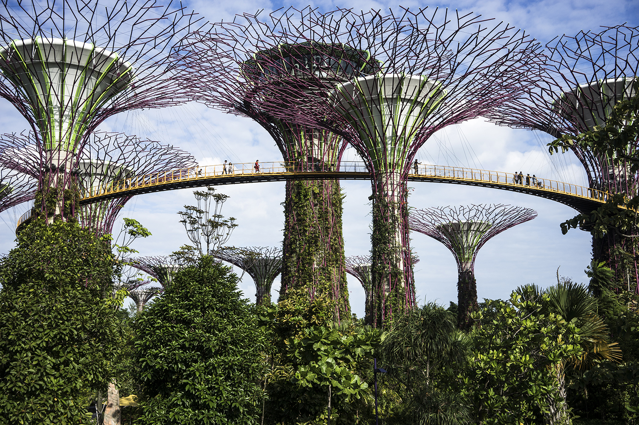
THE KEY OPPORTUNITY
Notes:
This research has established that change in demand and production is inevitable.
In the next decades a variety Of macro factors will cause consumers to live different lives than the generations before them and they will develop different behaviour leading to different purchase decisions which are likely to impact ornamentals. That change in demand raises the question if the ornamentals industry should reconsider the way it positions itself.
It is widely accepted, and taken for fact, that the world is urbanising in an increasing pace, and that we humans have an innate tendency to connect with nature (which is called biophilia). The irony of these two is that they result in a paradox that may hold the greatest opportunity for growth of the ornamental industry.
While the world as a whole will see a tremendous increase of consumer spending, it is the challenge for the ornamentals industry to capture its fair share of this growth in the following segments:
a) Governments, stimulated by the general public, will develop an increased demand for urban green space, which will affect government
policies on all levels from national ministries to city councils and even local neighbourhood action committees. As an example: areas with green space are seeing lower crime rates, increased property value, and lower demand on health services.
b) Consumers themselves will recognise the economics and health and well being benefits of greening their own living space. Examples are; reduced costs and loss of life quality by illness, less anxiety or mental stress, an increase in property value and better performance of children at school.
c) A broad range of private sectors is expected to recognise the economic benefits of green space and integrate flowers and plants into their business models. As an example, the recovery rate of patients in a green surrounding inside a hospital is shorter because of the connection to nature.
When assessing options to capture that demand it is obvious that the industry will face opportunities and constraints on the supply side and production base. The main question is if the production side of the current value chain is resilient
enough to deal with the changes ahead.
A KEY OPPORTUNITY FOR THE ornamentals industry (growers, service providers, and retailers alike) is to position itself in such a way that its products/services are considered as necessities in people’s lives and not mere luxuries. That is the best offense to deal with the change in buying motivations and likely keeps flowers and plants on the shopping list, even in times of economic downfall.
The value proposition of our industry in the future must focus on the unique ways in which quality of life is improved for consumers. Much research has validated the emotional and environmental benefits of flowers, plants, and trees. In a nutshell, green industry products and services improve emotional health, boost seniors’ wellbeing, enhance hospital recovery rates, enhance employee innovation and ideas, strengthen feelings of compassion, decrease worry and anxiety, express feelings of compassion, build stronger communities, mitigate environmental externalities, and improve the economic value of homes– just to name a few of the benefits.
The ornamentals industry cannot overemphasize the importance of this quality of life message, particularly in focusing its differentiation strategies in the future

Slide 44


