Slide 1

2019 European Region
Annual Conference
Stratford-upon-Avon, UK
Organiser: Karl O’Neill
The Bransford Webbs Plant Company
karl@bransfordwebbs.co.uk

Slide 2
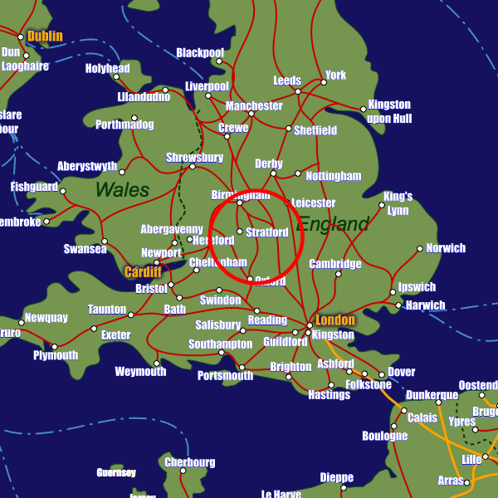


Stratford-upon-Avon, UK
Central location for UK visitors
Located close to Birmingham International Airport
Easy train access

Slide 3


Stratford-upon-Avon, UK
Located close to the renowned growing area of the Vale of Evesham
Excellent location for visits to leading nurseries in the UK
Beautiful old English town to visit for conference location

Slide 4





Nursery visits agreed:

Slide 5
2019 European Region
Annual Conference
‘Technical Times’
Dates to be agreed:
Provisionally Wednesday 9th to Friday 11th October 2019
Hotel to be agreed:
Central Stratford upon Avon location
If you have any suggestions for talks, visits, sponsors or would like to help in anyway please feel free to catch up with me today or contact me at karl@bransfordwebbs.co.uk

