Slide 1
Priva B.V. | Dennis de Wit | October 12th, 2018
dennis.de.wit@priva.nl
Understanding your business inside and out

Slide 2
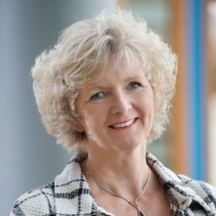
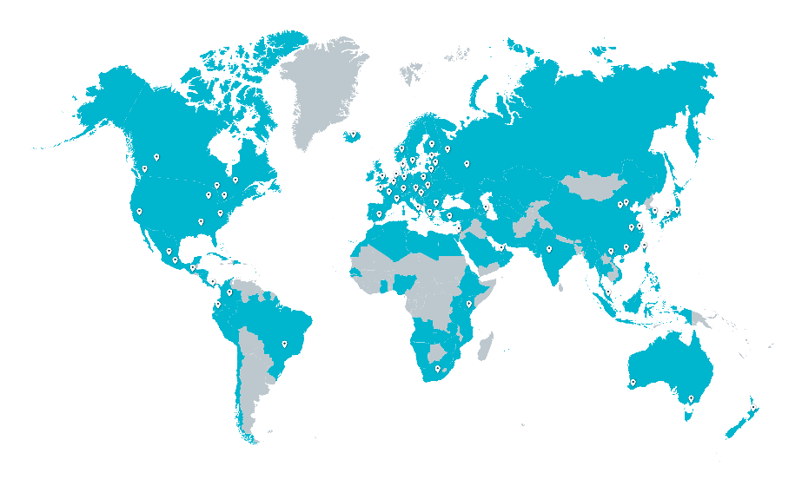

About priva
Worldwide
Horticulture
> 400 distributors
> 100 countries
We help entrepreneurs to take further steps in their development. From Mexico to China and from plastic multi-span greenhouses to high-tech closed greenhouses.
Meiny Prins
CEO
450 employees
15 offices
Utility Buildings
Hardware
For climate, energy and water process control
We create pleasant working environments in which people perform better while reducing energy consumption.
Software
Control software and management information systems
Indoor Growing
Combining our knowledge, we create perfectly controlled environments that result in high yield at the highest possible quality.
Services
Consulting, training and support

Slide 3
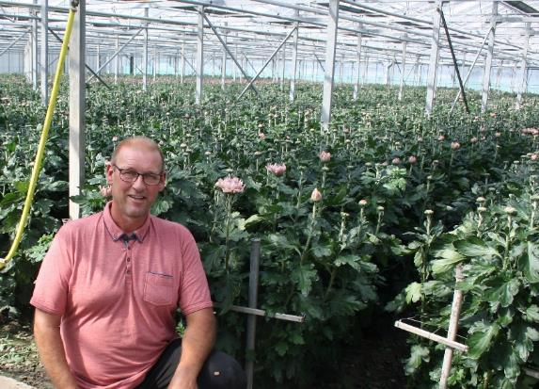
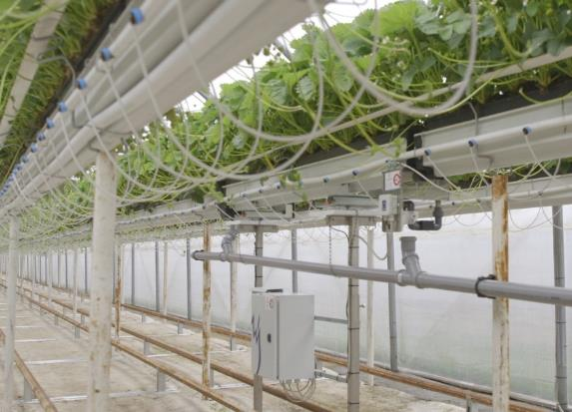
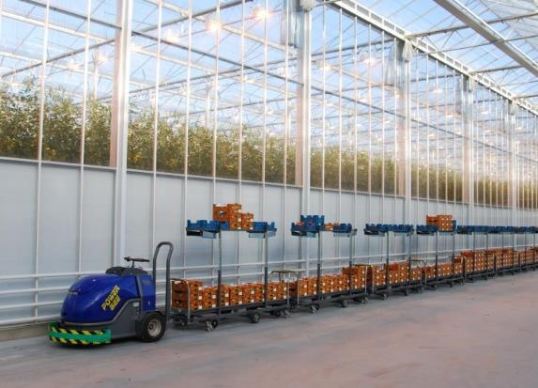
Horticulture
Leen van Velden flowers
Varieties of seasonal flowers
"The new process computer, Priva Compass, felt good, right from the start. It fits my business perfectly.”
Osterloh Strawberries
Strawberries for larger retailers
Ulrich Osterloh’s passion: be the best strawberry producer in Germany, or better still, in all of Europe.
CombiVliet Tomatos
97 ha high-tech greenhouses
One of the largest and most progressive tomato companies in the world with a long-term vision.

Slide 4
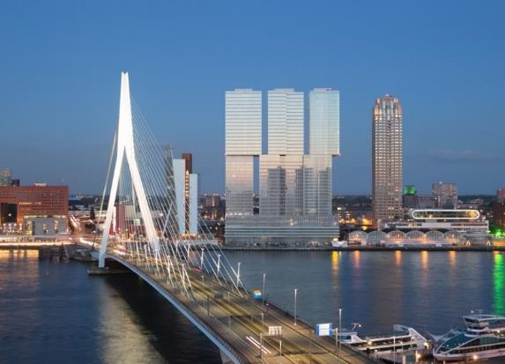


Building automation
The Rotterdam
Sustainable building automation
Sustainable and comfortable living, working and shopping in the Netherland’s largest multifunctional building.
Marks & Spencer
Effective energy monitoring
Nominated for Energy Efficient Partnership of the Year (final on 6 December 2017)
Westminster Abbey
Performance and cost benefits
Higher comfort with less effort, thanks to the Priva building management system.

Slide 5
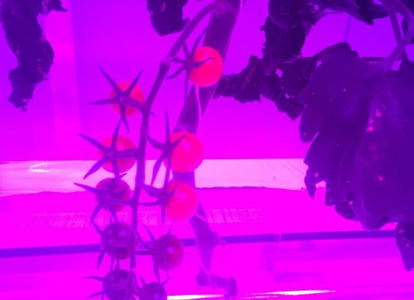
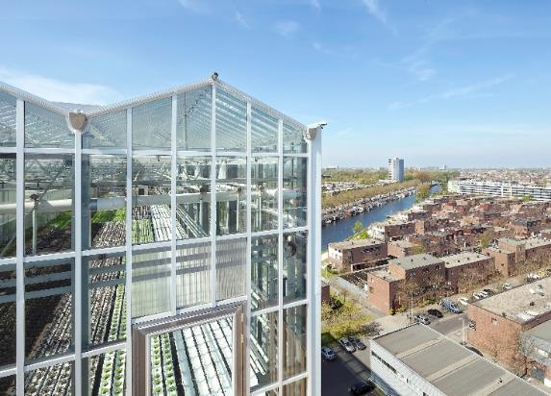
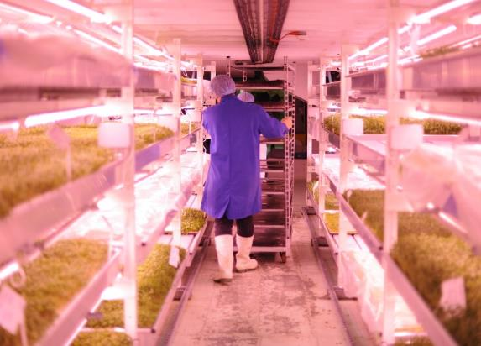
urban and indoor farming
Urban Farmers De Schilde
Largest rooftop farm in Europe
1200 square meters high tech greenhouse and 370 square meters indoor fish farm with maximum re-use of hydroponics and fertilizers.
80 Acres Farms
Indoor grown fruits and vegetables
If one container farm equals two acres of farmland, imagine what you can grow with 80 Acres.
Medicinal herbs
Canadian grown medicinal herbs
Health Canada Licensed Producers of medicinal herbs in North America.

Slide 6
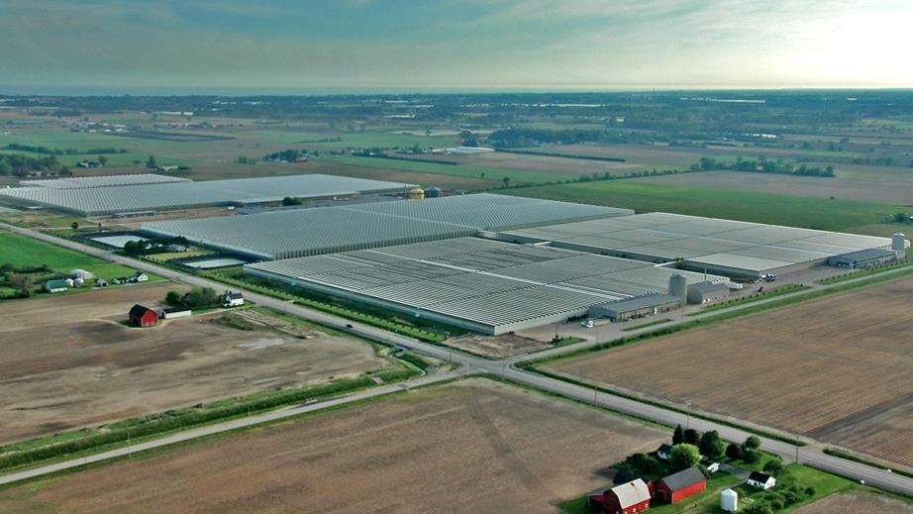
Glass greenhouse

Slide 7
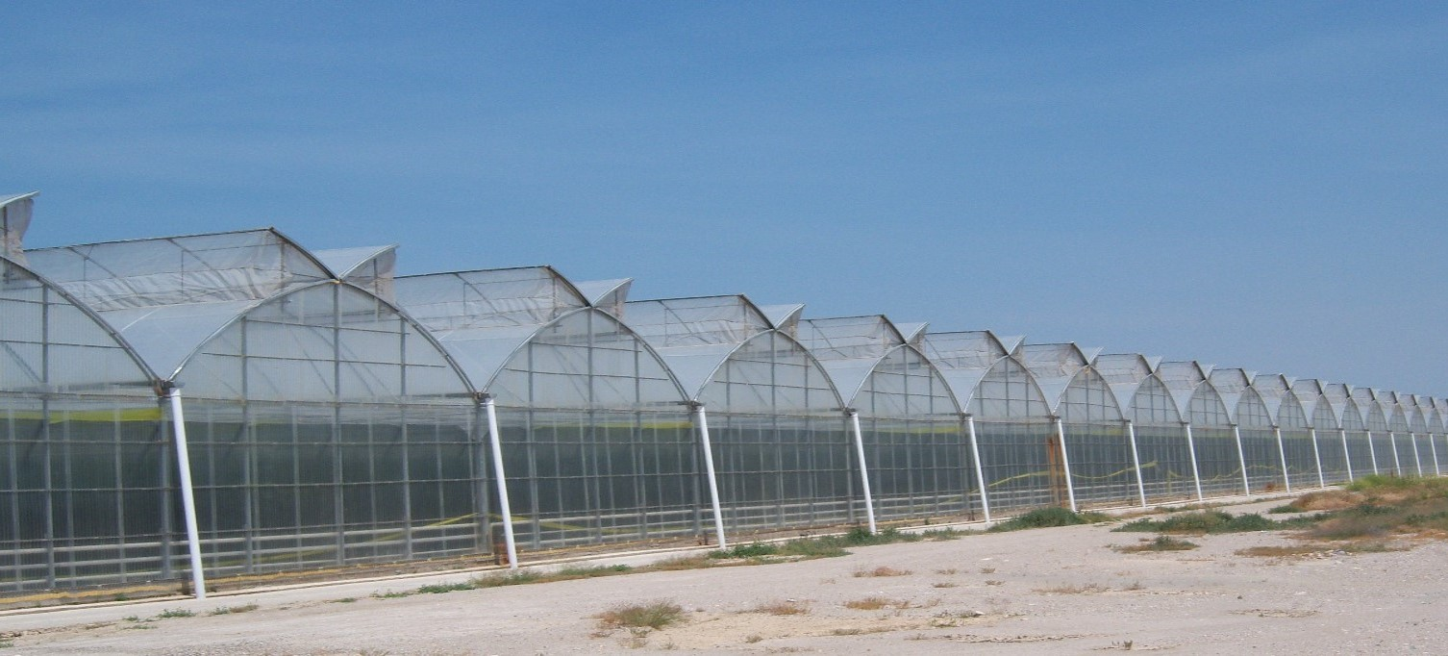
Plastic greenhouse

Slide 8
Your business inside and out

Slide 9

Are you in control?

Slide 10
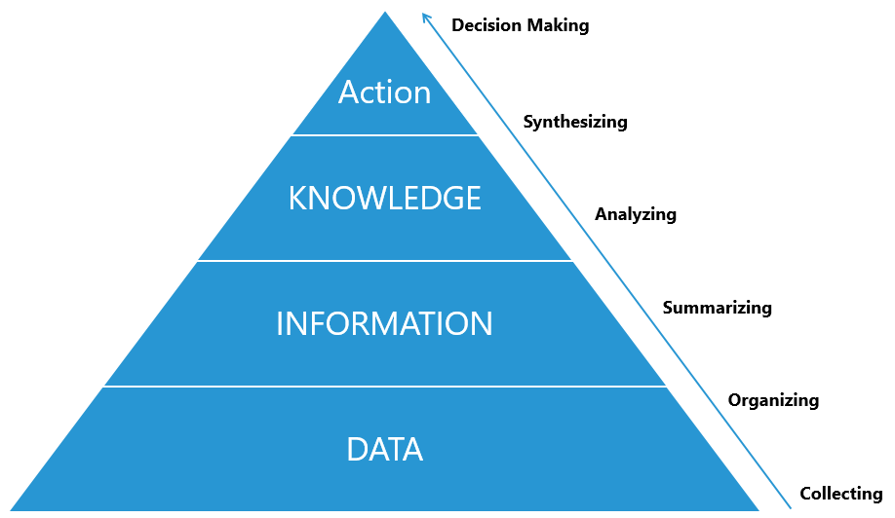
From Data to Information to Decision making

Slide 11
What do you need?

Slide 12

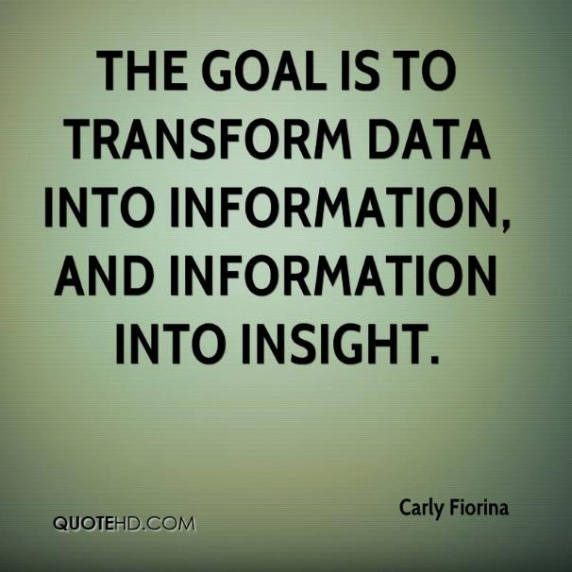
Information is key

Slide 13


Using information

Slide 14

Managing a business

Slide 15
What is information?
Information is data that has been processed to make it meaningful and useful
Data + Meaning = Information

Slide 16
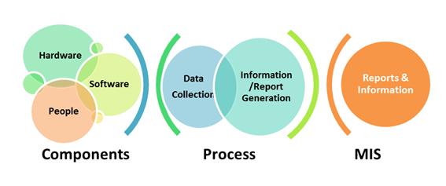
To start with

Slide 17
Collecting data | Climate, Energy and Water
Sensors:

Slide 18

Collecting data | Labour

Slide 19
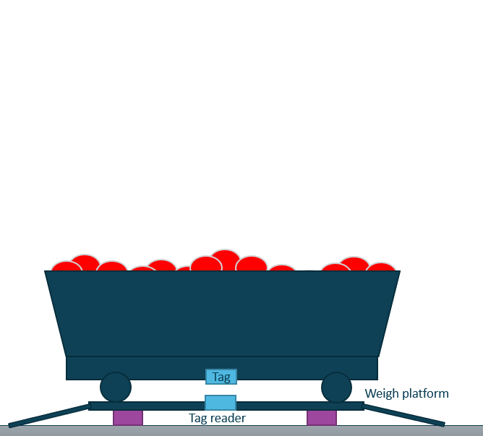
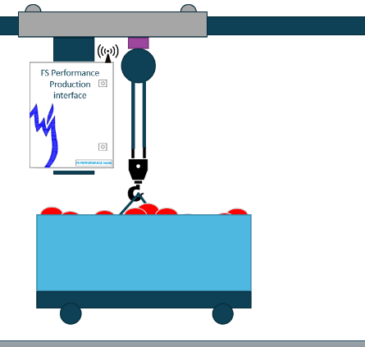
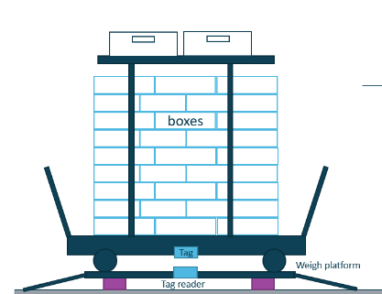
Collecting data | production

Slide 20
Collecting data | quality, Crop and Pests & Diseases

Slide 21
Collecting data | Packhouse

Slide 22






Managing a greenhouse operation
Site 1

Slide 23

WhAt is next?

Slide 24




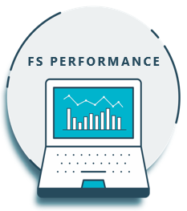





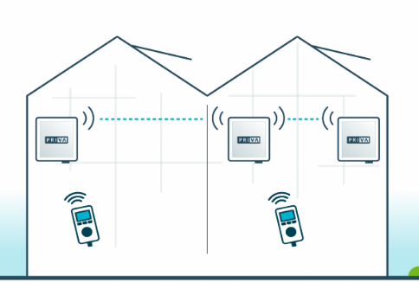
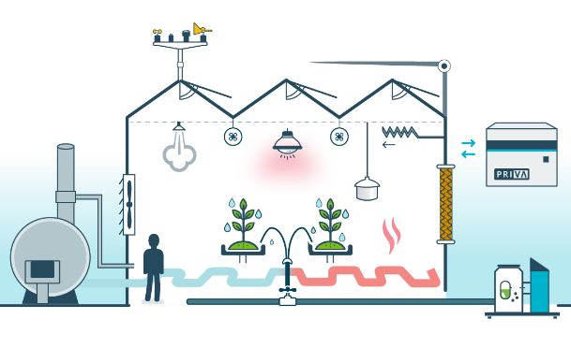


Labour, energy, water, fertilizer - consumption

Slide 25
FS Performance
Management information system

Slide 26
WhAt is next?

Slide 27
Report and information
Operational Dashboards
Operational reports
Information displays
Information apps
Tactical reports
Analysis
Management information system
Data export

Slide 28
Dashboards & reports

Slide 29
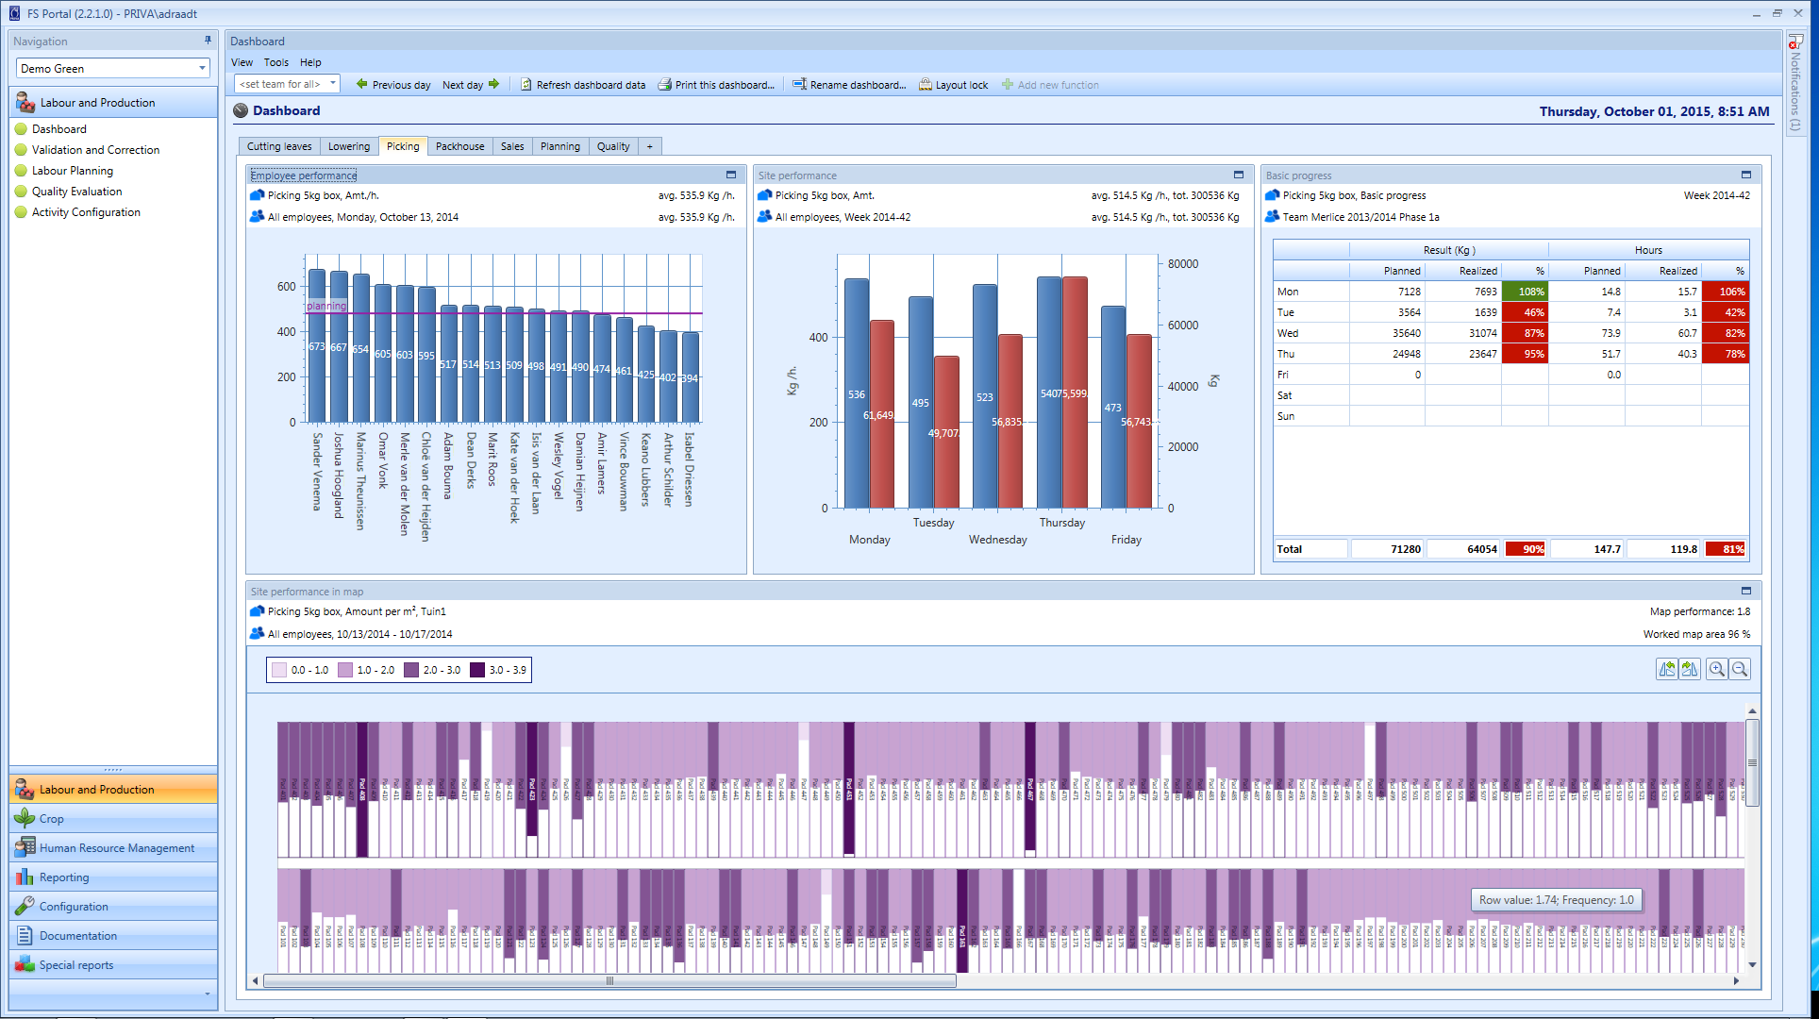
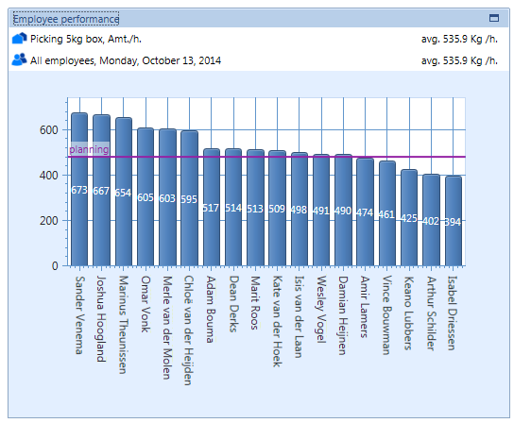
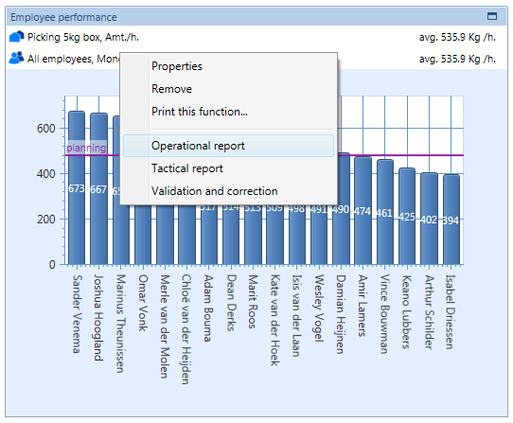

Slide 30
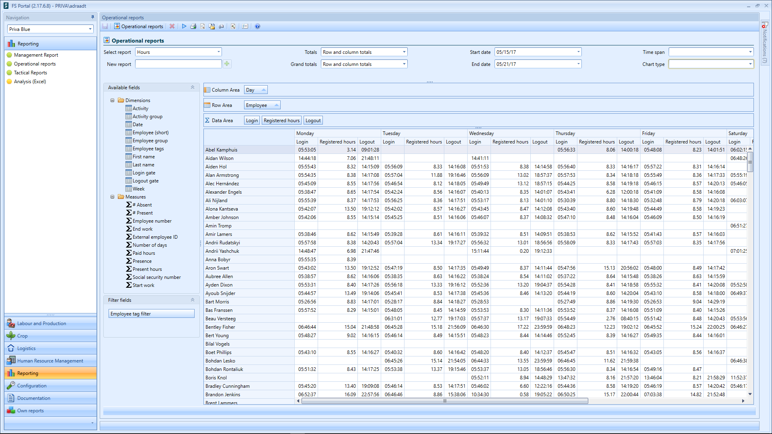

Slide 31
Information displays

Slide 32
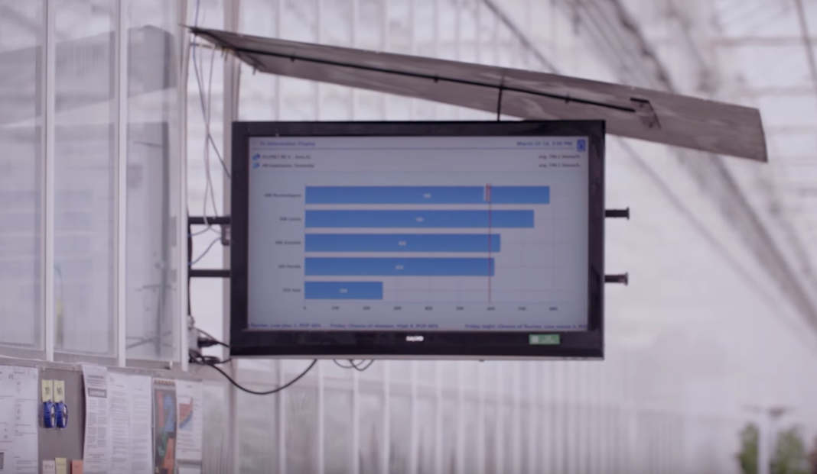
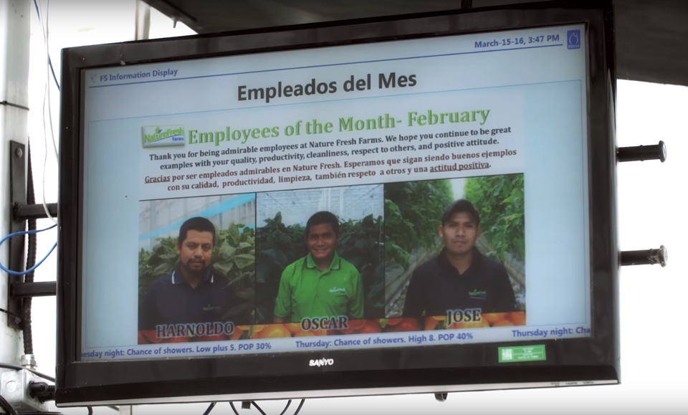
Information display | Pictures

Slide 33
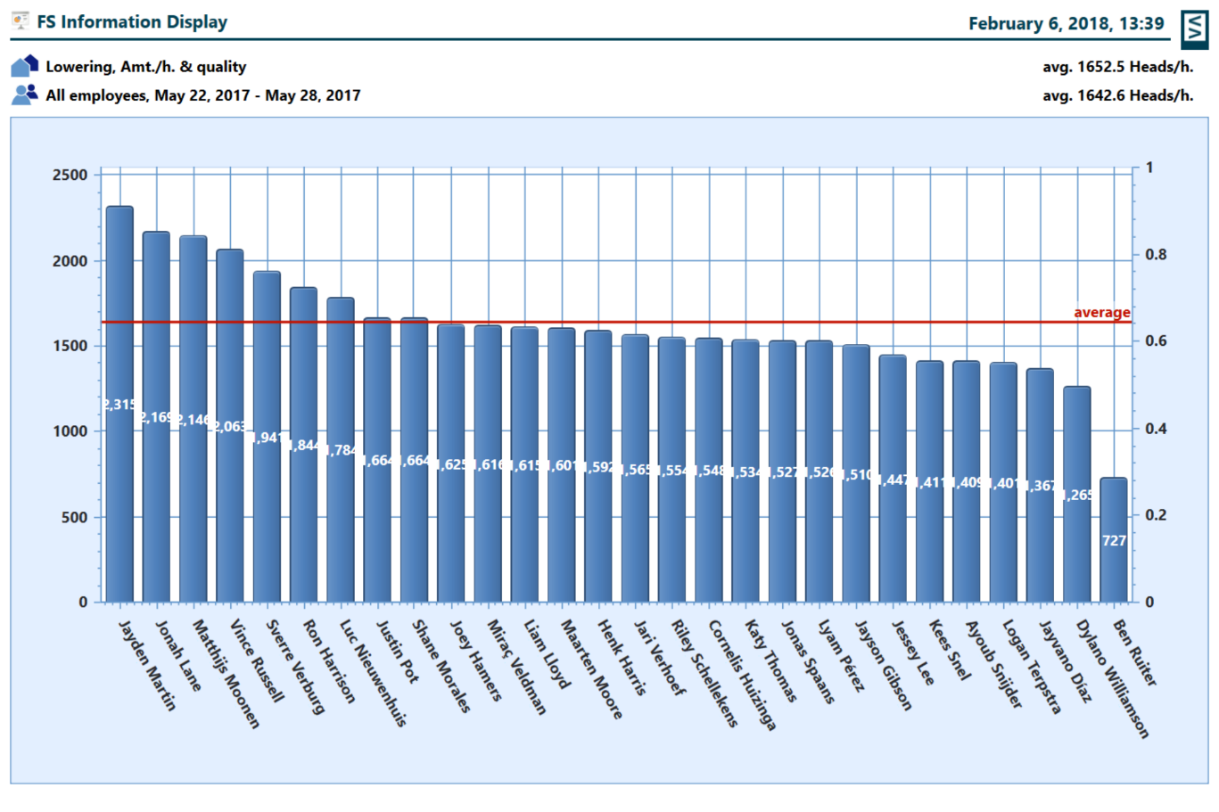
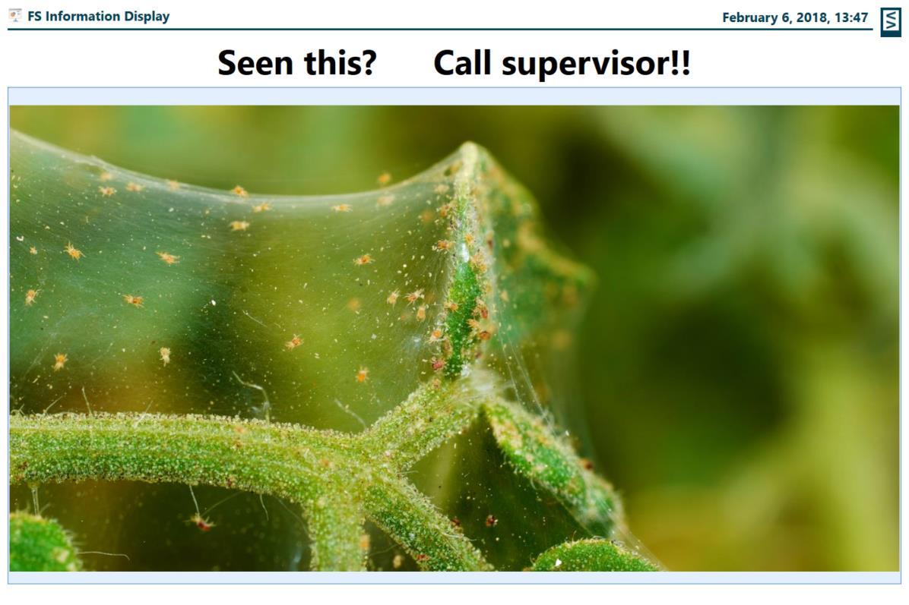
Information display | Performance

Slide 34
Analysis & export

Slide 35
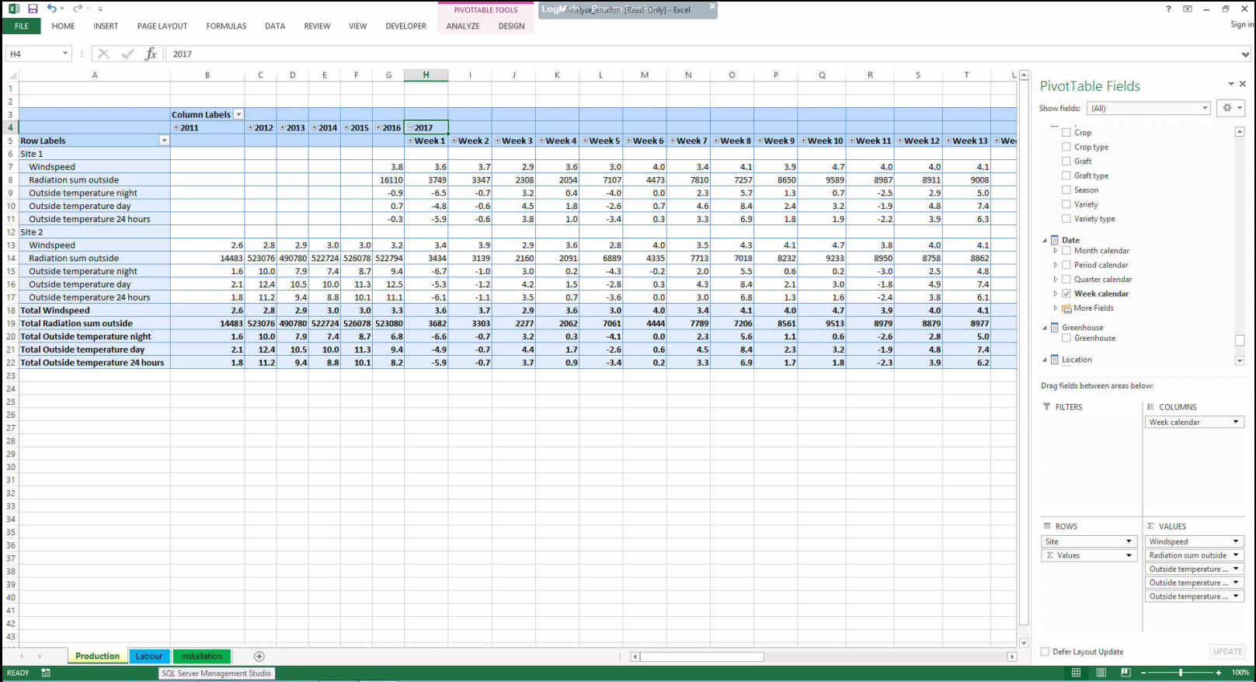
Comparing multiple years

Slide 36
.. Over multiple sites

Slide 37



Information export
FS Performance server

Slide 38
Summary

Slide 39



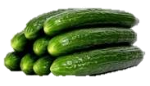



Maximize operational performance
Kg
Kg
  Increase employee efficiency
  Improve quality of the work
  Insights on resource usage per crop
  Accurate data
  Direct operational actions
  Strategic decisions based on data

Slide 40
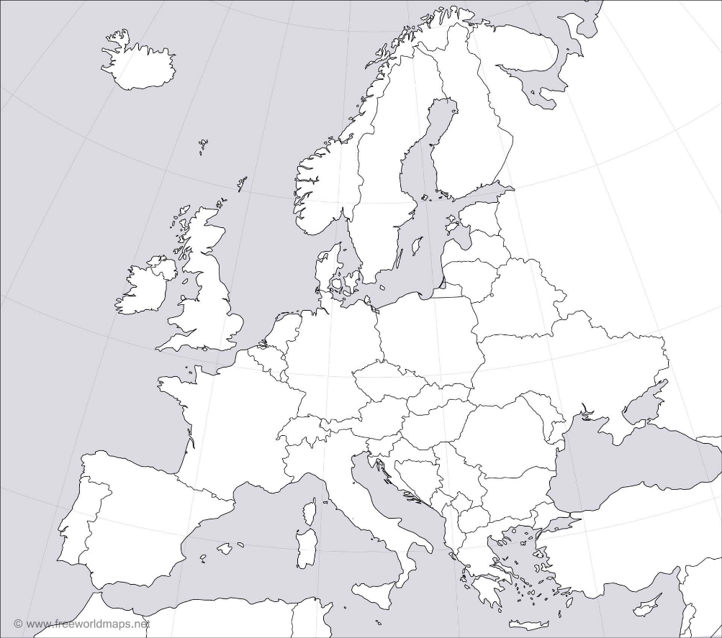






Business MANAGEMENT – MULTI SITE
Improve company performance
Uniform operational results per site
Benchmark against top performer
Improvement ideas
Make site-improvement plans

Slide 41


result

Slide 42
Thank you!
Dennis de Wit
Marketing Manager Horticulture EMEA
Kathryn Smethurst
Account Manager UK
+31 174 522 795
+44 1923 813480
dennis.de.wit@priva.nl
Kathryn.smethurst@priva.co.uk

