Slide 1


the Future of Buxus
Presentation by Didier Hermans
IPPS European Region Conference 12-10-2018

Slide 2
Herplant BVBA Belgium
IPPS European region 12/10/2018
Family business, 3 brothers, since 1985
Buxus and Taxus in different sizes and species
30 ha nursery
  10 ha grown in pots on container beds
  20 ha grown in field
export to entire Europe
More information: www.herplant.be
Herplant

Slide 3
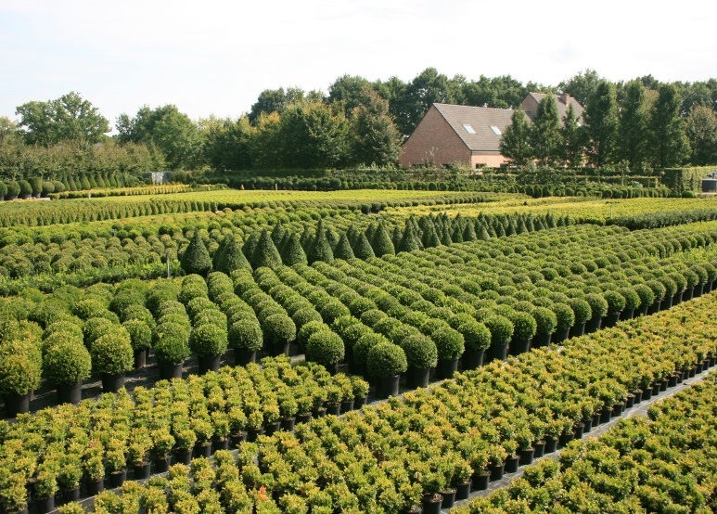
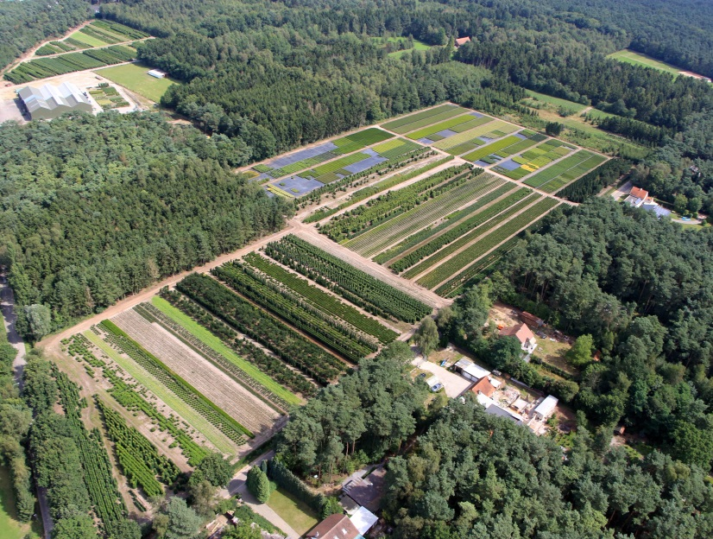
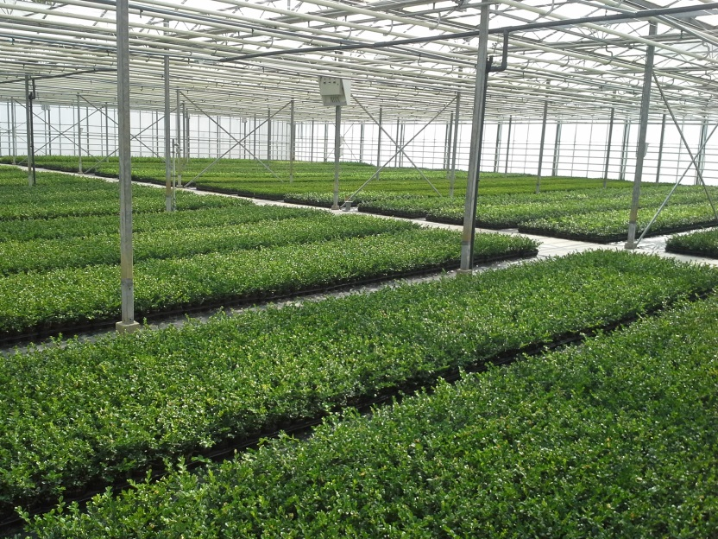
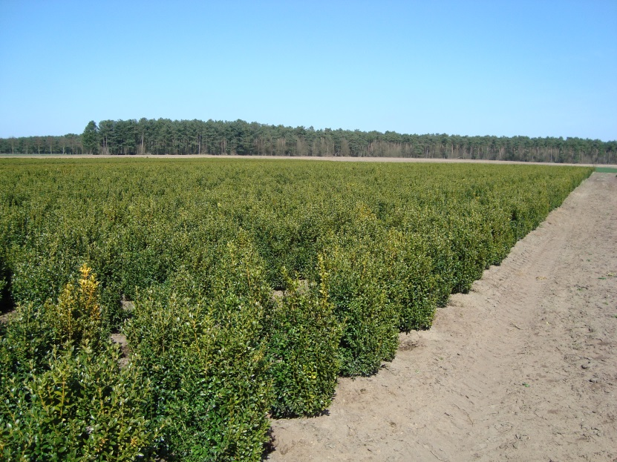
Herplant BVBA Belgium
IPPS European region 12/10/2018
container production
main nursery
Herplant
greenhouse production
field production

Slide 4
Cylindrocladium buxicola: new name
IPPS European region 12/10/2018
New fungus first discovered in 1994 in the UK
Cylindrocladium pseudonaviculata (Crous, 2002)
Cylindrocladium buxicola (Henricot, 2002)
2014: new name: Calonectria pseudonaviculata
New species found in Flemish research:
Calonectria henricotiae (Gehesquière et al, 2016)
Herplant

Slide 5
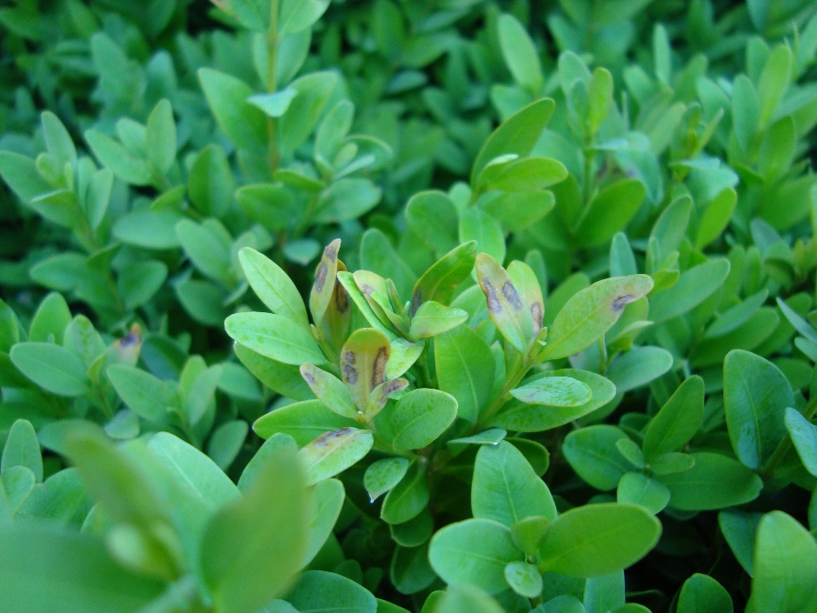
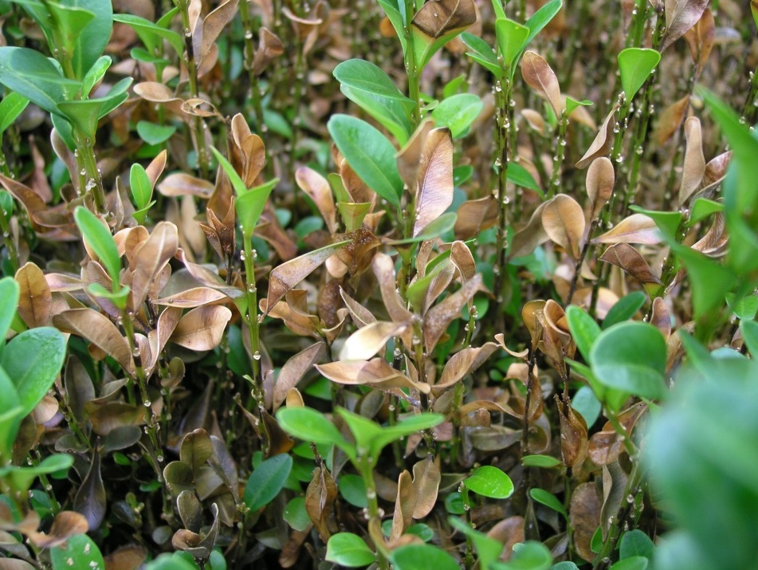
Calonectria pseudonaviculata
Symptoms:
  Brown to black leaf spots
  Rapid defoliation
  black stem lesions
  Doesn’t need wounds to enter
IPPS European region 12/10/2018
Herplant

Slide 6

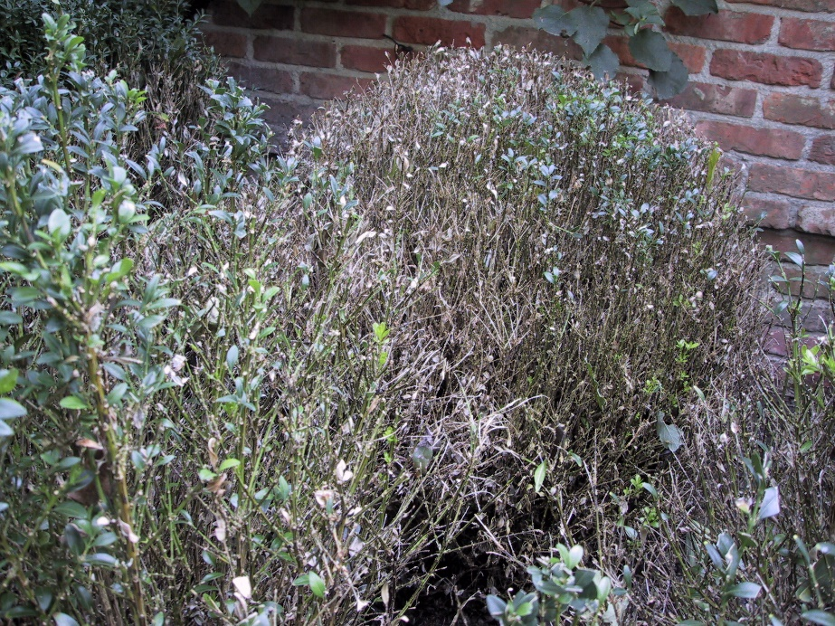
Calonectria pseudonaviculata
Infection and distribution:
  6 hours of leaf wetness (depending on cultivar and temperature)
  Optimum temperature 21° C (70°F)
  Mild and rainy conditions speed up the spread
  Now common throughout Europe, present in the entire world but not in Africa en Southern-America
IPPS European region 12/10/2018
Herplant

Slide 7



Calonectria Research Belgium
Preliminary fungicide efficacy trials (PCS + ILVO)
large 4-year research project in Flanders, Belgium
financed by government + boxwood industry
collaboration between : - scientists from ILVO
Kurt Heungens and Katrijn Van Laere
- scientist from PCS
Filip Rys
- conducted by Bjorn Gehesquière
Subjects:
  Fungicide efficacy
  Pathogen genetic diversity and population structure
  Host susceptibility and breeding potential
  Disease development and spread
IPPS European region 12/10/2018
Herplant

Slide 8

Calonectria: Buxuscare
website made in collaboration with researchers
and managed by Herplant.
See:
IPPS European region 12/10/2018
by Herplant
Herplant

Slide 9
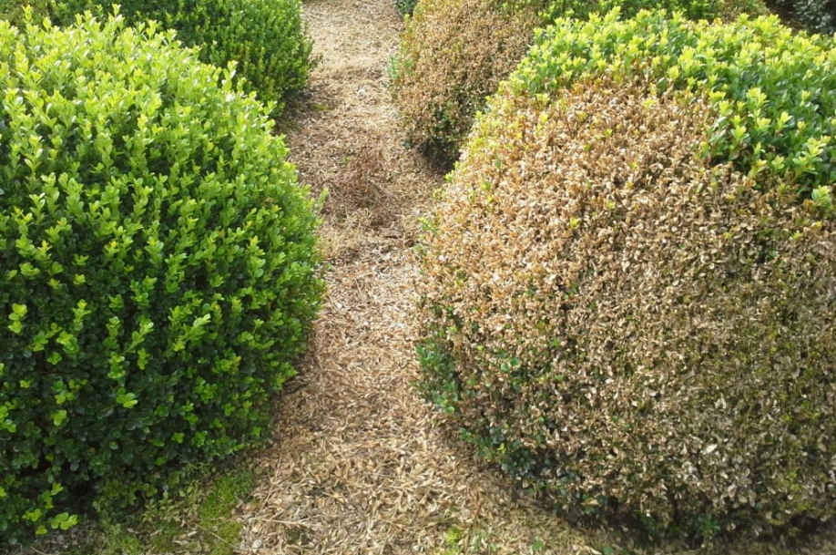
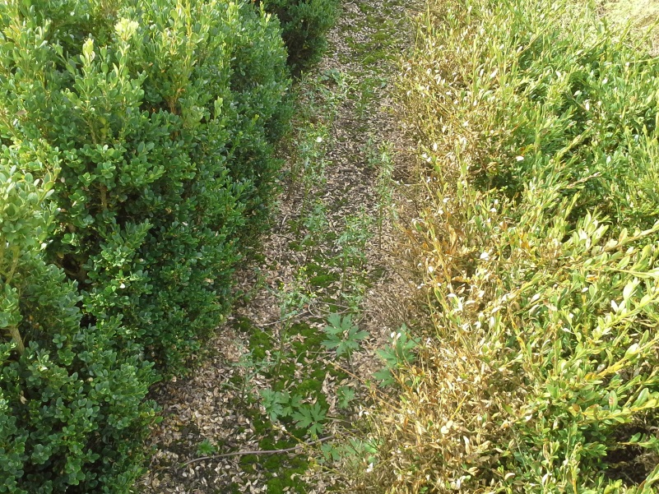
Existing Buxus sortiment
Which cultivars are better against Box Blight?
IPPS European region 12/10/2018
especially within the very diverse Buxus microphylla group
Plant shape!
  -> pruned plants are much more sensitive
Herplant

Slide 10
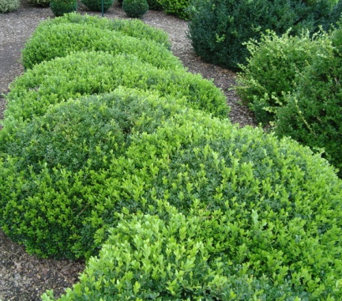
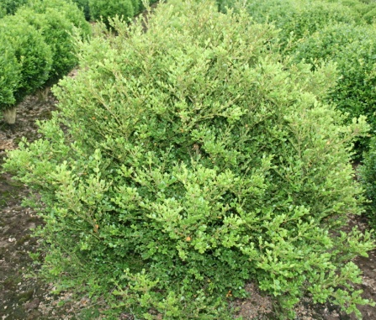
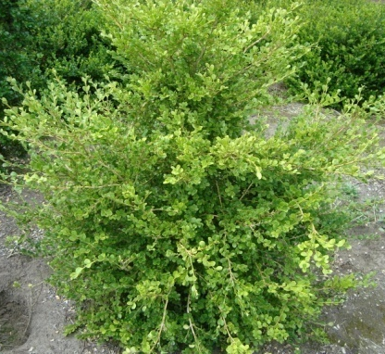
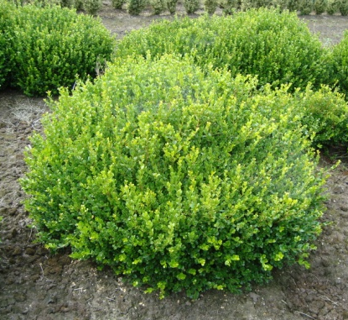
Buxus microphylla
botanically very diverse
with different characteristics
divided in cultivar groups
IPPS European region 12/10/2018
Microphylla
Group
(Japan)
Koreana
Group
(Korea)
Japonica
Group
(Japan)
Sinica
Group
(China)
Herplant

Slide 11
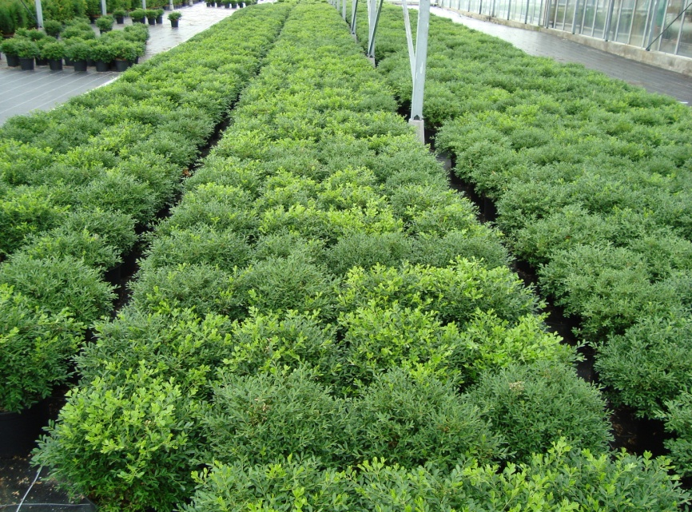
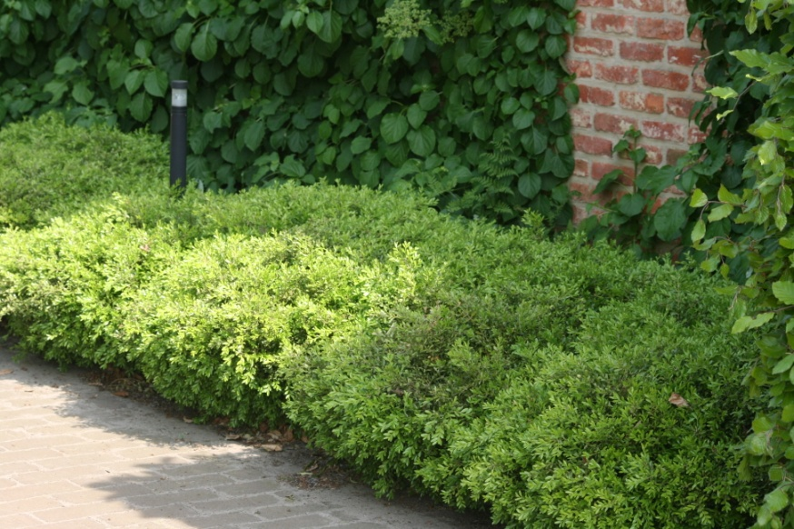
Buxus microphylla ‘Rococo’
IPPS European region 12/10/2018
ground covering,
fresh green, small leaves
low hedges, small ball shapes and low cloud shapes
needs no or less pruning , max. height 40 cm
grows best in shade, in full sun
extra water
optimize fertilizer
Herplant

Slide 12
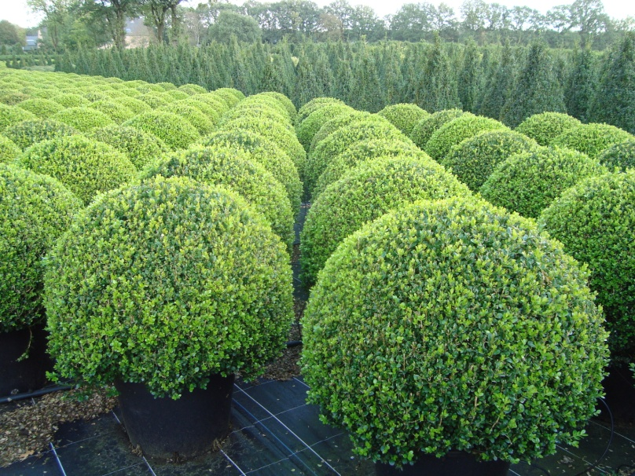
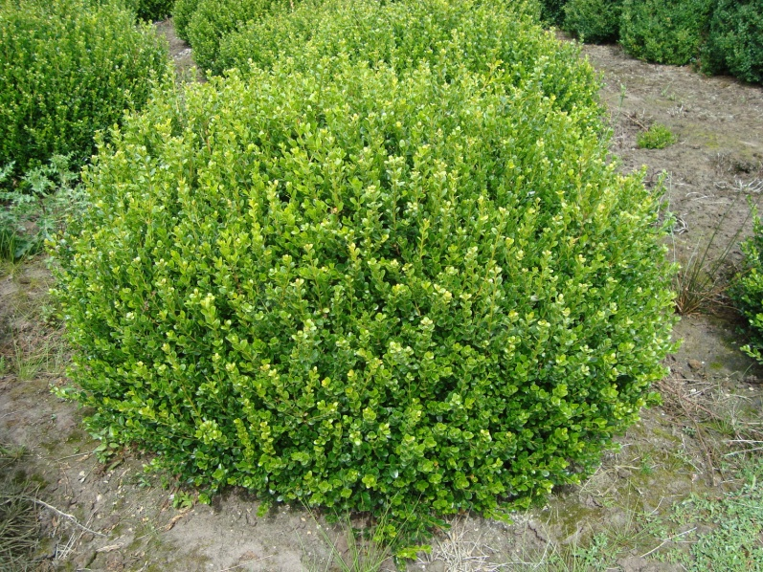
Buxus microphylla ‘Faulkner’
IPPS European region 12/10/2018
nice shiny, olivegreen leaves
bushy growth, ideal for clouds
and ball shapes
for heights max. 120 cm
most cultived of all the microphylla’s
Faulkner from Benelux≠
Italian Faulkner
Herplant

Slide 13
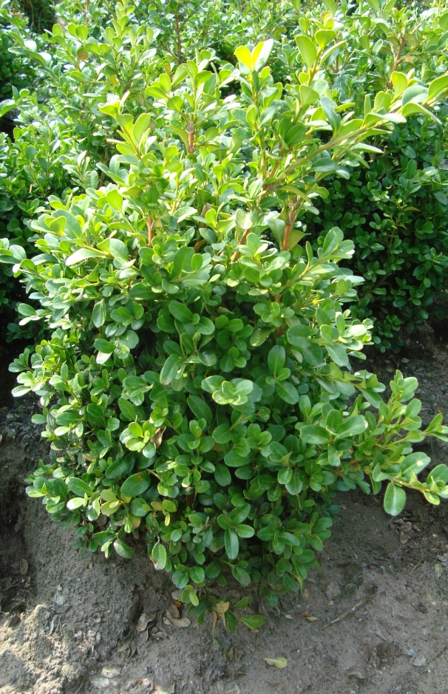
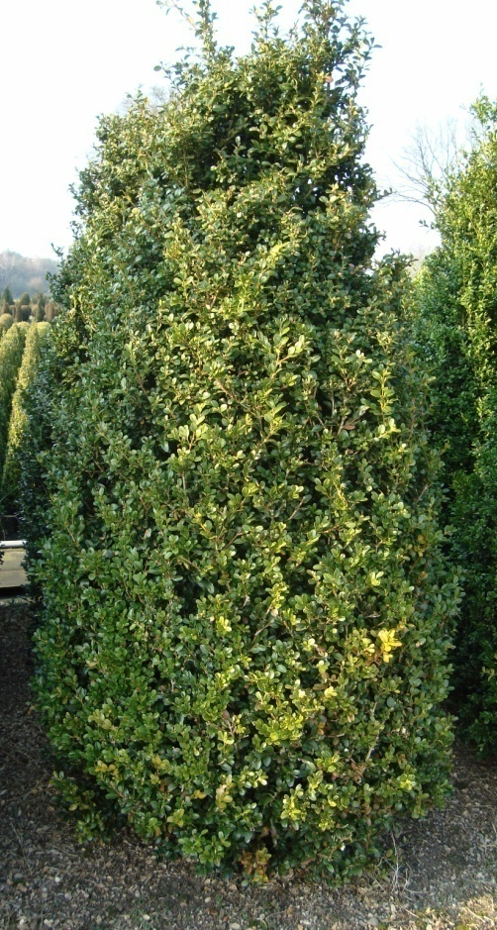
Buxus microphylla ‘National’
IPPS European region 12/10/2018
dark, big leaves
bushy growth, ideal for
block hedges, shapes and
hedges
replacement of Buxus
sempervirens‘Rotundifolia’
only few grown
Herplant

Slide 14
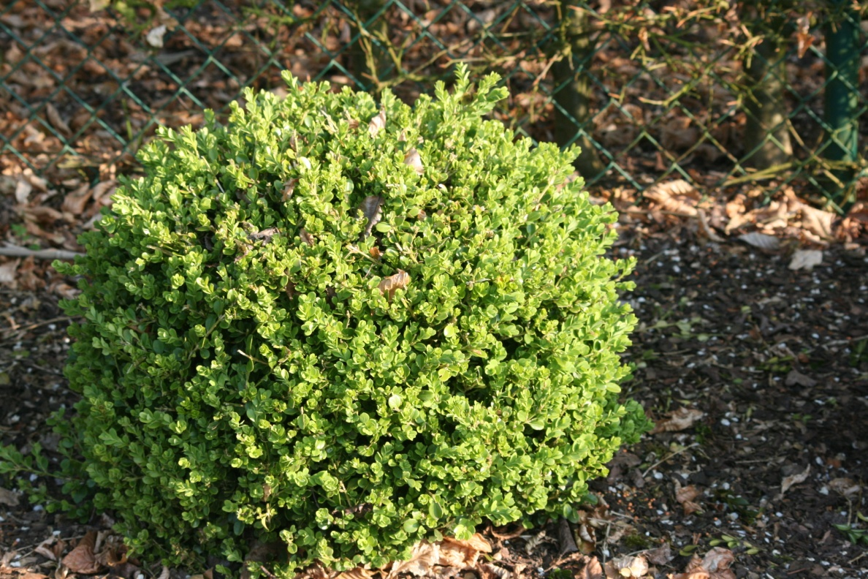


Buxus microphylla var. japonica
light green (pale green), round
leaves
natural growing, differs from
stereotype image of ‘green/tight'
Buxus
ideal for natural Buxus planting
areas in public green, but also
topiary and hedges
at this moment one of the best microphylla’s
IPPS European region 12/10/2018
Herplant

Slide 15
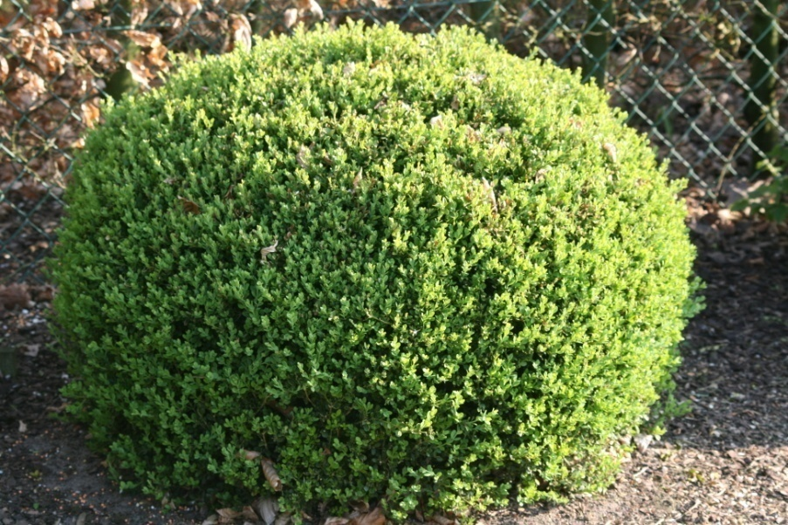
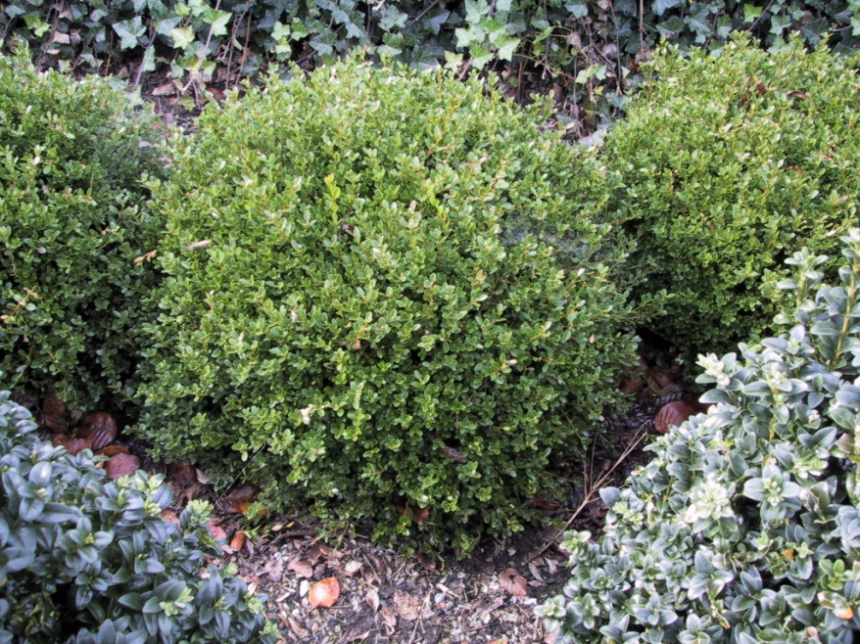
Buxus microphylla var. koreana
low growing, compact,
slow-growing shrub
smal, small fresh green
leaves
flowers in February with
yellowgreen, scented flowers-
bee plant !
ideal for low hedges and planting density, low balls and
low-maintenance applications
only few grown
IPPS European region 12/10/2018
Herplant

Slide 16
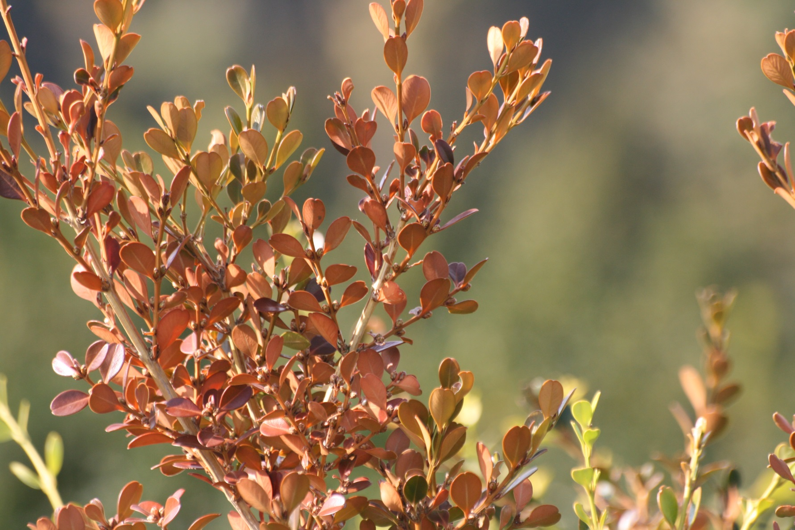

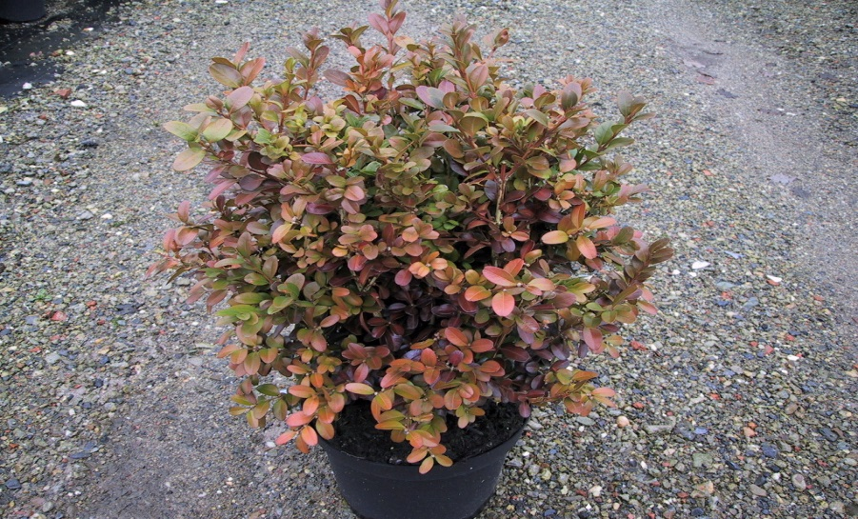
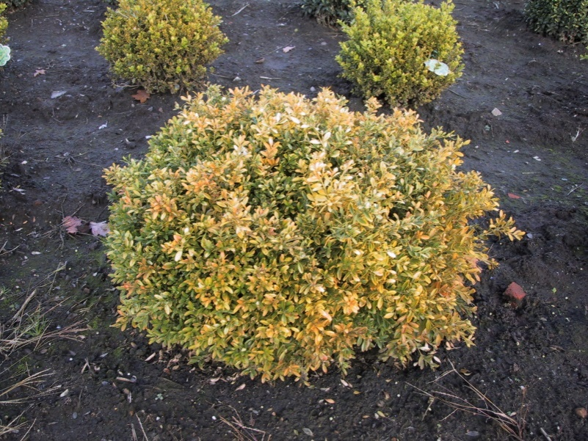
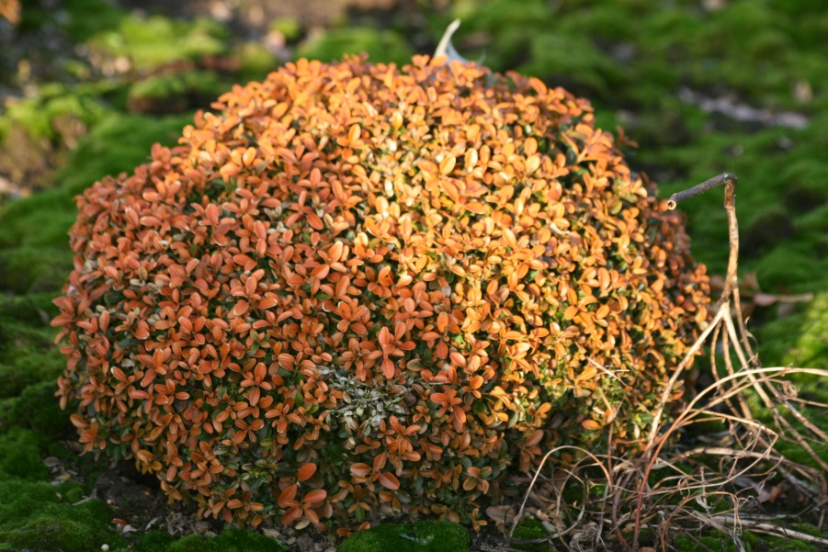
Winter colour Buxus microphylla=frost protection
IPPS European region 12/10/2018
Herplant

Slide 17
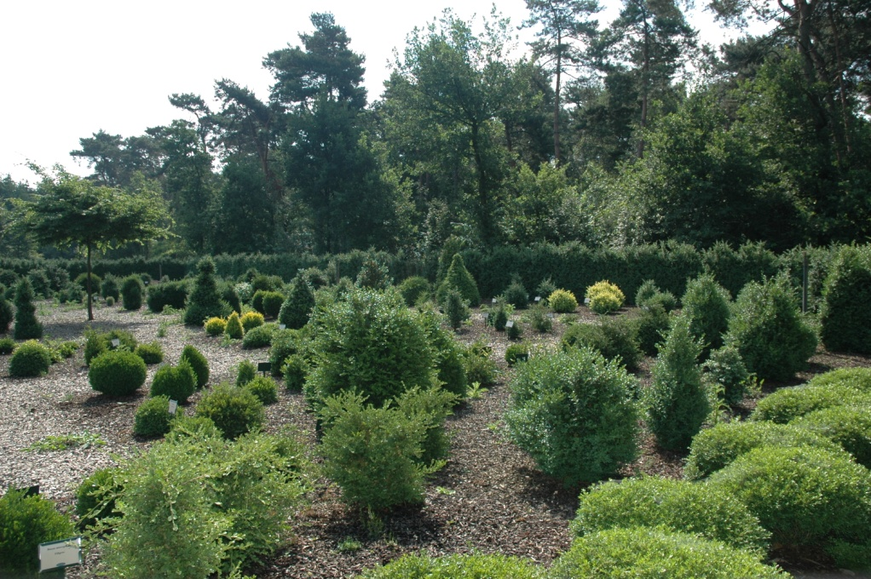
Buxus breeding
Goal: create resistant Buxus hybrids
Basis: our reference collection: more than 200 species and cultivars -> supported by DNA-based research
Knowledge about different stages present
IPPS European region 12/10/2018
Herplant
Buxus species and cultivar collection at Herplant

Slide 18
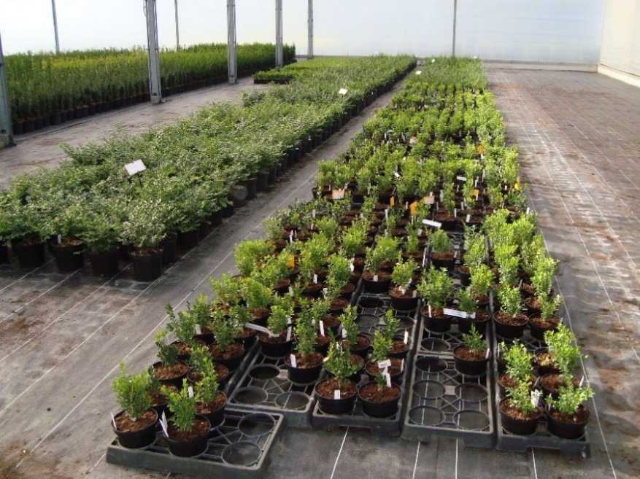
Buxus breeding
Data available regarding:
  - growth shape (height, compactness)
  - growth vigor
  - frost resistance
  - leaf shape
  - winter color
  - disease resistance
  - botanical characteristics
  - ploidy levels
  - genome size
  - genetic relationship (van Laere et al. 2011)
= basis for starting up a breeding program
IPPS European region 12/10/2018
Herplant

Slide 19
Buxus breeding
  cross breeding: flowers need to be available simultaneously
  more than 100 crossing combinations tested
  seedlings: take a long time to germinate: seed dormancy
  controlled inoculation with Calonectria for resistance screening:
  see further
  further selection: growth shape, leaf shape, colour, winter
  hardiness, etc.
  start propagation + commercial production
IPPS European region 12/10/2018
Herplant

Slide 20
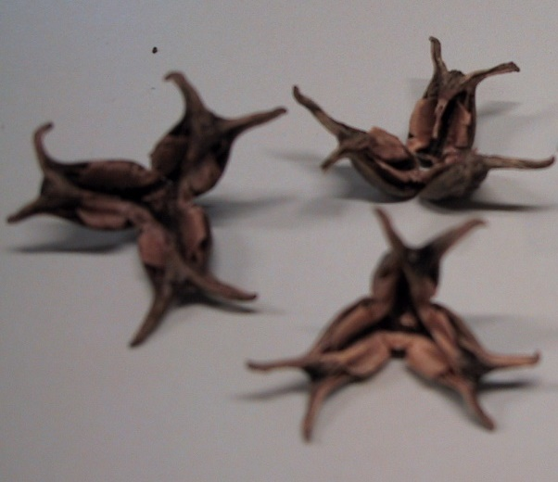
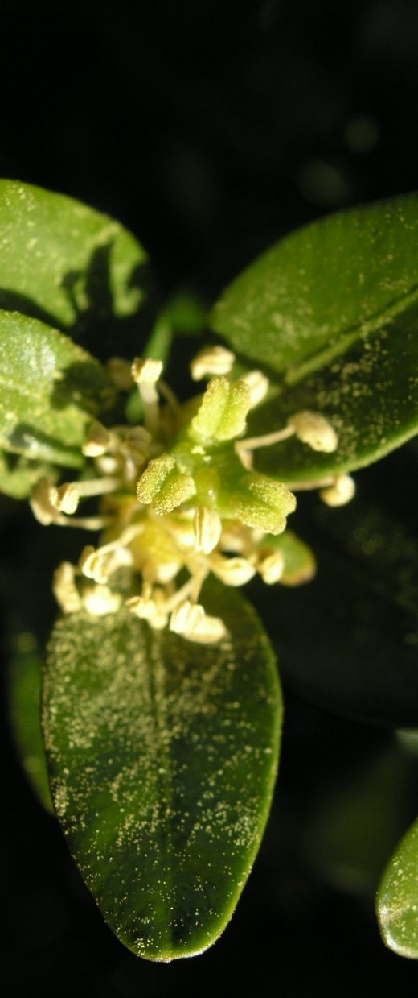
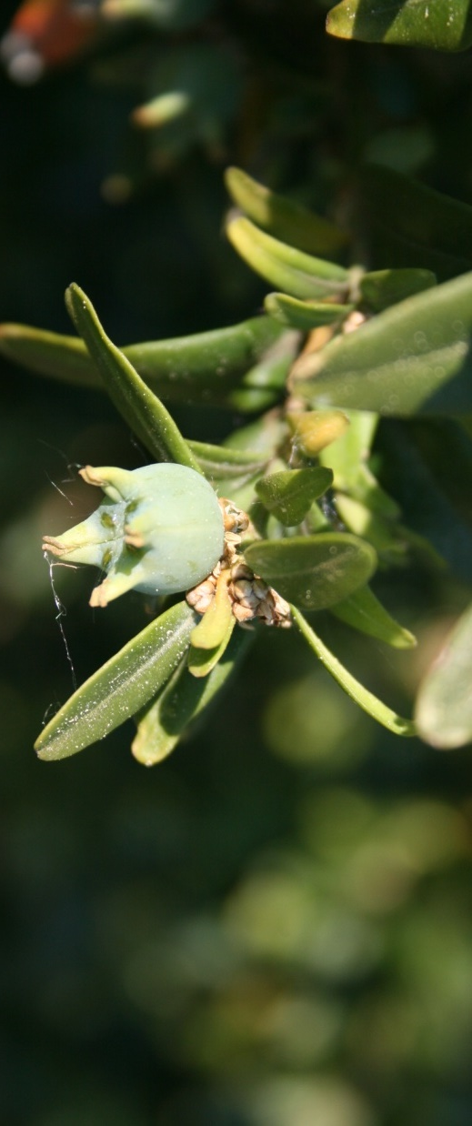
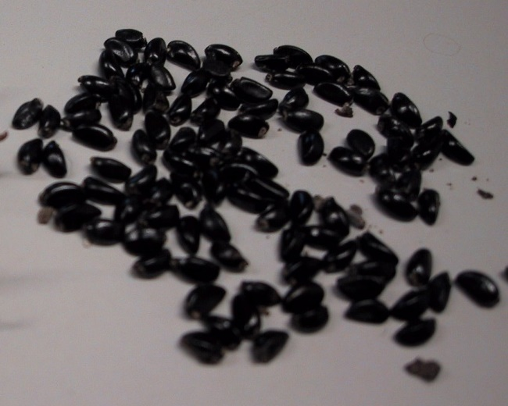
Buxus breeding
IPPS European region 12/10/2018
Herplant

Slide 21
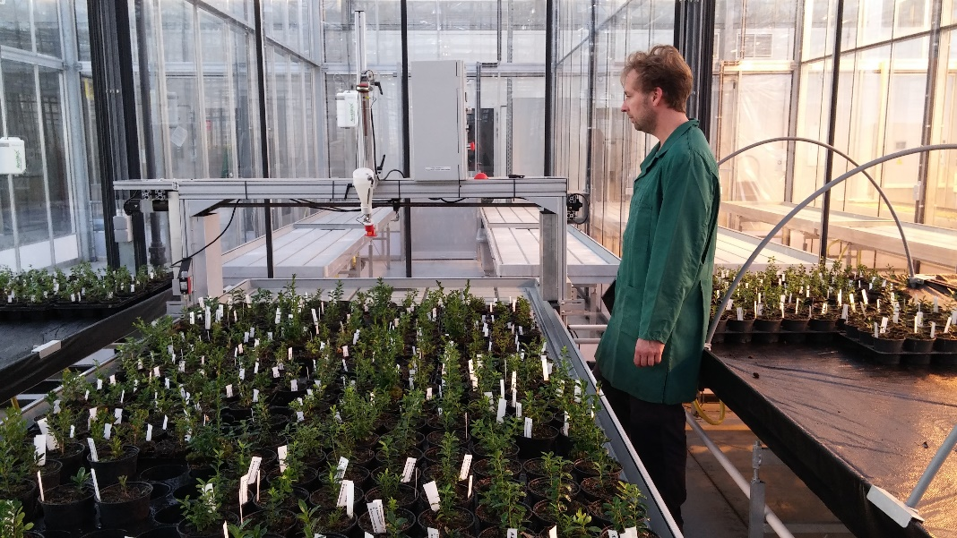
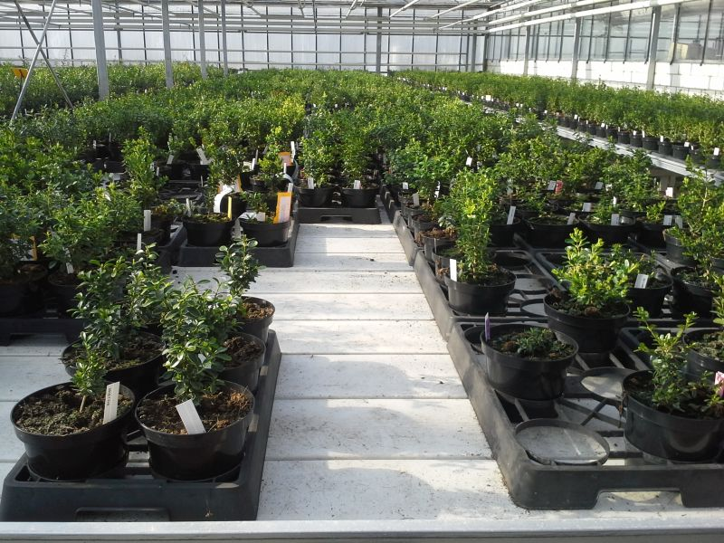
Buxus breeding
IPPS European region 12/10/2018
1st inoculation
Ready for field testing
Herplant

Slide 22
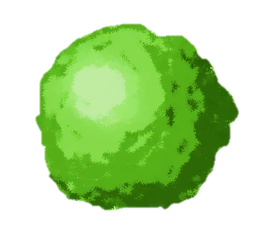

Buxus breeding
2007
?
research
Bad Zwischenahn 30/08/2018
IPPS European region 12/10/2018
2009
10,000
breeding
2013
3,000
inoculation
2014
150
selection / field test
2015
final selection
Herplant
2019
€
start sale

Slide 23
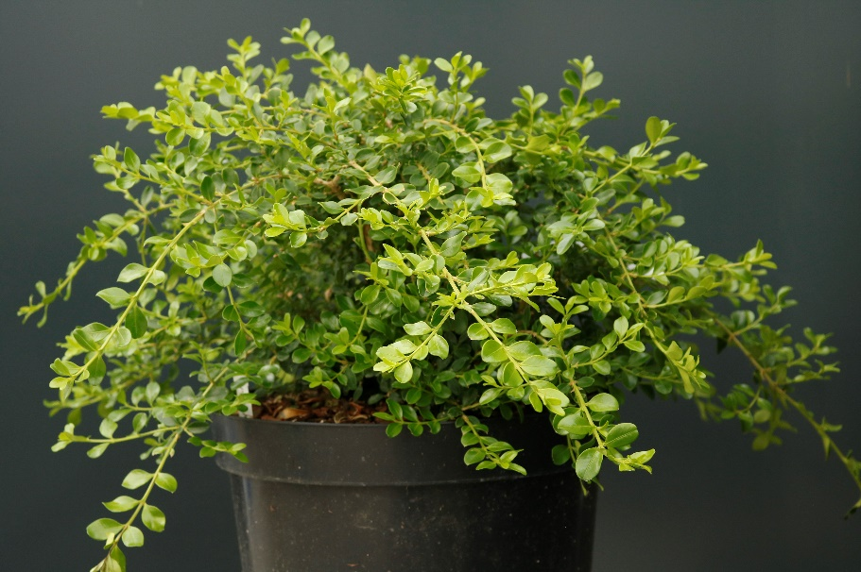
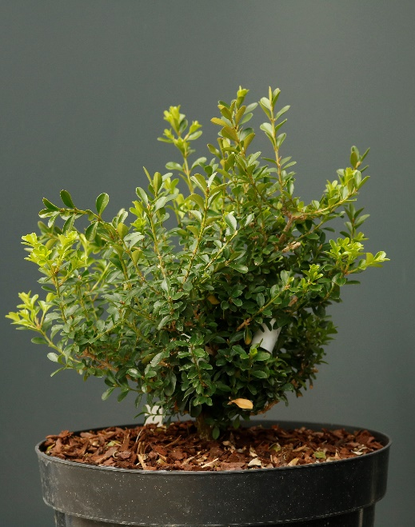
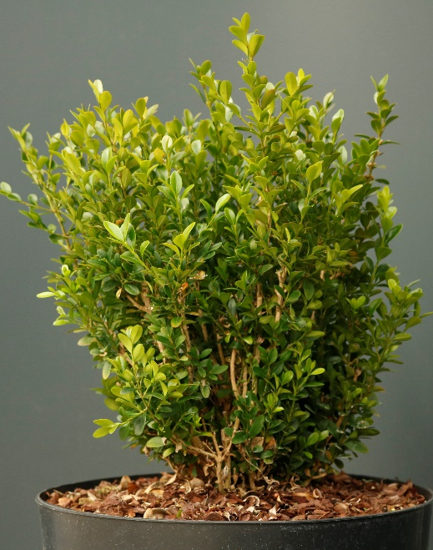
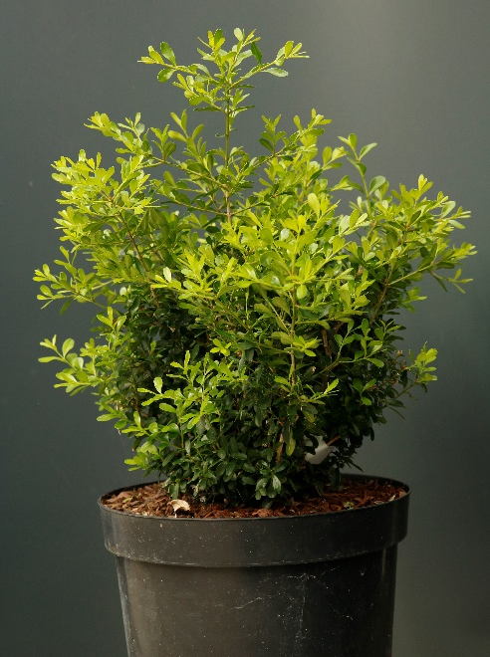
New resistant Buxus hybrids
after 8 years of
breeding and selection
final selection of 4 hybrids
IPPS European region 12/10/2018
Special type
Low growing type
Medium type
Tall growing type
Herplant

Slide 24
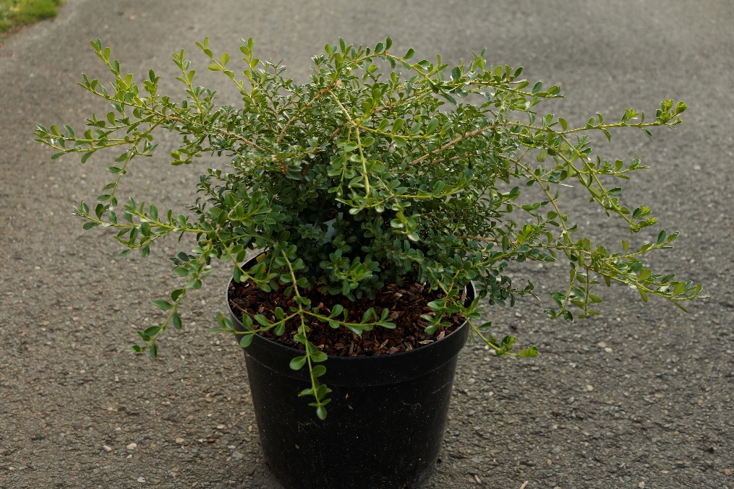
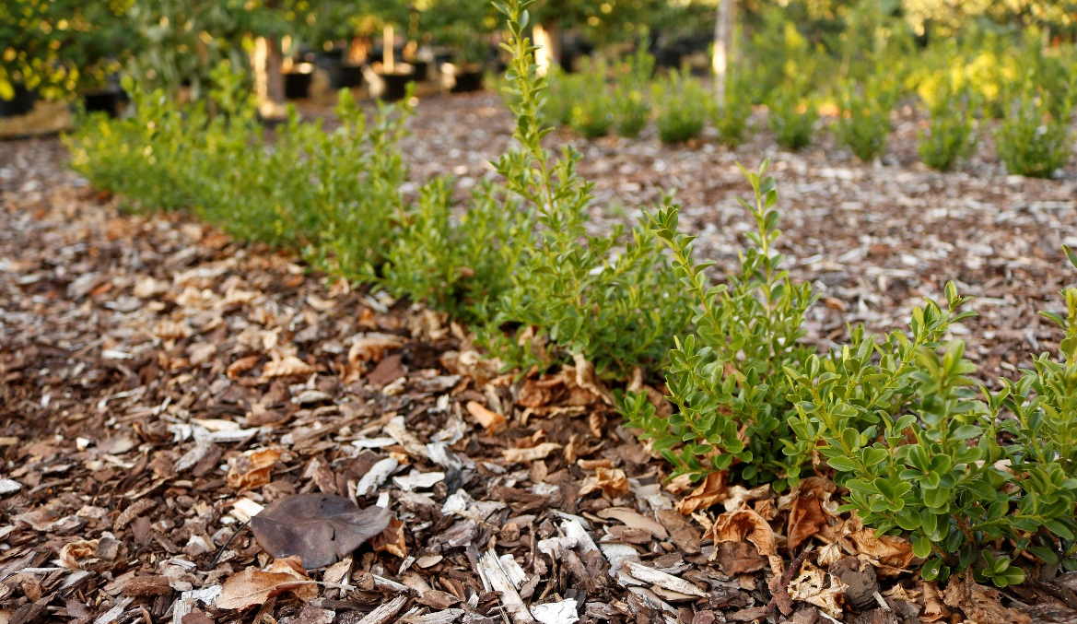
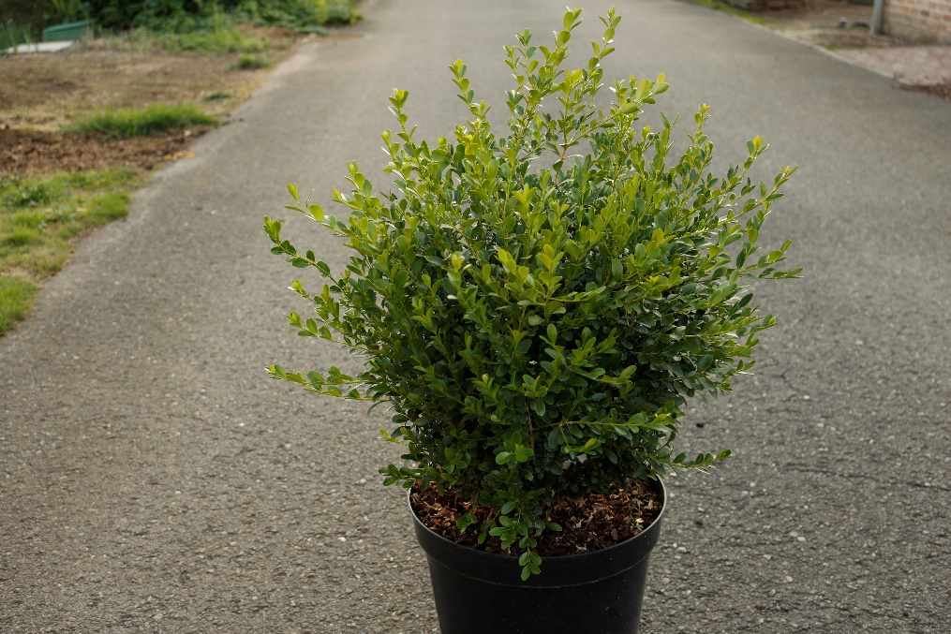
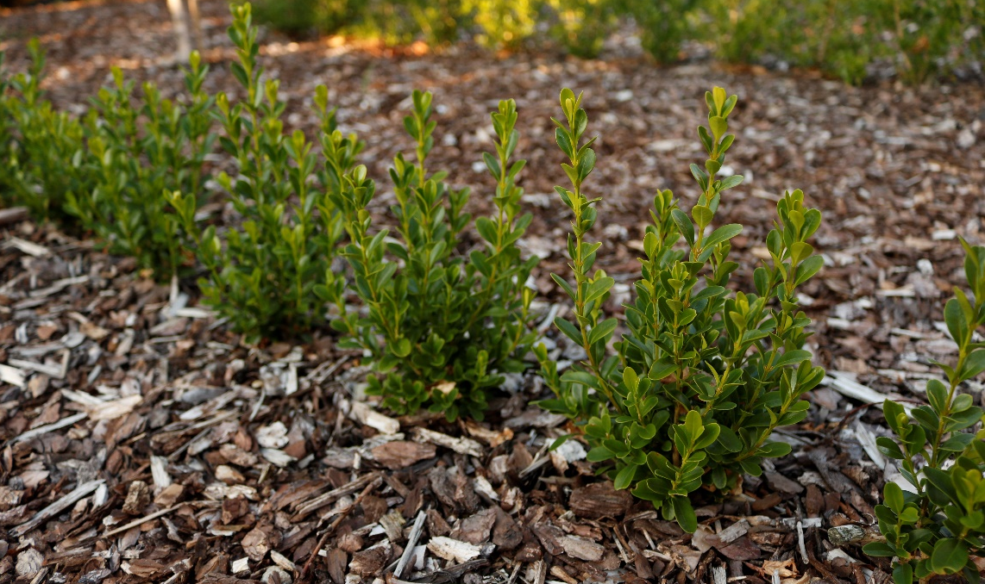
New resistant Buxus hybrids
IPPS European region 12/10/2018
LOW
Herplant
MEDIUM

Slide 25
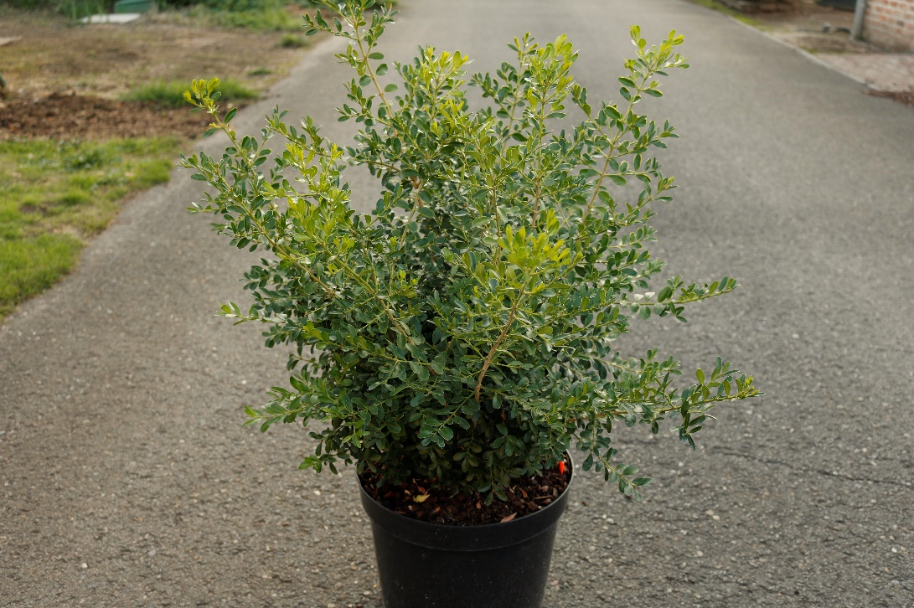
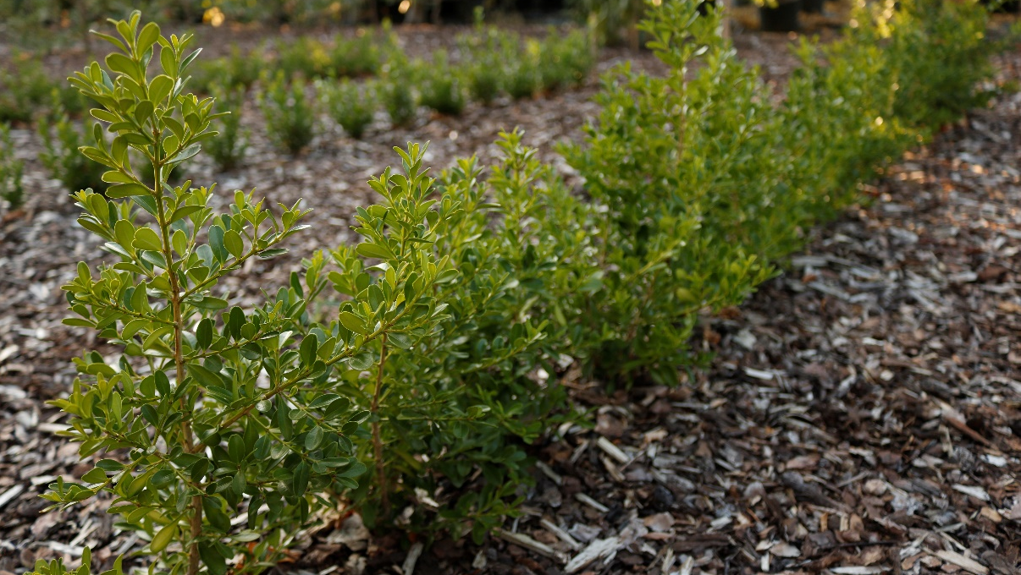
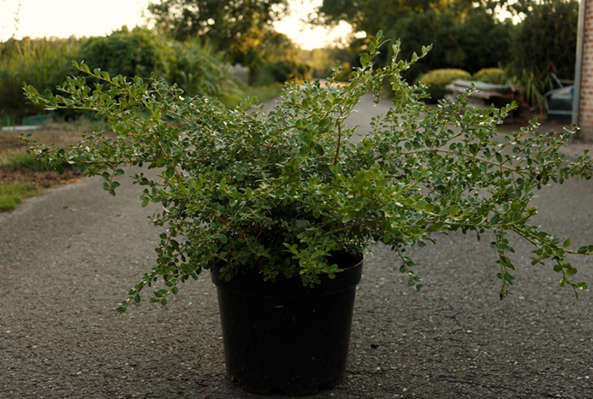

New resistant Buxus hybrids
IPPS European region 12/10/2018
TALL
Herplant
SPECIAL

Slide 26
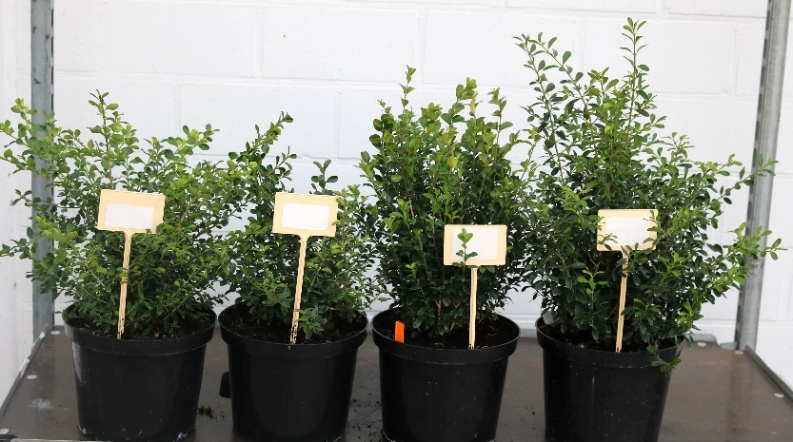
Resistant Buxus hybrids: protection and introduction
First commercial introduction in Europe : September 2019
IPPS European region 12/10/2018
new hybrids are being protected by
Plant Breeders’ Right in Europe and Plant Patent in US
propagation and production first years only by Herplant , later also by a select group of growers
Herplant

Slide 27
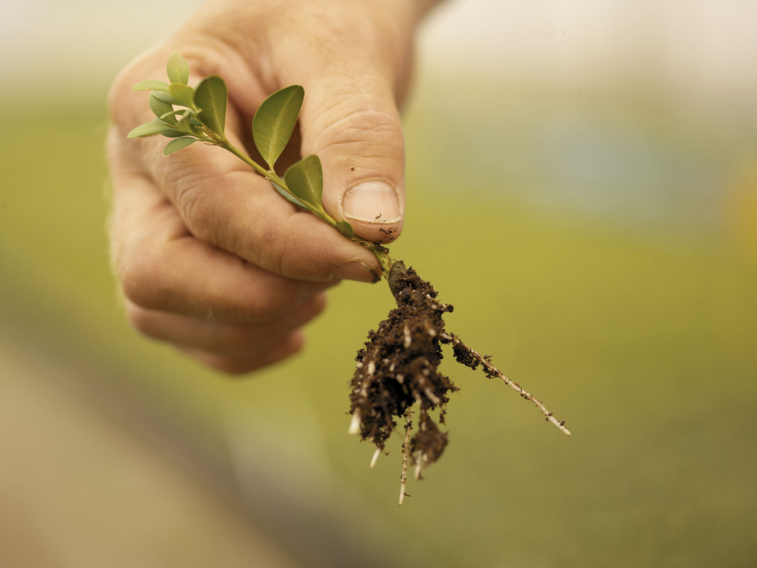

Are there any questions ?
IPPS European region 12/10/2018
Acknowledgments
Kurt Heungens ILVO Belgium
Katrijn Van Laere ILVO Belgium
Eline Hermans lay-out PowerPoint
Herplant

Slide 28
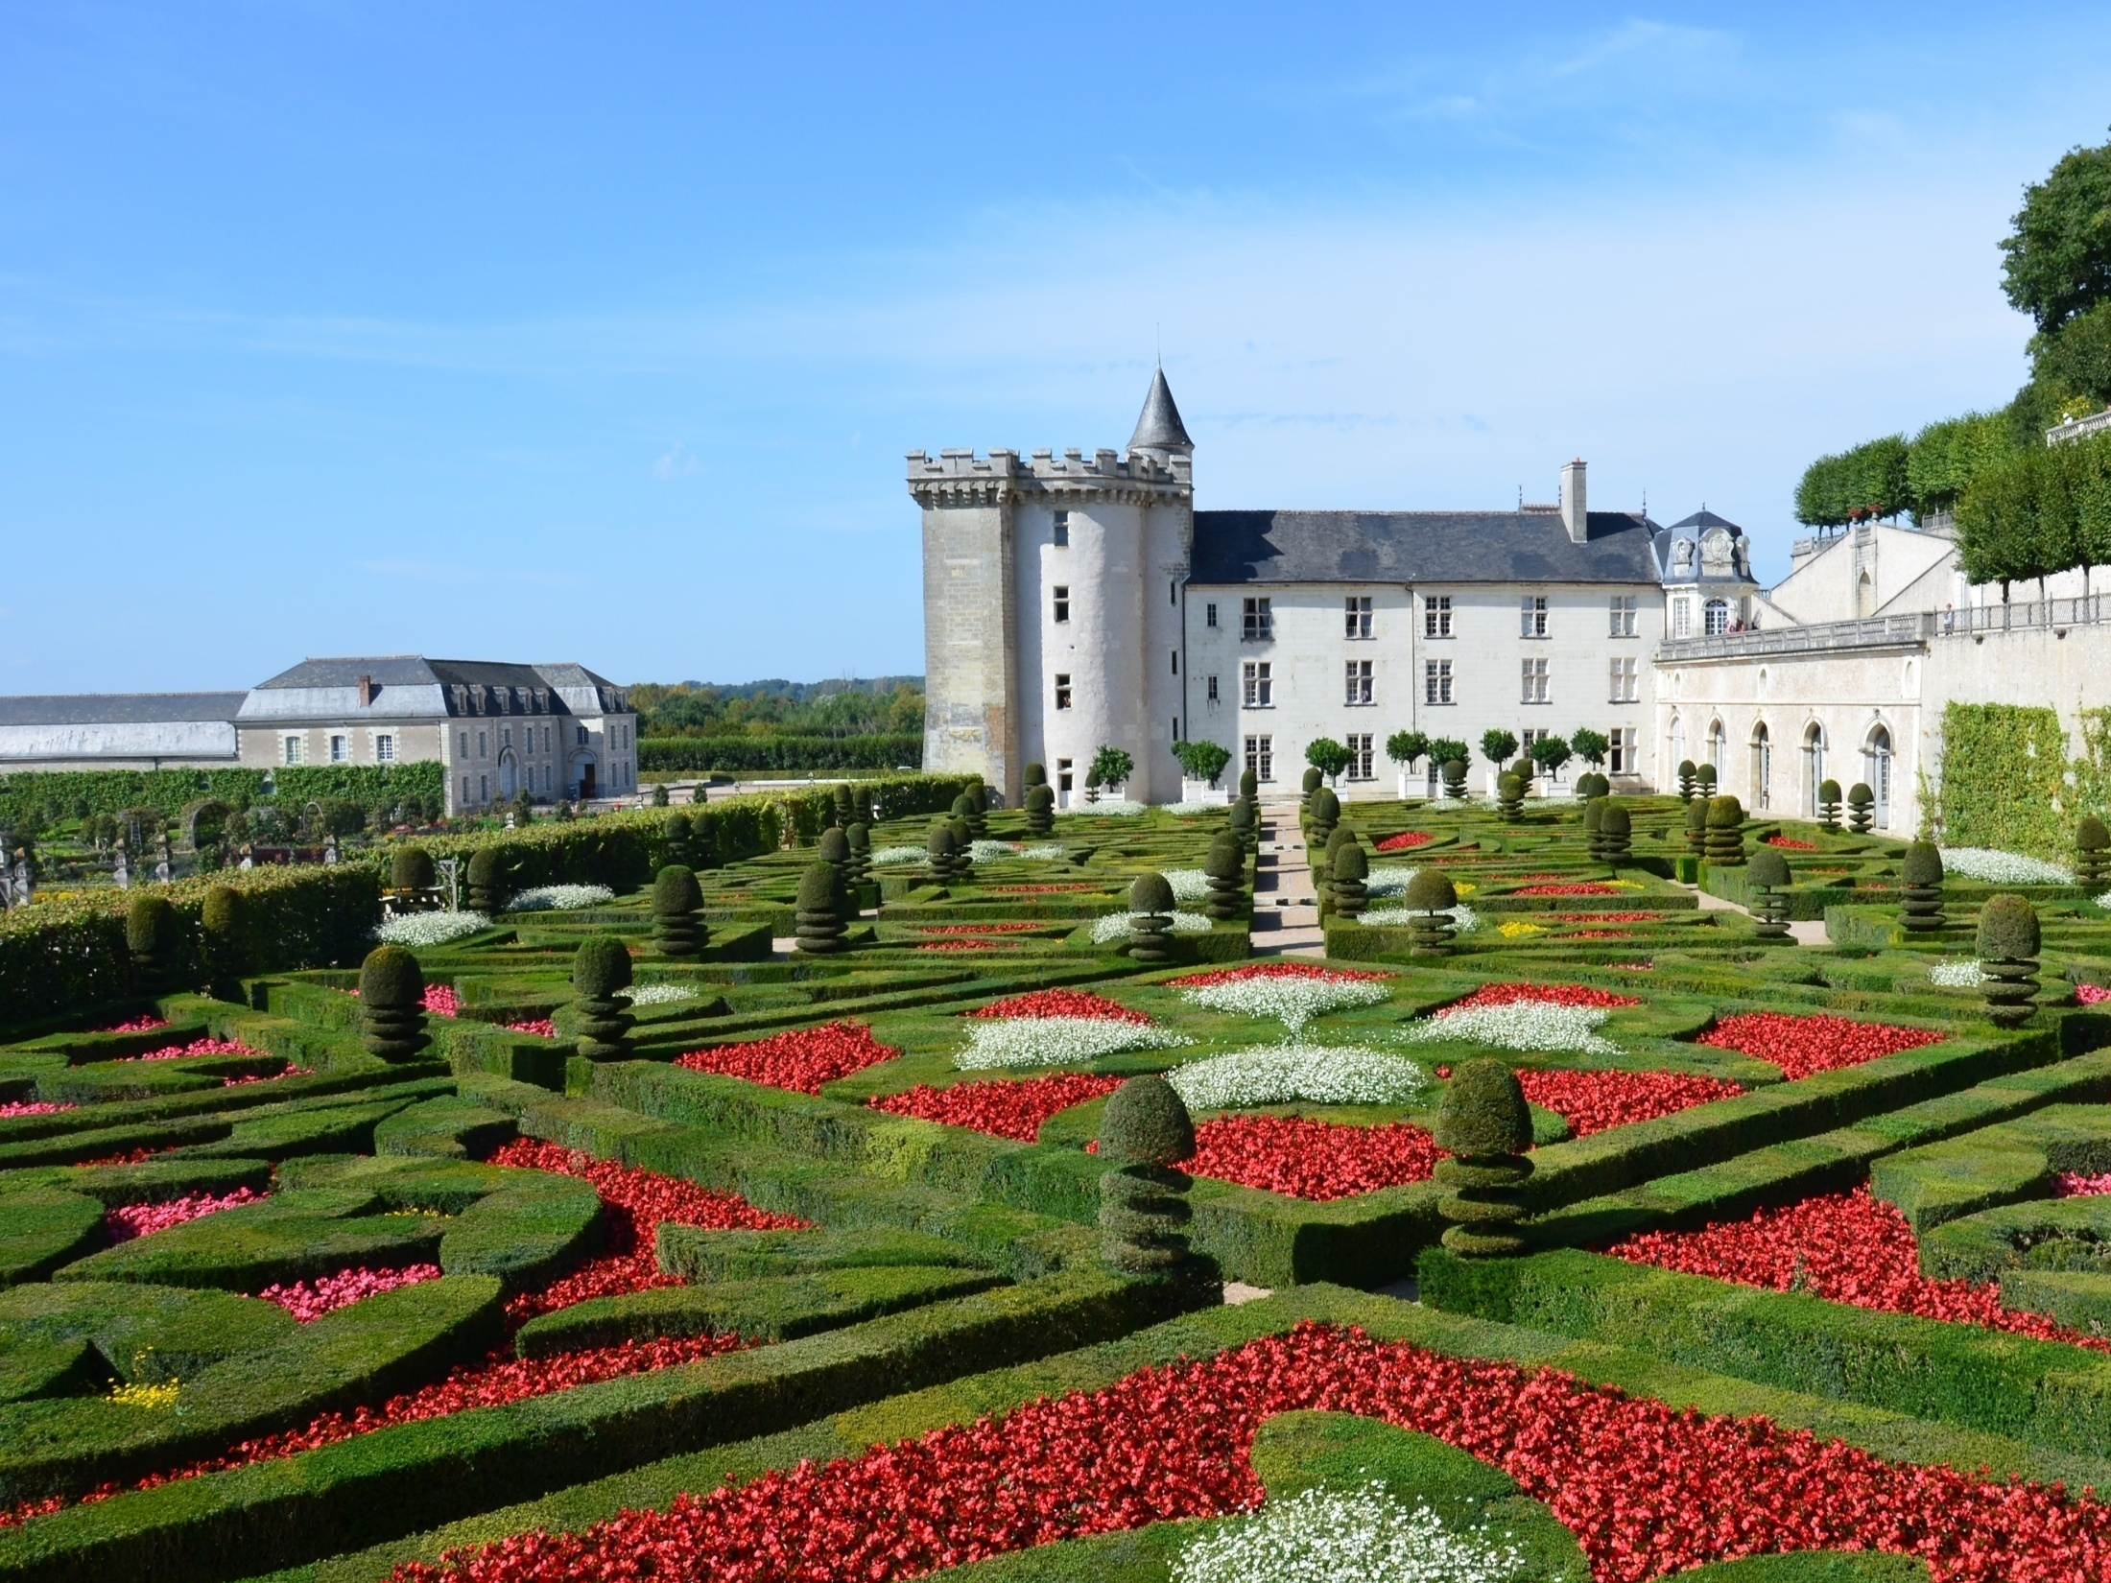
Thank you for your attention
Presentation by Didier Hermans
12th of Oktober 2018

