Slide 1

Dealing with quarantine pests and diseases
Anneke van Dijk
Policy advisor phytosanitary issues
Dutch Organisation agriculture and horticulture
(LTO Nederland)
Karin Visser
Senior Inspector
Phytosanitary affairs
NVWA

Slide 2




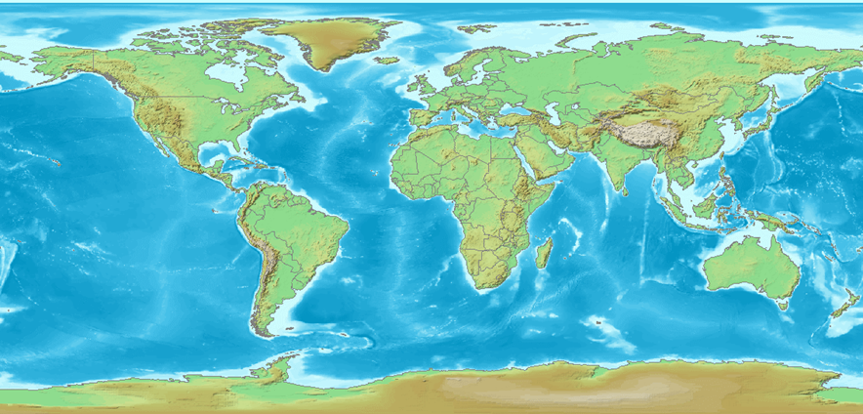








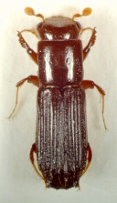
International Trade

Slide 3
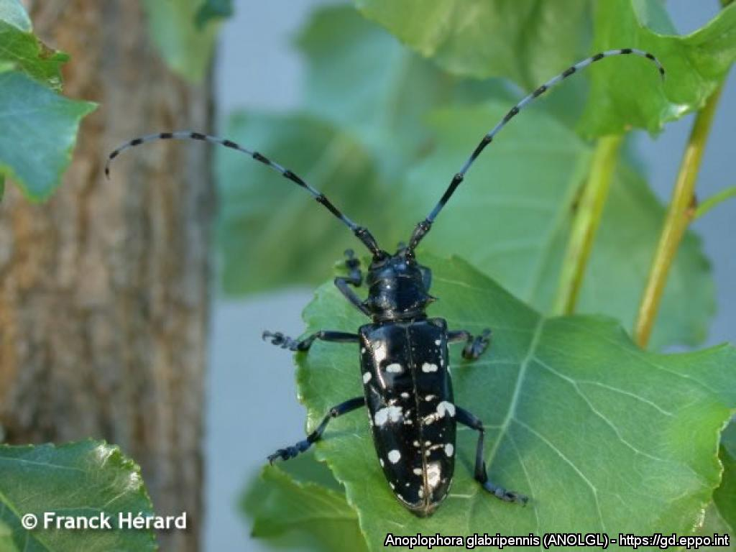
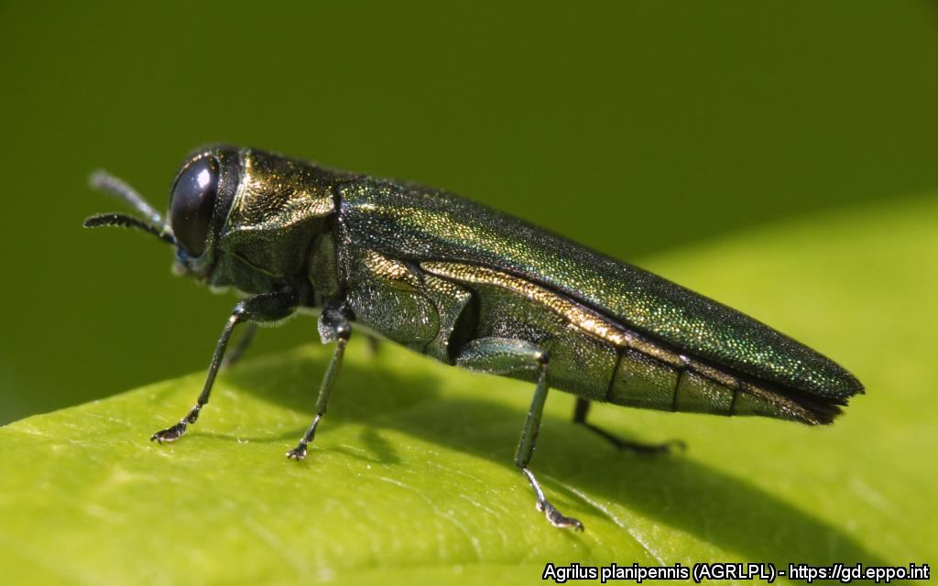
Some important organisms

Slide 4
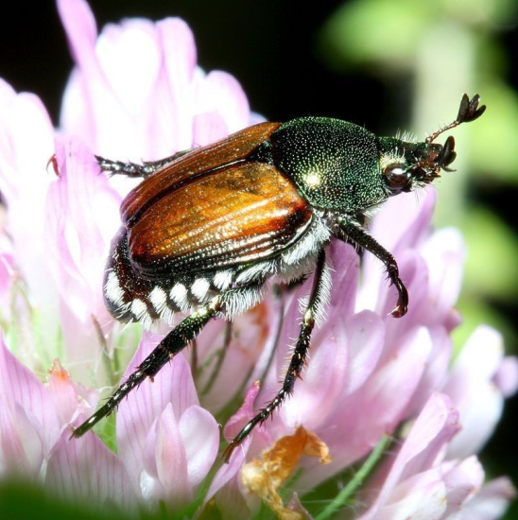
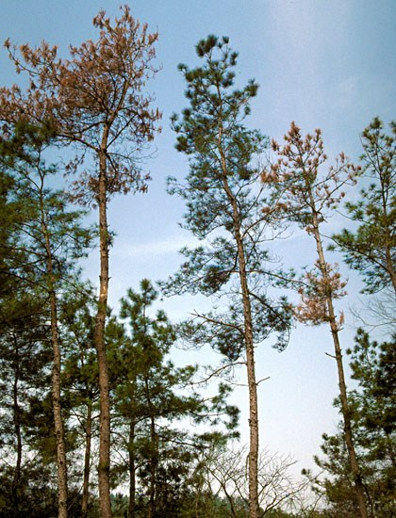

Slide 5
EU Phytosanitairy rules (directive 2000/29/EC)
Aim: to prevent entering and spread harmfull organisms in EU.
List of regulated organisms >300
Examples: Asian longhorn beetle, Emerald Ash borer, Pine Wood Nematode, Xylella fastidiosa, Popillia japonica
When an organism is found, National Plant Health Authorities must eradicate, if possible
Some organisms become widespread and in the end, cannot be eradicated
e.g. Ash Dieback: was rapidly spread by wind.

Slide 6
EU Phytosanitairy rules: changes december 2019
Directive becomes Plant Health Law (Regulation 2016/2031/EC)
Also connected to the Official Control Regulation (2017/625/EC)
Some important changes :
-Plant passport for all plant material.
-Registration for all growers and traders.
-New procedures for import
-New categorisation for plant disease and list of Priority organisms
-New format export certificate and introduction of pre-exportcertificate
-Prevention of introduction new pests through “High Risk”plants: import restrictions
More info:
https://ec.europa.eu/food/plant/plant_health_biosecurity/legislation/new_eu_rules_en
https://www.nvwa.nl/onderwerpen/fytosanitaire-wetgeving-vanaf-14-december-2019 (in Dutch)

Slide 7
Prevention: list of high risk plants
Why?
the plant genus or species is a mainhost plant of the pest;
the pest is not present in the EU;
no recent EPPO or EU-PRA is available;
the pest is currently not regulated;
plants for planting is the main pathway;
the pest is a ‘major pest’.
(Major pest: pest that is assessed to have major impacts on plant species which are of major economic, social or environmental importance to the Union territory if it would become established).
Prohibition of import of these high risk plants
From 14 December 2019

Slide 8
Prevention: list of high risk plants
34 genera and one species of plants for planting:
Acacia sp., Acer sp., Albizia sp., Alnus sp., Annona sp., Bauhinia sp., Berberis sp., Betula sp., Caesalpinia sp., Cassia sp., Castanea sp., Cornus sp., Corylus sp., Crataegus sp., Diospyros sp., Fagus sp., Ficus carica, Fraxinus sp., Hamamelis sp., Jasminum sp., Juglans sp., Ligustrum sp., Lonicera sp., Malus sp., Nerium sp., Persea sp., Populus sp., Prunus sp., Quercus sp., Robinia sp., Salix sp., Sorbus sp., Taxus sp., Tilia sp., Ulmus
one plant (Ullucus tuberosus),one fruit (Momordica genus), and
one wood (wood of Ulmus genus).
WTO consultation is now. Till 25 November 2018

Slide 9
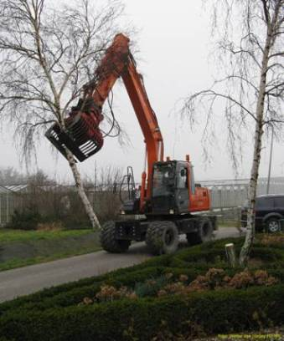
EU Emergency measures for some organisms
Aim: to eradicate
Examples:
-Asian Longhorn Beetles
-Xylella fastidiosa
-Pine Wood Nematode
Stringent measures,
high impact on companies, trade etc.
But in also impact on residential areas
See also:
https://ec.europa.eu/food/plant/plant_health_biosecurity/legislation/emergency_measures_en

Slide 10
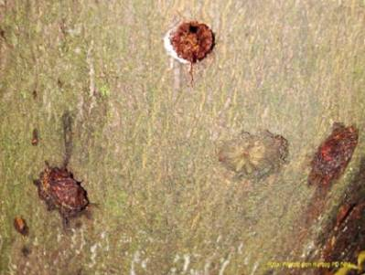
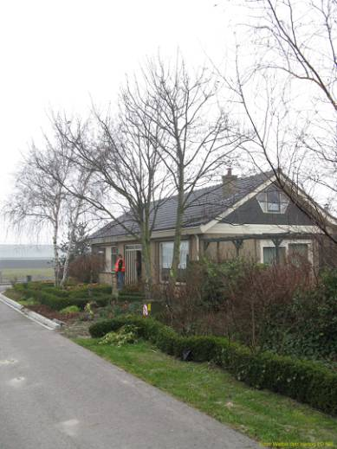
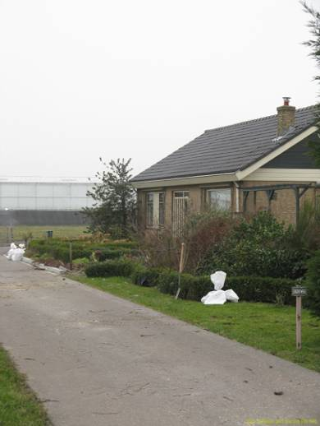
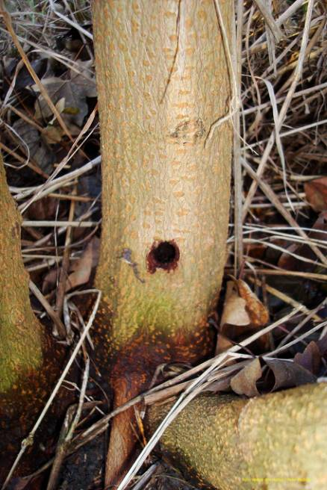
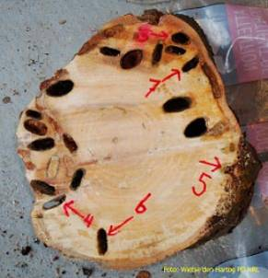
Eradication Anoplophora

Slide 11
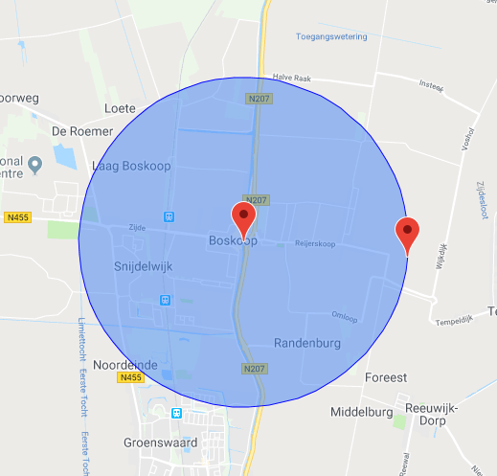
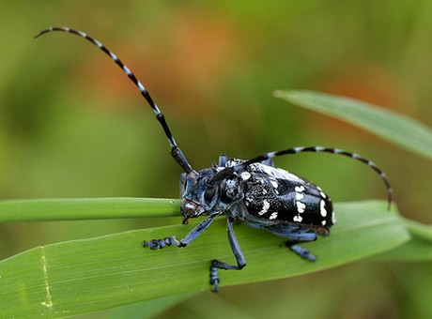
2 km Bufferzone in Boskoop 2009-2010

Slide 12
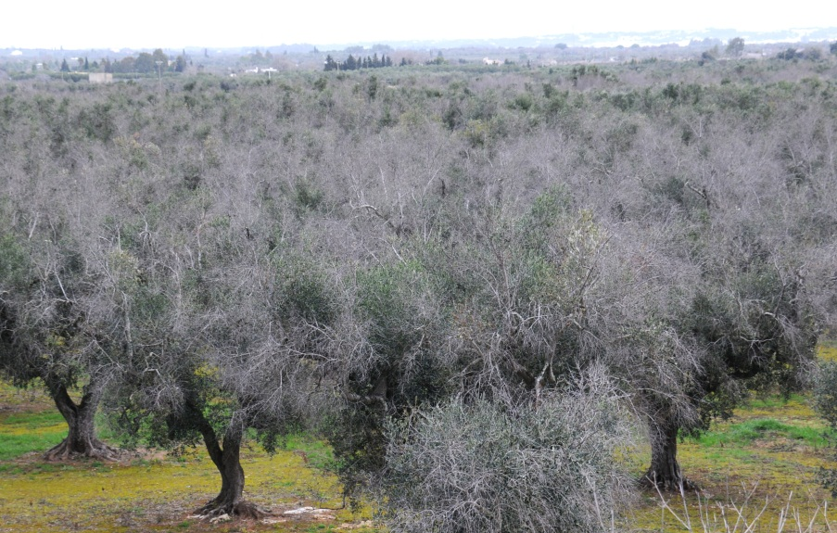
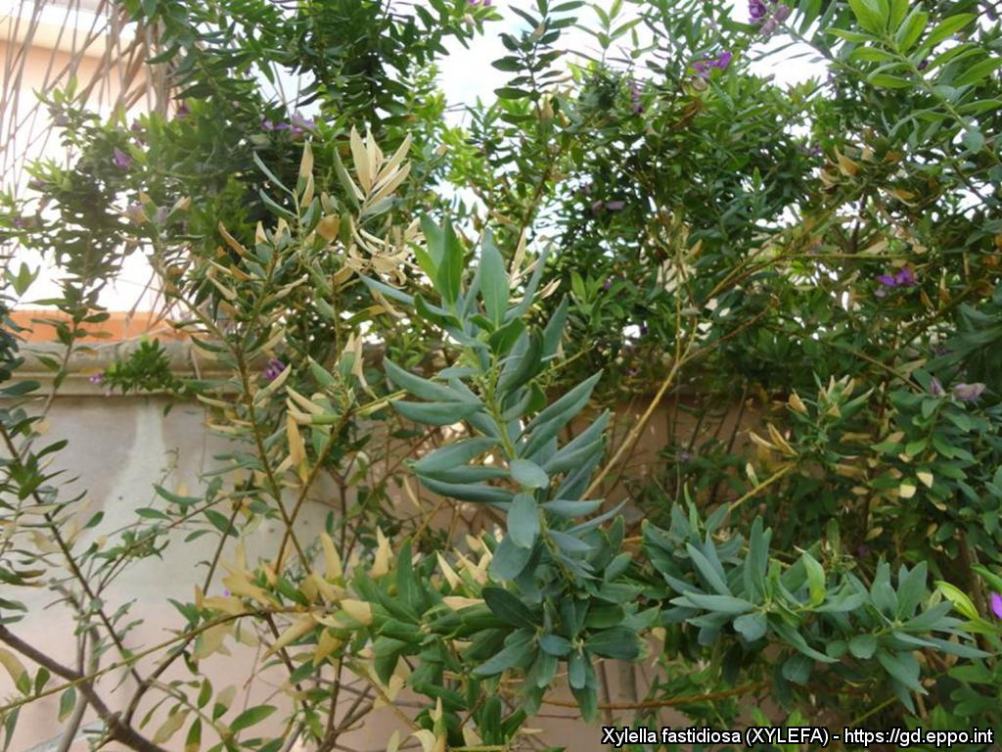

Slide 13
Xylella fastidiosa
First reported in Italy in 2013.
Emergency measures in 2014, since then updated regularly.
Found in
-Italy (south region)
-Corsica
-France (region Nice)
-Spain (region Alicante)
Last Thursday: Belgium intercepted Xf in olive trees from spain!

Slide 14
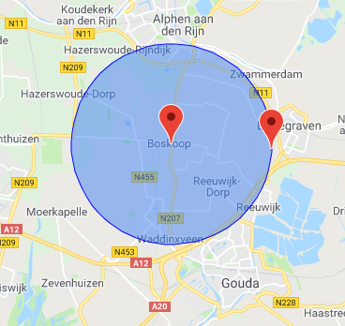
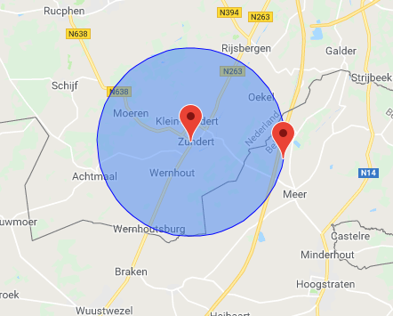
Xylella fastidiosa
5km bufferzone
Boskoop Zundert

Slide 15
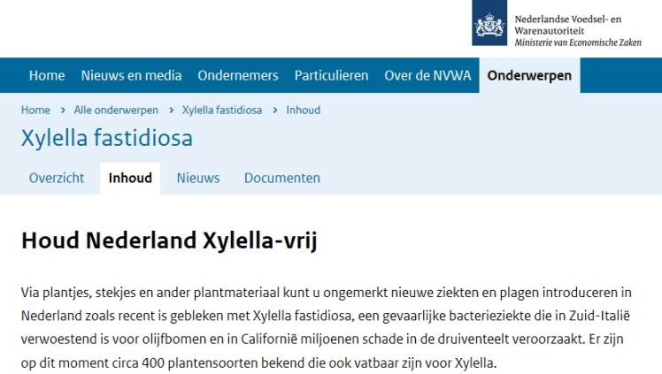
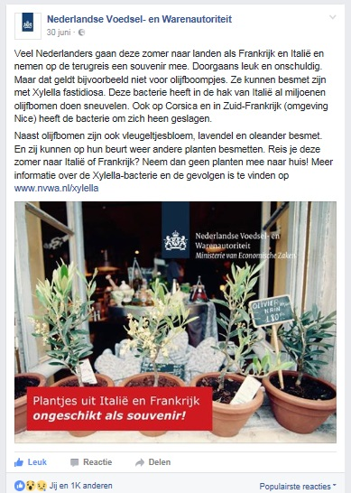

Raising awareness on plant pests (Xylella)
Websites, Flyers, Facebook

